Slide 1
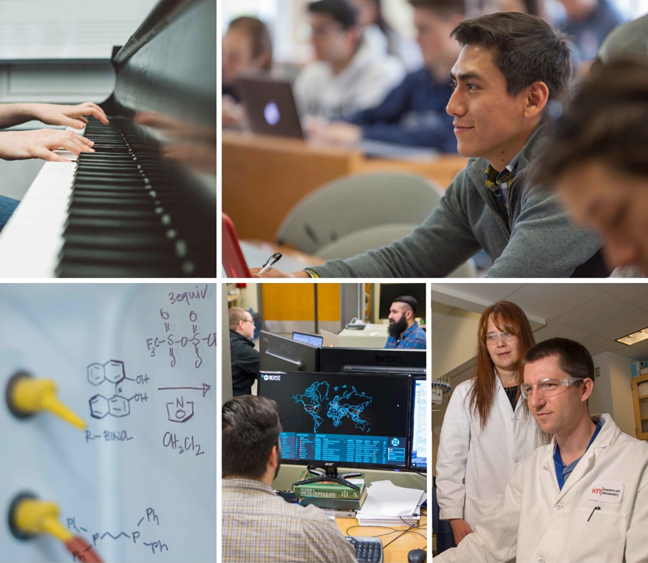
Pathways: Journey of Art & Sciences (over 18 months)
Jean King, PhD
Peterson Family Dean of Arts & Sciences
Notes:
This PowerPoint Template includes a series of slide masters with predefined layouts and color schemes for formatting slides
Slide Masters are displayed when you right click on a slide and select Layout from menu

Slide 2
Where do we begin:
My Big Question: How will we position ourselves to ensure the future success of the Arts and Sciences at WPI?
The 2 Big Questions: What is the role of Arts and Sciences at WPI? What is the role of the Dean of Arts and Sciences at WPI?

Slide 3
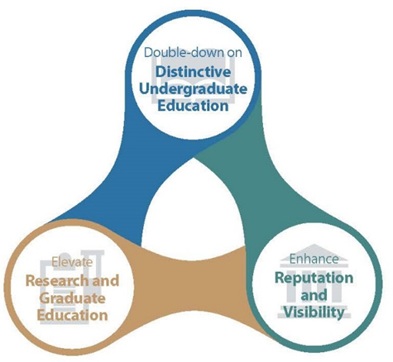
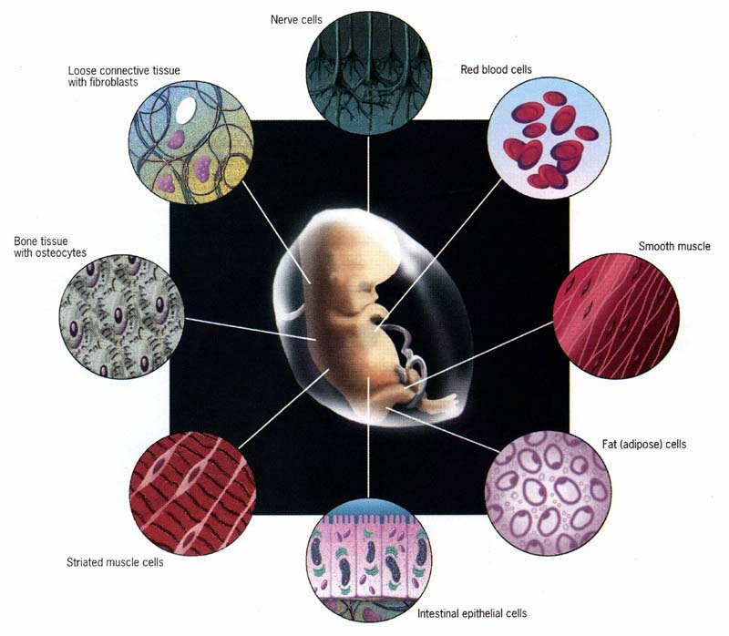
Determining Who We Are & Where We are Going

Slide 4
Strategic Vision: From Margins to Center
A&S Dean’s Office
A&S Community (Department Heads, Program Directors, Faculty, Staff, Students)
Internal Partners (Admissions, Advancement Marketing, VPR, Management Council)
Academic, Industry & Global Partners (UMMS, UML, Next-in-Bio, Boston Scientific, Microsoft, Abbvie)
External Stakeholders (MLSF, NIH, Project Centers, SFN, SwissNex)

Slide 5
Some Efforts to Support and Elevate the Impact of A&S in the WPI Ecosystem
Faculty Focus
Faculty recruitment, development, mentoring & engagement
Building the A&S graduate programs
Strengthening the A&S research enterprise
Educate, Excite & Engage Students
New academic programs
Supporting A&S students
A&S Advisory Councils
Specific groups (SACNAS)
Summer research fellowships
Dean’s Fund for Graduate Students
Cross-Collaborations
(Provost, Deans/VPR, Adm. MC)
STEM Faculty Launch
Social Justice Summit
A&S Week
Critical Conversations
Cross-divisional initiatives
Cross-cutting themes
Joint PhD program-UMMS
New Global Initiatives
Approximately 70% of Dean’s time is spent meeting and engaging with faculty and collaborating with A&S department and program leadership

Slide 6
Quick Highlights
Faculty
54% of WPI faculty and 59% of all UG credits
52% of all WPI research funding
Students
Undergraduate research awards, Dean’s graduate fund, student advisory councils
Neuroscience Initiative
Julia Kasparian Fund for Neuroscience Research, Music & the Brain, MS program
Community
A&S Week, Critical Conversations
Diversity
SACNAS, Social Justice Summit, STEM Faculty Launch
Several A&S programs have more women than WPI average (BBT, CBC, Math, BCB, Data Science)

Slide 7
In Brief: Role of the A&S Dean
Develop and implement cohesive strategic vision (external and internal) for the arts & sciences
Support budget priorities and help ensure fiscal responsibility
Communicate, support, and inspire faculty, students and staff to advance our academic mission
Foster new disciplinary and transdisciplinary activities and opportunities (cross divisions; academic entities etc.)
Work internally and externally to enhance the success of Arts & Sciences at WPI as an integrated organism to achieve our goals: 1) Global Polytechnic, 2) Significant impact on the world

Slide 8
This Is “Us”
AS Faculty, Students & Staff
Advisory Councils (3)
Dean’s Office
A&S Dept. Heads & Programs Leaders

