Slide 1
2017 Mathematics Institute for Secondary Teaching
Brendan Hamm

Slide 2
Once upon a time,
there was a nerdy kid…

Slide 3
Once upon a time,
there was a nerdy kid…
who was NOT properly motivated

Slide 4
When the kid grew up
Poker caught his attention

Slide 5
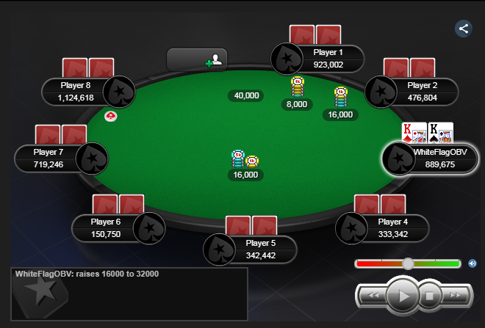

Slide 6
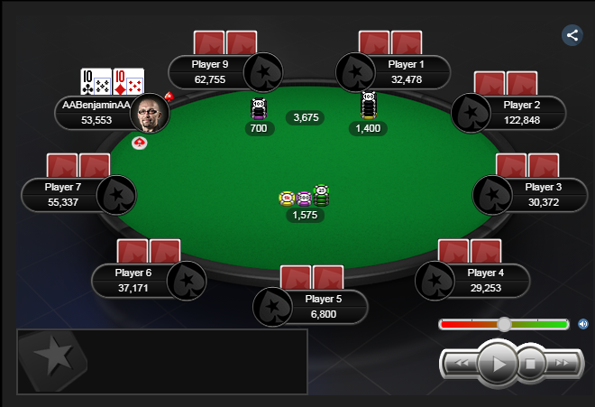

Slide 7
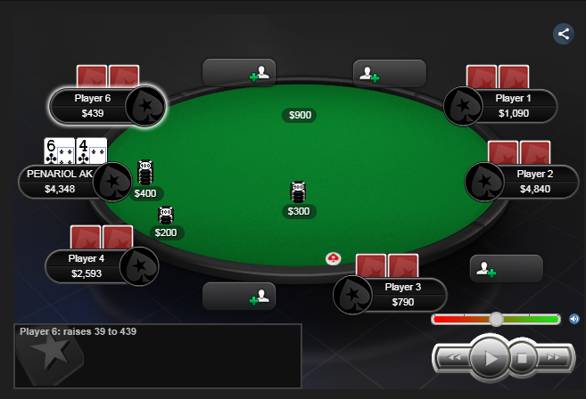

Slide 8
Now what?
Need more problems to solve?

Slide 9


Slide 10
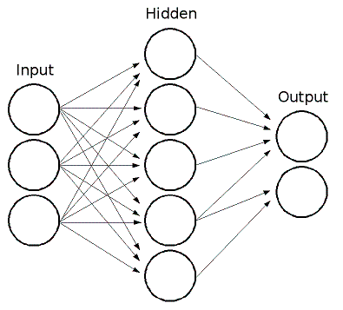
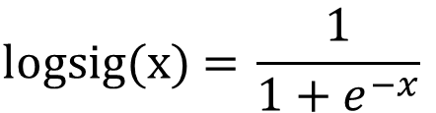
$$\text{l}\text{ogsig}\text{(}\text{x}\text{) = }\frac{1}{1+e^{−x}}$$

Slide 11


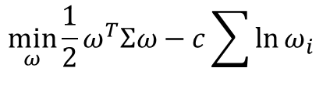
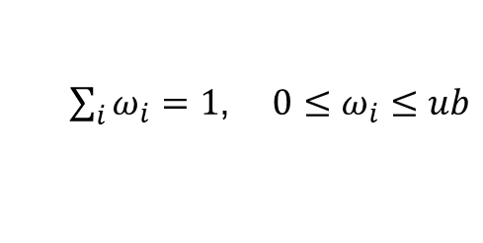
Markowitz:
$$\min_{ω}{ω^{T}Σω}$$
s.t.
$\sum_{i}{ω_{i}=1}$, ${0≤ω}_{i}≤ub$
$$\min_{ω}{\frac{1}{2}ω^{T}Σω−c}\sum{\ln{ω_{i}}}$$
s.t.
Risk Parity:
$${0≤ω}_{i}$$

Slide 12
Which is the more likely sequence?
Couple 1 | Couple 2
Boy | Girl
Girl | Girl
Girl | Girl
Boy | Girl
Girl | Girl

Slide 13



Slide 14
Time to motivate others!
https://www.mathworks.com/academia/student-competitions/moody-math.html
https://www.mathworks.com/academia/highschool/courseware.html
https://www.mathworks.com/academia/highschool/courseware/10-tasks-on-math-modeling.html
https://www.mathworks.com/academia/highschool/products.html

Slide 15
Questions?

