Slide 1
WPI Mathematics Institute for Secondary Teaching (MIST) 2017
Kathleen Haas
July 17-20, 2017
DISTRIBUTION STATEMENT A. Approved for public release: distribution unlimited.
This material is based upon work supported under Air Force Contract No. FA8721-05-C-0002 and/or FA8702-15-D-0001. Any opinions, findings, conclusions or recommendations expressed in this material are those of the author(s) and do not necessarily reflect the views of the U.S. Air Force. © 2015 Massachusetts Institute of Technology.
Delivered to the U.S. Government with Unlimited Rights, as defined in DFARS Part 252.227-7013 or 7014 (Feb 2014). Notwithstanding any copyright notice, U.S. Government rights in this work are defined by DFARS 252.227-7013 or DFARS 252.227-7014 as detailed above. Use of this work other than as specifically authorized by the U.S. Government may violate any copyrights that exist in this work.

Slide 2
Outline
Introduction
Radar: Calculating Distances
Radar: Calculating Precipitation Intensity
Calculating Storm Echo Top Heights
Polar and Cartesian Coordinates
Mapping Projections

Slide 3

Introduction
High school math is used for and provides the foundation of work at Lincoln
Lots of high school math applications to weather radar and forecast generation
If we didn’t have a good grasp of trigonometry, geometry, algebra, and calculus, we couldn’t do our jobs!
y
x

Slide 4
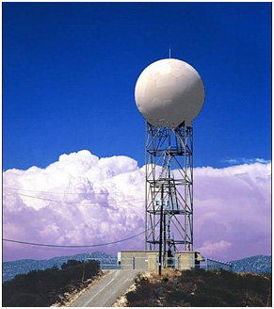
Radar Basics
Weather radars are used to detect, locate, and measure intensity of precipitation
WSR-88D Weather Radar

Slide 5
Radar Basics
Weather radars are used to detect, locate, and measure intensity of precipitation
WSR-88D Weather Radar

Slide 6
Radar Basics
Weather radars are used to detect, locate, and measure intensity of precipitation
WSR-88D Weather Radar

Slide 7
Radar Basics
Weather radars are used to detect, locate, and measure intensity of precipitation
WSR-88D Weather Radar

Slide 8

Calculating Distances
distance = rate * time
$$d=c∗\frac{t}{2}$$
d
d: distance
c: speed of light through air
t: round-trip time for pulse
to hit target and return
If you can measure elapsed time accurately, you can calculate distance accurately!

Slide 9
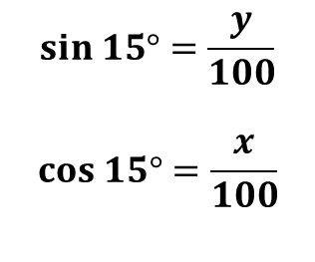
Calculating Distances (cont.)
$$sin 15°=\frac{y}{100}$$
$$cos 15°=\frac{x}{100}$$
100 km
y
15°
x
Note! In reality, radar beams usually bend
slightly towards Earth, and the Earth is not flat.

Slide 10
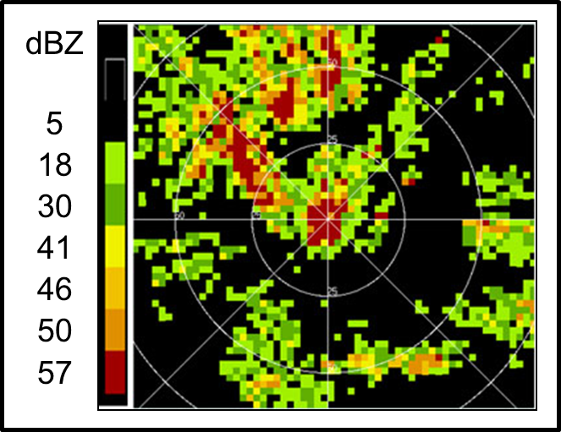
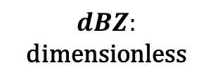
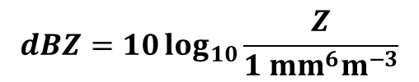

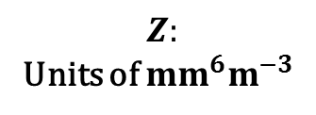
Calculating Precipitation Intensity
$$Z \text{∝}\sum_{i}{d_{i}^{6}}$$
$$Z:$$
Units of $mm^{6}m^{−3}$
1 m
$$dBZ=10\log_{10}{\frac{Z}{1 mm^{6}m^{−3}}}$$
$$dBZ:$$
dimensionless
1 m
1 m
Water droplet with
diameter d mm

Slide 11
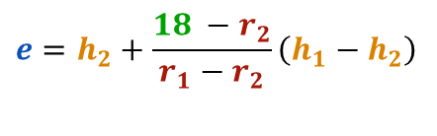

Calculating Storm Echo Top Heights
h₁ = 40 kft
r₁ = 15 dBZ
h₂ = 35 kft
r₂ = 20 dBZ
Below 18 dBZ
Above 18 dBZ
b₁
b₂
$$e=h_{2}+\frac{18 −r_{2}}{r_{1}−r_{2}}\left(h_{1}−h_{2}\right)$$
$=37$ kft

Slide 12
Calculating Storm Echo Top Heights
Similar calculations can be carried out for different ranges and azimuths!

Slide 13
Calculating Storm Echo Top Heights
Similar calculations can be carried out for different ranges and azimuths!

Slide 14
Calculating Storm Echo Top Heights
Similar calculations can be carried out for different ranges and azimuths!

Slide 15

Polar and Cartesian Coordinates
Polar Coordinates
Cartesian Coordinates

Slide 16
Polar and Cartesian Coordinates
Polar Coordinates
Cartesian Coordinates

Slide 17
Converting from Polar to Cartesian
How do we go from a polar coordinate to a point on a Cartesian grid?

Slide 18

Converting from Polar to Cartesian
How do we go from a polar coordinate to a point on a Cartesian grid?

Slide 19
Converting from Polar to Cartesian
How do we go from a polar coordinate to a point on a Cartesian grid?

Slide 20

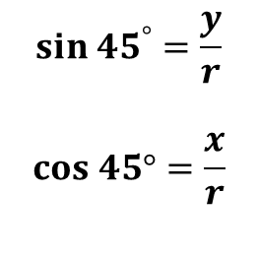
Converting from Polar to Cartesian
r
y
45$°$
O
x
$$sin {45}^{°}=\frac{y}{r}$$
$$cos 45°=\frac{x}{r}$$

Slide 21
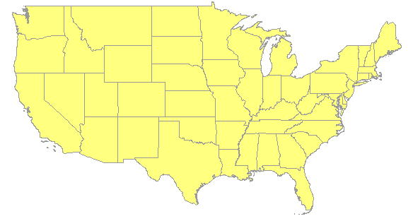
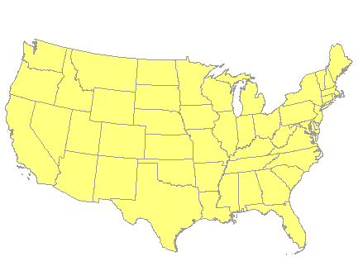
Mapping Projections
Different organizations can use different mapping projections.
How do we compare forecasts on maps that don’t look the same?
Mercator Projection
Stereographic Projection

Slide 22
Stereographic Projections
N
A point P on the sphere is mapped to a unique point P’ on the plane
That is, a point P on the Earth is mapped to a unique point P’ on the map
P
O
P’
S

Slide 23
Stereographic Projections
N
A point P on the sphere is mapped to a unique point P’ on the plane
That is, a point P on the Earth is mapped to a unique point P’ on the map
P
O
P’
S

Slide 24
Stereographic Projections: Simplified
N
P
A point P on the circle is mapped to a unique point P’ on the line
O
P’
S

Slide 25
Stereographic Projections: Simplified
N (0,1)
P (-0.4, 0.2)
Two ways to find P’:
Find equation of line from N to P
Use similar triangles
O (0,0)
P’
S (0,-1)

Slide 26
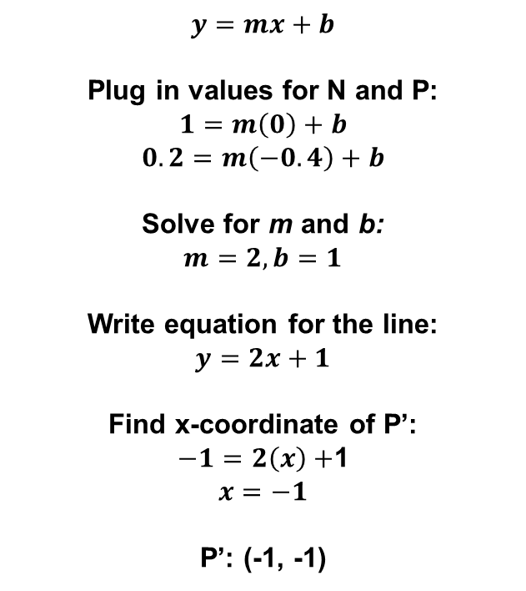
Finding Line from N To P
$$y=mx+b$$
Plug in values for N and P:
$$1=m\left(0\right)+b$$
$$0.2=m\left(−0.4\right)+b$$
Solve for m and b:
$$m=2, b=1$$
Write equation for the line:
$$y=2x+1$$
Find x-coordinate of P’:
$−1=2\left(x\right)+$1
$$x=−1$$
P’: (-1, -1)
N (0,1)
P (-0.4, 0.2)
O (0,0)
P’(x,-1)
S (0,-1)

Slide 27
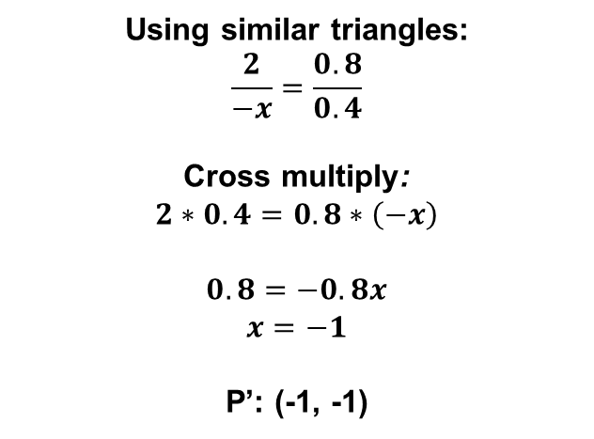
Using Similar Triangles
N (0,1)
Using similar triangles:
$$\frac{2}{−x}=\frac{0.8}{0.4}$$
Cross multiply:
$$2∗0.4=0.8∗\left(−x\right)$$
$$0.8=−0.8x$$
$$x=−1$$
P’: (-1, -1)
0.8
P (-0.4, 0.2)
0.4
2
P’(x,-1)
-x
S (0,-1)
You could imagine extending these ideas to add another dimension!

Slide 28
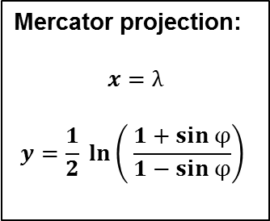


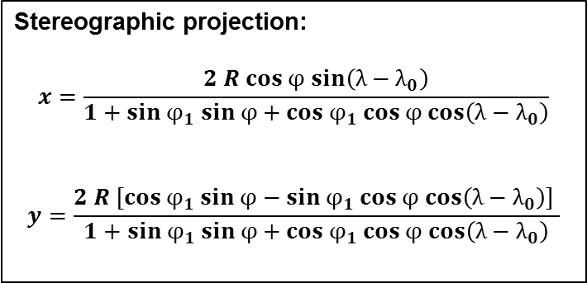
Converting Between Projections
If $φ$is latitude, $λ$is longitude:
Mercator projection:
$$x=λ$$
$$y=\frac{1}{2} ln\left( \frac{1+sin φ}{1−sin φ}\right)$$
If $φ$is latitude, $λ$is longitude, $φ_{1}$is central latitude,
$λ_{0}$is central longitude, and R is local radius of Earth:
Stereographic projection:
$$x=\frac{2 R cos φ sin\left(λ−λ_{0}\right)}{1+sin φ_{1} sin φ+cos φ_{1} cos φ cos\left(λ−λ_{0}\right)}$$
$$y=\frac{2 R [cos φ_{1} sin φ−sin φ_{1} cos φ cos\left(λ−λ_{0}\right)] }{1+sin φ_{1} sin φ+cos φ_{1} cos φ cos\left(λ−λ_{0}\right)}$$

Slide 29
Summary
High school math has many applications to weather radar and forecast generation
Calculating storm position/intensity and disseminating that information would not be possible without high school math
Without math, we’d be left sticking our heads out the window for weather information!

