Slide 1
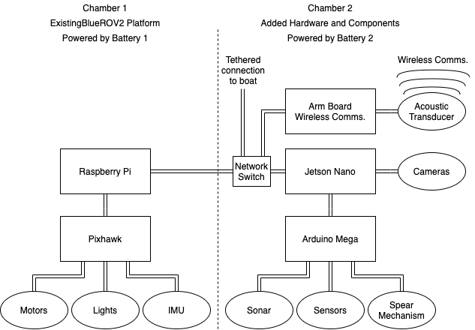
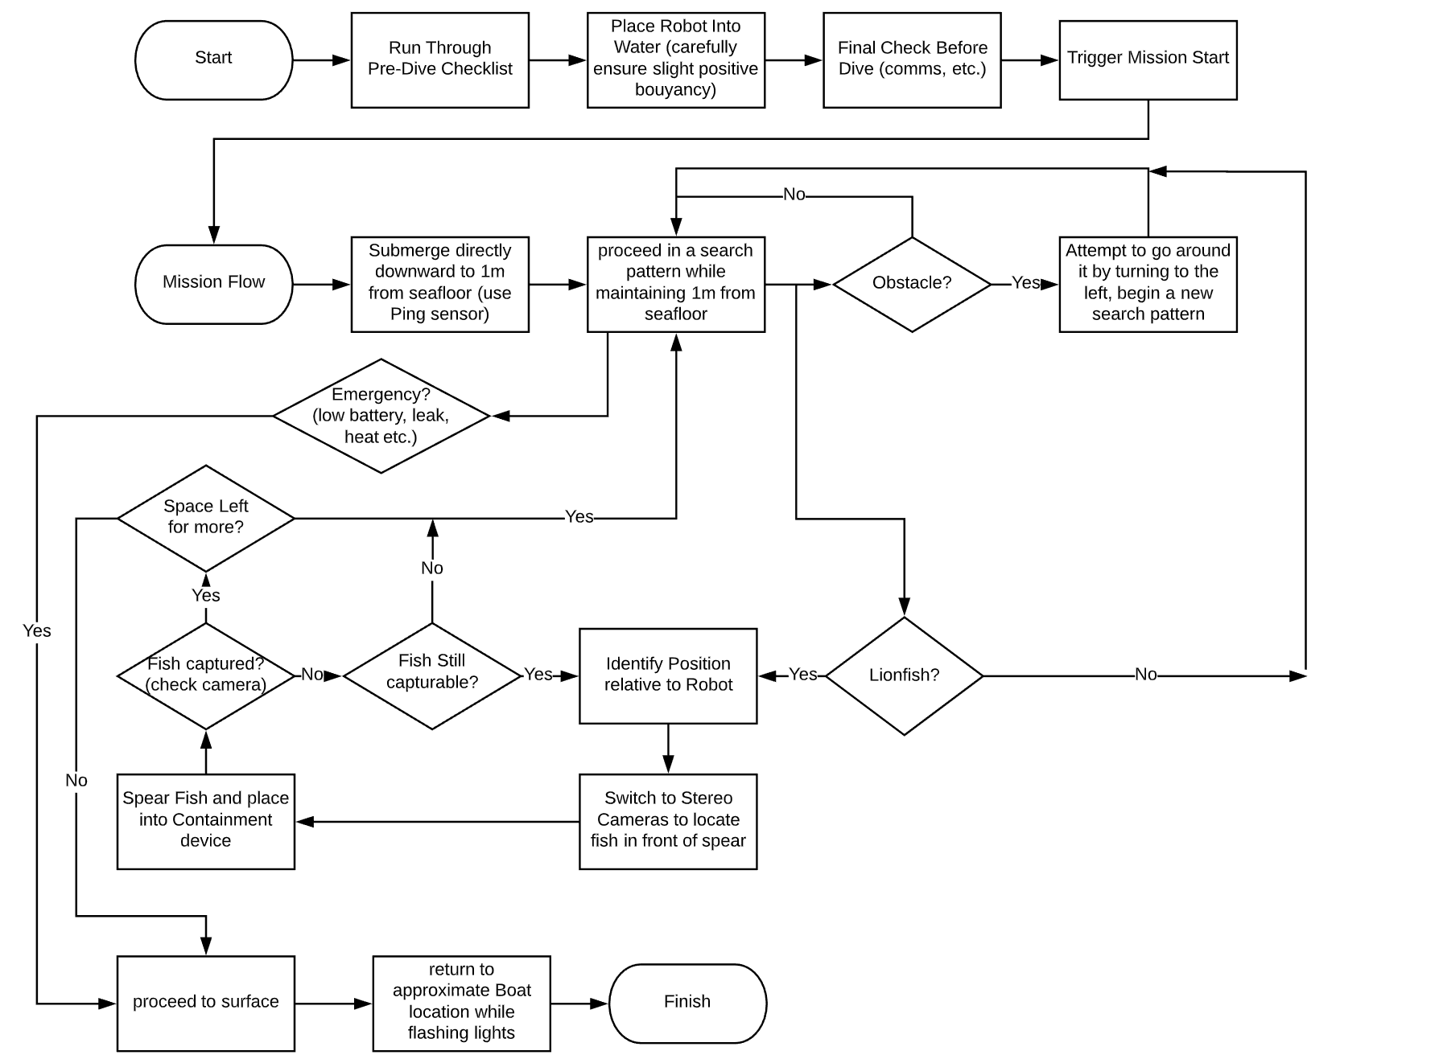
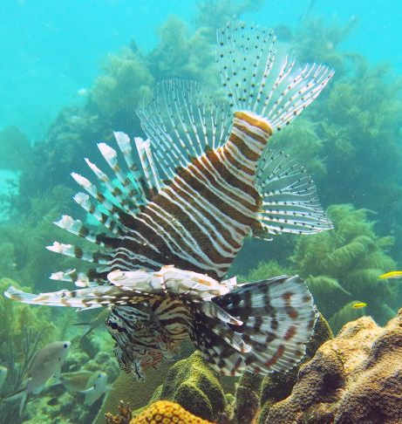
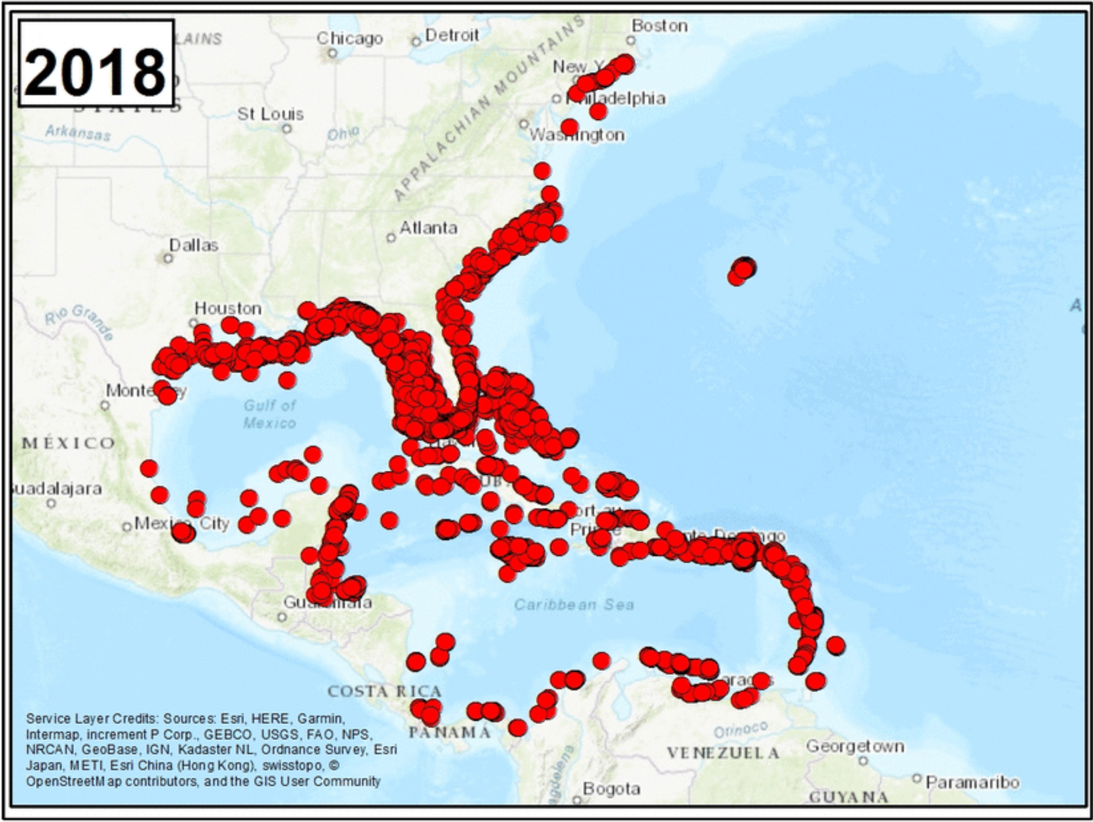
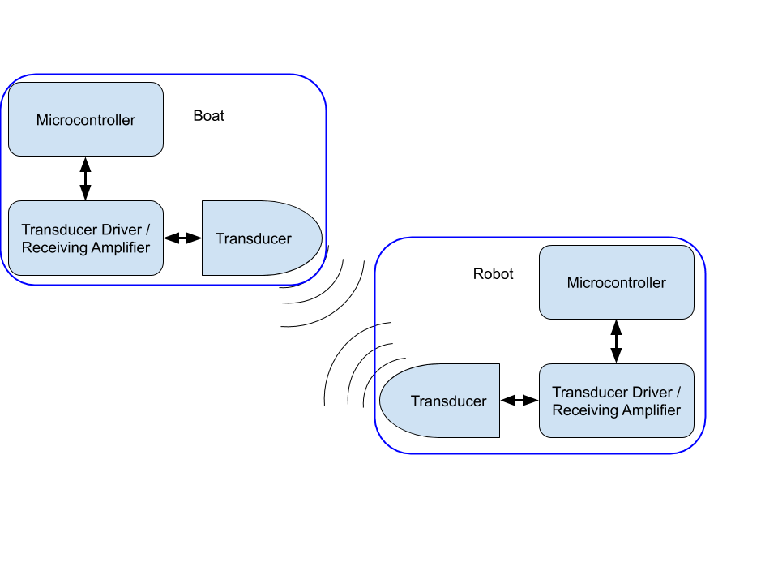
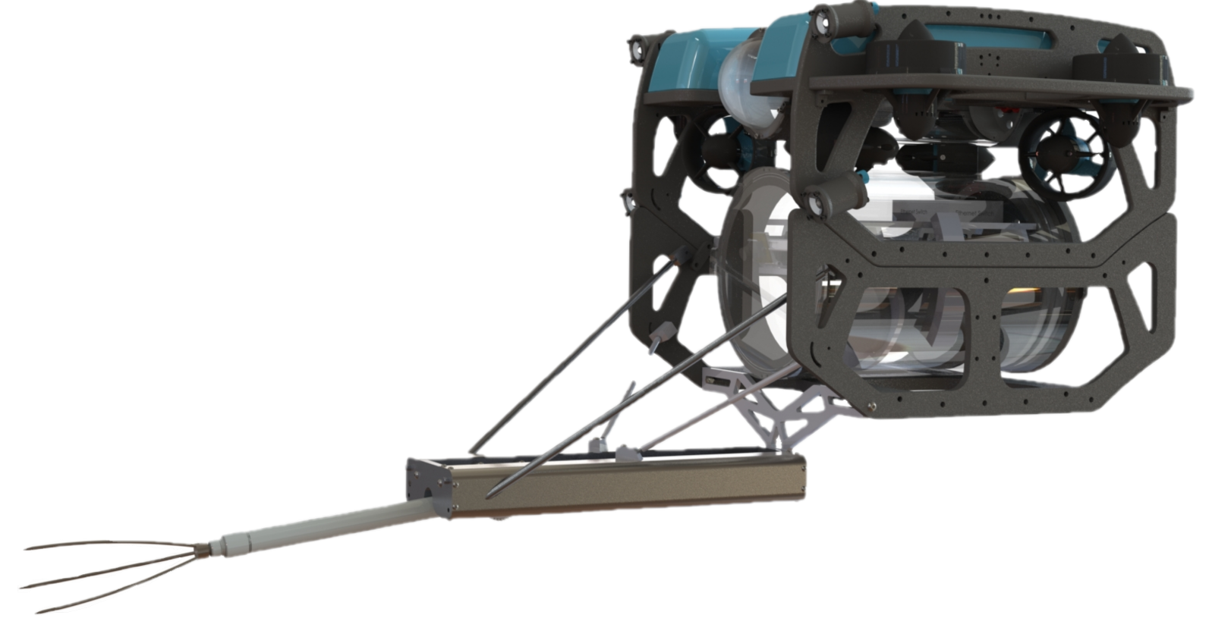
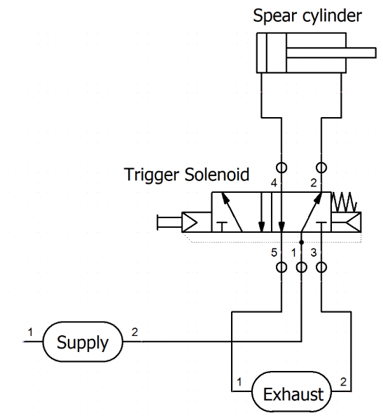
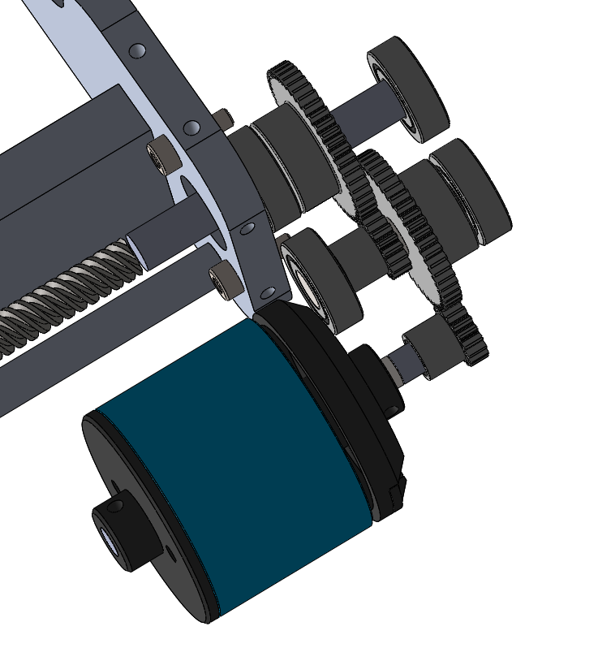
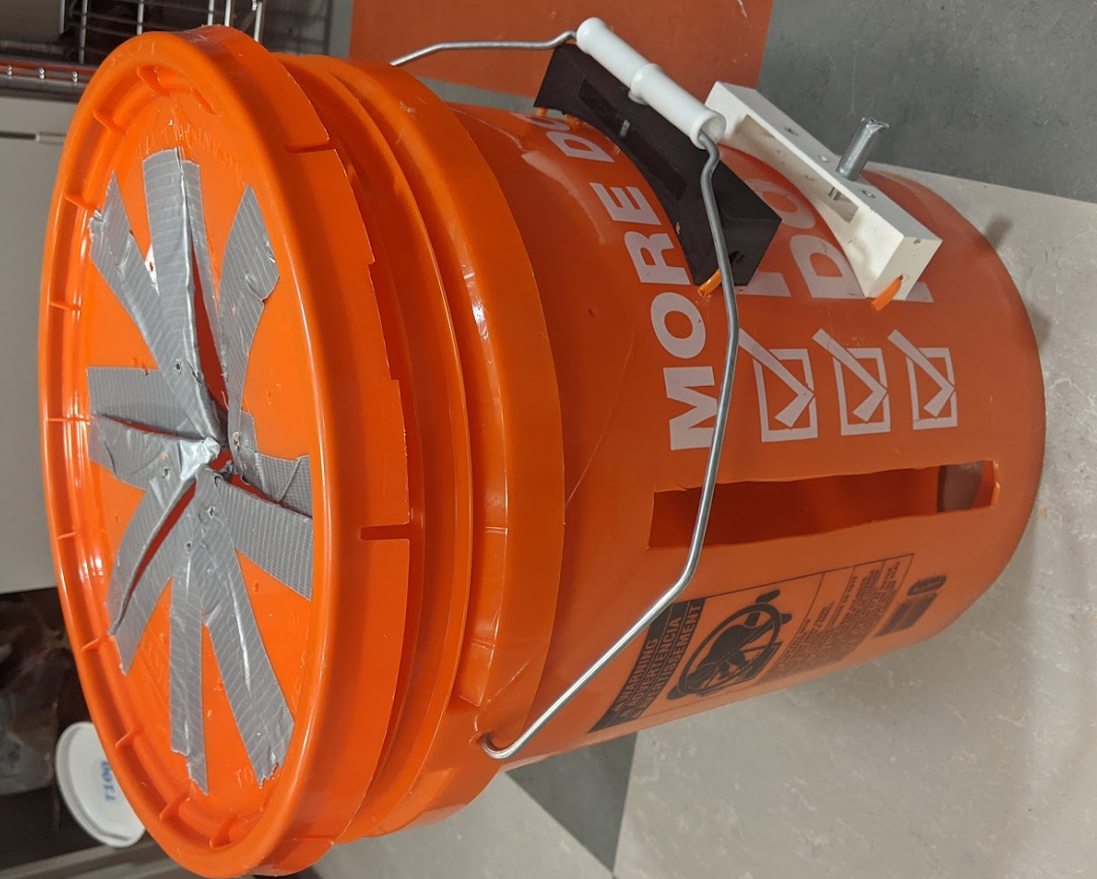
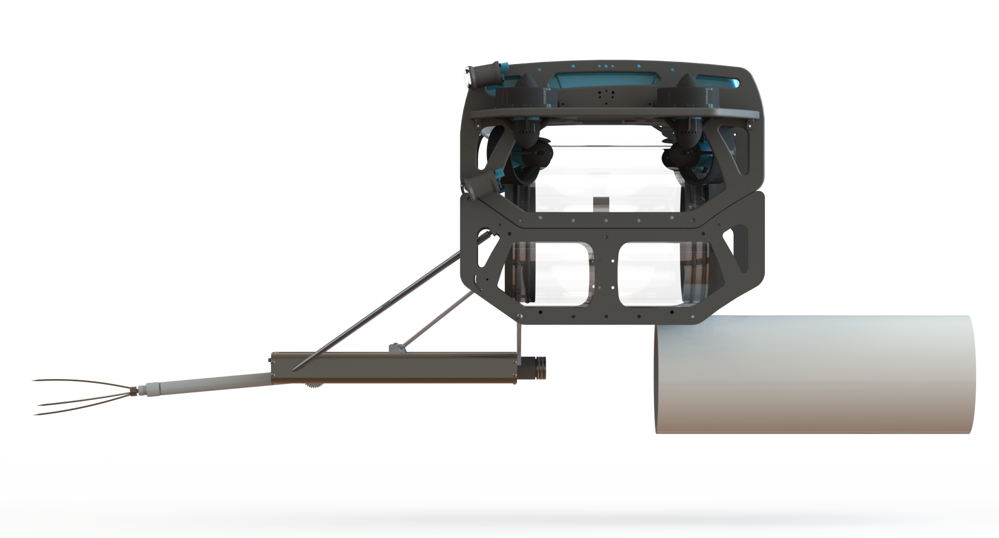
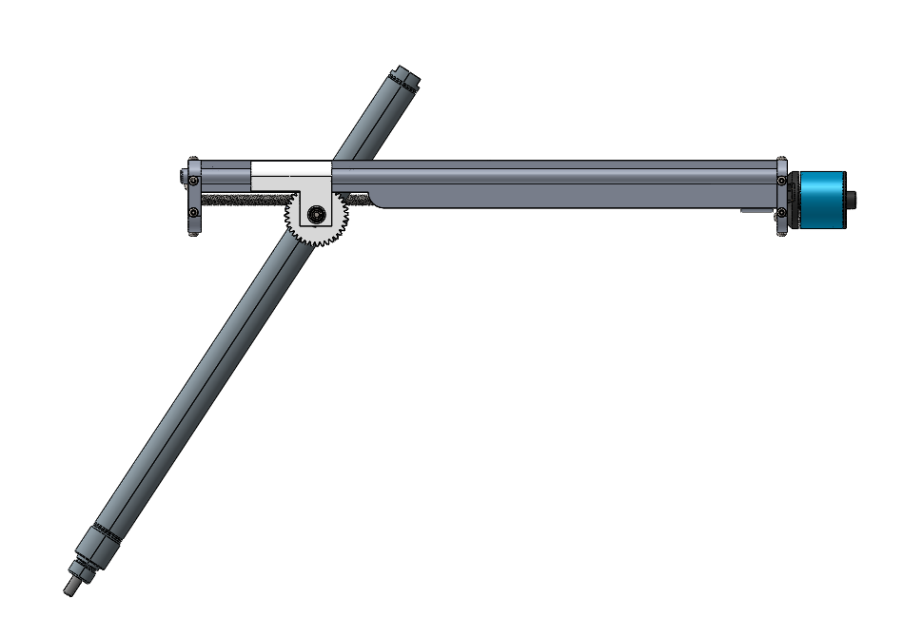
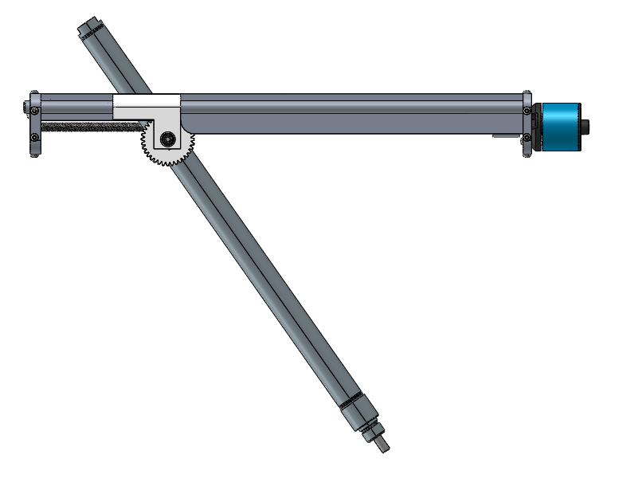
Autonomous Underwater Lionfish Harvester
Phase III
Michael Abadjiev (RBE/ME) | Leo Chen (RBE/ECE) | Clark Ewen (ECE) | Nicholas Johnson (RBE/CS),
Nicholas Olgado (ECE) | Harrison Saperstein (RBE) | Orion Strickland (RBE/ME) | Christopher Whimpenny (CS/ME)
Advisors: Prof. Craig Putnam (RBE/CS) | Bradley Miller (RBE) | Prof. William Michalson (RBE/ECE/ME)
Brief Overview
Lionfish are an invasive species in the Caribbean Sea and on the Eastern Coast of the USA.
This MQP proposes a fully autonomous robotic solution to kill and capture the invasive species.
Building off previous teams’ work, this year’s focus is on developing a new harvesting system, refined identification algorithm, and autonomous navigation algorithm.
System Architecture Overview
Navigation
The system was developed on the BlueROV2 underwater rover system.
3 separate computing devices were added to the system:
Jetson Nano – for running the identification neural network and making high-level navigation and emergency decisions.
Arduino Mega – for integrating and managing different sensors and the spear mechanism.
ARM Board – for processing communications with the topside boat.
The navigation system was created using motion building blocks:
Move Forward/Backward
Ascend/Descend
Turn to a heading
Using sonar, we implemented object detection to navigate safely.
Combining the building blocks and obstacle detection, we were able to create more advanced search patterns.
Background
What are Lionfish?
Lionfish are an invasive species in the Atlantic
Lionfish can grow up to 15” and weigh approximately 2.6lbs
Female lionfish can lay 2,000,000 eggs per year
Why are Lionfish a problem?
They have no natural predators in the area
They devastate local fish populations and threaten coral reef habitats
Lionfish can eat anything up to 2/3 their body size
What is being done to alleviate the issue?
There are little to no fishing regulations
Organizations host lionfish hunting derbies
Countries are promoting Lionfish consumption
Human Limitations on diving
Scuba diver fisherman are limited to ~130 ft depth
Lionfish have been spotted as far as 820 ft
Why Autonomous?
Robotic harvesters that are operated through a tether can damage the coral reefs
As a result most are not allowed in the areas
Chamber 1 includes the existing BlueROV2 infrastructure, connected to our added components in chamber 2 via an IP network configuration.
The AUV’s mission flowchart for navigating an
Ocean environment.
Acoustic Link – Wireless Communications
Communication between robot and boat.
Vital for disarm, return home
Protocol with CRC frame for error proof.
Symmetrical design in hardware and protocol
Signals are carried by sound wave through the water.
Piezo transducer to transmit and receive sound waves.
On-off keying used to modulate the signals.
Demodulation done by microcontroller through sampling and edge detection.
Identifying Lionfish and Divers
17,000 Images for Training
14,000 Lionfish
5,000 Divers
SSD MobilenetV2 performed the best
Key Objectives
The overall goal of our MQP was to implement an autonomous system to hunt and capture lionfish with the following objectives:
1.) Navigate the AUV’s environment effectively and thoroughly while avoiding obstacles and fragile reef habitats.
2.) Identify lionfish with greater than 90% accuracy and pursue them safely, without alarming them, and with the same intent as objective 1.
3.) Spear and harvest lionfish with a capacity of minimum 5 fish.
4.) Establish basic communications with mothership
SSD MobilenetV2: Actual
Harvester Mechanism
Pneumatics powered spear Spin-Spear rotating mechanism One motor to flip and store Lionfish Container
- No elastic bands, no springs - One fluid motion to flip and store - Single DC motor - One-way fish valve
- Vent into evacuated exhaust chamber - Rack and pinion flippers - quick-swap AUV attachment
Convolutional Neural Networks (CNN)
1.) SSD MobilenetV2
FPS: 20.6
Recall: 0.76
SSD MobilenetV2: Ground Truth
2.) SSD InceptionV2
FPS: 17.2
Recall: 0.73
3.) SSD Resnet
FPS: 7.5
Recall: 0.48
References
“Red Lionfish | National Geographic.” [Online]. Available: https://www.nationalgeographic.com/animals/fish/r/red-lionfish/. [Accessed: 03-May-2020].
“1985-2018 Lionfish Invasion.” [Online]. Available: https://www.usgs.gov/media/images/1985-2018-lionfish-invasion. [Accessed: 02-May-2020].
“lionfish (Pterois volitans/miles) - Species Profile.” [Online]. Available: https://nas.er.usgs.gov/queries/FactSheet.aspx?speciesID=963. [Accessed: 03-May-2020].

