Slide 1
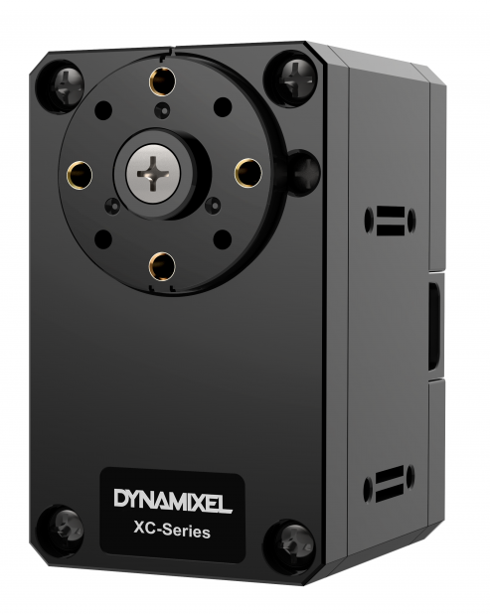
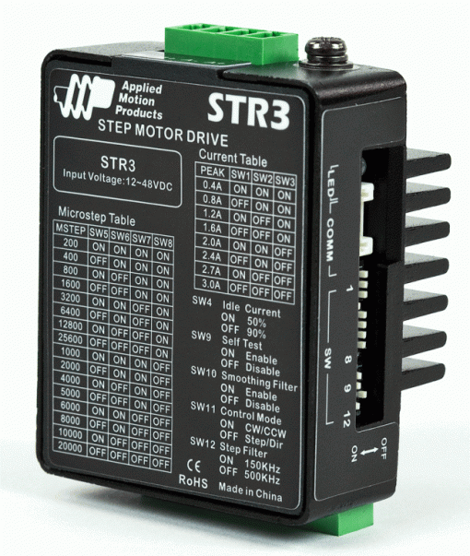
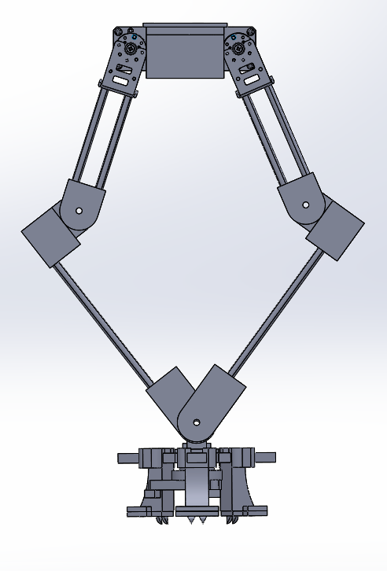
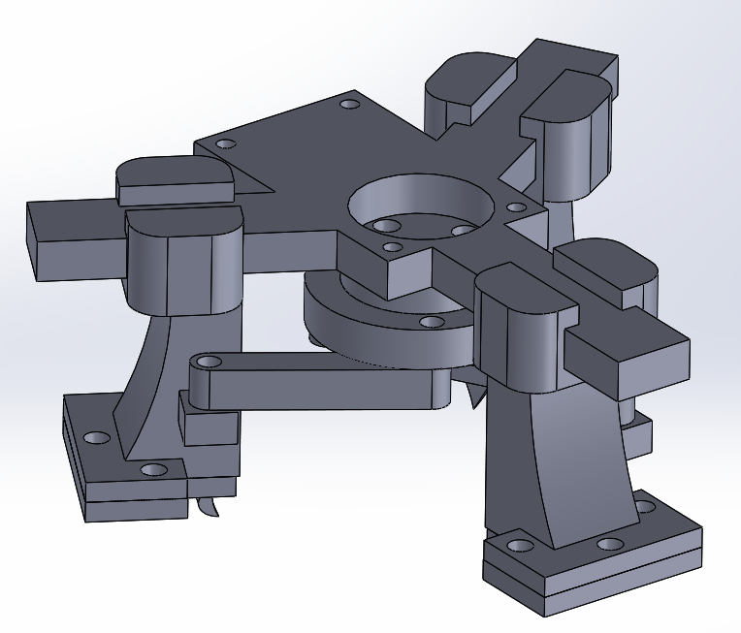
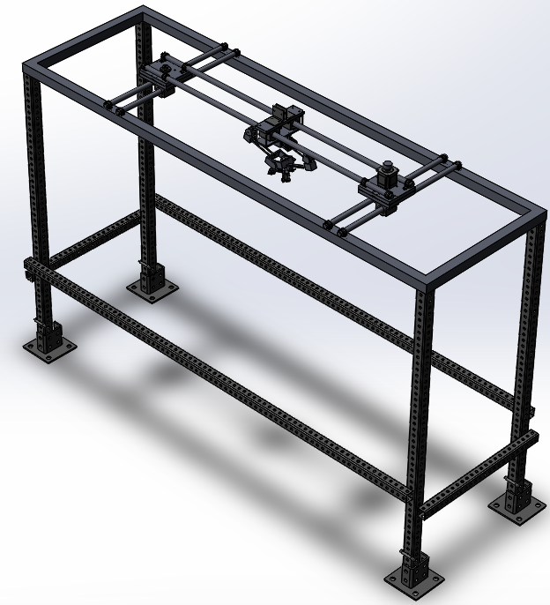
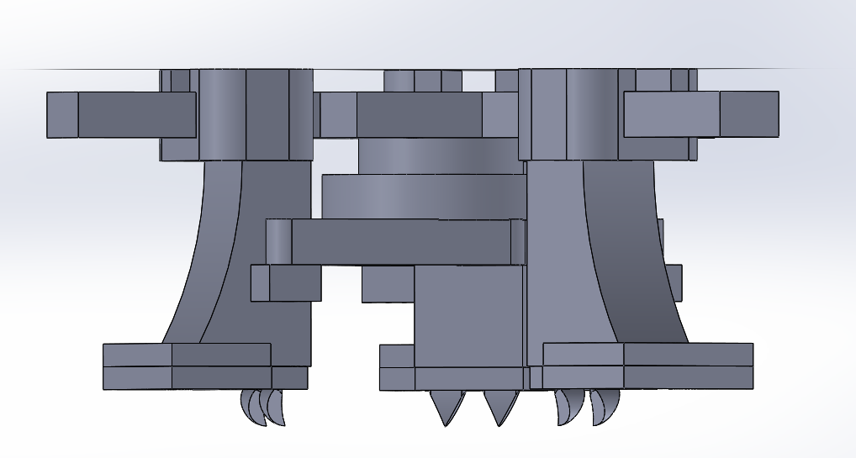
Robotic Waste Sorting
Mikayla Fischler (RBE, CS), Kyle Heavey (RBE), Arianna Kan (RBE)
Advisor: Professor Berk Calli (RBE)
This project contributes to the long-term goal of developing a waste-sorting robot to efficiently sort single-stream recyclables. Such technology will also change the role of recycling workers from handling the hazardous, and sometimes toxic waste streams to being robot and process supervisors. Robotic solutions would allow faster and more precise sorting of the waste streams, reducing the percentage discarded but essentially recyclable. Enabling the processing of currently discarded materials can also result in a significant decrease in landfill use. Our goal for this project was to develop a test bed suitable to simulate a real-world recycling plant environment containing a robot capable of identifying and removing cardboard from a stream of mixed recyclables.
Design Criteria
Our robot utilizes stepper motors to move along the X-Z plane precisely and closed-loop controlled Dynamixel servos to move the arm and gripper. Limit switches are used to calibrate and regulate the stepper motors to prevent damage. For user safety, E-Stop buttons are used to cut AC power to the motor DC power supplies.
ROS Melodic is used as the core of the software component of the control system. ROS runs on a desktop PC (ROS Master) and on a Raspberry Pi 4B. In addition to these devices, a Teensy 3.6 microcontroller is used to control the stepper motors and for digital I/O that requires interrupts.
Abstract
Control System
Test Bed
Robot mounted above or adjacent to a conveyor belt
Platform/Rail System
High reliability and precision in 3-dimensional space
Linkage Arm and Gripper
Precise control in Y direction
Control System
Variable speed conveyor belt for testing purposes
Modular robot supporting multiple types of grippers
Large rectangular work envelope, ideal above conveyor system space
Effective for horizontal travel
Simple design and straightforward operation
Ability to grip cardboard
Precise and fast control to easily account for the movement of a conveyor belt
Modular and extensible software
Safety-minded operation
Background
There is high demand for effective processing solutions for single stream recyclable waste due to China enacting their National Sword policy in January 2018, limiting recyclable waste imports to a maximum of 0.5% contamination. This is problematic because China previously accounted for 45% of the global recyclable waste imports, and cleaning and sorting single stream recyclables to meet this regulation is often prohibitively expensive. This has led to the diversion of contaminated recyclables domestically to landfills or internationally to less developed nations unequipped to handle the waste properly. Investigations into some of these nations often exposes burning of the waste, including plastics, causing harm to nearby communities.
Implementation
The arm had 2 motors, each controlling one side of the 5 link arm, which was joined at the center. When moving the motors opposite, the joining point moved up and down in a straight line using a 5 linkage system., achieving the desired vertical motion. At the joining point the gripper was attached.
The frame had 6 rails, 2 for each of the 3 carts that would move in the x-z plane of the system. The center cart, where the arm was attached, could move anywhere within that plane, defining the robot’s range of motion. The frame was to be mounted over a moving conveyor belt to simulate the recycling center’s in place systems.
Dynamixel Servo
ROS Melodic, Raspberry Pi 4B, Teensy 3.6
Stepper and Driver
Future teams will need to complete wiring of the control system and build upon the existing software. They will then need to implement inverse kinematic control of the X-Z cart system. The camera we selected and purchased will then be used to identify target waste, and the arm and gripper will be controlled using this information to pick and remove that targeted waste.
The frame is modular and will allow for lots of future mechanical development. The arm and gripper can be replaced to target new materials or to test other arm designs like a multi-degree-of-freedom arm.
Next Steps
Consequences of Single Stream Recycling
The gripper uses a motor to rotate a disk attached to the 3 jaws of the gripper pulling them towards the center. At the end of each jaw were small spikes, which would be dug into the cardboard to achieve grip before lifting the piece.
Benefit
Increased recycling rate
Consequence
Decreased quality of materials recovered
Adjustment
Employ human workers as sorters
Error
Unfortunately, these workers are exposed to intense stress, dangerous machinery, and hazardous materials
Leads to rejection from waste processors
Current Robotic Solutions
We looked at many different designs of current robotic solutions seeking to sort recycling. Some use vision to detect objects to remove and determine what it wants to pick up before anything enters the robot’s range of motion. Current industry used robots use suction grippers to pick the objects up quickly. Some robots in development are attempting alternatives to vision detection by detecting the object’s material after it is picked up.

