Slide 1
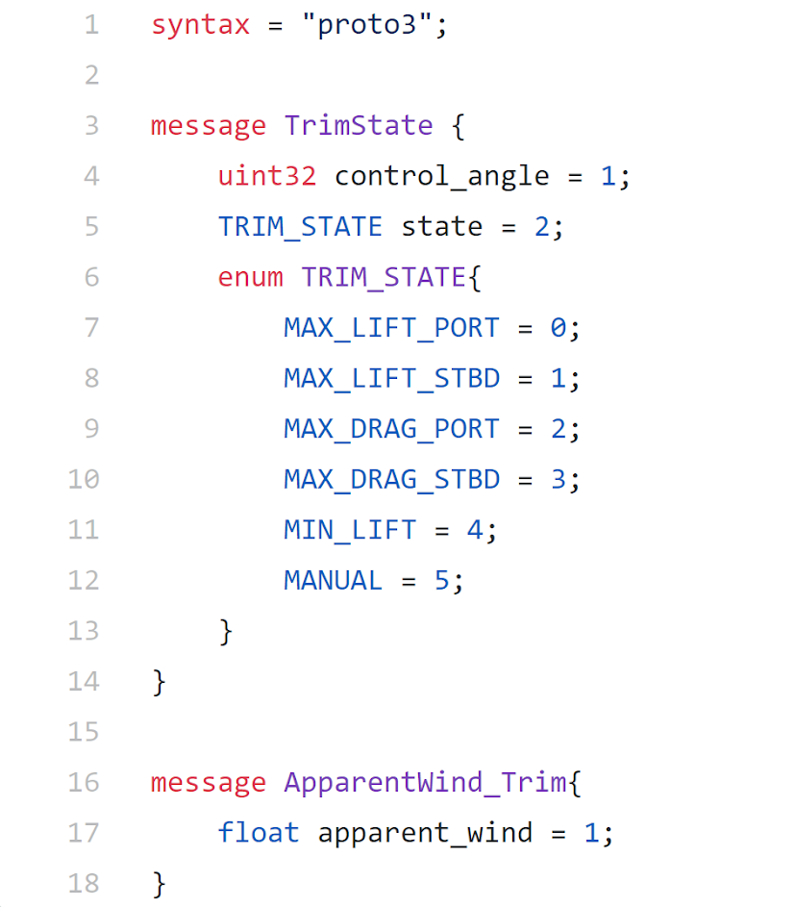
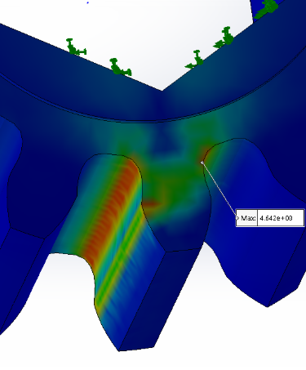
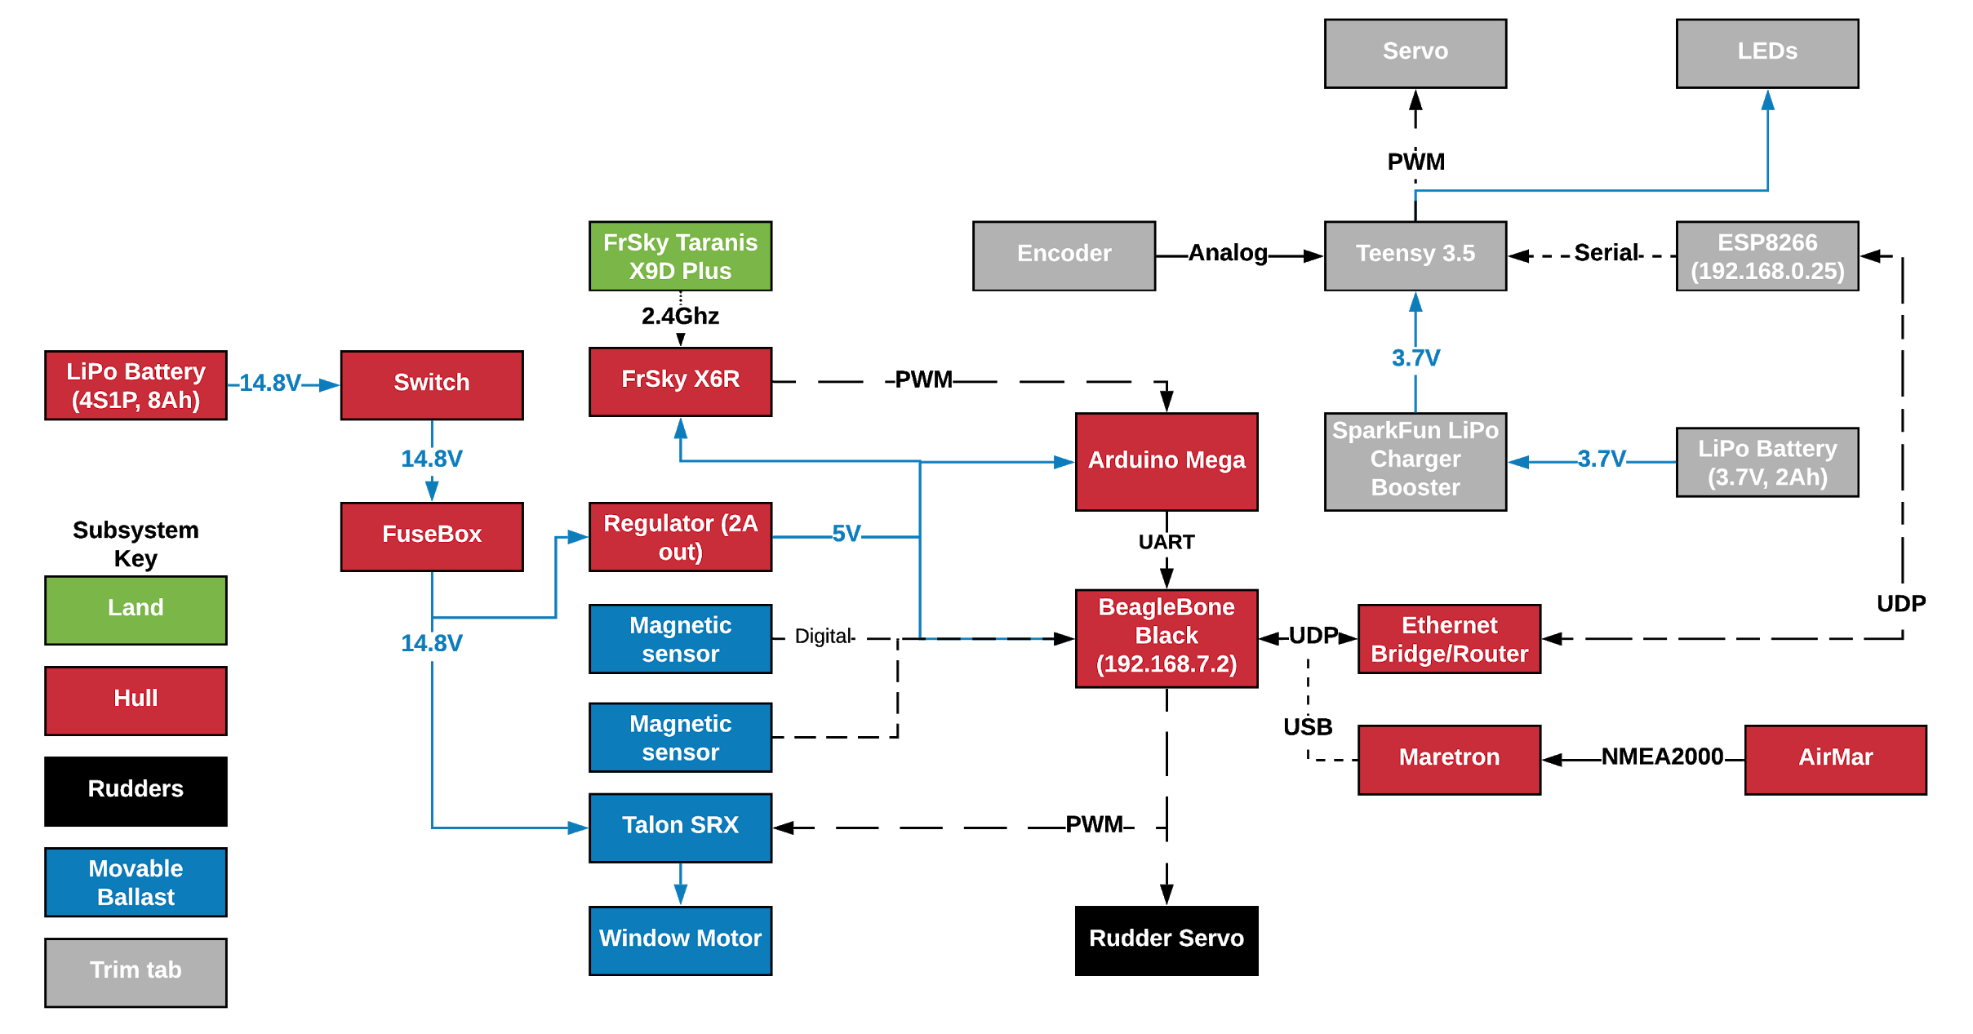
Sailbot 2019-2020
Mylena Guzman (ME), Irina Lavryonova (ECE/RBE), Kyle Reese (RBE/CS), Andrew Thomas (ME)
Advisors: Kenneth Stafford (RBE/ME), William Michalson (RBE/ECE/CS)
Abstract
The goal of this project was to improve in major ways upon the autonomous robotic sailboat known as the “The Wide Awake.” Using the rules of the International Robotic Sailing Regatta as a guide, the team improved the boat’s mechanical, electrical, and software performance and reliability by improving upon the systems that were already in place from previous years as well as devising new solutions to existing problems. The focus of this year’s MQP was to implement reliable RC control and to pave the way for the implementation of autonomous operation in future years.
Rigid Wing
Hull to rigid sail communication achieved over WiFi using libraries and streamlined message structures
Trim tab electronics housing redesigned to increase durability and improve trim tab range of motion
Movable Ballast
Converted control from a CTRE HERO board to direct PWM control from either the RC receiver or the BBB
Installed hard stops to prevent over-rotation
Added magnetic limit switches to supplement the hard stops
Analysed gear damage and identified solutions to reduce gear play
Previous Sailbot
2018-2019
Operated using a WiFi controller
Unable to use the rigid wing sail in competition
Ballast and gears were damaged by over-rotation
Little existing code that could be used from previous years
Battery
Changed from lead acid to LiPo battery, maintaining compatibility with both
Airmar
Wrote a program to parse collected data
Simulated wind flow to determine rigid sail interference
Solidworks Analysis of stresses on tooth of internal ballast gear
Project Goals
Create a more robust Sailbot
Change from WiFi to RC control
Enable successful use of the rigid wing sail
Hardware Setup
Main infrastructure of the boat was changed to a BeagleBone Black with an Arduino Mega.
Code Base
Three different systems written in two languages
Arduino & Teensy: Arduino
BeagleBone Black: Python
Rudders
Re-surfaced to improve aerodynamics
Made rudders interchangeable
Keel Insert
Improved fit
Increased waterproofing around keel insert cavity

