Slide 1
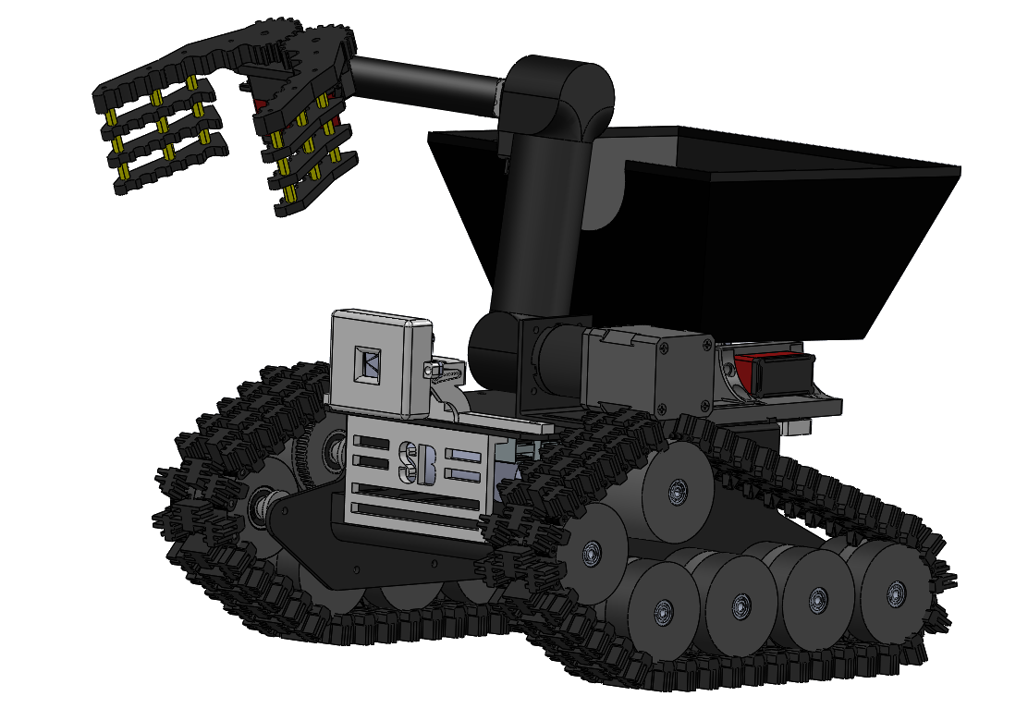
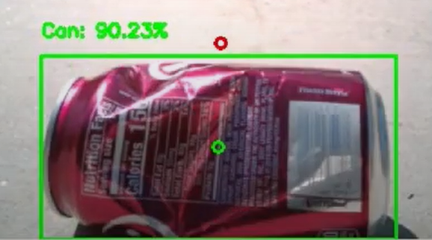
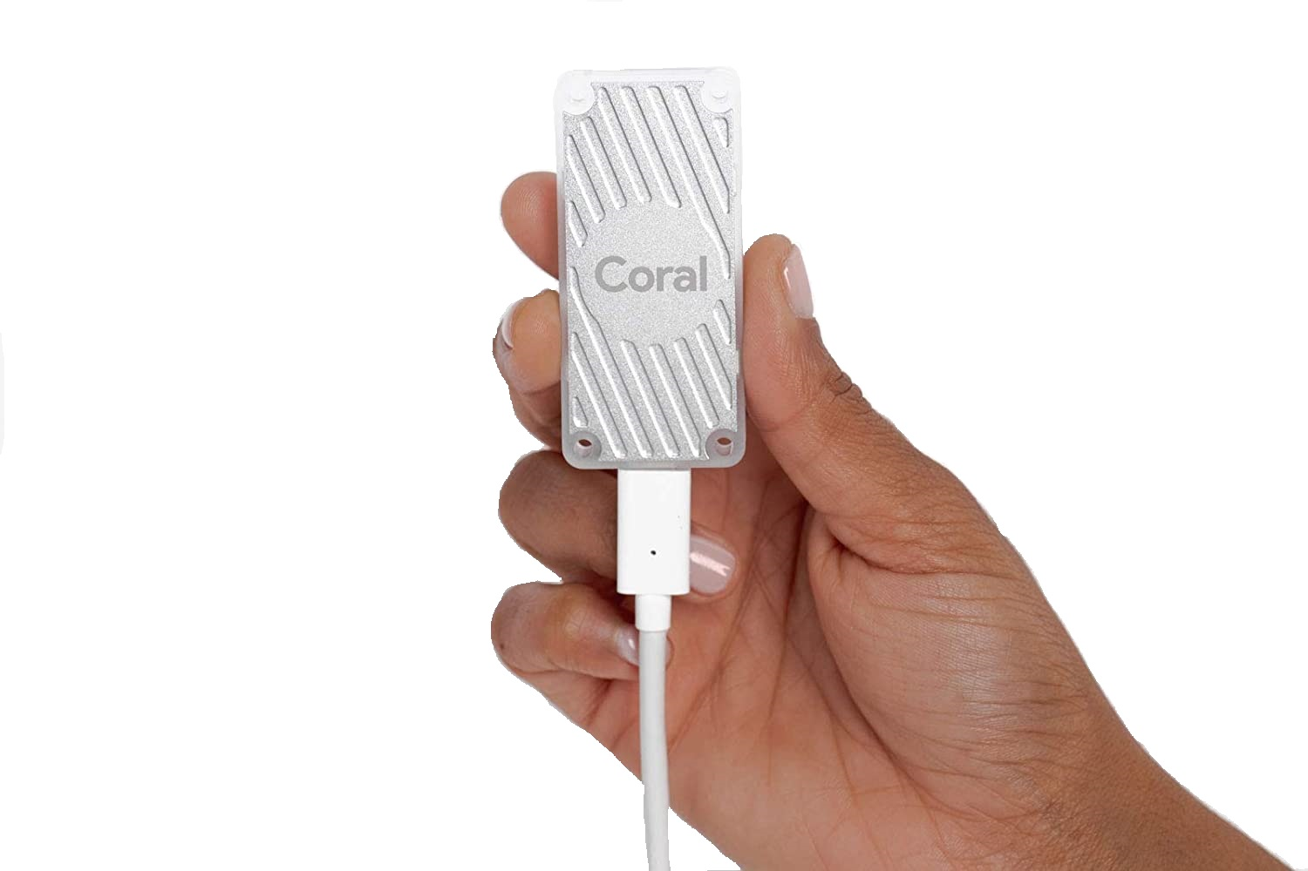
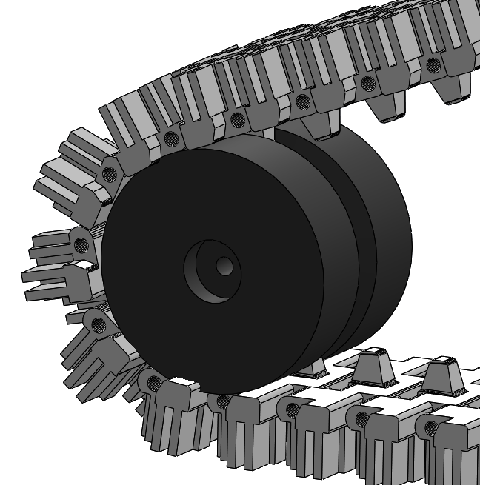
Beach Bots
Sebastien Casimir (RBE), Christopher Grier (RBE), Everett Johnson (RBE)
Benjamin Seibert (RBE), Sean Tidd (RBE)
Advisor: Professor Nicholas Bertozzi (RBE), Brad Miller (RBE)
Abstract
Beaches across the globe are being polluted by human trash. While there are solutions to remove pollution from beaches, they mostly entail large machines that are not environmentally friendly and require a human operator. The goal of this MQP is to develop a robotic solution to clean these beaches effectively. This project aims to develop building blocks for later MQPs including the development of one small robot, a base station with a beach mapping system, and the communication methods between them.
2
Smallbot Computer Vision
3
Smallbot implements a Tensorflow Lite Model to detect cans
Smallbot uses a Google Coral USB Accelerator to process camera video
4
6
5
System Architecture
1
Multi Robot System: Communicates with ROS over wifi
Task Based Objectives: Job data types that have their target zone position, job type (clean, avoid, dump), and other info
Basebot: Master robot that creates an occupancy grid of the beach and sends tasks to Smallbots. Can manage many Smallbots at once
Smallbot: Worker robot that executes given tasks and uses given occupancy grid to path plan with A Star
Smallbot Design
.
Field Testing
Simulation:
ROS communication between robots was successful
Basebot was able to send tasks to the Smallbot
Smallbot was able to reach its the start of the zone and clean
Smallbot was able to complete several zones in succession
This simulation is scalable to multiple Smallbots
Debris Collection Test:
The Smallbot was able to detect soda cans, drive to them and pick them up
The robot was able to store multiple cans and dump when required to.
Drive Train
3D printed tread system with inverted sprocket and chain
Maximum linear speed .42 m/s
Weight: 400 grams
Basebot Mapping
ZED Stereo Camera: The camera creates a 3D mesh of the beach. The 3D mesh is composed of triangles
Occupancy Grid: Using the mesh, the Basebot creates an occupancy grid that the Smallbots to use to path plan
Zone Generation: Algorithmically divide the world into zones relative to the start. Each zone is then cleaned by a single robot
Two Degrees of Freedom Arm
3D printed arm with a stepper motor for the shoulder joint and servo for elbow connection
Maximum reach distance: 310 mm
Maximum lifting weight: 0.6 kgs
Gripper
Machined metal tooth gripper powered by a servo
Maximum gripping force: 14 N
Bucket
3D printed bucket with a volume of 0.0014 m³
Able to contain 3-5 soda cans
Electronics Protection
3D printed cases protects electronics from damage
Compact and durable construction with ABS plastic
Smallbot Camera Mount
3D printed case protects from glare and elements
1 Degree of Freedom
Lipo Battery
3 cell, 8000 mAh
System runtime: 1.12 hours
Future Work
Continue development of system architecture
Design and fabricate the Basebot
Improve Smallbot scalability
Implement GPS sensor and wifi routers
Install better motors
Senior Instructor of Robotics Nicholas Bertozzi
Associate Director, Robotics Resource Center Brad Miller
Worcester Polytechnic Institute
Acknowledgements

