Slide 1
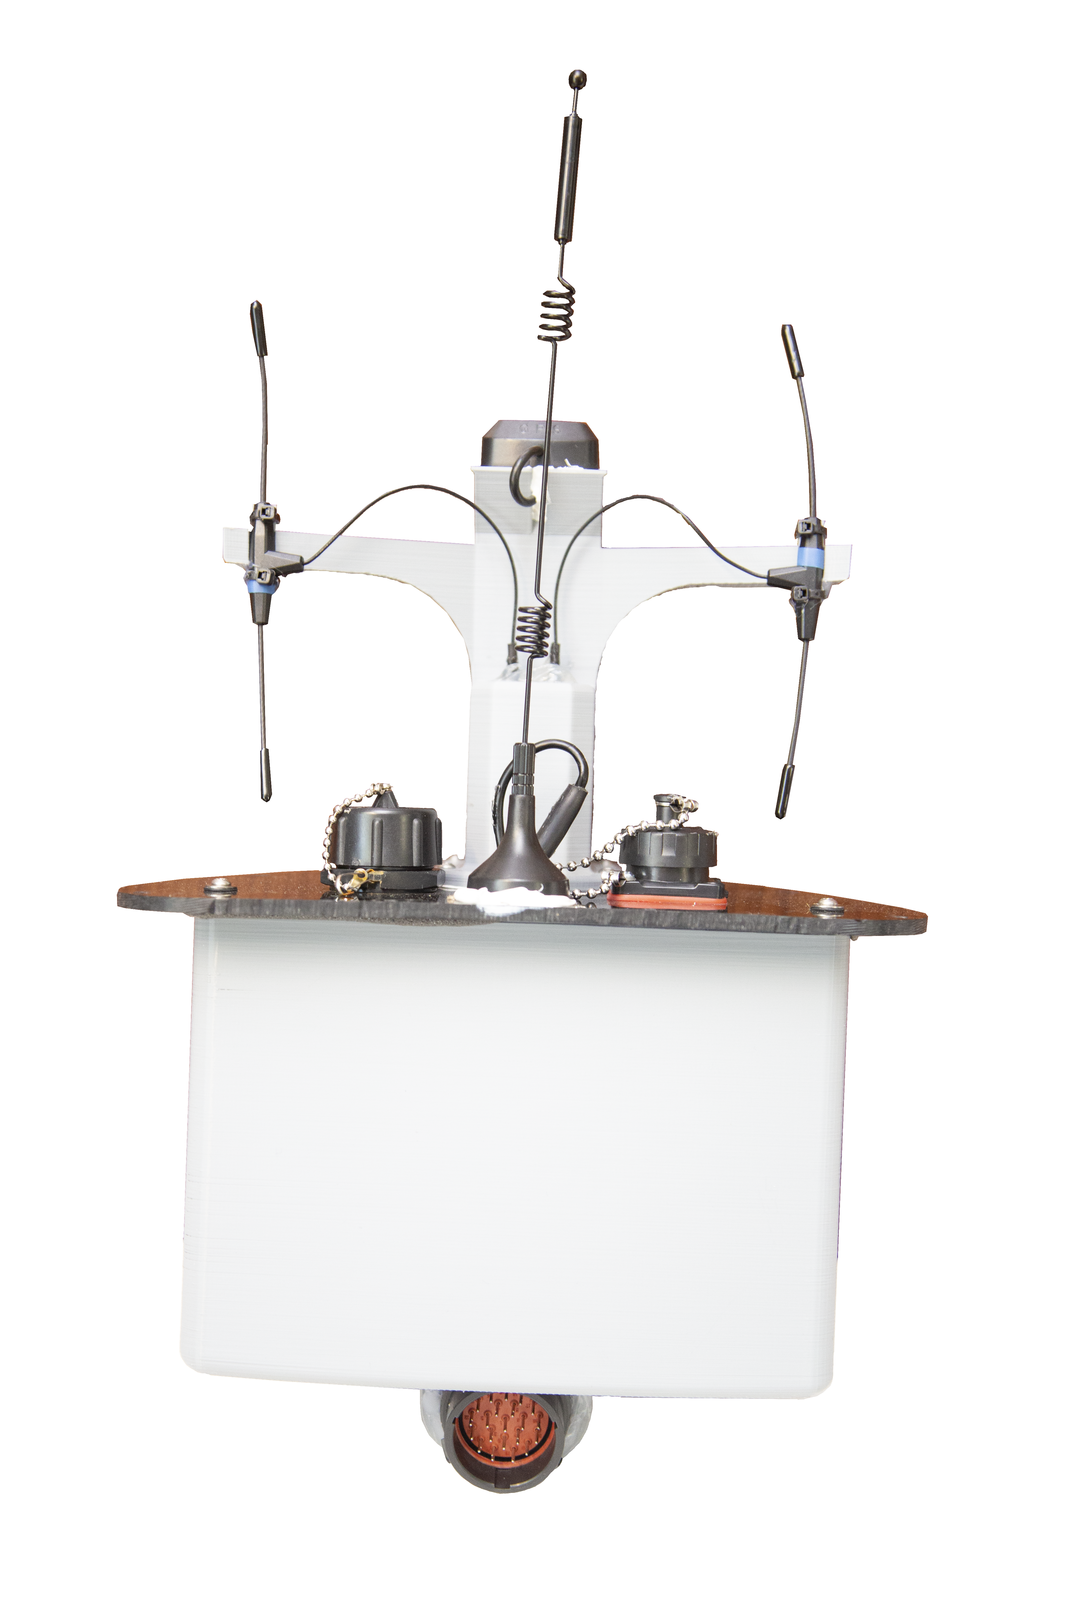
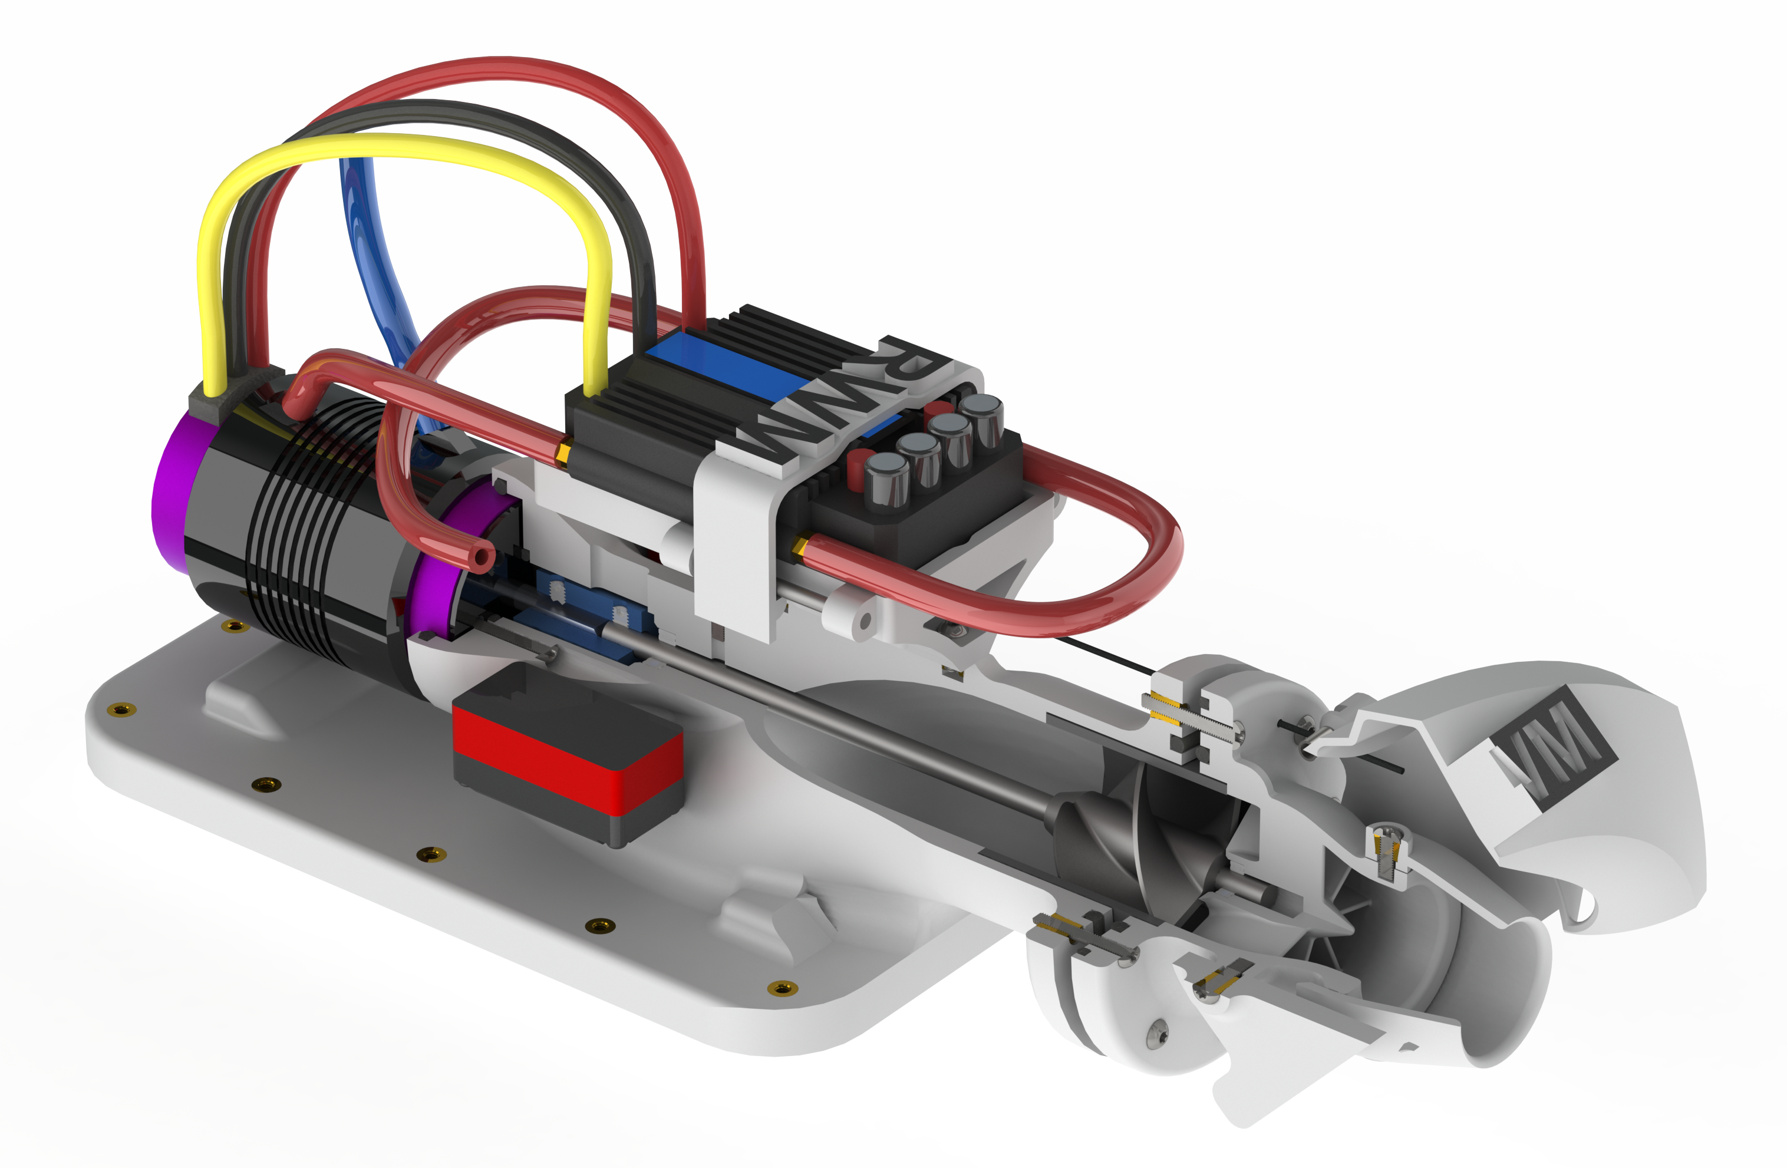
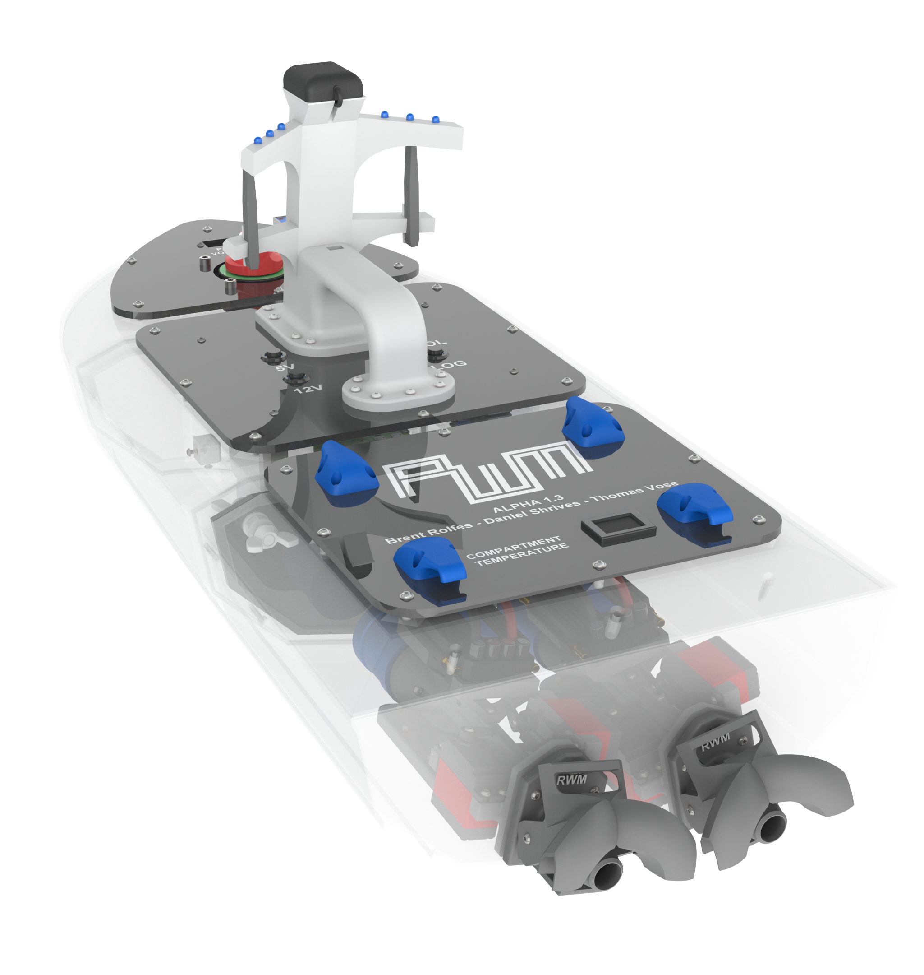
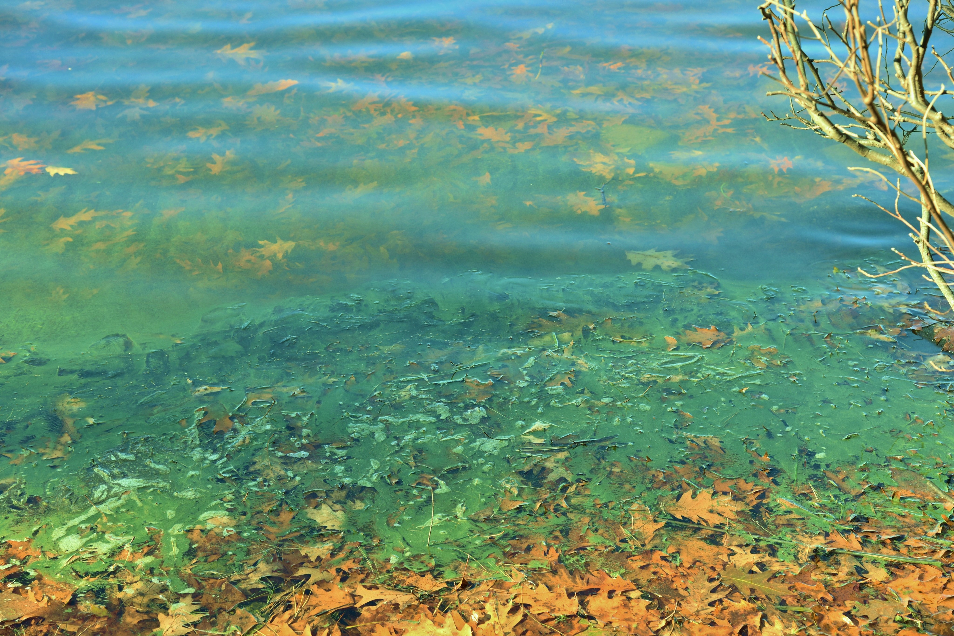
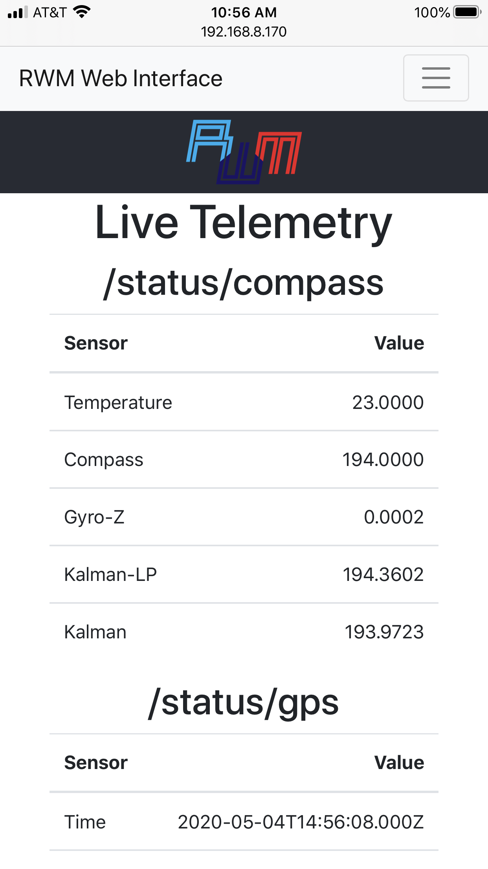
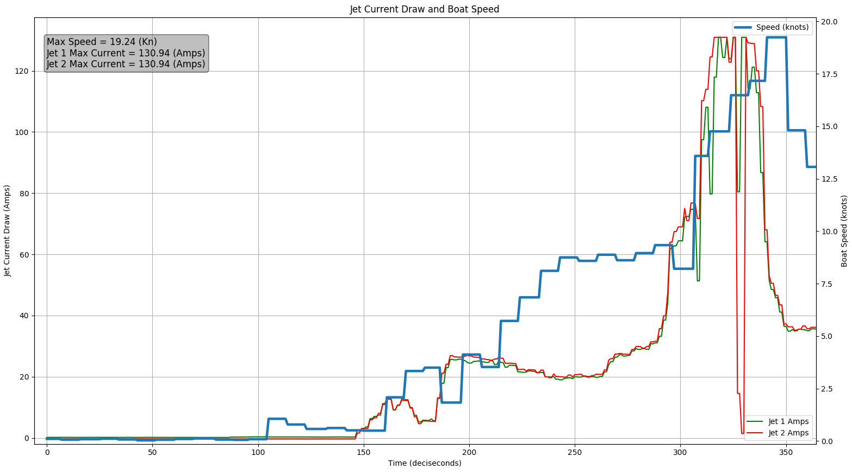
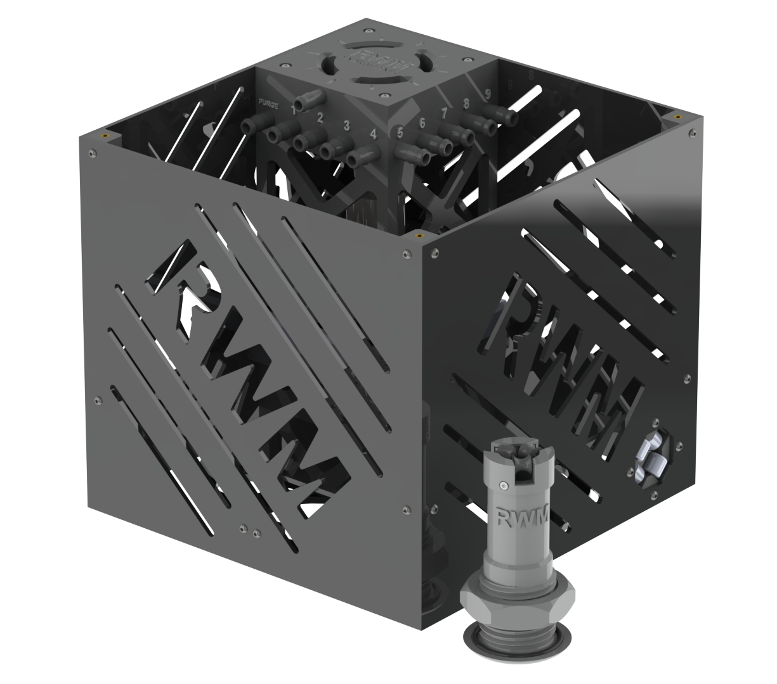
Robotic Water Monitoring
Brent Rolfes (RBE), Daniel Shrives (RBE), Thomas Vose (RBE)
Advisor: Professor William Michalson (ECE/RBE)
Hardware
Use Case
Software and Electronics
Due to the complexity of each system component, prototype models, known as the Alpha series, reduced risk and provided a foundation for research and development. The Beta boat is the culmination of all prototype work and is the final product.
Both RWM boats contain all processing, sensing, and actuation to facilitate autonomous waypoint missions
Abstract
With devastating funding cuts propagating through environmental agencies countrywide, the monitoring of local water bodies has been one of the essential services to be curtailed. The health of every body of water is crucial to the diverse aquatic ecosystems as well as the human populations who reside near their shores. Poor water quality has a disastrous impact on a region much larger than the body's footprint, and changes are rarely reversible. Although sampling is critical, the process is time and resource intensive meaning most bodies of water are either unmonitored, or sampled by volunteer groups. The Robotic Water Monitoring boat is a tool to expedite sampling, enabling the state to better allocate scarce resources by significantly increasing the quantity and quality of water samples.
75 – 80% of lakes in New Hampshire go unmonitored for 15 – 30 years
Excess nutrients causes rapid algal blooms and are introduced through lawn fertilizer, pet waste, leaky septic tanks, household chemicals, agriculture, and the burning of fossil fuels
Autonomy and Control Enclosure
MQTT protocol enables subsystem communication
Provides manual override authority throughout mission
Software developed on the Alpha boat is utilized in the Beta boat
Jet Drive
Iteratively designed axial flow water jets using custom Jet Testing Rig to analyze data on thrust and efficiency
Sensors and Electronics
Sensor suite provides status on internal and external states of the boat
Interfaced sensors: GPS, 9-DOF IMU, five temperature sensors, two current sensors, and a voltage sensor
Kalman Filter smooths compass values
900MHz transceiver module used for long-range manual control
Wi-Fi and 3G radios used for communication
Four Raspberry Pi Zero W’s control different subsystems
Alpha water jets produce 2.2kgf of thrust with a maximum efficiency of 45 gf/amp
Beta water jets produce 6.0kgf of thrust with a maximum efficiency of 130 gf/amp, exceeding system requirements
Hull Design
3D printed, assembled, and tested to determine favorable dynamic characteristics
Alpha boat range of 1.2 NM with a top speed of 13 knots
Beta boat range of 5NM with a top speed of 19 knots
Logging and Telemetry
Control enclosure hosts website providing data logging and live telemetry of relevant compass, GPS, temperature, current, and voltage values
Water Sampling Unit
Algal Bloom - NHDES
Nine sample bottles totaling 3L filled from depths up to 5m using onboard peristaltic pump and water switch
Unit is replaceable, allowing for multiple lakes to be sampled in a single day
Contained in the Beta boat’s modular payload area
Algal blooms kill aquatic species in large numbers, produce toxic byproducts, lower real-estate values, reduce recreation, and contaminate drinking water
Regular sampling can pinpoint nutrient sources, reducing the risk of algal blooms

