Slide 1
WPI Main Campus
Two Electrical Power Shut Downs
July 18th & July 25th
7:00-am to 7:00-pm
June 24, 2020

Slide 2
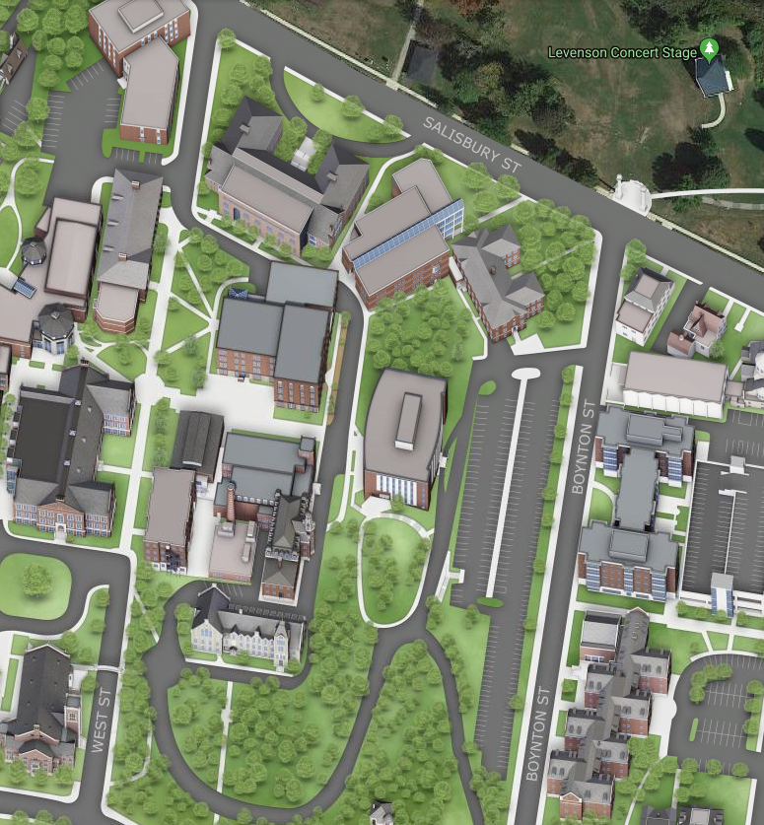

WPI Main Campus
Two Electrical Power Shut Downs
July 18th & July 25th
There will be two campus power shutdowns: Saturday July 18th & Saturday July 25th. The shutdowns will impact all of the WPI campus buildings inside of Salisbury Street, Boynton Street, Institute Road, & Park Ave (except for the Recreation Center). Power will be off from 7:00-am to 7:00-pm for each Saturday shutdown.
We are replacing the WPI Main Campus Switch Gear in partnership with National Grid (NGrid). The majority of the construction was in an area near the intersection of Salisbury Street & West Street.
We will be shutting down power to the campus to perform final connections to the new switch gear.
Switch Gear Construction Area
New Electric Services: Installed in Existing Conduits

Slide 3
WPI Main Campus
Two Electrical Power Shut Downs
July 18th & July 25th
Impacted University Buildings:
Impacted Student Residences:
Alden Memorial | Atwater Kent | Bartlett Center | Boynton Hall
Foisie Innovation Center | Fuller Labs | Goddard Hall | Gordon Library
Harrington Auditorium | Higgins House | Higgins Labs | Kaven Hall
Olin Hall | Power House | Project Center | Rubin Campus Center
Salisbury Labs | Skull Tomb | Stratton Hall | Washburn Shops
Daniels Hall | Messenger Hall | Morgan Hall | Sanford Riley Hall

