Slide 1
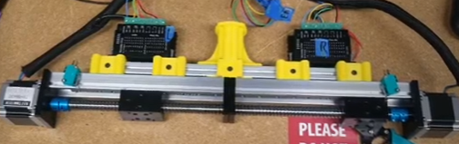
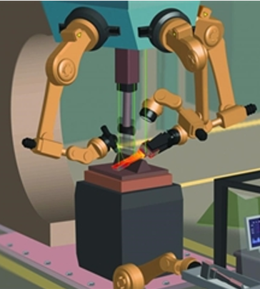
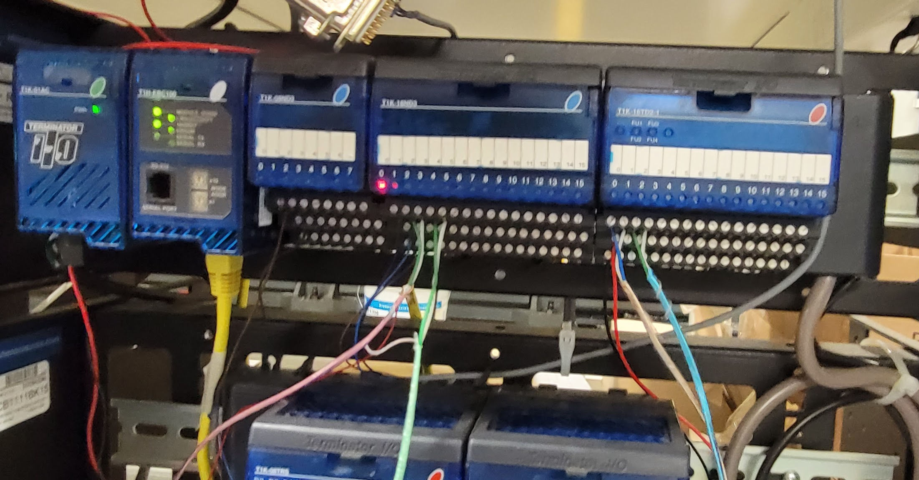
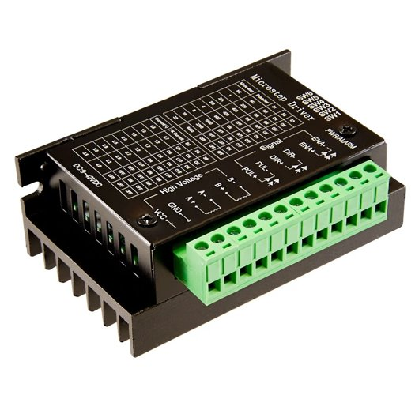
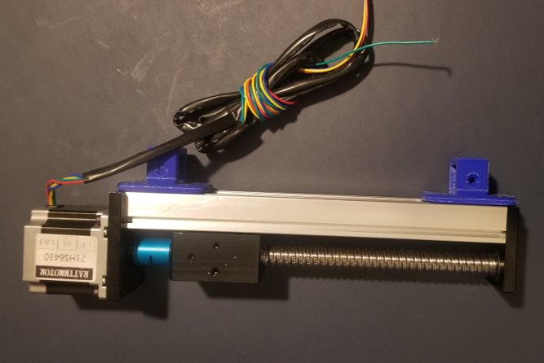
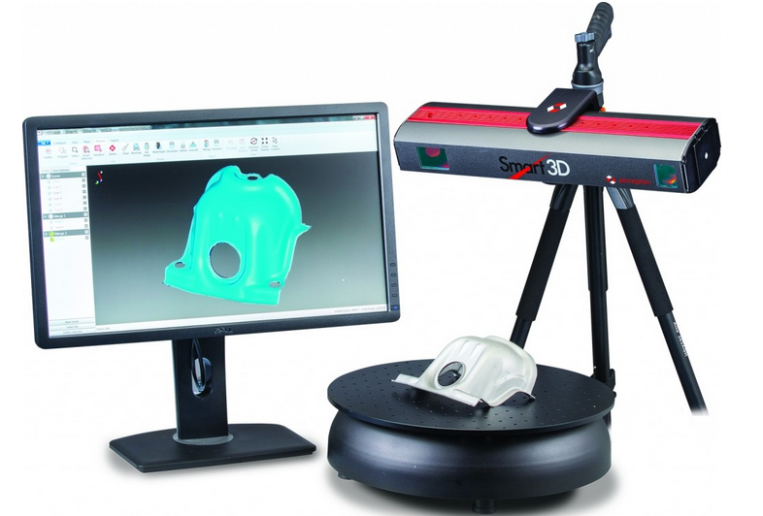
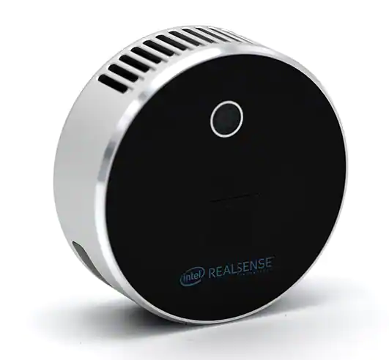
Metamorphic Manufacturing
Ryan Beaver (RBE), Ethan Campbell (ME), Nate Gere (RBE), Antoinette Mavrotheris (RBE), Arnold Muralt (RBE)
Advisors: Berk Calli (RBE), Sneha Narra (ME), Adam Powell (ME), Craig Putnam (RBE)
Abstract
The aim of this project is to develop a prototype metamorphic manufacturing system capable of shaping plasticine clay. The system should be capable of incrementally deforming the clay to produce desired geometries while minimizing material waste.
Design
Testing
Testing of linear actuators
Wiring and signal testing
3D printed parts strength testing
Gripper mechanism with interchangeable pressing faces to deform the plasticine
Tooling rack with various clay shaping attachments
External mold for reshaping plasticine clay into uniformly sized blanks
Background
Programming
Robotic Blacksmithing
Forms parts by using tools to mold heated material into a desired shape
"3rd Wave" of Digital Manufacturing
Less wasteful than Subtractive or Additive Manufacturing
Using Robot Studio and Do-More Designer, the system was programmed
to move each jaw
independently, in order to
accurately deform parts and
pick up tools.
A PLC was utilized to control
the gripper and talk to the
robot controller. Ladder logic programming was utilized to compare sensors on the grippers, with the expected position of the jaws.
System Features
Future Work
Stepper motor powered linear actuator
Stepper motor controller
QC-11 connector
Interchangeable tools
3D scanning of part
Computer vision feedback
Addition of heating element

