Slide 1


THEORY
PRACTICE
IMPACT
Notes:
Cover for a full photo background

Slide 2
WPI’s Mission
OUR VALUES
Respect – Community – Inclusion – Innovation – Achievement
OUR MISSION
WPI is committed to its mission to transform lives,
turn knowledge into action to confront global challenges, and revolutionize STEM through distinctive and inclusive education, projects, and research.

Slide 3
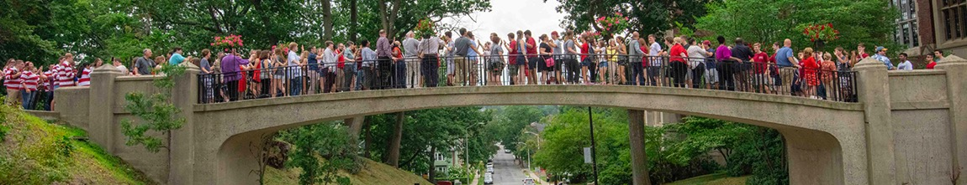
WPI at a Glance
OUR STUDENTS
Undergraduate and Graduate
DEGREES AWARDED 2023
5,454
undergraduate students
65%
of first-time WPI students graduated
high school with a 4.0 GPA (2022)
94%
first year retention rate (2022/23)
1,900
graduate students
100%
of graduate students receive 1:1 support
from dedicated student success managers
68
professional development program sessions
for graduate students (2023)
1,088
bachelor’s degrees
785
master’s degrees
88
doctoral degrees
70+
degree programs
THE RESEARCH ENVIRONMENT
Record-setting Growth
$42.4M
Government, corporate, and private funding
$62M
Research expenditures

Slide 4
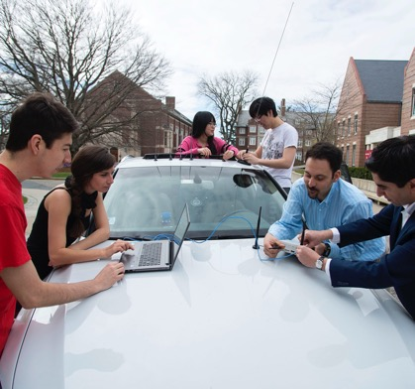
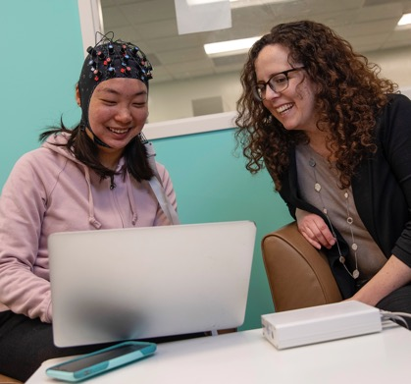
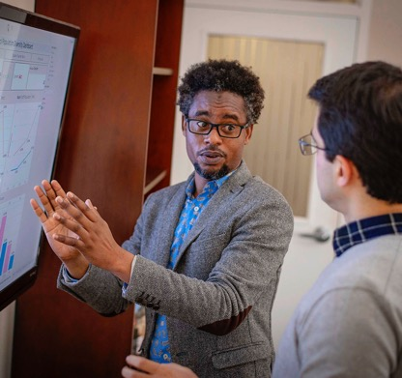
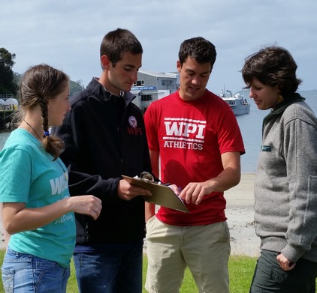
Four Schools, One WPI
SCHOOL of
ENGINEERING
SCHOOL of
ARTS &
SCIENCES
THE BUSINESS
SCHOOL
THE GLOBAL
SCHOOL

Slide 5
WPI Rankings
#28 OUT OF 4,500
higher education institutions for 30-year long-term ROI
Georgetown University’s Center on Education and the Workforce (2022)
#4
national universities where grads are paid well
U.S. News & World Report (2021)
TOP 5.4%
worldwide out of 20,000 universities
Center for World University Rankings (2022)
TOP 20%
U.S. college rankings
Times Higher Education, World University Rankings (2022)
#10
in Massachusetts, Best US Universities for Excellence, Equity, and Employability
QS World University Rankings: USA (2020)

Slide 6
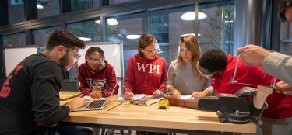
The WPI Plan and Project-Based Learning
The WPI Plan is the university’s distinctive approach to STEM education. For more than 50 years, the student-centered, project-based, and life-changing approach has revolutionized how our students learn and create value with their work.
WPI Is a Global Leader in Project-Based Learning: It’s Theory and Practice, Not Theory then Practice
1970
restructured education known as the WPI Plan
100%
undergraduate students complete two major projects before graduation
7 Weeks
per term, three courses per term, for undergraduate studies to create space for cooperative, open-ended project work
100%
of undergraduates complete the equivalent of a minor in Humanities & Arts to become well-rounded STEM leaders
98%
of alumni surveyed had projects in at least some courses
at WPI (2021)

Slide 7
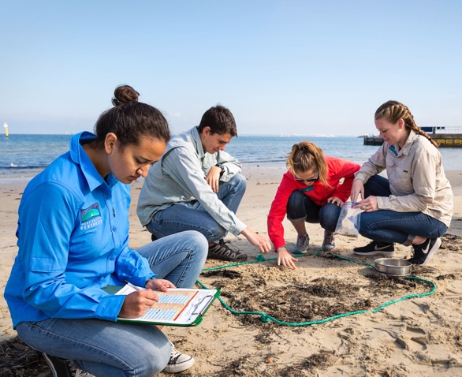
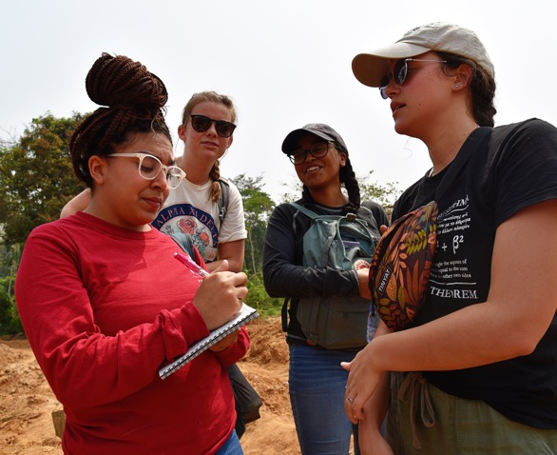
The Global Projects Program:
Not Your Typical Study Away Program
WPI’s groundbreaking Global Projects Program empowers and inspires students to become civically engaged, compassionate, globally aware individuals who know how to thoughtfully approach solutions to real-world problems.
50 Years
global projects program
50+
global project centers on six continents
100%
undergraduate students eligible for global scholarship
85%
of all WPI undergraduate students participate in program
AY 22/23
1,114
students participated in global projects program in ’22-’23 academic year

Slide 8
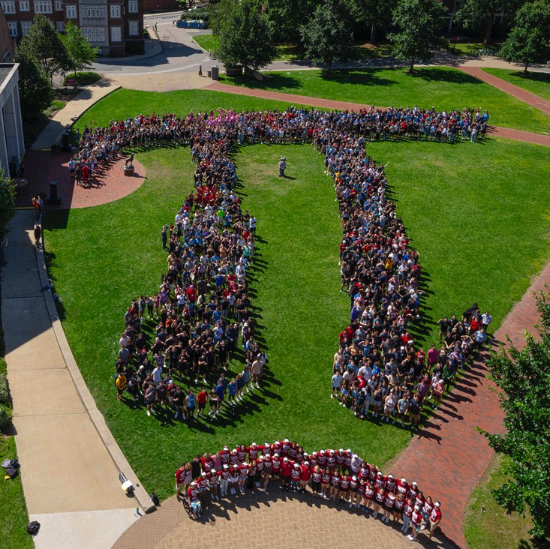
Student Body
235+
student clubs and organizations (from professional societies to a Lego club and a cheese club)
Students who call WPI home humanize STEM, gleaning inspiration from the world around them and infusing themselves and their passions in their experiences how only they can.
80%
of students are involved
in sports activities
27%
of female students
join sororities (2022)
25%
of male students
join fraternities (2022)

Slide 9
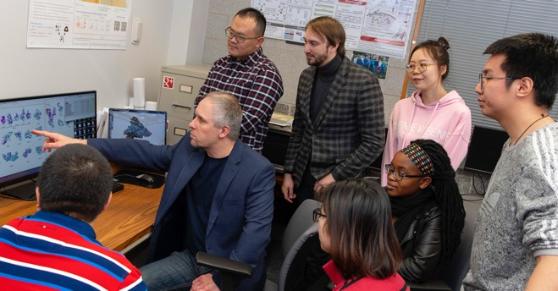
Faculty
2021
DELPHI AWARD WINNER
Recognizing WPI’s
work to improve the professional lives
and experiences of
non-tenure-track faculty
598
full- and part-time faculty 2022
25
Fulbright scholars
40+
CAREER Award recipients

Slide 10
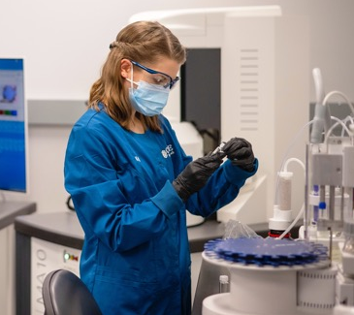
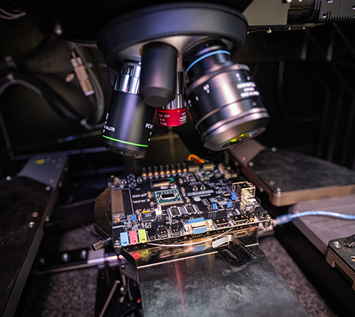
Research & Innovation
WPI's research focuses on discovery and innovation that has purpose, with an emphasis on sustainability. Our patents reflect
our innovation ecosystem and entrepreneurial spirit.
63
new invention disclosures
(2023)
13
issued patents
(2023)
$47.7M+
awarded to WPI researchers in government, corporate, and private funding
13%
increase in funding from 2021 (86% since 2017)

Slide 11
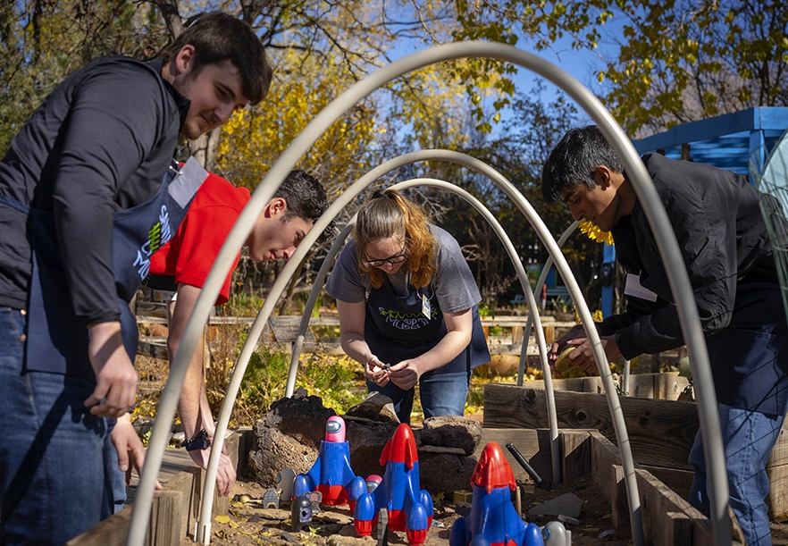
Alumni Results
The WPI alumni community is active and thriving, boasting a worldwide network
92%
of alumni surveyed reported being satisfied or very satisfied with their careers (2021)
MORE THAN 40,000
alumni live in more than 100 countries
95%
of alumni surveyed reported that
their project experience prepared them
for their current careers (2021)

Slide 12
wpi.edu
Notes:
Cover for a full photo background

