Slide 1
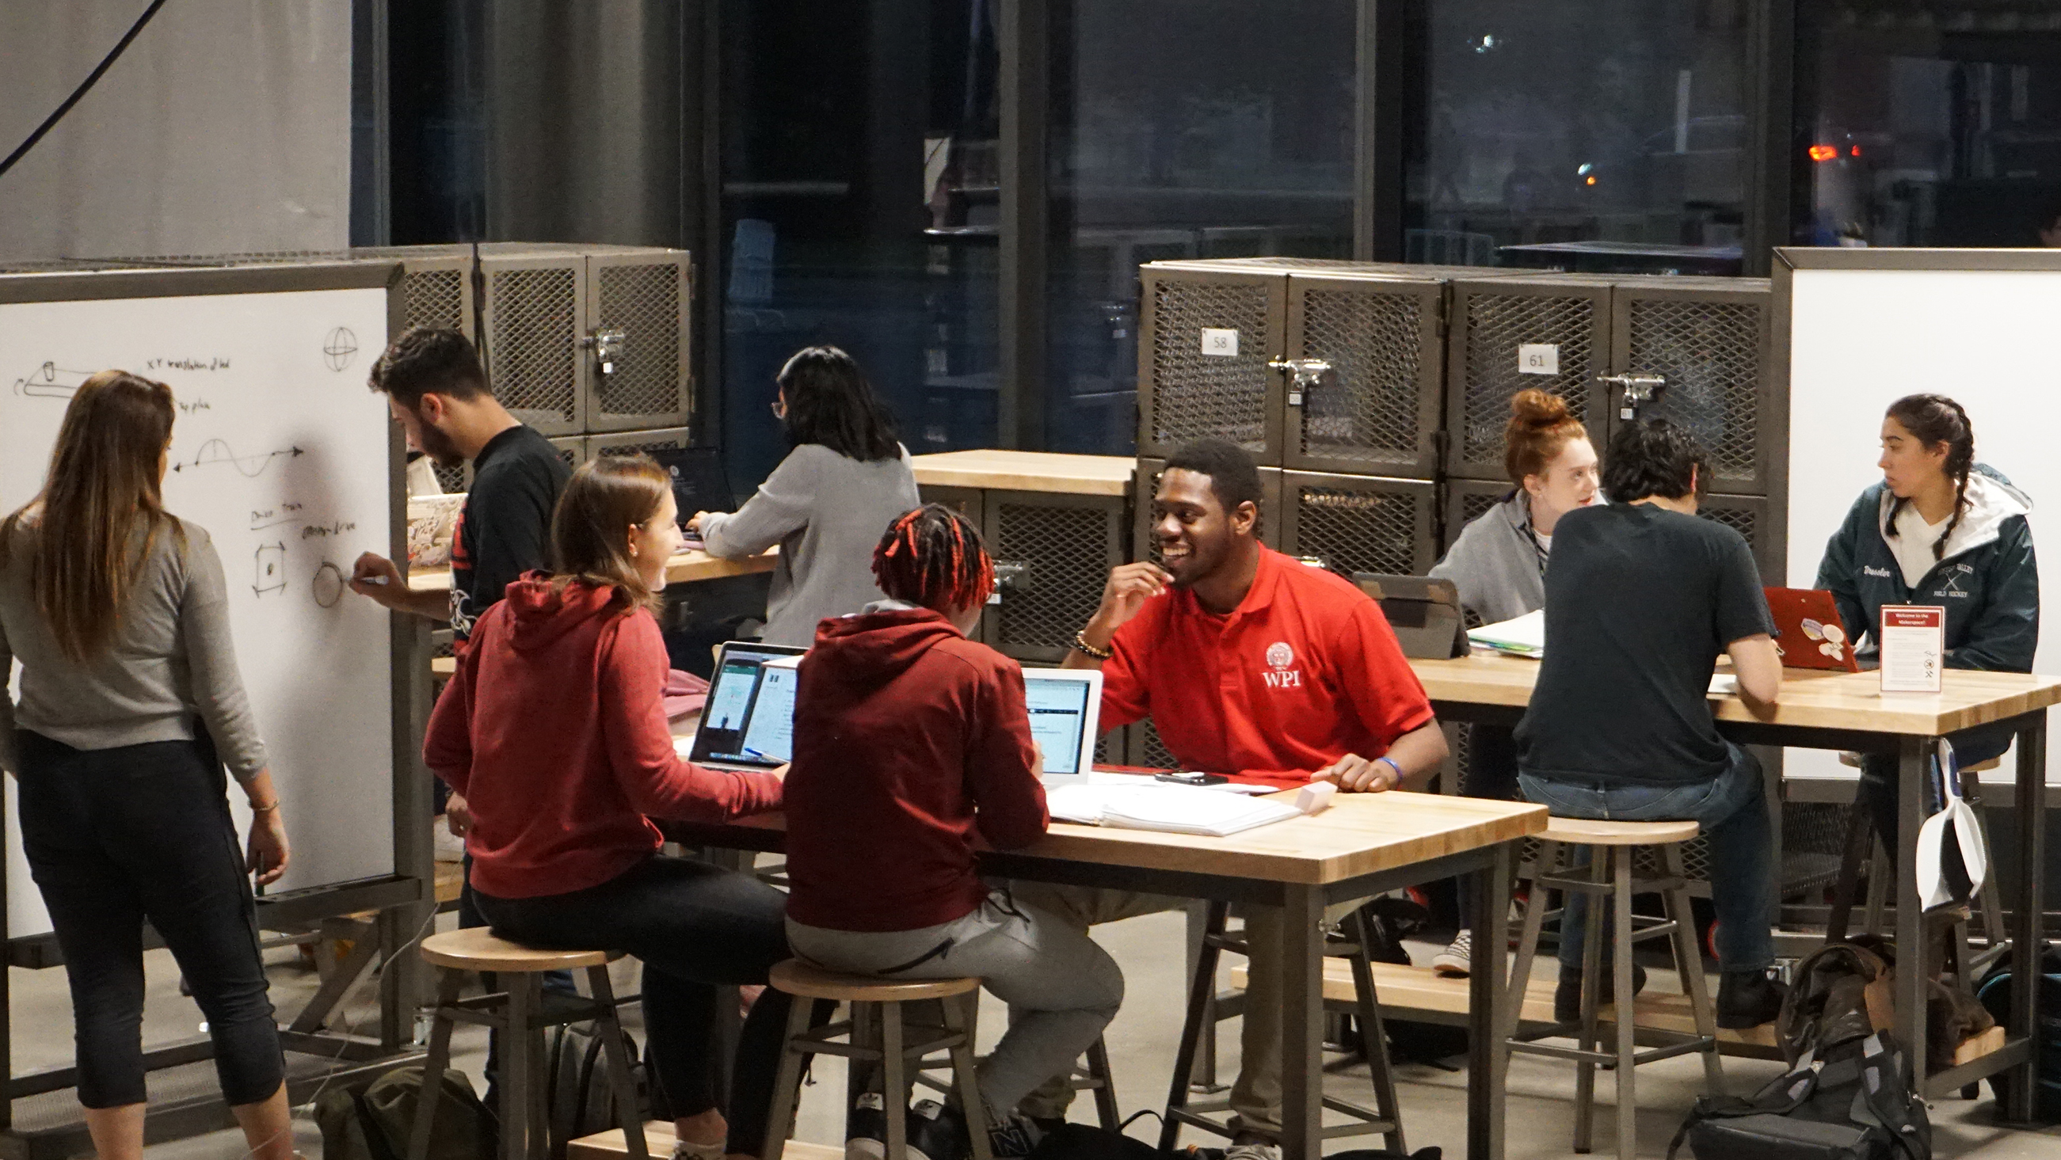
A Project-Based Education
Notes:
Cover for a full photo background

Slide 2
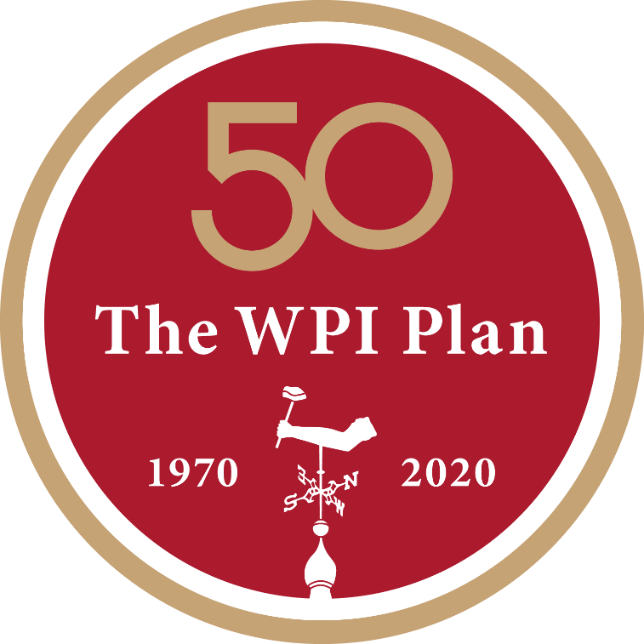
WPI Plan. Our Distinctive Approach to STEM Education.
In 1970, the WPI Plan was a bold experiment—a radically new, student-centered, project-based approach to learning. Today, it’s a proven, highly effective, and sought-after model for academic innovation—one that will help guide further change at WPI and throughout higher education.
This distinctive approach to education gives students:
Freedom to chart their academic paths
The essential professional and personal skills and mindset for the future
Real-world experience and impact
An expanded world view and global perspective

Slide 3
The Global Leader in Project-Based Learning: It’s Theory and Practice, Not Theory then Practice.
Leadership in Project-Based Education—Over 50 Years
Projects at the Heart of the WPI Education—Three Major Project Degree Requirements
Proven Hands-on Approach to Learning—Preparing Graduates for Careers and Lives
Groundbreaking Global Projects Program—Tackling Real-World Problems
The Global School—Empowering and Inspiring Students to Become Civically Engaged, Compassionate, and Globally Aware Individuals

Slide 4
Project-Based Learning at WPI—Because Learning is an Active Verb
1st Year
3rd Year
Great Problems Seminar (GPS)
Interactive Qualifying Project (IQP)
Optional
University-level research to address problems focused on themes of global importance
Degree requirement
Interdisciplinary team projects to address a problem or need that lies at the intersection of science and technology
Usually an off-campus project experience working with sponsor partners at 50+ project centers around the globe
2nd Year
Humanities and Arts
Degree requirement
Seminar or practicum in chosen area

Slide 5
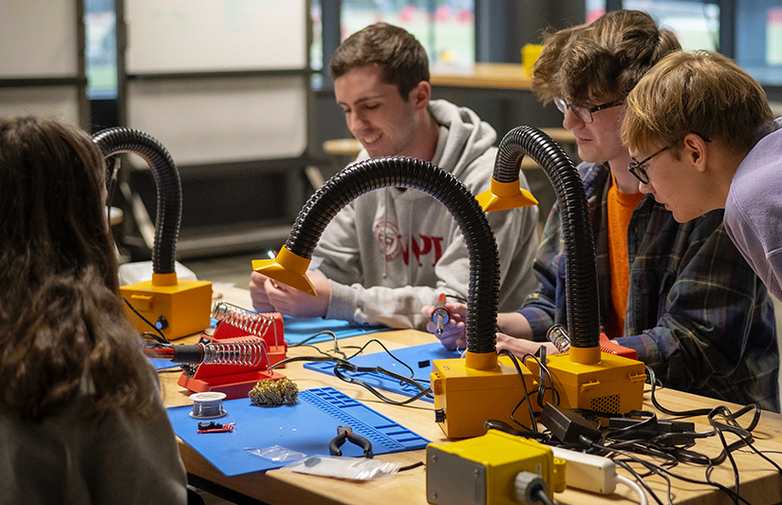
Project-Based Learning at WPI—Because Learning is an Active Verb
4th Year:
Major Qualifying Project (MQP)
Degree requirement
Major-specific research, design, and creative projects
1st – 4th Years:
Course Project Work
~70% of faculty have introduced a project into 1 or more courses
98% of WPI alumni surveyed in 2021 indicated they had projects in at least some of their courses

Slide 6
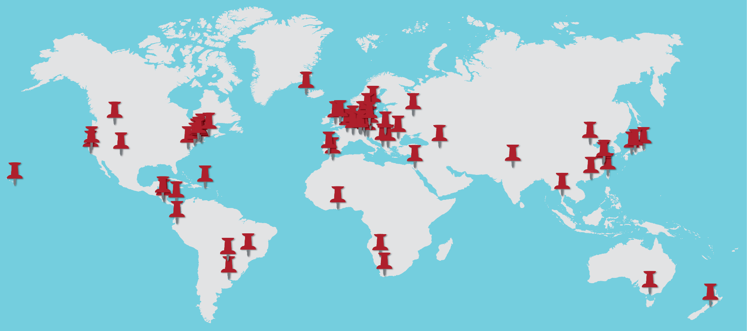
The Global Projects Program. Not Your Typical Study Away Program.
50 Years of Undergraduate Project Experiences Through the Global Projects Program
Academic Year 2022-2023
100% of Undergraduate Students Eligible to Receive Global Scholarship
85% of all WPI Undergraduate Students Participate in the Program
1114 Student Participants
54 Project Centers
30 Countries
6 Continents

Slide 7
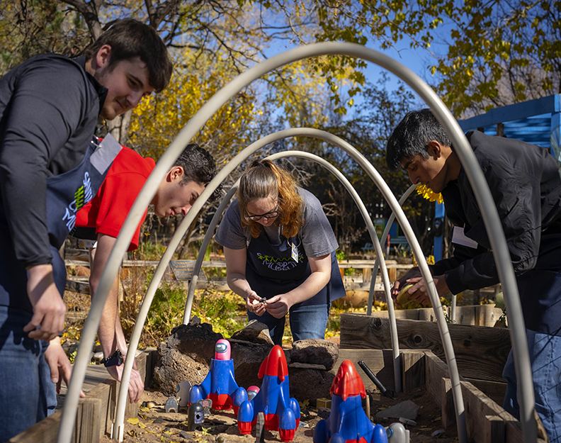
Lifelong Impact of WPI’s Project-Based Education
WPI’s distinctive project-based educational model has been praised by the most recognized and valued resources in the academic world, as well as by those who know the benefits of a WPI education firsthand—WPI students and alumni.
Powerful empirical evidence of its effectiveness—an extensive study of more than 2,200 WPI alumni, conducted in 2021 and 2012, has confirmed that there are lifelong professional and personal benefits of experiential, hands-on learning through project work.

Slide 8
Lifelong Impact of WPI’s Project-Based Education
In the 2021 survey—analysis conducted by Hanover Research—alumni were asked to rate the extent to which their project work contributed to 39 professional skills and abilities, world views, and personal attributes. Respondents from this survey reported significantly greater impact from formal project experience across all 39 areas as compared to alumni surveyed in 2012 regarding the same 39 attributes.
The 2021 survey also revealed:
Female alumni reported more positive impact of project work than males in all 39 areas, with the most notable differences in world views and personal impacts.
95% of respondents reported that their project experience prepared them for their current career.
In addition to major project requirements, 98% of respondents indicated they had projects in at least some of their courses at WPI.

Slide 9
2021 WPI Alumni Survey on the Impact of Project Work Professional Areas of Impact – Interpersonal and Communication Skills
Indicate the extent to which your formal project experience at WPI (through GPS, HUA capstone (enquiry seminar/practicum or sufficiency), your IQP, and/or your MQP) enhanced your ability to:
% Moderately, Much or Very Much
93%
92%
90%
89%
Effectively function on a team
Effectively manage a project
Write clearly and effectively
Effectively manage interpersonal dynamics
88%
87%
86%
86%
Communicate effectively visually
Speak clearly and effectively
Make connections across disciplines
Be an effective leader

Slide 10
2021 WPI Alumni Survey on the Impact of Project Work Professional Areas of Impact – Professional Abilities
Indicate the extent to which your WPI formal project experience (through GPS, HUA capstone (enquiry seminar/practicum or sufficiency), your IQP, and/or your MQP) contributed to:
% Moderately, Much or Very Much
94%
94%
94%
93%
Take responsibility for own learning
Integrate information from multiple sources
Develop ideas
Identify, analyze, and solve problems creatively through sustained critical investigation
89%
87%
79%
74%
Use current technology
Deliver effective presentations
Awareness of how your decisions affect and are affected by others
Understanding of ethical responsibilities

Slide 11
2021 WPI Alumni Survey on the Impact of Project Work Professional Areas of Impact – Professional Advancement
Indicate the extent to which your formal project experience at WPI (through GPS, HUA capstone (enquiry seminar/practicum or sufficiency), your IQP, and/or your MQP) enhanced your ability to:
% Moderately, Much or Very Much
91%
91%
91%
88%
Effectively interact as a professional
Opportunities you believe students from other universities did not have
Development of a solid base of knowledge
Function effectively in the "real world"
88%
83%
71%
51%
Mastery of fundamental concepts and methods in you major
Succeed in business or industry
Knowledge or experience that helped you change your mind about your future plans
Professionally beneficial connections

Slide 12
2021 WPI Alumni Survey on the Impact of Project Work Personal Areas of Impact
Indicate the extent to which your WPI formal project experience
(through GPS, HUA, IQP, and/or MQP) contributed to:
% Moderately, Much or Very Much
88%
84%
77%
77%
Develop a stronger personal character
Feelings that own
ideas are valuable
Feelings of being connected to the WPI community
Feelings of being able to "make a difference"
75%
65%
65%
57%
56%
Enriching life in ways that were not necessarily academic or work-related
Feelings of being connected to a non-WPI community
Desire to maintain involvement with the WPI community
Achieve work/life balance
Desire to maintain involvement with a non-WPI community

Slide 13
2021 WPI Alumni Survey on the Impact of Project Work World Views Impact
Indicate the extent to which your formal project experience at WPI (through GPS, HUA capstone
(enquiry seminar/practicum or sufficiency), your IQP, and/or your MQP) enhanced your ability to:
% Moderately, Much or Very Much
88%
82%
71%
View Issues from several different perspectives
Understanding of the connection between technology and society
Understanding of global issues
70%
69%
66%
Respect for cultures outside your own
Understand people of other cultures
Understand people of other racial and ethnic backgrounds

Slide 14
What Alumni Say About their WPI Project Experience
“[Project-Based Learning] is the "crown jewel" of the WPI undergraduate education experience and is an excellent experience preparation for the working world after college.”
—WPI Alumnus ’95, Environmental Engineering
“Project work is key to prepare students for real life work.”
—WPI Alumnus ’16, Chemical Engineering
“I am incredibly grateful for my project experiences at WPI. It definitely shaped me to be the person and the professional that I am today.”
—WPI Alumnus ’17, Mechanical Engineering
“The project-based learning made me feel empowered with ownership of my education. It was fantastic and I would recommend it to others.”
—WPI Alumnus ’06, Applied Physics
“My experience at WPI was one that shaped my career and set the stage for my success in the real world.”
—WPI Alumnus ’10, Industrial Engineering

Slide 15
What Alumni Say About their WPI Project Experience
“Project work transformed my educational (and later professional) mindset from passive repetition to an active/proactive (empowered) participant. I became actively responsible and vested in my educational and problem-solving process.”
—WPI Alumnus ’88, Electrical Engineering
“Working as part of a team is an essential life skill that is not taught as a default by many institutions. I'm forever thankful WPI is one that forces you to learn it—and travel, especially long-term travel, is enriching in so many ways.”
—WPI Alumnus ’11, Mechanical Engineering
“In industry, it isn't what you know today, but more importantly what you are able to learn. WPI and its project-based curriculum taught me how to learn and feel comfortable with the unknowns.”
—WPI Alumnus ’00, Electrical Engineering
“I am forever grateful for the WPI project plan curriculum. This curriculum is what made WPI stand out against other schools and ultimately led me there in the first place. I have never regretted this decision.”
—WPI Alumnus ’05, Biomedical Engineering
“The project program was the primary reason I chose WPI. I had incredible opportunities there that I couldn't have had at other schools. The real world is project-based, so I think it's extremely valuable experience.”
—WPI Alumnus ’04, Electrical & Computer Engineering

Slide 16
PBL In Higher Education
Center for Project-Based Learning. Sharing PBL Expertise for the Betterment of Higher Education.
Advancing PBL Across Higher Education
Serving as PBL Hub For Higher Education
Supporting Equity and Inclusion Through PBL Within Higher Education
Strengthening PBL Network Through Strategic Academic Collaborations
Founding in 2016:
2,000+ Faculty and staff engaged in Center professional development offerings
30+ PBL resources (research briefs, newsletters, webinars, podcasts, etc.)
2021 Inaugural Center Equity Audit
nearly 50 Network of Partners

