Slide 1

STEM OPT

Slide 2
Eligibility for STEM OPT
Must have a STEM eligible major from current degree (or*)
CIP code XX.XXXX on your I-20 has to be on the DHS eligibility list
Must be working for an E-Verify employer (learn more about E-Verify here)
Must be employed at the time of applying for STEM OPT
Must have proof of degree completion (degree or transcript)**
STEM OPT is only available twice in your lifetime as a student, regardless of number of degrees.
* If you have a STEM degree from a previous level (Bachelors, or Masters) but you didn’t use STEM OPT at that level, and you received that degree less than 10 years ago, if your current degree is not STEM eligible you can potentially use this previous degree to extend your current OPT.
** special consideration for PhD dissertation completion (very rare)

Slide 3
Timelines
Application timeline is connected to “post-completion OPT end date” (12-month OPT) on I-20.
Earliest application date is 90 days before OPT end date
Must apply BEFORE the end date of your 12-month OPT end date.
You can keep working for your employer while waiting for the new STEM EAD (OPT) card to come in the mail (up to 180 days), even if your wait period is after the 12 month OPT EAD is complete, as long as you have OPT receipt notice– however other issues: driver’s licenses
Once your STEM OPT begins, you have an additional 60 days of unemployment, this is added to whatever you have remaining from the original 90 days of unemployment from the 12-month OPT, giving a maximum total of 150 days if no days have been used
Within 90 days-prior, submit application
<180 dates, can still work with receipt notice while waiting for EAD
STEM OPT (+60 days of unemployment, starts)
12 month OPT end date
STEM OPT start date

Slide 4
Process for Applying for STEM OPT this information is also listed on the International House Student Forms page under “Apply for 24-Month STEM OPT Extension”
Fill out the WPI Application Form, the I-765 Form, and the I-983 Form and submit through the IH submission portal for review before your OPT appointment time.
The I-983 Form must be signed (pages 1, 2, and 4) and completed (pages 1-4), or we will not be able to release your I-20 during your OPT appointment.
2) Book an appointment with one of the IH advisors
3) During the STEM OPT appointment you will receive the STEM OPT I-20 and review your forms. We can do appointments through Zoom or in person.
4) After the appointment you will login to the USCIS government portal to upload your materials, pay your fee, and submit to the government queue.

Slide 5
What you need for the application
For IH appointment:
WPI application– all forms are on the IH forms page
I-983– if we do not have this form (pages 1-4) filled out and signed, we cannot complete the OPT appointment or release the STEM OPT I-20 form. This form is not uploaded to USCIS, but needs to be collected by IH for government storage.
For appointment and to upload to USCIS:
I-765
Passport ID page scan
I-94 screenshot
Scan of previous EAD card(s)
Diploma or official transcript (recommend diploma)
Additional for upload to USCIS:
Passport-sized digital photo– less than 6 months old, not a picture you used for passport/visa/previous OPT
$470 through debit/credit to pay online
I-20 with OPT recommendation (will receive from IH same day as OPT appointment)
Scans of previous I-20s

Slide 6
Please note:
Once your I-20 with OPT recommendation has been created USCIS must receive your OPT packet within 60 days of the I-20 creation date. Please do not wait to submit your packet to USCIS, as this could affect your OPT approval.

Slide 7
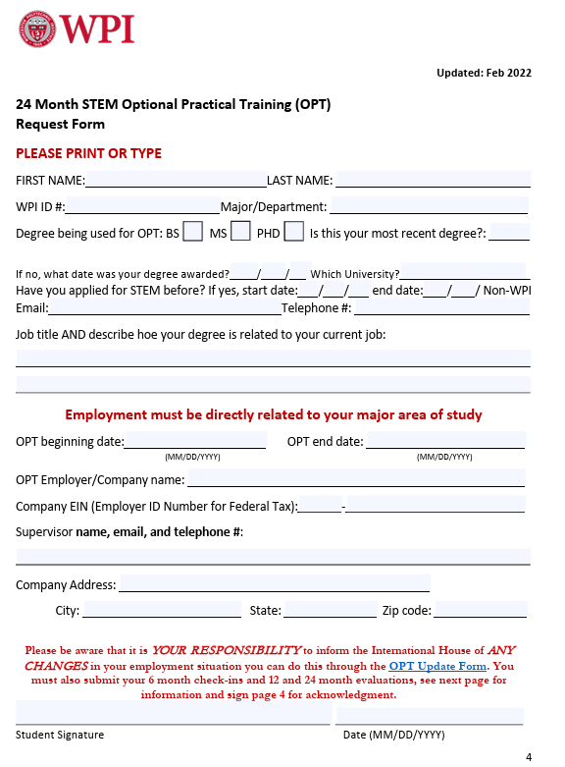
WPI Application
Sections must be fully filled out, including your employment information.
OPT beginning date will be the day after your current OPT expires, and will end two years minus a day later.
Example: 06/01/2025-05/31/2027

Slide 8
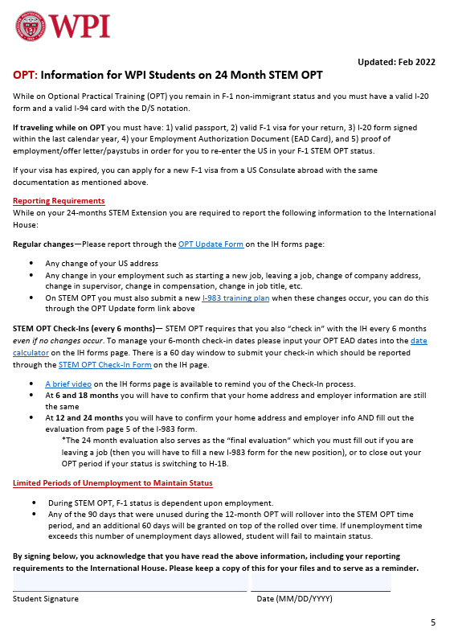
Verifies that you read and understood future reporting requirements

Slide 9
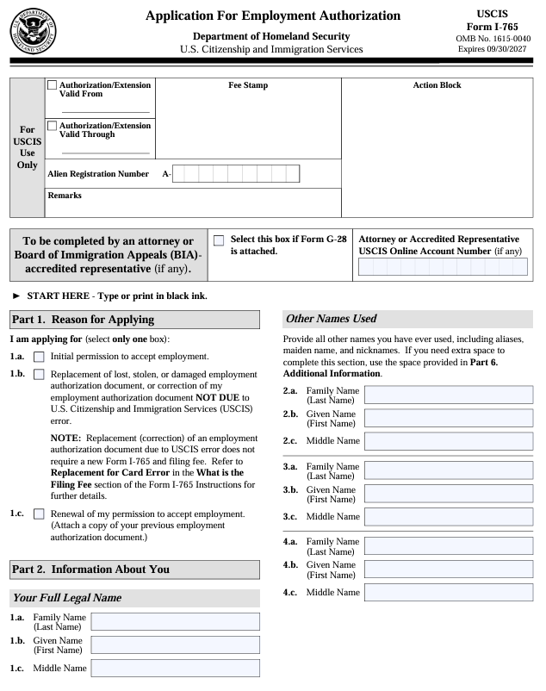
I-765 Government App.
An IH advisor will review the draft of your I-765 OPT application. Once your answers have been verified you will later log in to USCIS.gov to resubmit your answers through the dynamic survey version of the I-765 on USCIS’s website. You will not upload the pdf of the form to USCIS.
On the following slides, the highlighted sections are the sections you will fill in.

Slide 10
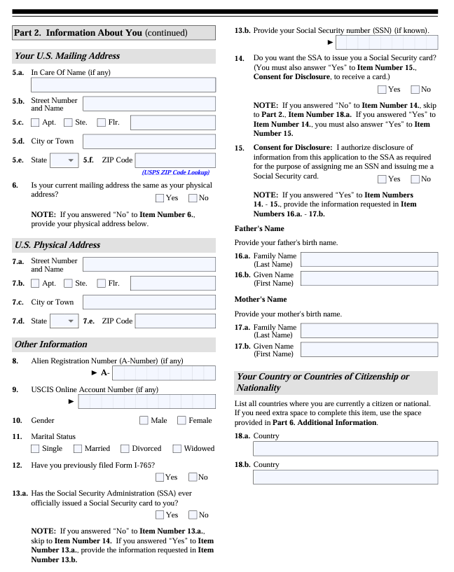
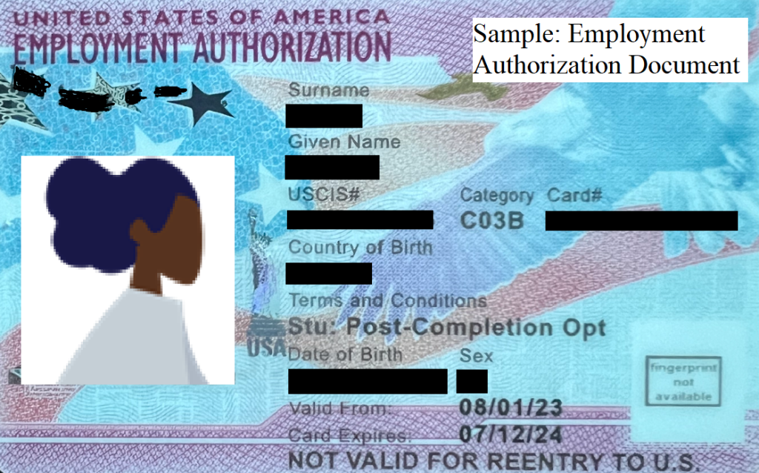
e
This will be the USCIS number on your EAD card

Slide 11
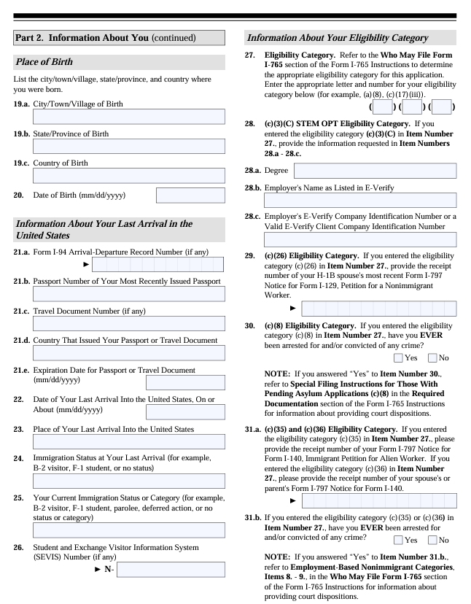
Eligibility Category will be (C) (3) (C)
E-Verify number does not have any dashes, special characters or letters. Only numbers

Slide 12
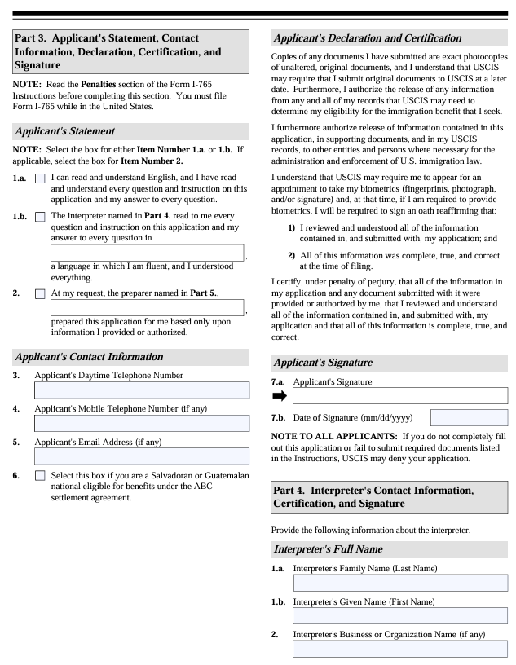
The application is 7 pages long, but only need pages 1-4.

Slide 13
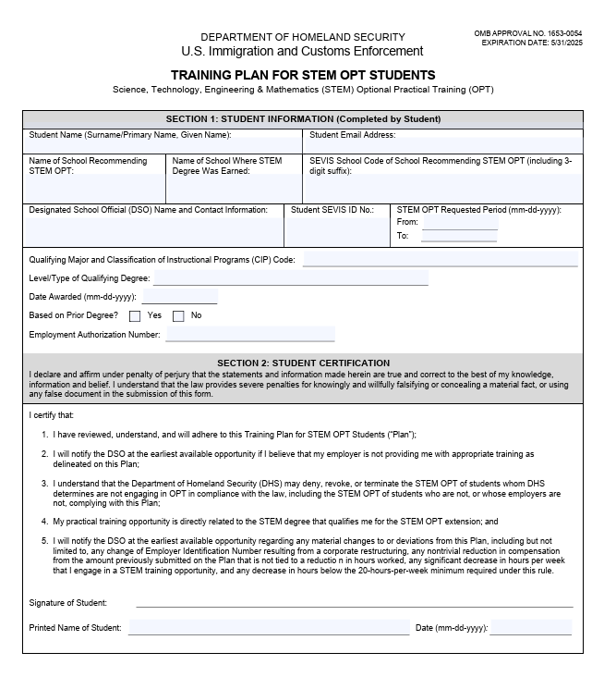
I-983 Forms
Name of school: WPI
SEVIS code: BOS214F00381000
DSO: One of the int’l advisors at IH
SEVIS #: N00 number on your I-20
CIP code: XX.XXXX near your major on your I-20
Level: BS, MS, or PHD
Date Awarded: Date on your diploma
Based on prior degree: no (unless using a degree before your current degree)
Employment Authorization Number: from your EAD card

Slide 14
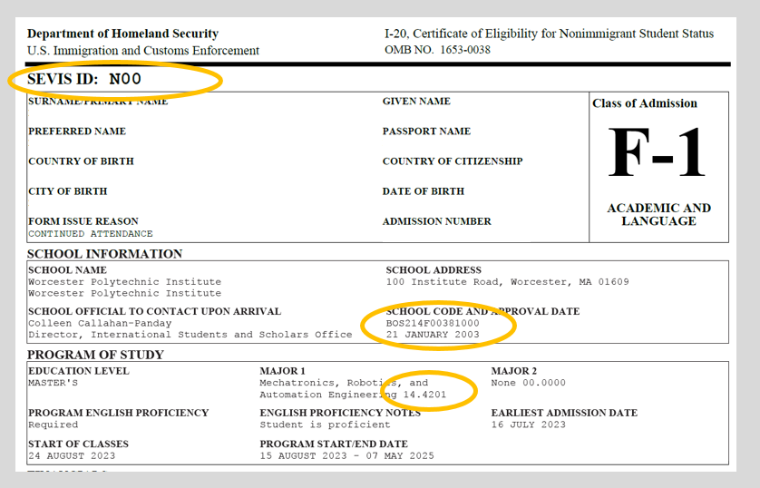

Slide 15
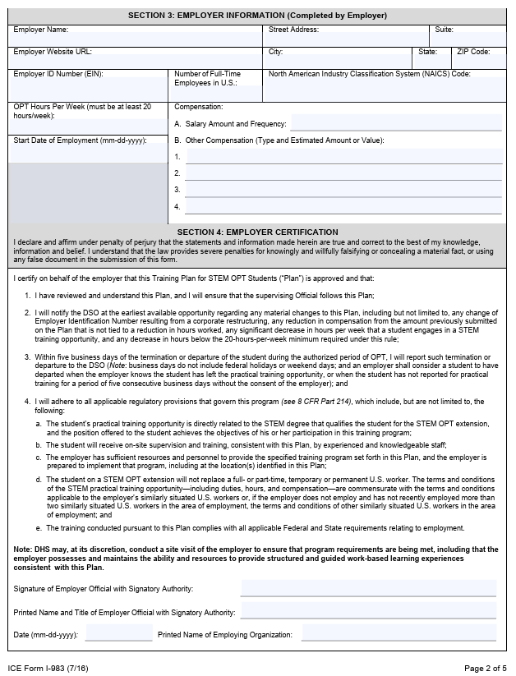
Start date of employment: When you started working at the company, not when you started your STEM OPT
NAICS Code: Industry code in Human Resources

Slide 16
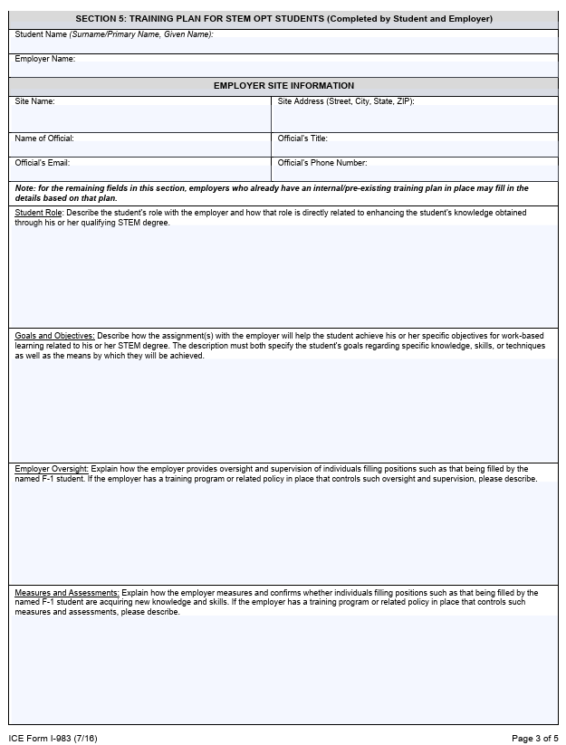
Name official: your supervisor
We need their email and telephone number for SEVIS as well.

Slide 17
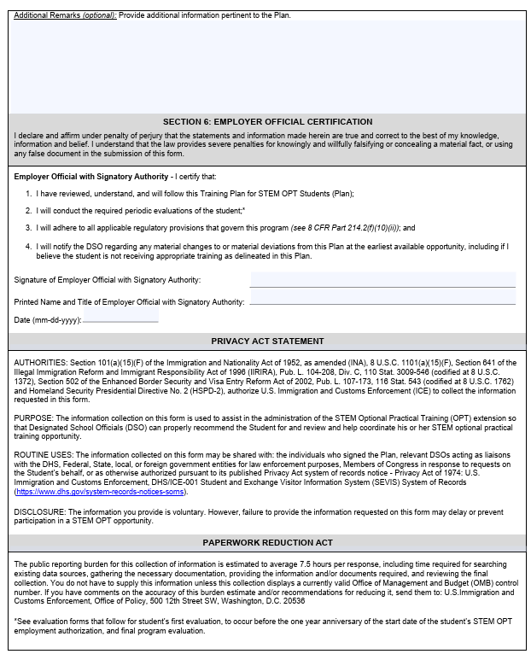

Slide 18
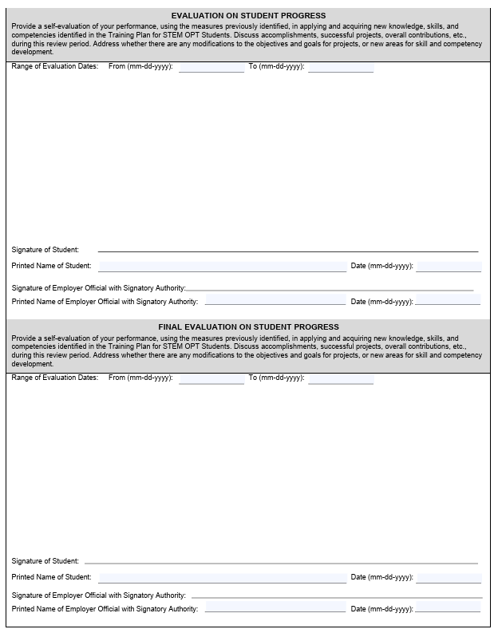
Page 5– do not fill out for OPT appointment. We will go over this page during the appointment for future usage.

Slide 19
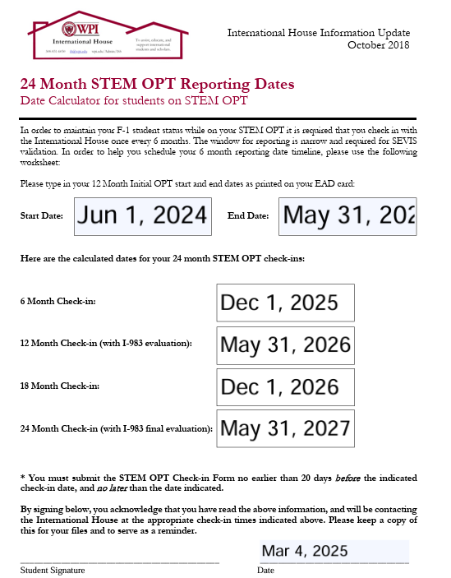

Slide 20
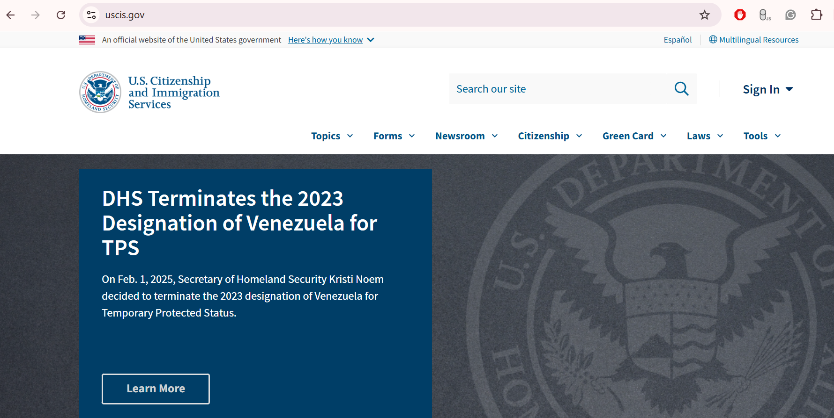

Slide 21
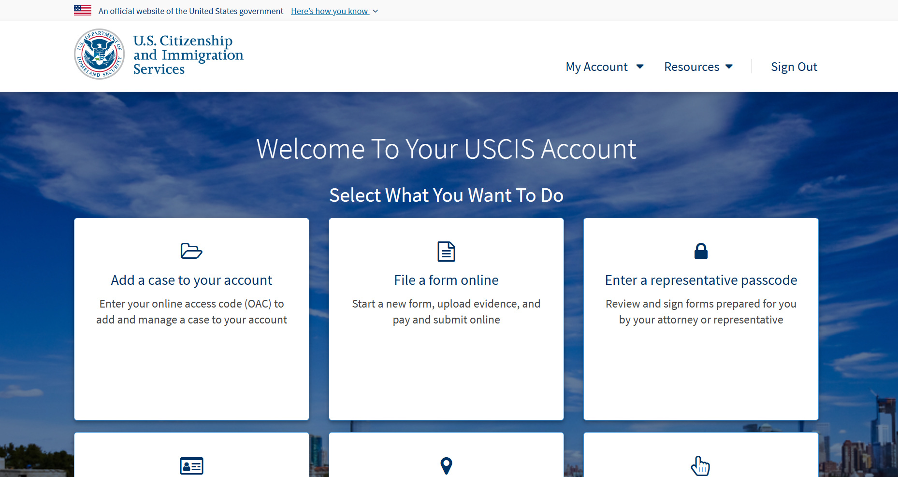

Slide 22
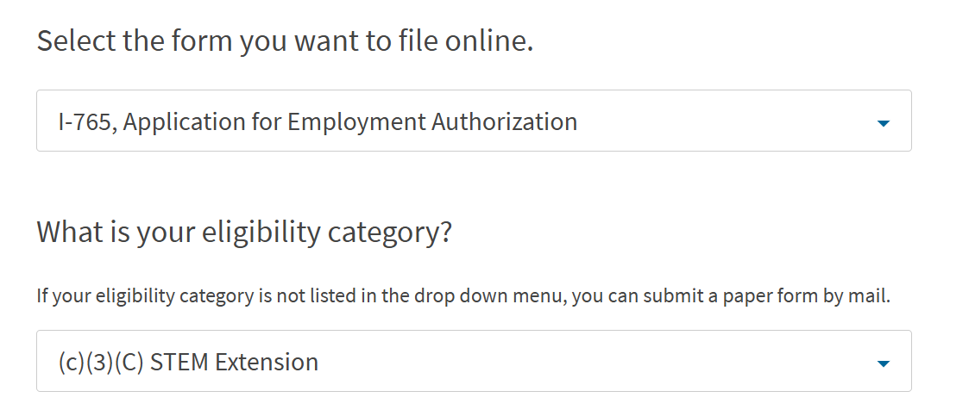

Slide 23
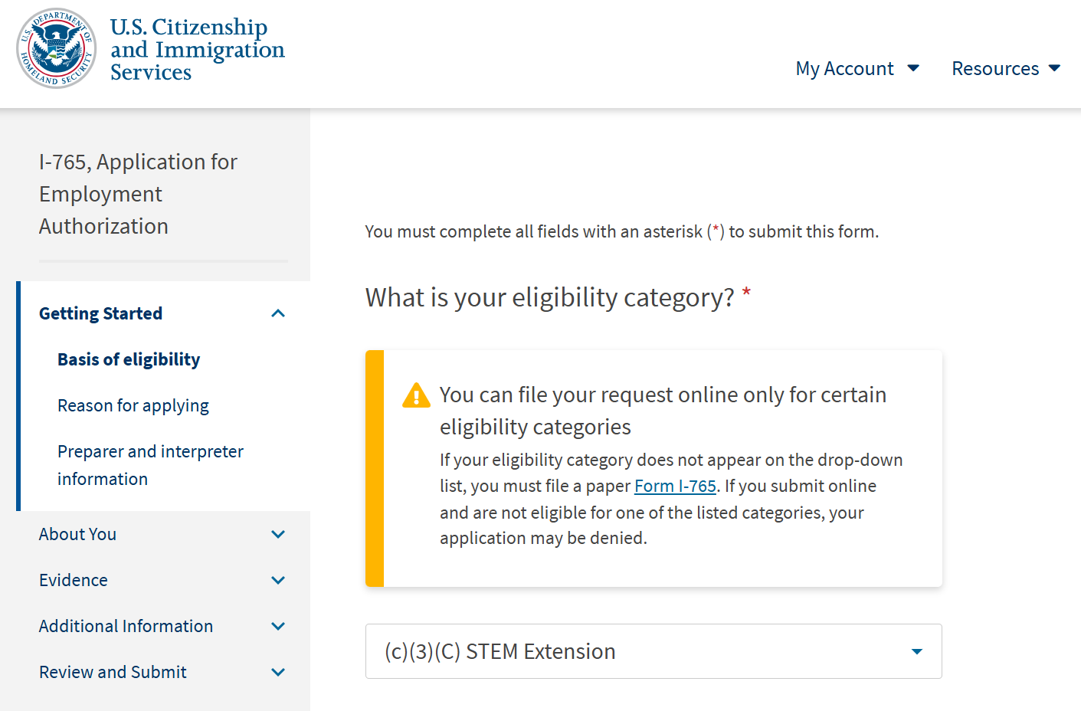

Slide 24
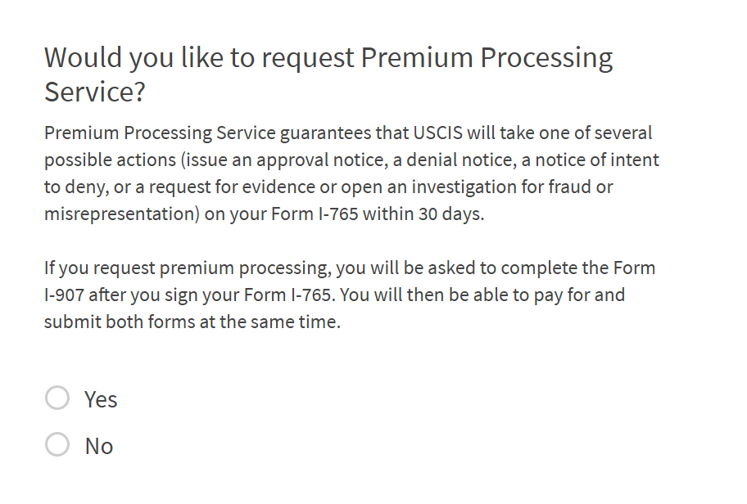
Premium Processing Fee
Only select “yes” if you are planning to pay the additional $1685 premium processing fee. This will ensure your OPT EAD is processed within 30 days; but will make the total cost of your OPT $2,155.

Slide 25
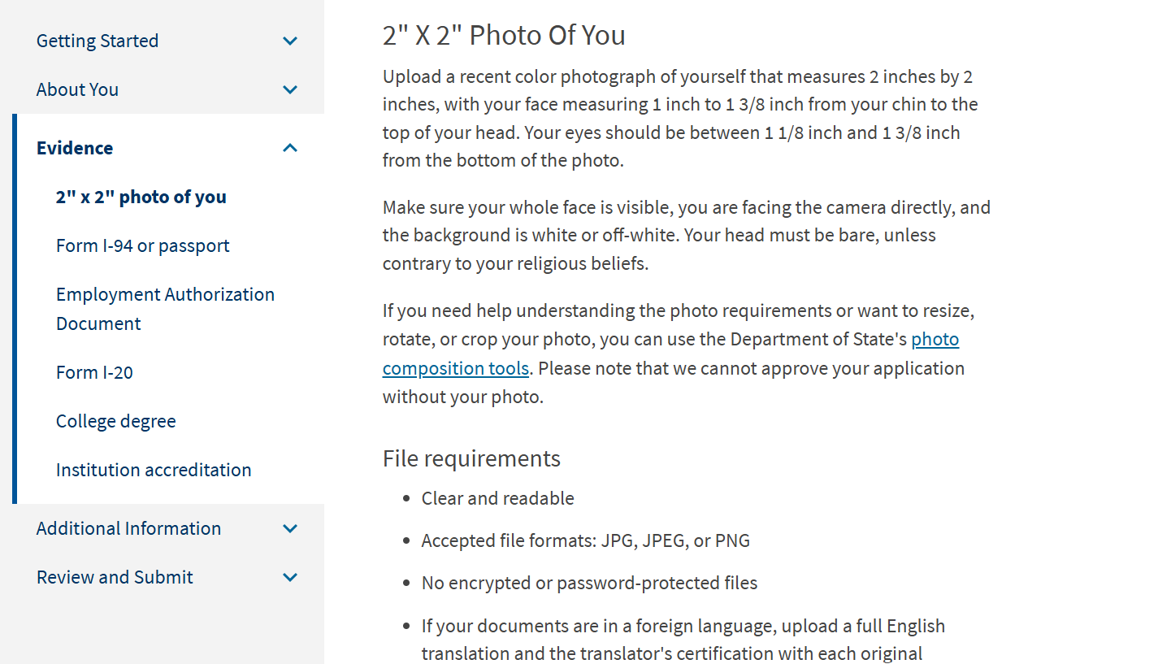

Slide 26
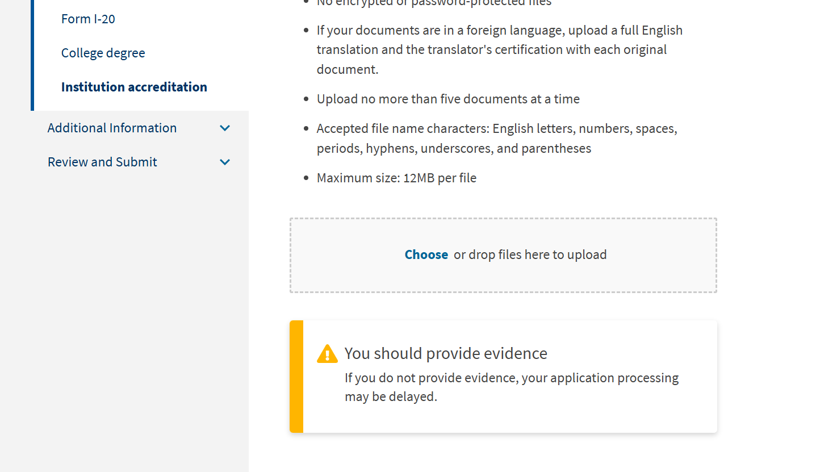

Slide 27
What is “Employment”?
Related to your major
At least 20 hours per week
Receive compensation (comparable to US workers in similar situations)
Must have supervisor/manager that oversees your training plan
Must have a bona fide employer/employee relationship

Slide 28
Frequently Asked Questions
Do I need a job to apply for STEM OPT?
Can I work on another degree while on STEM OPT?
What if I don’t use all my STEM OPT time? Can I save some of that time for a future degree?
Can I travel on STEM OPT?
Is STEM OPT a different visa category?
Can I renew my F-1 visa on STEM OPT?

Slide 29
Connecting to H-1B
Industry H-1B process is seasonal, timeline starts March (lottery) then April-June (submission of petition if selected). Most H-1Bs are approved over the summer and activated Oct 1
H-1B and Green Card workshop (Feb 2025) video available
As long as the H-1B petition is filed prior to the end date of your OPT (or STEM OPT) you can keep working on “cap gap extension” while waiting for the OPT to activate on October 1

