Slide 1
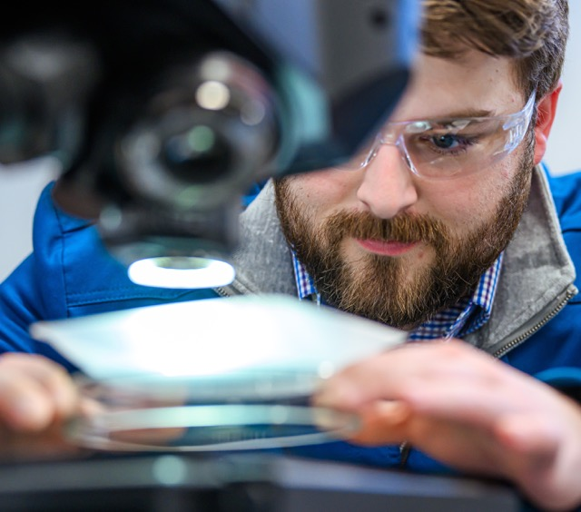
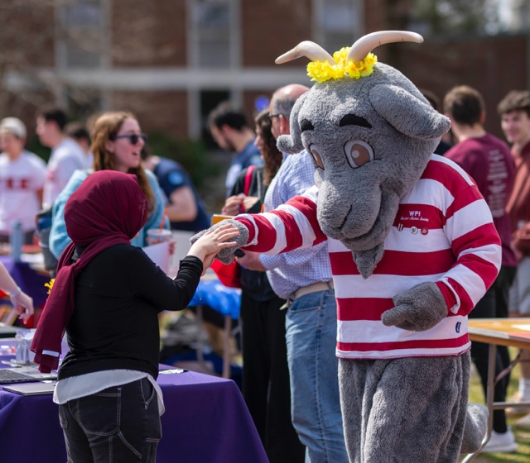
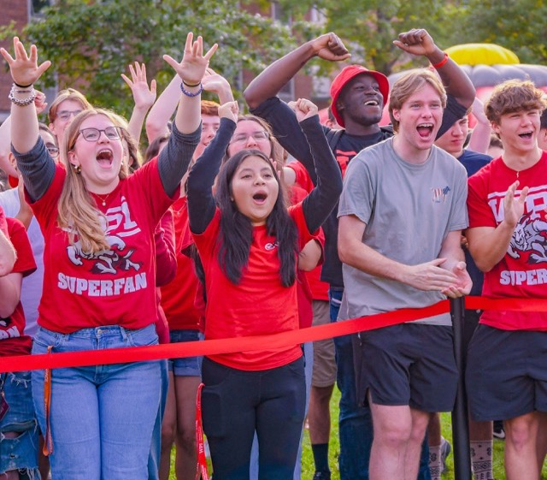
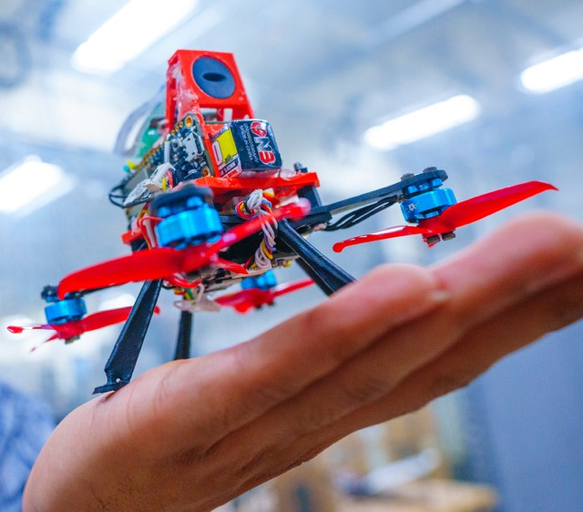
THEORY
PRACTICE
IMPACT

Slide 2
WPI’s Mission
OUR VALUES
Respect – Community – Inclusion – Innovation – Achievement
OUR MISSION
WPI transforms lives, turns knowledge into action to confront global challenges, and revolutionizes STEM through distinctive and inclusive education, projects, and research.

Slide 3

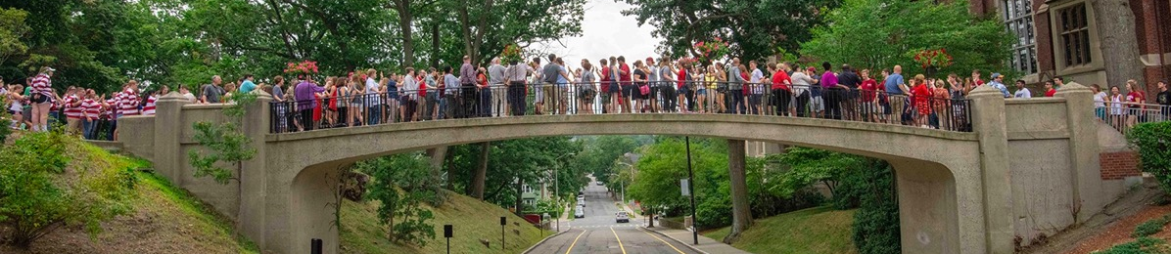
WPI at a Glance
OUR STUDENTS
DEGREES AWARDED 2025
5,461
undergraduate
students (2025–26)
1,927
graduate students (2025–26)
95%
first-year retention
rate (2024–25)
82%
4-year graduation rate
1,298
bachelor’s degrees
867
master’s degrees
87
doctoral degrees
100+
degree programs
THE RESEARCH ENVIRONMENT
Record-Setting Growth
OUR SCHOOLS
top recognition for research spending and doctoral degrees
$79.2M
research expenditures
(FY2025)
School of Engineering
School of Arts & Sciences
The Business School
The Global School
DIII ATHLETICS
10
men’s teams
10
women’s teams

Slide 4
WPI Rankings
#39
Best colleges for long-term career success
LinkedIn (2025)
#18
40-year return on investment (2025)
#84
Best national university (2026)
#7
Senior capstone (2026)
#11
Co-ops/internships (2026)
#56
Most innovative
schools (2026)
#64
Best undergraduate engineering programs (2026)
#18
best graduate
online engineering program (2026)
TOP
COLLEGES
with highest
4-year graduation rate (2026)
Top 5%
Worldwide out of 20,000 universities
Center for World University Rankings (2025)
Top 7%
Best colleges in the U.S.
Princeton Review (2025)
#7
Business school with the highest salary for grads
Poets & Quants (class of 2024)​
#2
Top Colleges for Career Outcomes in Engineering
LinkedIn (2025)
U.S. News & World Report

Slide 5
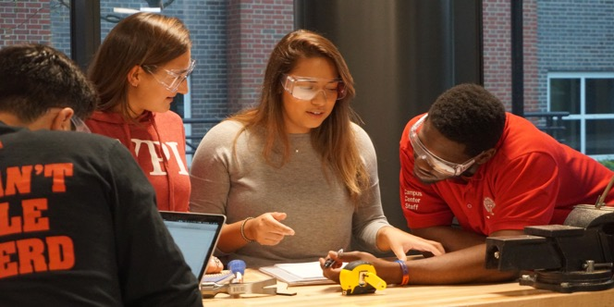
The WPI Plan and Project-Based Learning
The WPI Plan is the university’s distinctive approach to STEM education. For more than 50 years, the student-centered, project-based, and life-changing approach has revolutionized how our students learn and create value with their work.
WPI Is the Global Leader in Project-Based Learning: It’s Theory and Practice, Not Theory Then Practice.
1970
restructured education known as the WPI Plan
100%
of undergraduate students complete three required projects before graduation
7 Weeks
per term, three courses per term, for undergraduate studies to create an immersive environment for cooperative, open-ended project work
100%
of undergraduates complete the equivalent of a minor in Humanities & Arts to become well-rounded STEM leaders

Slide 6

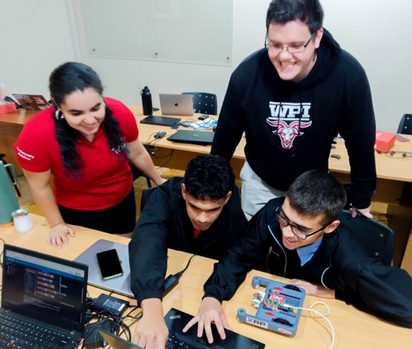
The Global Projects Program:
Not Your Typical Study-Away Program
For more than 50 years, WPI’s groundbreaking Global Projects Program empowers and inspires students to become civically engaged, compassionate, globally aware individuals who know how to thoughtfully approach solutions to real-world problems.
50+
global project centers on six continents
89%
of all WPI undergraduate students participated in the Global Projects Program (2024–25)
1,245
students participated in a global project in the
2024–25 academic year

Slide 7
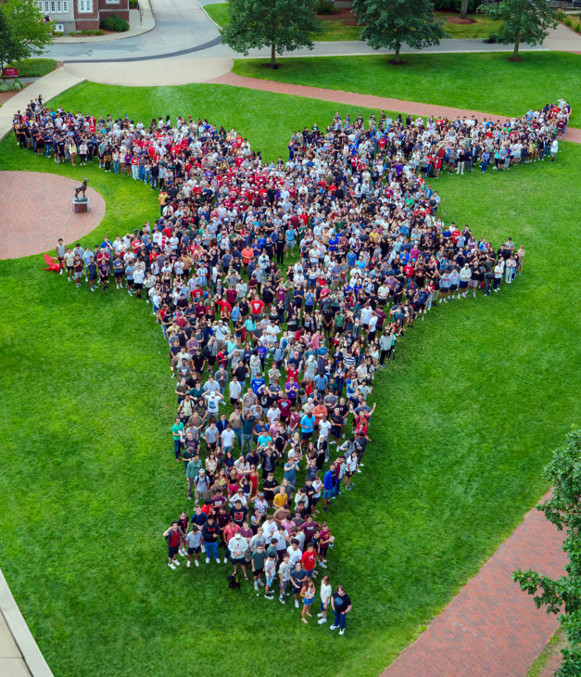
Student Body
235+
student clubs and organizations
(from professional societies to a Lego club and a cheese club)
Students who call WPI home humanize STEM, gleaning inspiration from the world around them and infusing themselves and their passions into their experiences in unique ways.
80%
of students are involved
in varsity, club, or intramural sports
14%
international students (fall 2025)
90
countries represented
23%
of all undergraduate students join a fraternity or sorority (2025)
50
states represented
3.87
average high school GPA of first-year students (fall 2025)
231
transfer students
(2025)

Slide 8
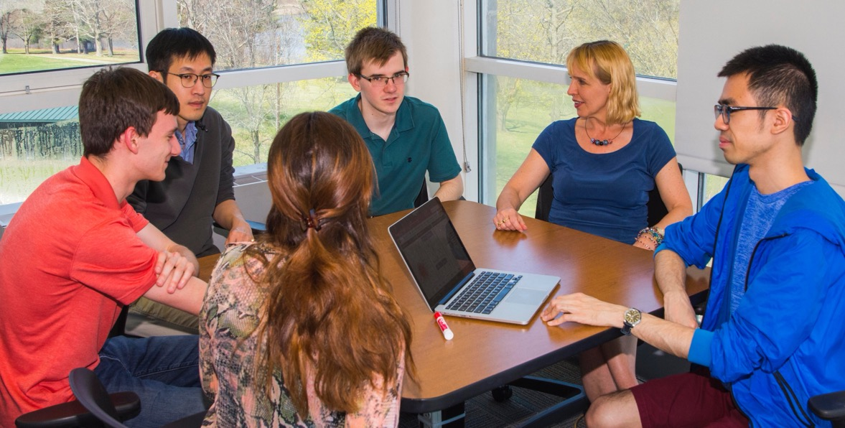
Faculty
40+
Faculty on the innovative tenure pathway for excellence in teaching—the first such program in the country—since its creation in 2021
555
full- and part-time faculty (2025)
40+
CAREER Award recipients
13:1
students to faculty

Slide 9
Awards and Recognitions
Winner
Senator Paul Simon Spotlight Award
for Campus Internationalization
NAFSA: Association of International Educators (2024)
Winner
IIE Andrew Heiskell Award for Innovation in International Education
Institute of International Education (2023)
Honor Roll
for mental health services
Princeton Review (2026)
Winner
Award for Undergraduate
Research Accomplishments
Council on Undergraduate Research (2023)
#5
Undergraduate Participation in Study Abroad: Leading Doctoral Universities, 2023/24
IIE 2025 Open Doors Report

Slide 10
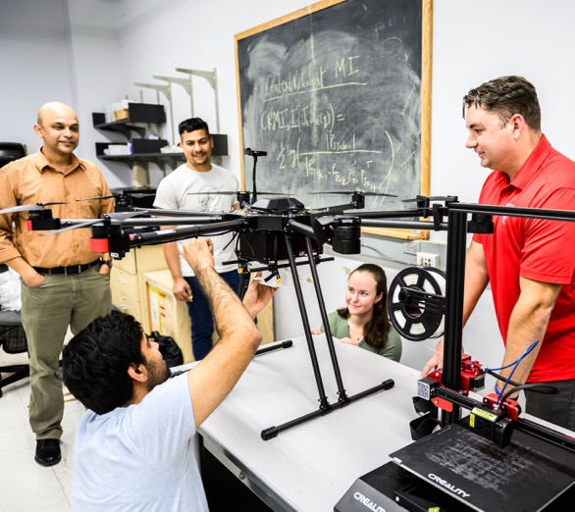
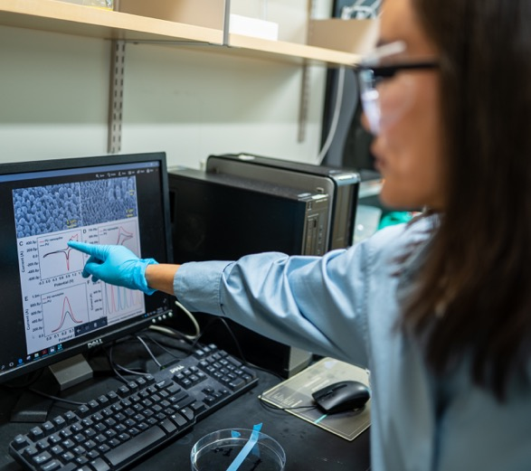
Research and Innovation
WPI’s research focuses on discovery and innovation with purpose. Patents filed by faculty and students reflect
our innovation ecosystem and entrepreneurial spirit.
63
new invention disclosures
(FY2025)
15
issued patents
(FY2025)
$56.2M
awards received through the Office of Sponsored Programs (FY2025)

Slide 11
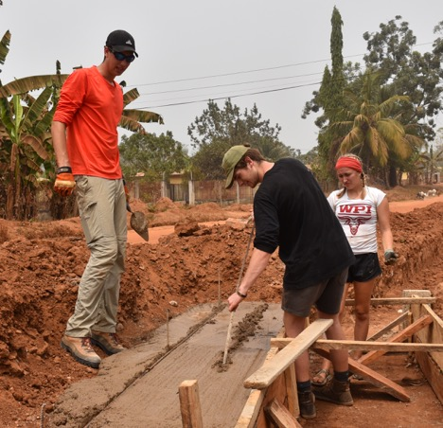
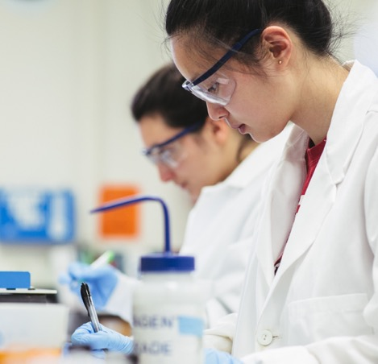
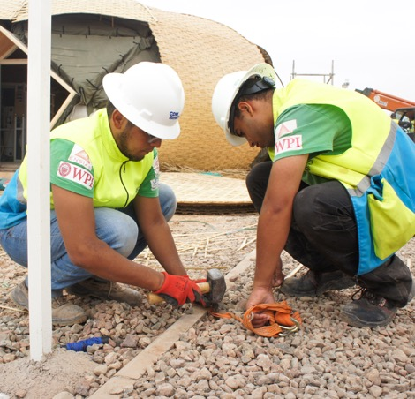
Alumni Success
The WPI alumni community is active
and thriving, boasting a worldwide network.
$80,294
average starting salary for bachelor’s degree recipients (2024)
92%
of alumni surveyed reported being satisfied
or very satisfied with their careers (2021)
95%
of alumni surveyed reported that their project experience prepared them for their current careers (2021)
50,000+
alumni live in
115 countries
89%
of graduates are employed, in graduate school, serving in the military, or doing volunteer service 6 months after graduation (all degree levels) (2024)

Slide 12
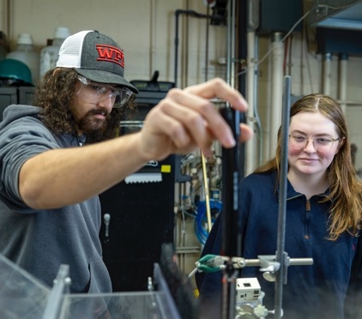

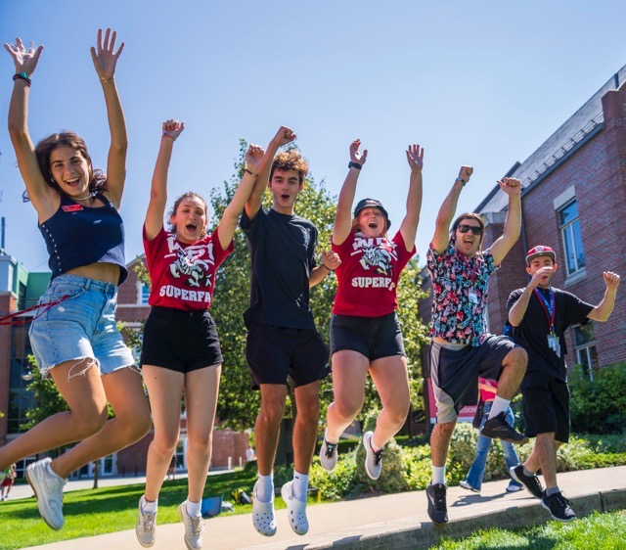
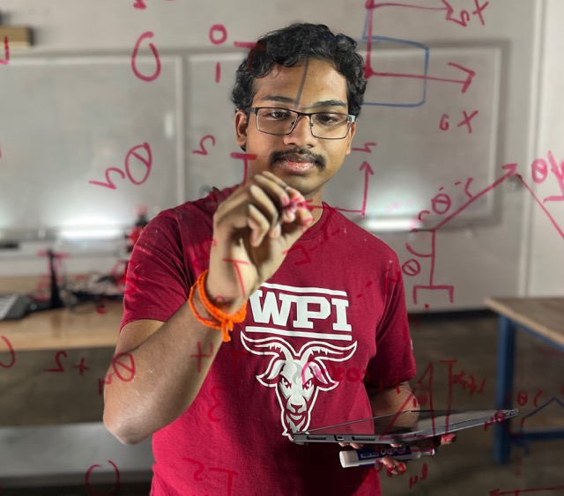
wpi.edu

