Slide 1
Non-Resident Alien Tax

Slide 2


Disclaime
The aim of this presentation is to provide you with a general understanding of tax principles as they apply to international students and is for information purposes only. Each individual has a unique tax situation and is responsible for his or her own tax determination and compliance.
Notes:
Should be available by end of December – usually around this time

Slide 3
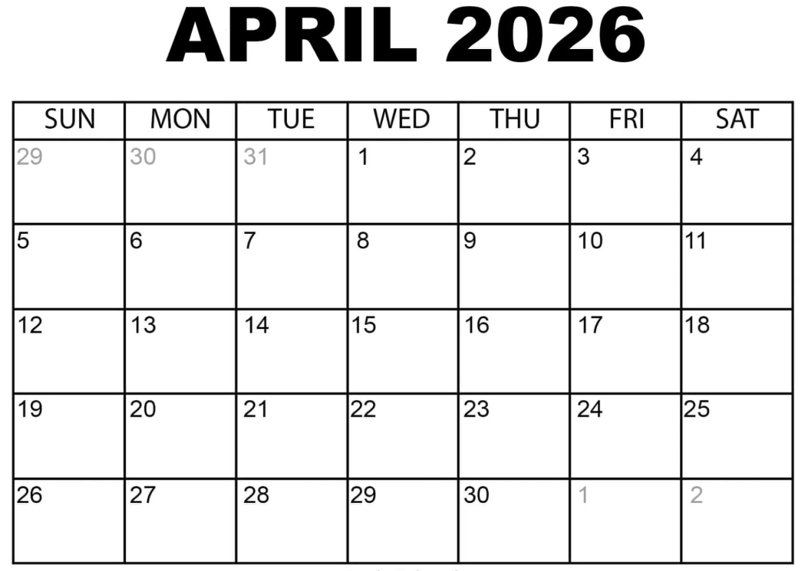
Important dates for Tax Season 2025
2025 tax filling season is for income from
          1st January – 31st December 2025
          Filing deadline is Wednesday, April 15th 2026

Slide 4
Getting started:
Internal Revenue Service (IRS)
vs
Massachusetts Department of Revenue

Slide 5

Differences between residents and nonresidents

Slide 6
Resident or nonresident for tax?
Independent of visa/immigration status
Generally, most international students & scholars who are on F, J visas are considered non-resident for tax purposes.
International undergraduate students on J1 & F1 visas are automatically considered non-resident for their first 5 calendar years in the US
Scholars/Researchers on J visas are automatically considered non-residents for 2 out of the last 6 calendar years in the US
If you’ve been in the US for longer than the 5 or 2 year periods, the Substantial Presence Test will determine your tax residency.

Slide 7
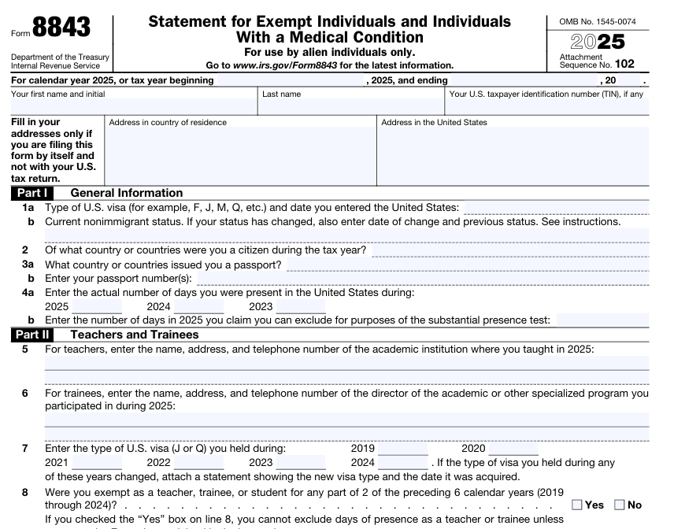
Form 8843 – minimum filing requirement for all

Slide 8
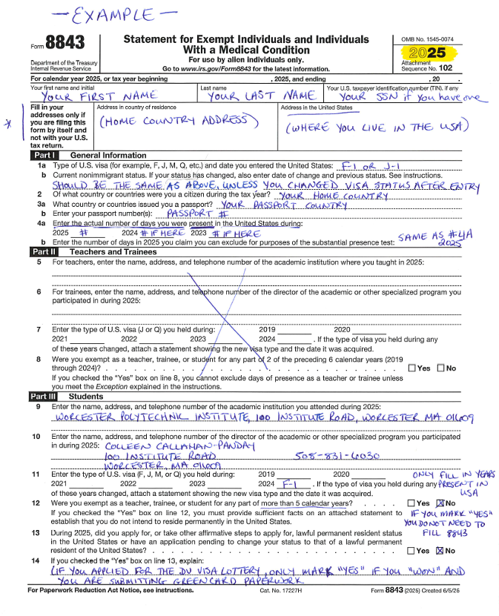
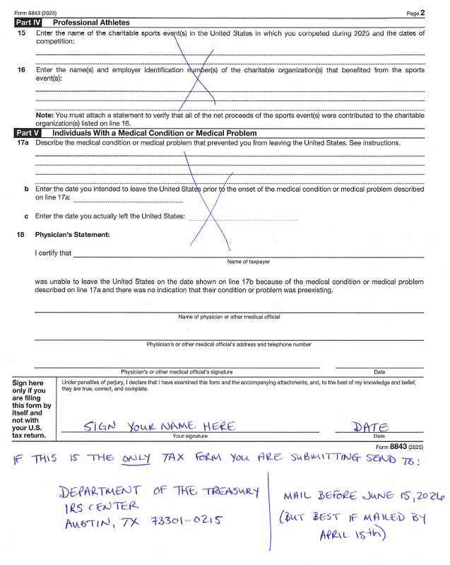

Slide 9

WHO MUST FILE FOR 2025?
Received taxable earnings or income over $0 in 2025
Everyone has some type of IRS filing obligation…
Received a taxable stipend, grant or allowance in 2025
Everyone must complete Form 8843 – irrespective of income or days of presence.

Slide 10
Documents
Prior to filing your taxes
W-4 → Federal (when you first start a job)
  M-4 → MA state
SSN or ITIN
When filing your taxes
W-2 → Federal (Usually receive in late January)
1042-S → Federal (Usually receive in March)

Slide 11
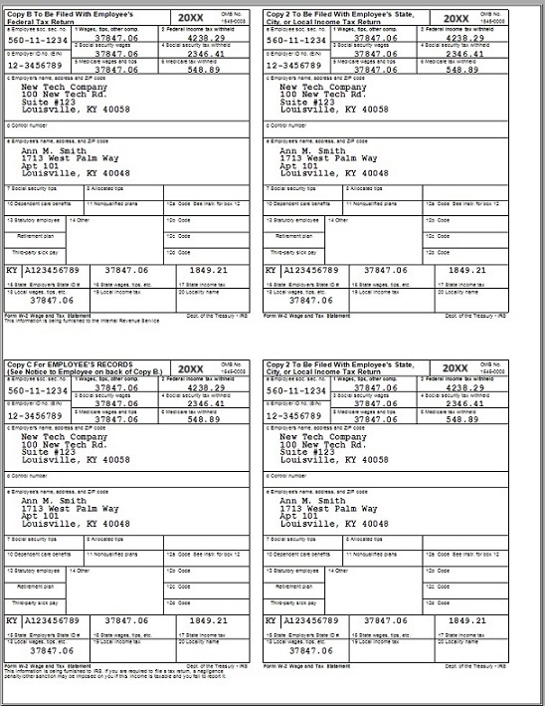
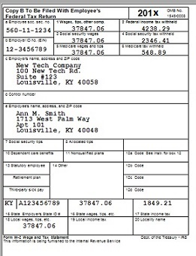

Slide 12
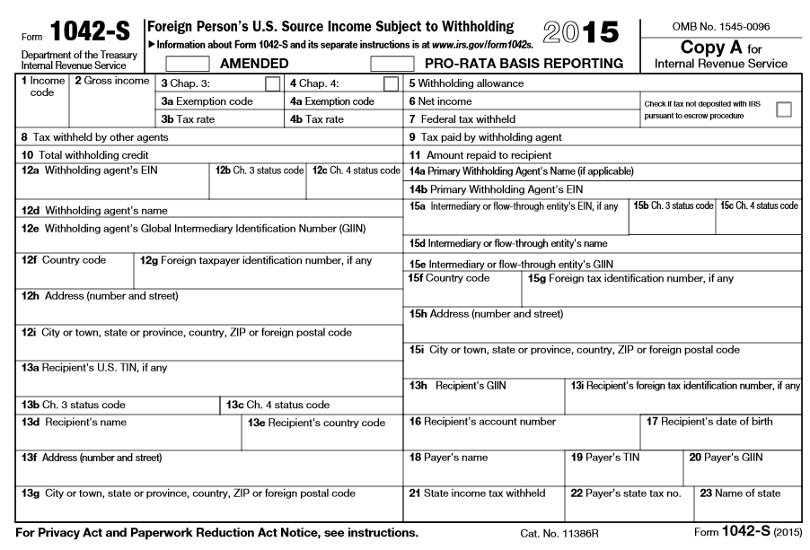

Slide 13
Withholding tax
As a nonresident ‘withholding tax’ may be applied to some or all payments made to you at a rate of 30%
65 country specific tax treaties in place to reduce or to exempt that income
Opportunity to claim refund via year end tax return

Slide 14

Federal requirement – Form 1040NR
Everything over $0 is taxed!
US Source Income
    Wages
    Taxable Stipend, Grant, Scholarship, Award
    Interest, rental, royalty or other income

Slide 15
What tax documents will students receive
W2
Wages, Salary, Compensation (Employment Earnings)
Certain tax treaty benefits (not all)
Fellowship
Scholarship Stipend/Non-Degree Aid
Prize/Award/Miscellaneous foreign payments
1042-S
1042-S
Rental income
Investment Income
Commissions
Other income
Independent Contractor Services
1099 Series

Slide 16
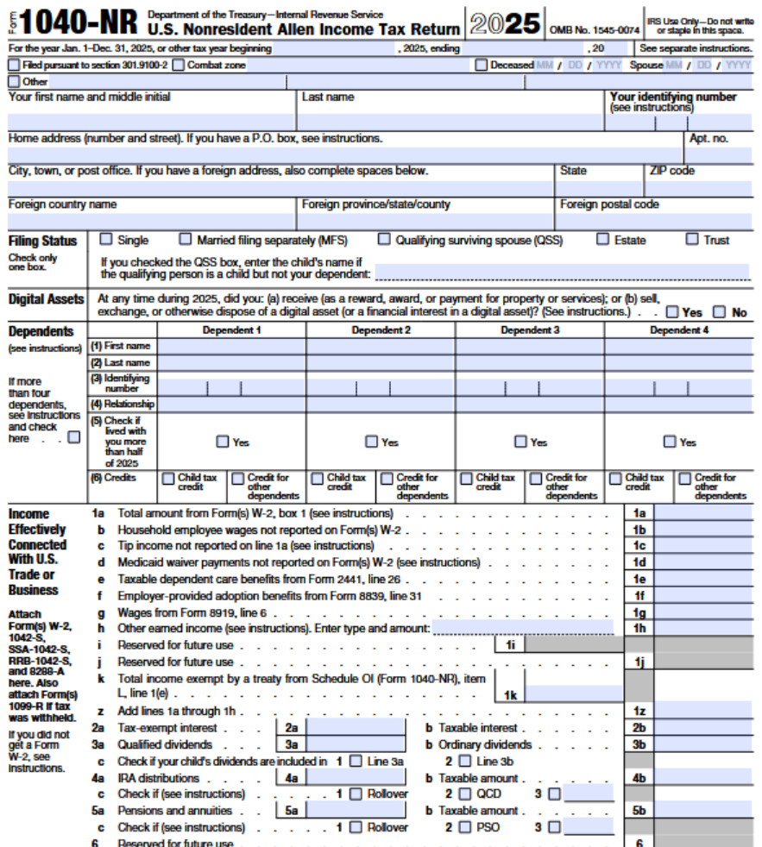

Slide 17

Income which does not trigger a filing requirement
Scholarship for tuition and related expenses
Scholarship received from outside the US
Money transferred from parents/relatives overseas
Income ‘earned’ in their home country (investment income, rent, job before moving to US, etc.)
Interest on regular savings account

Slide 18

Items needed when preparing return
Income documents (W-2, 1042-S, 1099-MISC)
Passport
Visa - I-20, DS-2019, etc.
Entry and exit dates
SSN/ ITIN
1099HC (MA forms)

Slide 19

Nonresident spouse and dependents
Same filing requirements as visa holder:
No joint returns for Nonresidents
Obligations
  Minimum is Form 8843
  1040NR if applicable
  Each dependent should mail them in separate envelopes
Nonresident can elect to file as resident – when married to a tax resident (ex H-1B)

Slide 20

FICA taxes
Nonresident international students and scholars (J1 & F1) are exempt from paying FICA
H-1B and J-2 visa-holders, are subject to FICA taxes from their first day of employment.
Opportunity to claim back
  From employer
  Via Form 843 & Form 8316- Sprintax can help with this

Slide 21
1098 T - Tuition Statement
Tuition Statement
Mostly used to claim education tax credit
Significant cause of misfiling for nonresidents
Not relevant for tax nonresidents
Sometimes - all students with an SSN on file with school will get one – even tax nonresidents, so it can cause a lot of confusion!

Slide 22

1095 A, B & C Series
                Form 1095-A:
  Healthcare coverage purchased through Health Insurance Marketplace – ‘ObamaCare’
  Generally not applicable to international students & scholars
  Can be used on a ‘resident’ tax return, in limited circumstances
Form 1095-B:
  Healthcare coverage provided through insurance provider or self-insured employer
  You do not need 1095-B for your non-resident return
Form 1095-C:
  Healthcare provided through employer (generally more than 50 employees)
  You do not need 1095-C for your non-resident return

Slide 23

Missed a year? File as resident by mistake?
    Don’t panic - but do set the record straight
    Never filed….
        Catch up
        Can back file at any stage
        Can only claim a refund for previous 3 years
    Misfiled…..
        1040X - Amended U.S. Individual Income Tax Return
          Simple form, similar to 1040

Slide 24


Implications of not filing
International students are required to comply with all US laws, including IRS
Filing tax forms (even if only 8843) is part of maintaining visa status in US
Not filing could affect future immigration status (like H1B, LPR)
Fines, penalties, interest can accrue if the IRS are owed
Might be missing out on a refund!

Slide 25
Form 1NR/PY (non-resident), Form 1 (resident)
Schedule HC (Health Insurance, only for Form 1)
If you earned below $8,000 filing is optional, if you earned above $8,000 filing is required.
  If you earned less than $8,000 you will be refunded all the state tax taken, however you must file to get this refund
Massachusetts Department of Revenue
MA State Taxes

Slide 26
Tax Resources
NON-RESIDENT ALIEN TAX RESOURCES
Sprintax
  To receive a code, you must:
    Pay here (and take a screenshot of your confirmation email)
    Fill out the request form here
  Sprintax resources
    • Virtual workshops
    • A helpful YouTube channel
    • A Non-Resident Alien Tax Blog
VITA clinics
    Worcester Volunteer Income Tax Assistance Program (VITA)
RESIDENT ALIEN TAX (after 5 years)
Turbotax
H&R Block
Tax accountants
Resident tax forms do not have the “NR.” Only use if you are no longer a non-resident alien

Slide 27
Use caution and common sense
IRS would never ask for personal details without proper communication
IRS not seeking to penalize anyone – just want to make sure the fair and correct taxes are paid on time
Similar format to other schemes
  Money owed
  ‘Instant’ payment will make problem go away
  Voucher/prepaid credit card reference preferred payment option
Tax scams

Slide 28
WHAT SHOULD BE SENT IN YOUR TAX Packet
Federal (IRS)
  8843
  One part of W-2/1042-S
  1040NR
  Send to Austin, Texas (if receiving a refund) or Charlotte, North Carolina (if paying a tax fee)
State (MA)
  One part of W-2/1042-S
  Form 1/ Form 1 NR/PY
  Schedule HC (if filing Form 1)
  Send to Massachusetts address

