Slide 1
Student Employment
Supervisor Training
August 2026
Notes:
Presenter: Talent - Kelly Draper
Welcome to the 2026 supervisor training for student employment. We appreciate all of you coming today to learn about what’s new for the upcoming academic year.
Please note, Talent & Inclusion has several team members supporting student employment, so we kindly ask you contact Talent@wpi.edu, rather than individuals for support moving forward.

Slide 2
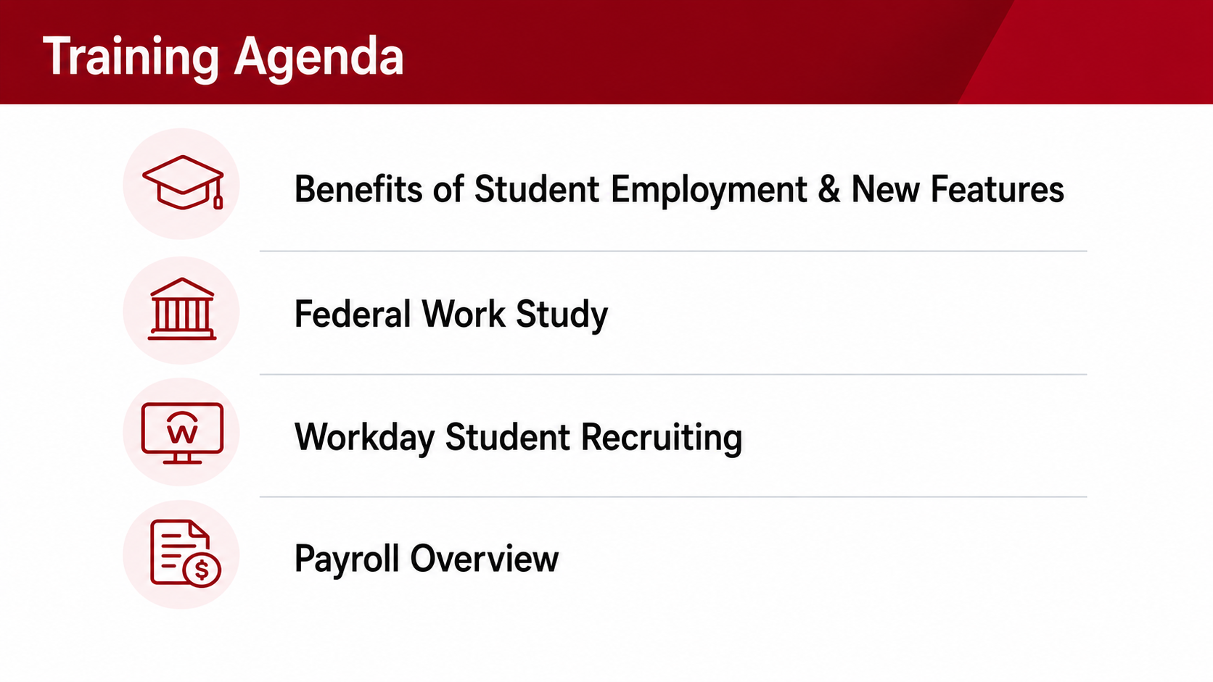
Notes:
Presenter: Talent - Leanne Kay
During today’s presentation, we’ll cover the topics shown on screen, including: the benefits of student employment, federal work study, Workday’s new student recruiting process, payroll reminders, and resources available to support you throughout the academic year. As we conclude each topic, we’ll share key contacts and resources for support after today.
Once more, thank you for your partnership as we work to enhance the student employment experience at WPI.

Slide 3
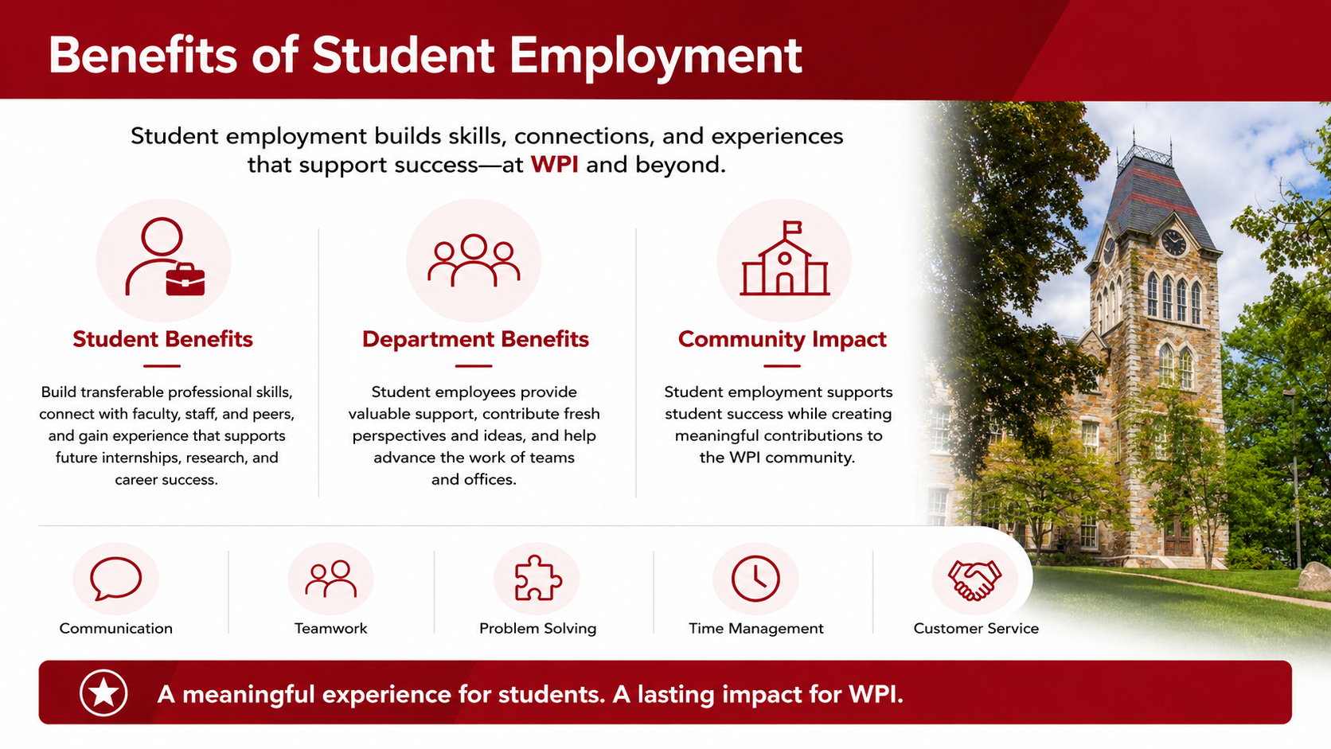
Notes:
Presenter: Talent - Leanne Kay
Student employment is often a student's first professional experience. Beyond earning income, student employment helps build transferable skills and strengthens engagement with the university.
Through their employment experience, students develop professional skills such as communication, teamwork, problem solving, time management, and customer service. They also build meaningful connections with faculty, staff, and peers while gaining experience they can leverage in future internships, research opportunities, and careers after graduation.
Departments benefit as well. Student employees provide valuable support across campus, contribute fresh perspectives and ideas, and help advance the work of their teams and offices.
At its core, student employment is not just about filling positions. It's an opportunity to support student success while creating meaningful contributions to the WPI community.

Slide 4
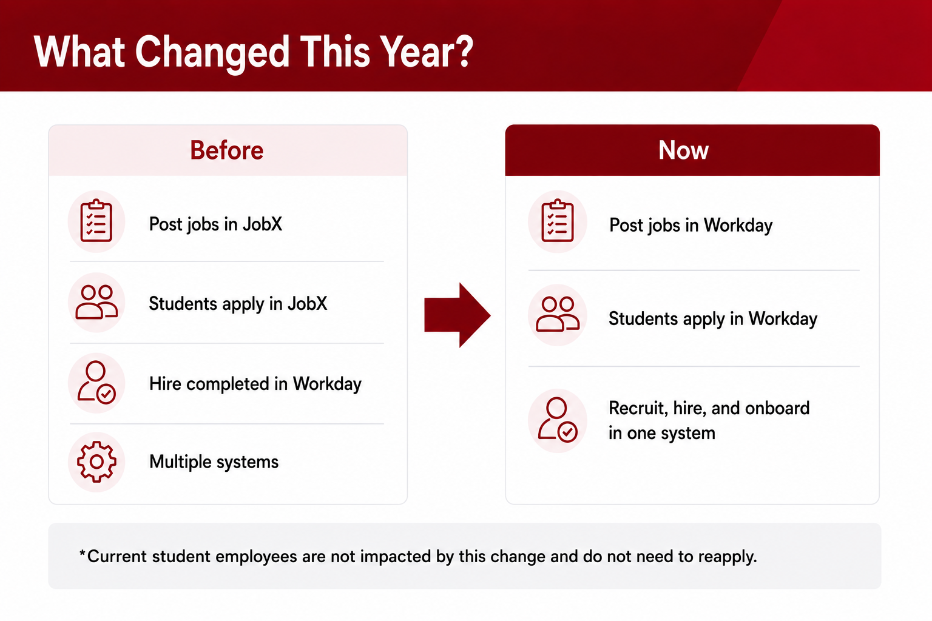
Notes:
Presenter: Talent - Leanne Kay
The biggest change this year is the retirement of JobX.​ Previously, supervisors posted student positions in JobX and then completed portions of the hiring process in Workday.​ Beginning this academic year, student recruiting activities will occur entirely within Workday Student Recruiting.​
​
This means supervisors will create job requisitions, post positions, review applicants, and initiate hiring actions all within one system.​ Current student employees are not impacted by this transition and do not need to reapply. ​
In addition, the process to hire Federal Work Study students has been updated. You’ll no longer utilize the “Move Worker – Supervisory” task, instead opting to pull a report of eligible students with FWS, then hire them into the Federal Work Study Job Profile and Cost Center. We’ll walk through these steps together shortly.

Slide 5
Federal Work Study Overview
Office of Financial Aid Contact: finaid@wpi.edu
Notes:
Presenter: Office of Financial Aid – Gina Havel
Hello and welcome.
By way of introduction, I am Gina Havel Palmatier and I am an Assistant Director – Financial aid Programs at the WPI Office of Financial Aid. I manage the Federal Workstudy Program as far as student aid application and Workstudy awards, monitor FWS earnings with reports from Payroll, and send out Student communications regarding their FWS award and our community service obligation.
Today I will go over Federal Workstudy basics, Community Service Workstudy and the FWS student earnings reports I will be distributing to you.

Slide 6
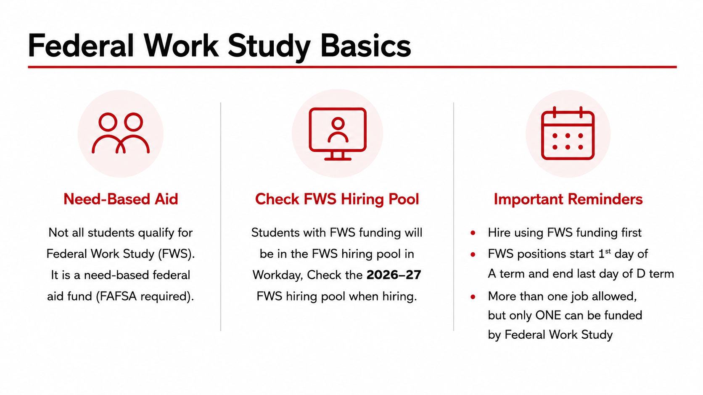
Notes:
Presenter: Office of Financial Aid – Gina Havel
Federal Workstudy is a Federal Student Aid program administered by the Financial aid office at WPI.
WPI is allocated a fixed amount of FWS funding from Federal Student Aid each year.
Student eligibility for FWS is initially determined by their FAFSA application. With limited funds allocated to us, we cannot offer FWS to every student who has demonstrated financial need. My team has a FWS Waiting list for students interested in Workstudy who were not offered FWS funding as part of the Financial aid award letter.
Departments hiring students should check the FWS pool in Workday when hiring students and students hired into FWS positions should report time on the FWS position first. Students can have more than one job, but only ONE position can be designated as FWS funded.

Slide 7
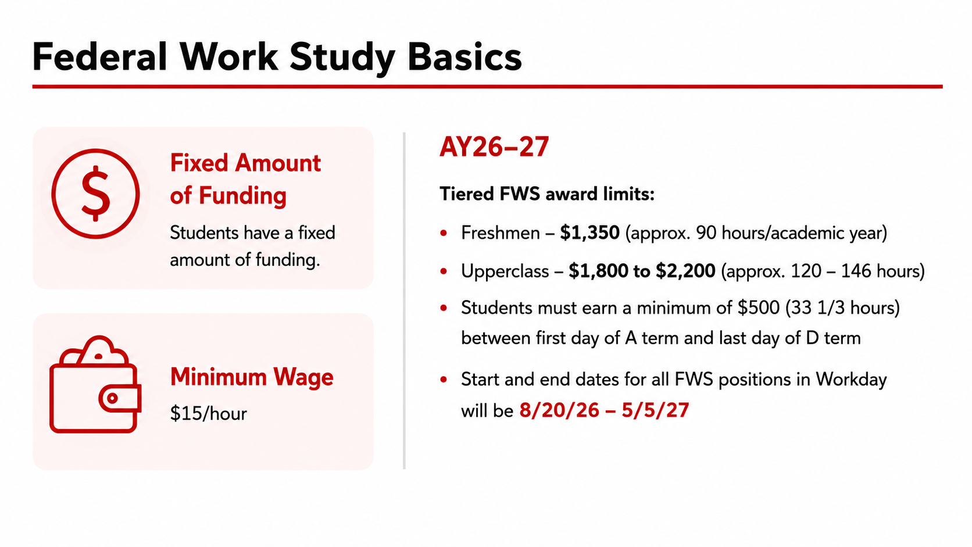
Notes:
Presenter: Office of Financial Aid – Gina Havel
Because WPI’s Federal aid funding allocation for Workstudy is limited, a student’s award amount is also limited. Increases to a student’s FWS award are reviewed periodically as the student’s earnings gets close to reaching the maximum award limit and is contingent on available FWS funds and the student’s individual Financial aid application.
New for 26-27 the Financial aid office is going with a tiered FWS award limits approach:
New students (Accepted Freshman, new transfer students and students “new” to getting FWS) are awarded $1350 to start.
Upperclass/returning students range between $1800 and $2200 to start depending on if they completed the Community Service hours obligation last year or not. Students with the $1800 initial starting point can have their FWS award reviewed for increase if they complete at least 5 hours of Community Service by the end of B term.
Workday currently does not show you the FWS Award amount for a given student. However, you may request the student to show you a copy of their Financial aid award letter or email me.
The default hourly wage for FWS is $15/hour. Hiring managers can propose a higher wage during the hiring process in workday if the student role, experience, responsibilities would otherwise warrant a higher wage. (Demonstration later in this presentation). Refer to the Student Wage Guidelines page. Workstudy students will mostly fall into Level 1 and Level 2, depending on experience and the position.
FWS students hired with hourly wages greater than $15/hour are not automatically increased. Be aware that they will earn their FWS award amount faster.
Same goes with students who work more hours. The Average is between 4 and 7 hours/week. Try to keep them to no more than 10 hours per week for balance with their academic responsibilities.
FWS positions have fixed & regulated starting and ending dates: 8/20/26 – first day of A term to 5/5/27 last day of D term.
Workstudy funding is not available during the summer.

Slide 8
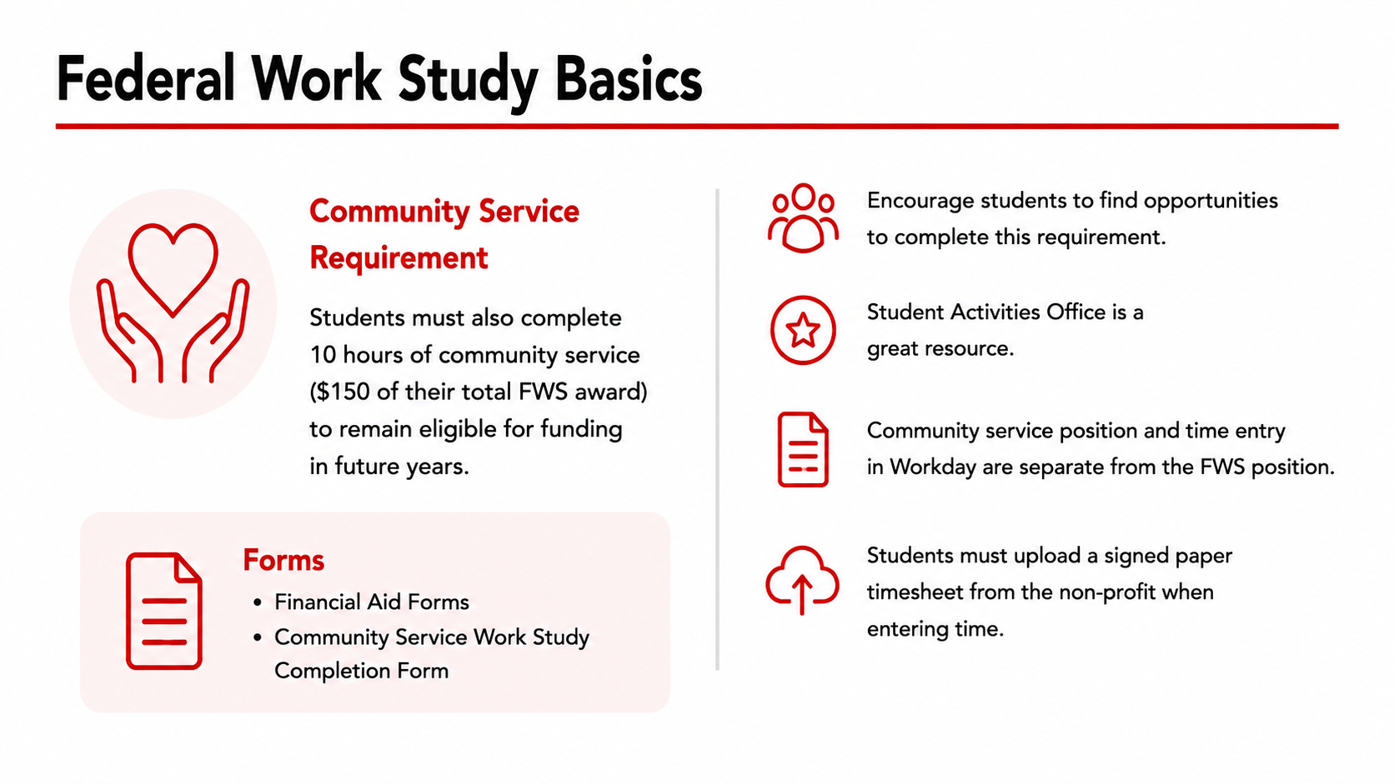
Notes:
Presenter: Office of Financial Aid – Gina Havel
A condition on the FWS funds allocated to WPI is that 7% of our allocation must be earned through Community Service.
To help us reach this mandate, each students with a FWS award must complete a minimum of 10 hours of Community service.
SAO has partnered with several nearby non-profits for “full term CSWS opportunities as well”. For students in those positions, ALL of their FWS funding counts as Community Service earnings. Students are compensated $15/hour for approved community service hours. More on that in a few minutes.
Student Activities office is a great resource for helping students find Community Service opportunities through their Community Service list serv Newsletter and posting events on the My WPI Calendar.
The Financial aid office maintains a list of PREAPPROVED Community Service opportunities specifically for Federal Workstudy as well as the CSWS forms students need to submit to get credit for the CSWS hours they do.
While the Student Activities Office and the Financial aid office engages with students to do their CSWS hours, I ask for your assistance in encouraging your workstudy students to complete this obligation. It’s only 10 hours over the whole academic year and many of these nonprofits need volunteer’s “year-round”, so students should not wait until April!

Slide 9
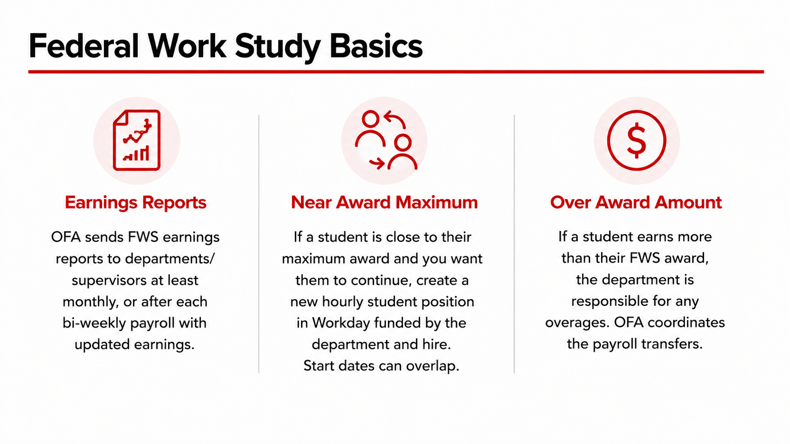
Notes:
Presenter: Office of Financial Aid – Gina Havel
Biweekly FWS earnings reports:
To help you keep track of your Workstudy students’ earnings, the financial aid office will provide a biweekly FWS earnings report to all managers (JM-Supervisors). If there is a person/contact in your department who oversees student wages for budget purposes, please let me know so I can send them a consolidated FWS earnings report for the department.
This report contains FWS award amounts, earned amount, remaining FWS funds, Percentage earned.
I also include estimate hours worked/paid, estimated hours remaining and Community Service hours/earnings.
Communications will come from the gr-FWS-Supervisors list-serv and FWS earnings report in Excel format will be shared to you from my WPI –sharepoint drive.
I’m mainly monitoring two things: Student earnings as they approach & reach maximum and Community Service hours.
I will reach out for students reaching their FWS award limit especially if an increase isn’t possible. For these, their FWS job WILL BE ENDED when they reach their FWS award limit. Any overage (student earning more than the FWS award limit) will be charged back to the department cost center, via payroll transfer.

Slide 10
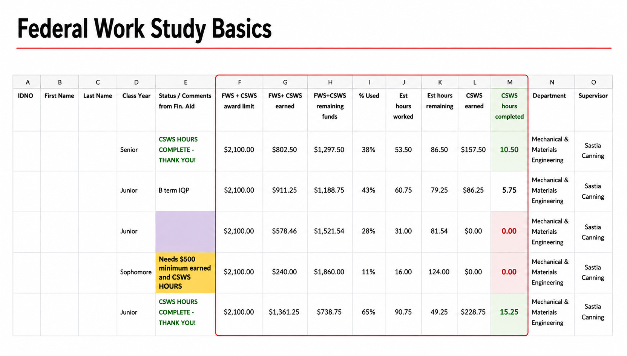
Notes:
Presenter: Office of Financial Aid – Gina Havel
Here’s a sample of what the FWS earnings report distributed by Financial aid looks like.
Note the FWS+CSWS award limit (that’s the amount of FWS funds a student is awarded)
Earnings from Workday / Payroll
Remaining funds (how much FWS funding do they have left?)
Estimated hours worked
Estimated hours remaining (how many hours can they work before reaching their award limit)
And Community Service Workstudy (earnings and hours completed).

Slide 11
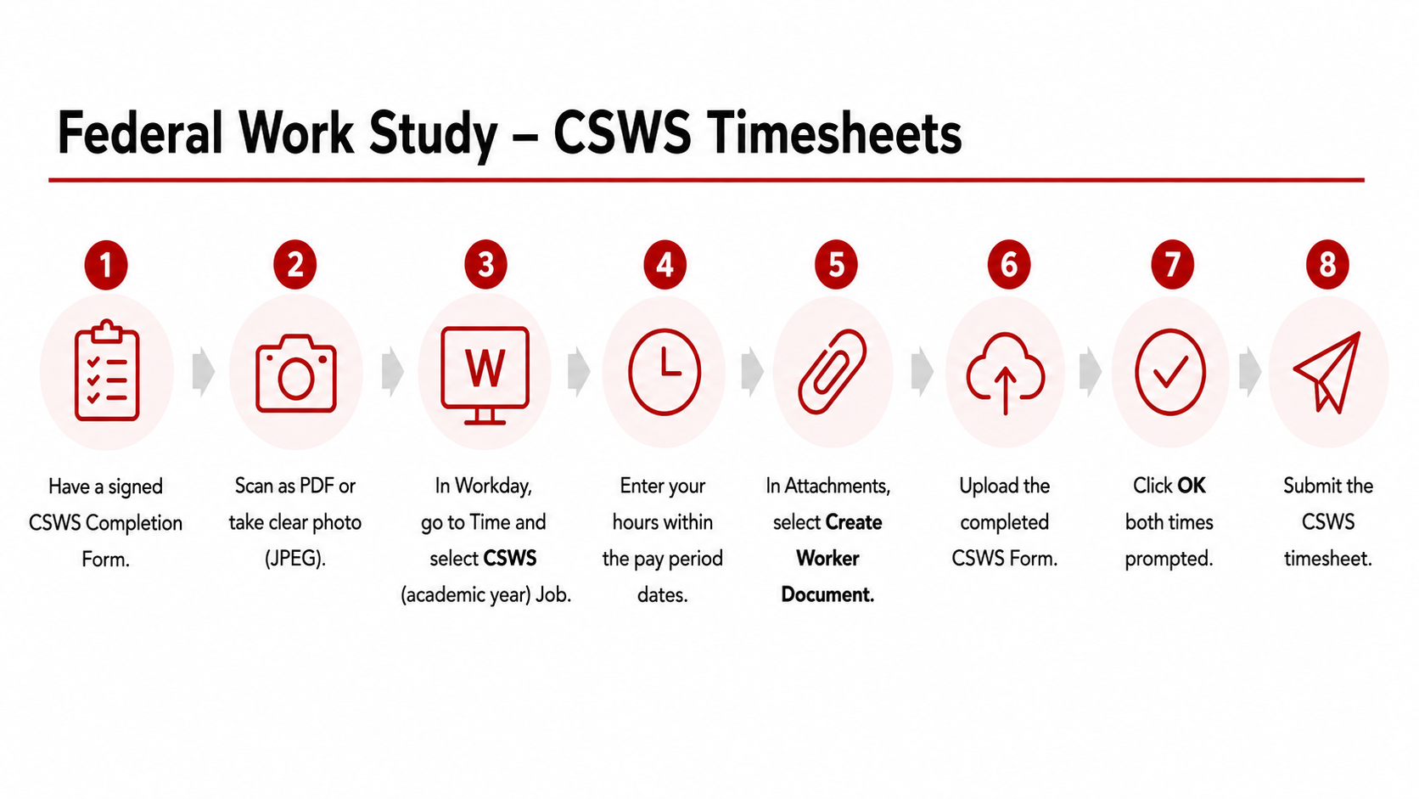
Notes:
Presenter: Office of Financial Aid – Gina Havel
Community Service Timesheet Steps –
As I mentioned earlier, students with FWS awards will also have a second job position in Workday, specifically for Community Service Work Study, under my JM (CSWS – Gina Havel). Having a separate job/position in workday means that FWS and CSWS timesheet approvals are distinct – a delay in a CSWS Timeheet will not delay the approval and payroll for regular FWS. CSWS hours must be submitted by the student within the workday payperiod – similar to regular student hourly timesheet deadlines.
For the student, the main difference between turning in a CSWS timesheet and submitting a regular FWS timesheet in workday is the CSWS Completion Form.
This form acts as a paper timesheet, signed by the student and the volunteer coordinator for the Agency/Event where the student completed Community Service hours, and must be uploaded as a Worker Document to the CSWS timesheet in Workday. Students should take a CSWS completion form WITH THEM to the volunteer event/agency, so it can be filled out and signed.
Blank forms are available on the Financial aid office’s Community Service Workstudy information page. The Student Activities office also has blank CSWS completion forms available.

Slide 12
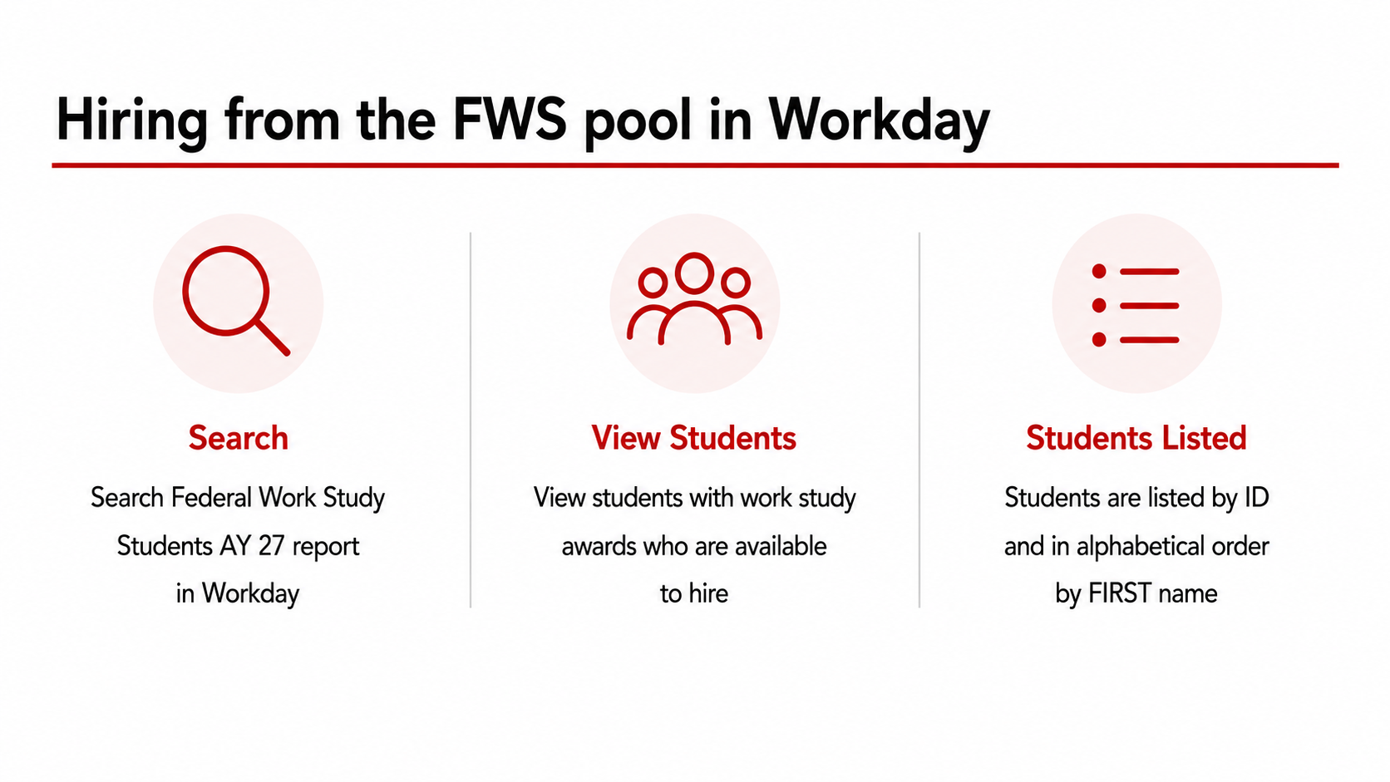
Notes:
Presenter: Office of Financial Aid – Gina Havel
Student Hiring Process – Talent will go over this with you shortly.
Instead of A FWS pool in workday from which you “move worker supervisory” task to hire under workstudy funding, there is now just a report in workday which has all of the students with Federal Workstudy funding available to hire.
If you are trying to hire a student for FWS and they are not on the list, it could be because they’ve already been hired into a FWS by another department. Beyond that, please email me as there could be a variety of Financial aid application reasons why a student isn’t on the list in workday.

Slide 13
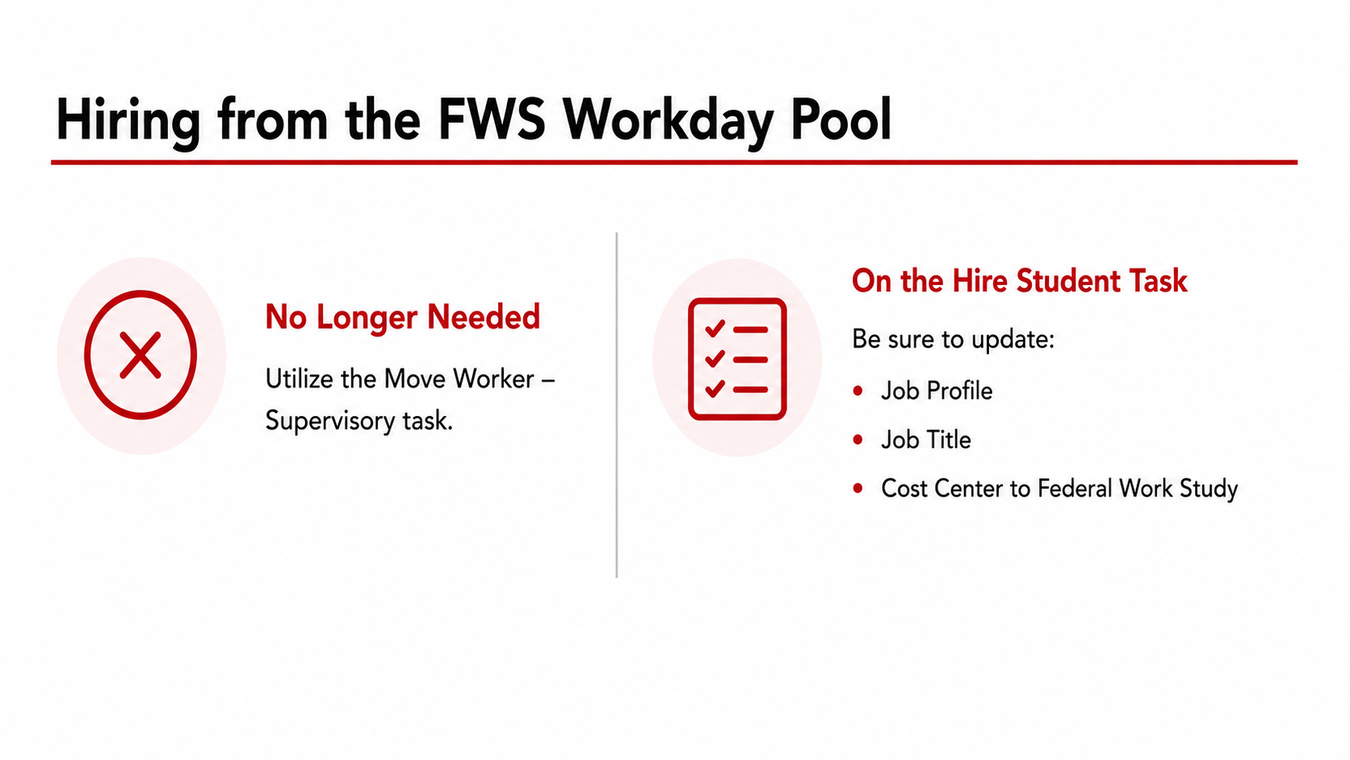
Notes:
Presenter: Office of Financial Aid – Gina Havel
Hire Student Task: Talent will demonstrate this in a few minutes.
You’ll need to be sure you update the Job Profile to Federal Workstudy,.
Unlike in the past when FWS positions had generic Job titles, you can enter a specific Job Title.
You’ll also enter the Cost Center for Federal Work Study.
Start and end dates are 8/20/26 to 05/05/27.

Slide 14
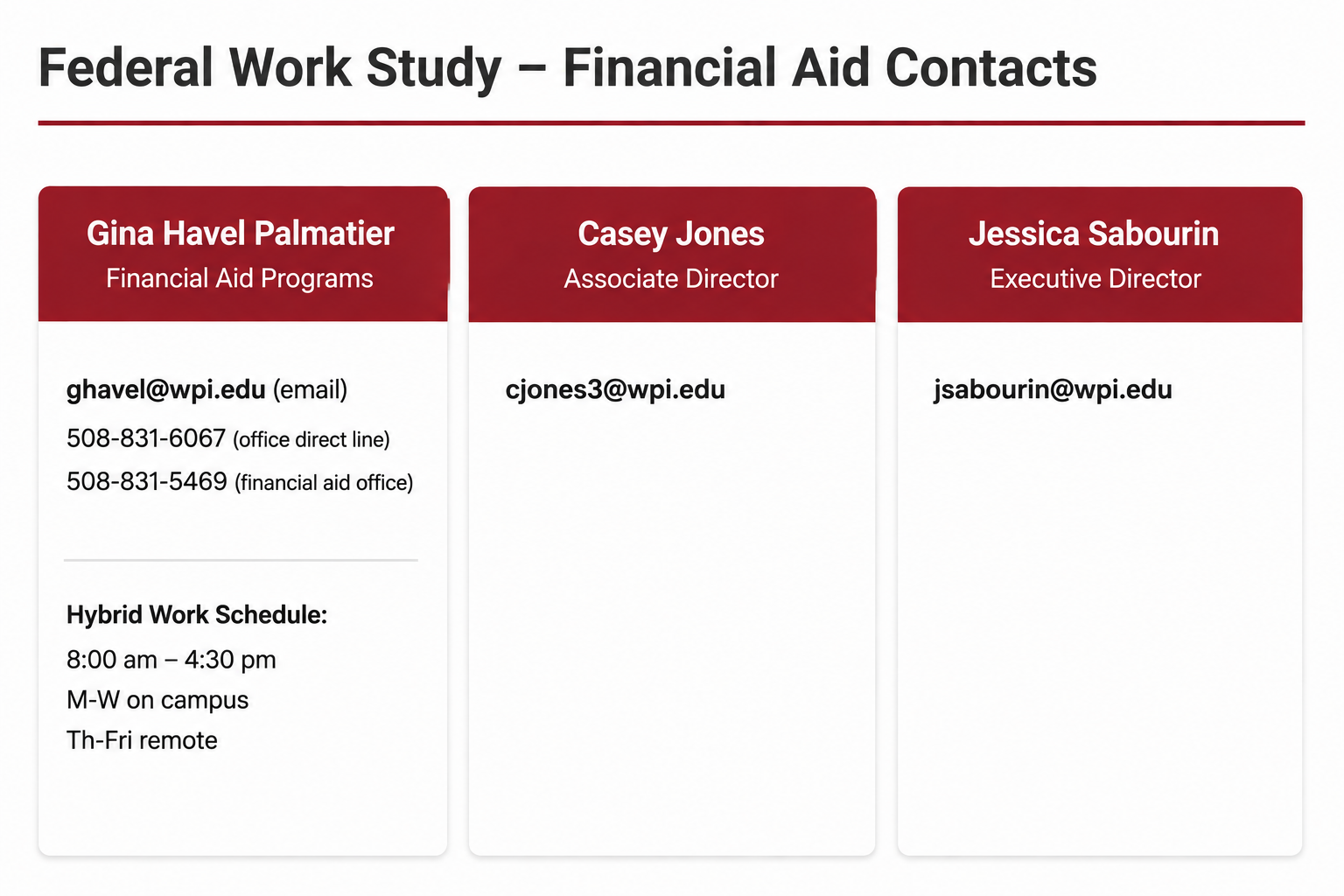
Notes:
Presenter: Office of Financial Aid – Gina Havel
Thank you for your attention today.
Here is the contact information for the Financial aid Office Federal Workstudy Team.
Feel Free to reach out to me with your questions.
Upcoming Federal Work-Study Events:
Student Attendance is not required, but we highly encourage students to attend, if able.
FWS Information Session
Wednesday August 19, 2026, 9:30 am – 10:15 am in Unity 500
Community Service Work-Study Fair & Info session
Wednesday August 19, 2026, 10:30 am – 12:00 pm in Unity 400
2026-27 Annual Student Employment Job Fair
Wednesday, August 19, 2026, 1:30 pm – 3:00 pm in Alden Hall – Please RSVP with Talent to reserve a table at the Job Fair!

Slide 15
Workday Student Recruiting Overview
Student Employment Contact: talent@wpi.edu
Notes:
Presenter: Talent - Leanne Kay
Now that we've reviewed Federal Work Study and the responsibilities associated with funding and managing student employment, let's shift our focus to the recruiting and hiring process itself.
Whether you're hiring a Federal Work Study student or grant and department-funded student employee, all recruiting activity now begins in Workday Student Recruiting.

Slide 16
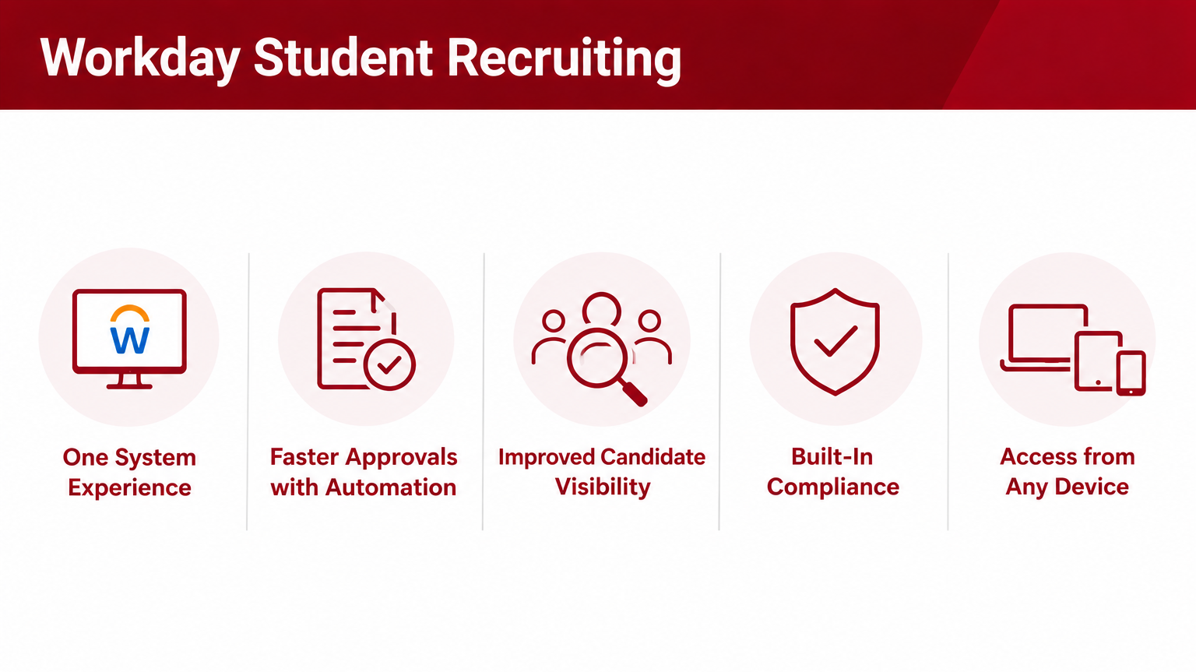
Notes:
Presenter: Talent - Leanne Kay
Workday Student Recruiting creates a more streamlined hiring experience for both supervisors and students.
As mentioned previously, instead of moving between JobX and Workday, recruiting, hiring, onboarding, and employment management now occur within a single system.
Workday’s automated workflows help ensure positions are reviewed and approved efficiently. Built-in compliance checks help ensure employment requirements are completed before students begin to work, including tasks like completing the I-9.
Supervisors and students can complete tasks and monitor progress from any device, including a laptop, cell phone, or tablet through the Workday app.

Slide 17
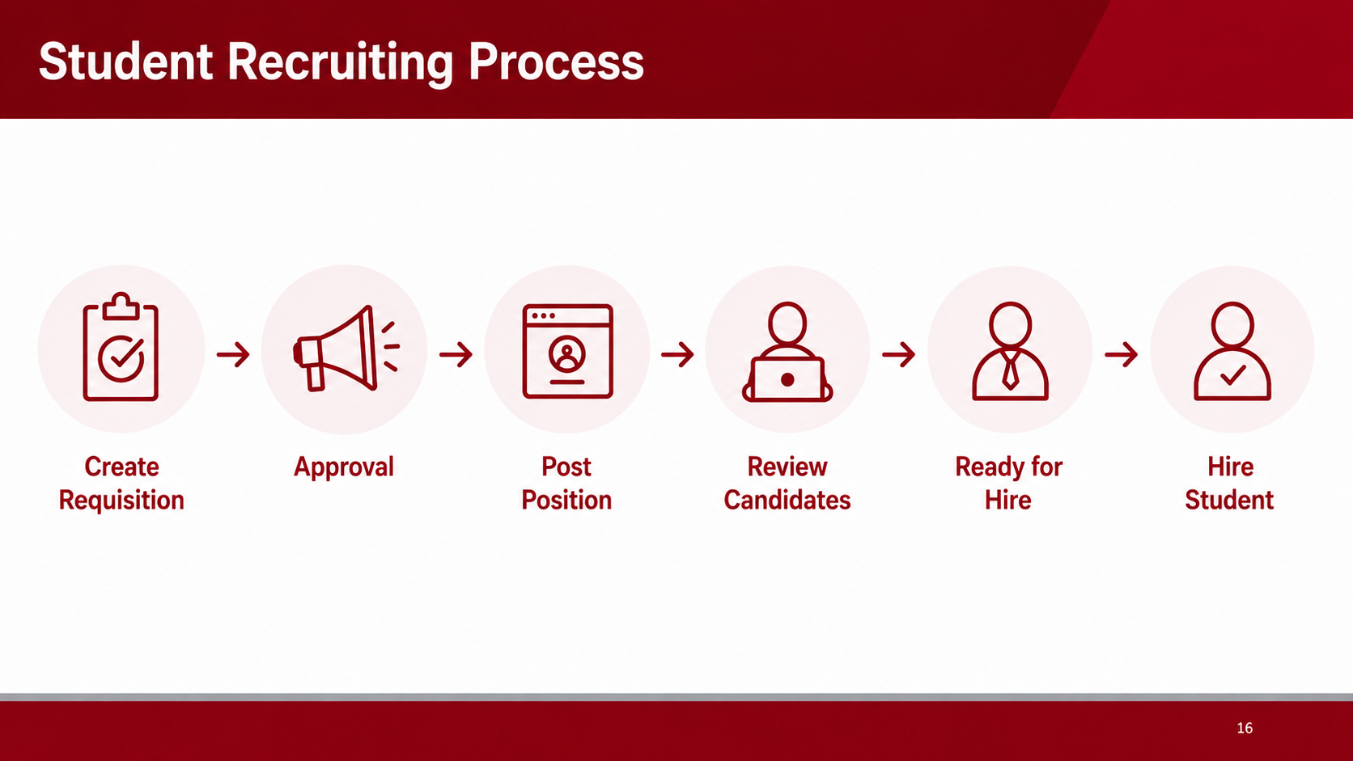
Notes:
Presenter: Talent - Leanne Kay
Now let's look at the overall recruiting process before diving deeper into each stage.
Student hiring begins with the creation of a job requisition. This is where supervisors define the position details, including the job title, job description, number of openings, cost center, and supervisory organization.
Once the requisition is submitted, it moves through the approval process. Talent & Inclusion reviews the request to ensure the position information is complete, compliant, and aligned with university guidelines.
After approval, the position can be posted to the Internal Career Site for Students, making it visible to eligible student applicants.
As applications are received, supervisors can review candidates directly within Workday. This includes reviewing resumes, application materials, and moving candidates through the recruiting stages as needed.
When you've identified the candidate you'd like to hire, you'll move that applicant to the Ready for Hire stage. This action signals that you're ready to begin the employment transaction.
The final step is hiring the student. Depending on whether the student already has an active position at WPI, Workday will guide you through either the Hire Employee process or the Start Additional Job process.
In the next few slides, we'll take a closer look at each stage of this process, starting with how to create and submit a student job requisition.

Slide 18
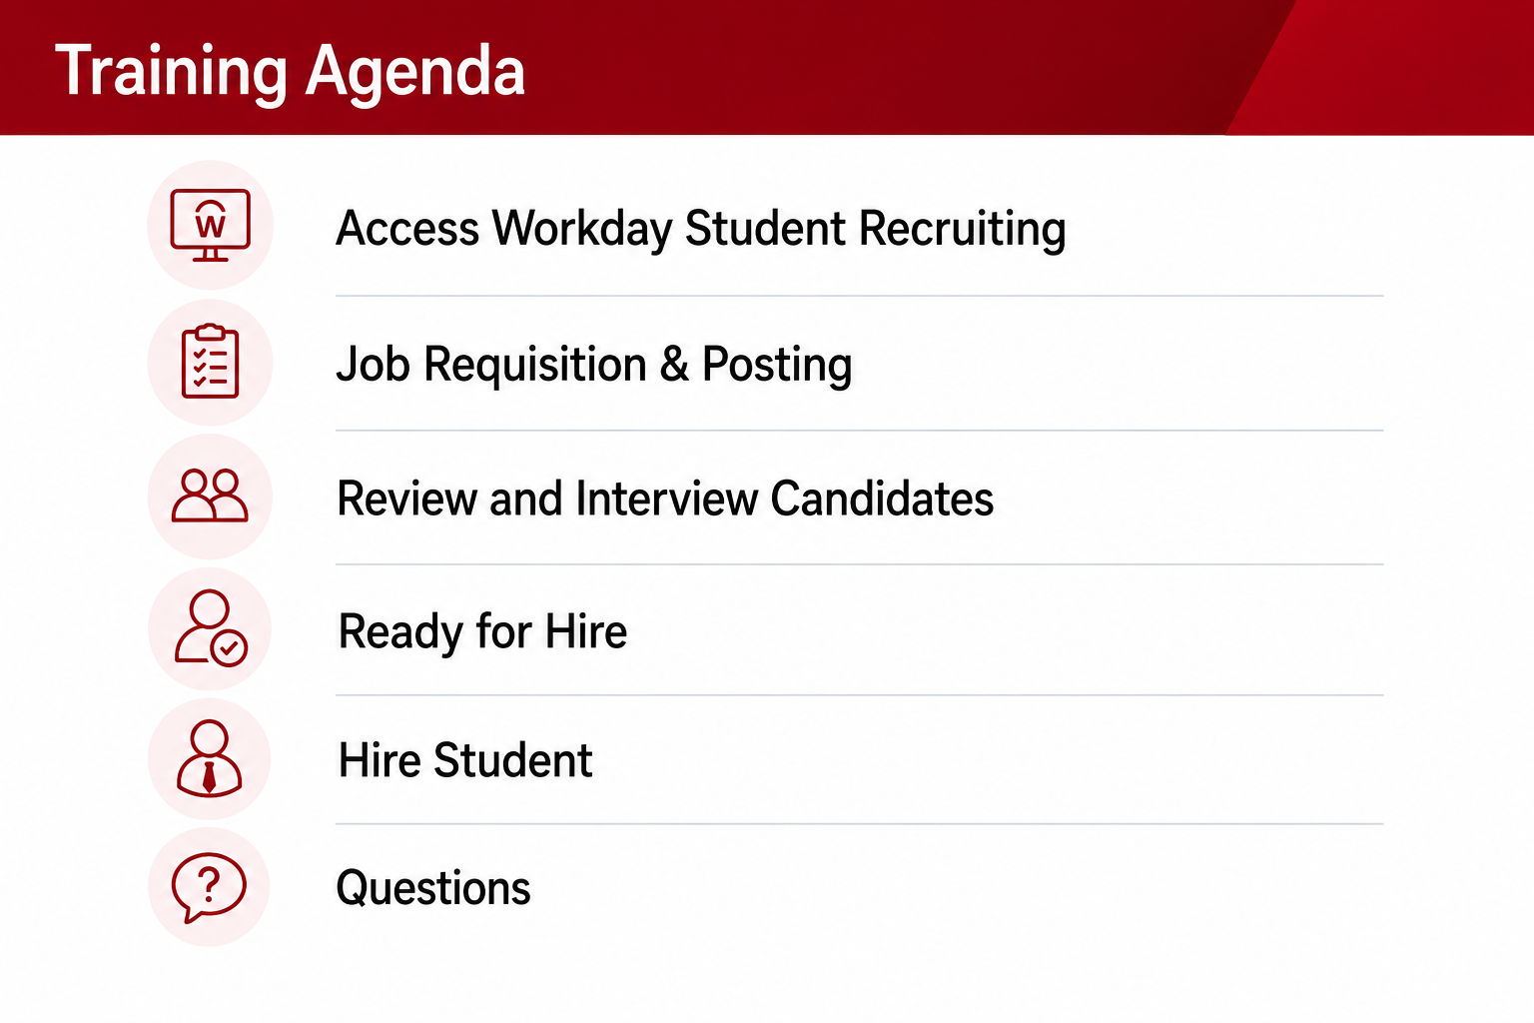
Notes:
Presenter: Talent - Leanne Kay
We’ll now proceed to look at the new Workday processes from start to finish. This will include live demos in Workday and job aids will also be available in the coming weeks on the student employment website to reference throughout the year.

Slide 19
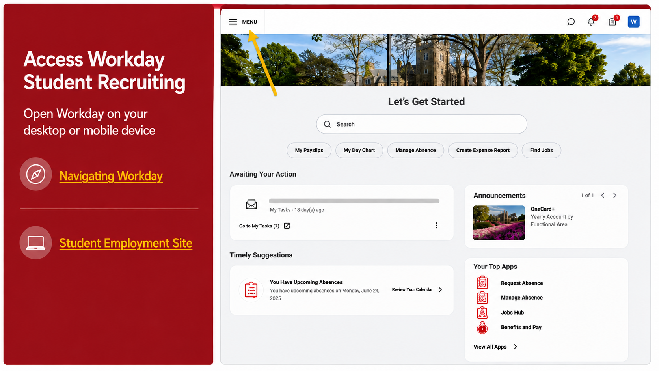
Notes:
Presenter: Talent - Leanne Kay
To begin, open the Workday system on your desktop or mobile device. You no longer need to request access to an external job site or create new credentials.
Login by using your WPI Email and Password credentials via SSO (Single Sign-On).
On the screen you’ll also find a guide of how to navigate Workday as you explore new features in Workday’s menu.

Slide 20
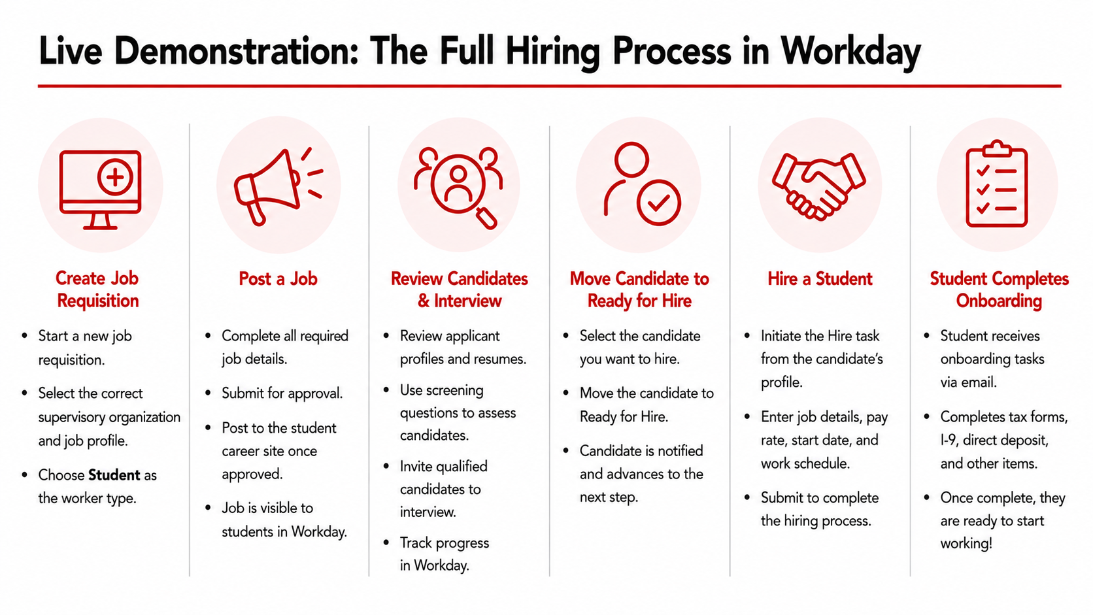
Notes:
Presenter: Talent - Leanne Kay
Navigate to Workday for live demonstrations in Workday; anticipated 15-25 minutes for demo
For guidance after the live student employment August 2026 supervisor trainings, visit the Student Employment website for job aids & contact information. Please note, there is a new section titled “Hiring Manager Resources” which is the best tab to review as a student supervisor or administrative support.
Link: https://www.wpi.edu/offices/talent/student-employment

Slide 21
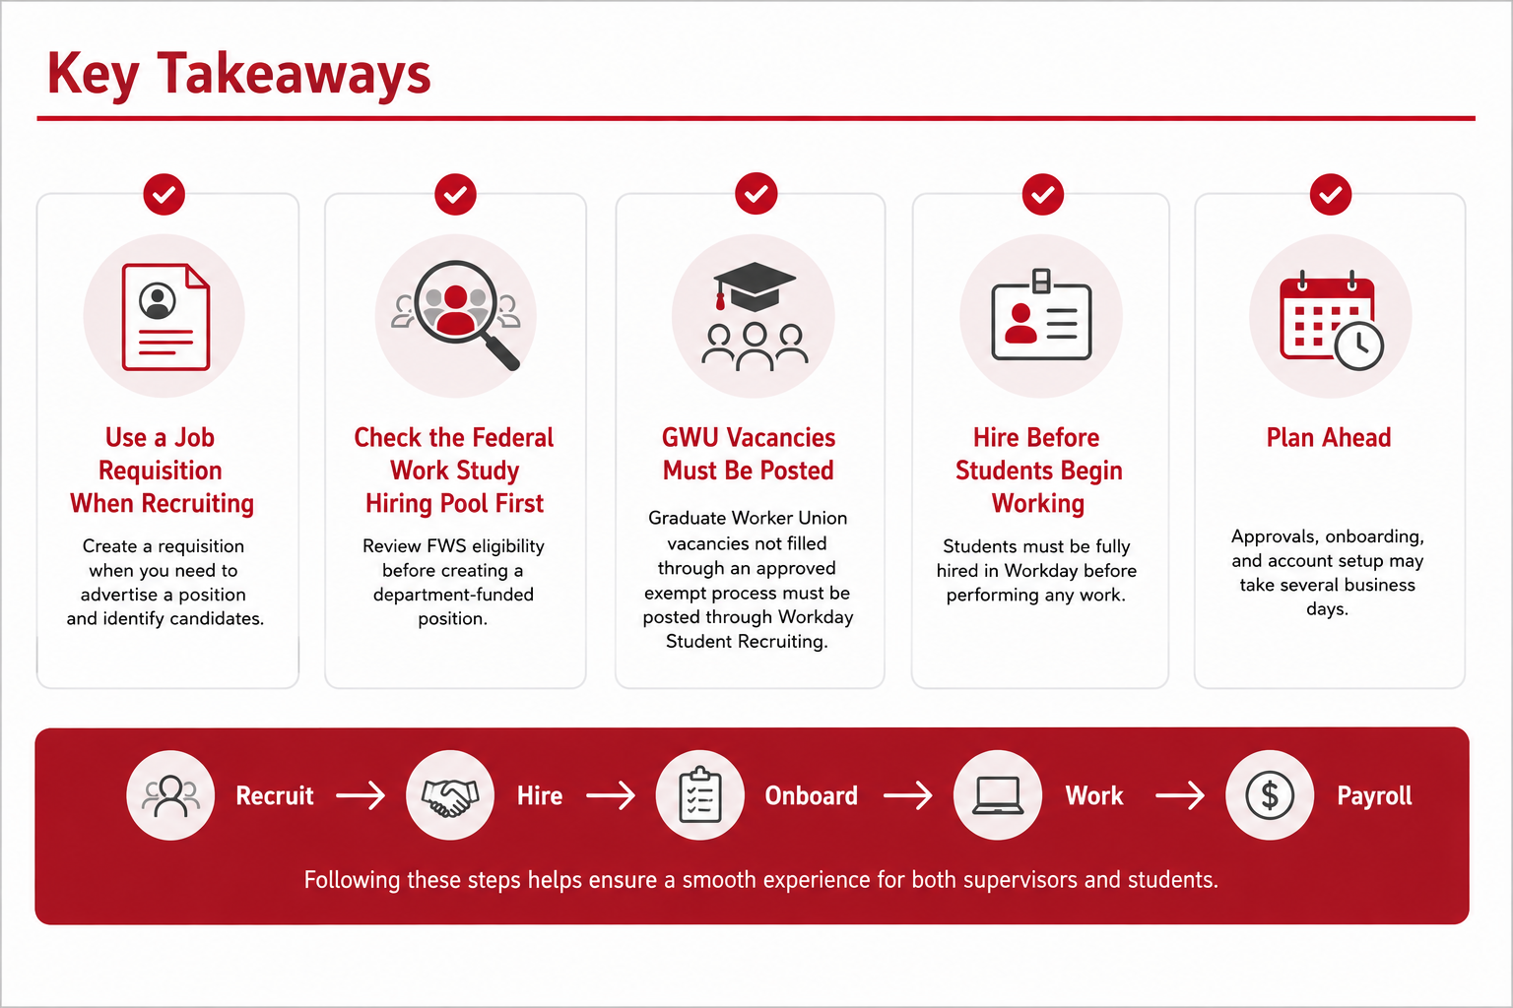
Notes:
Presenter: Talent - Leanne Kay

Slide 22
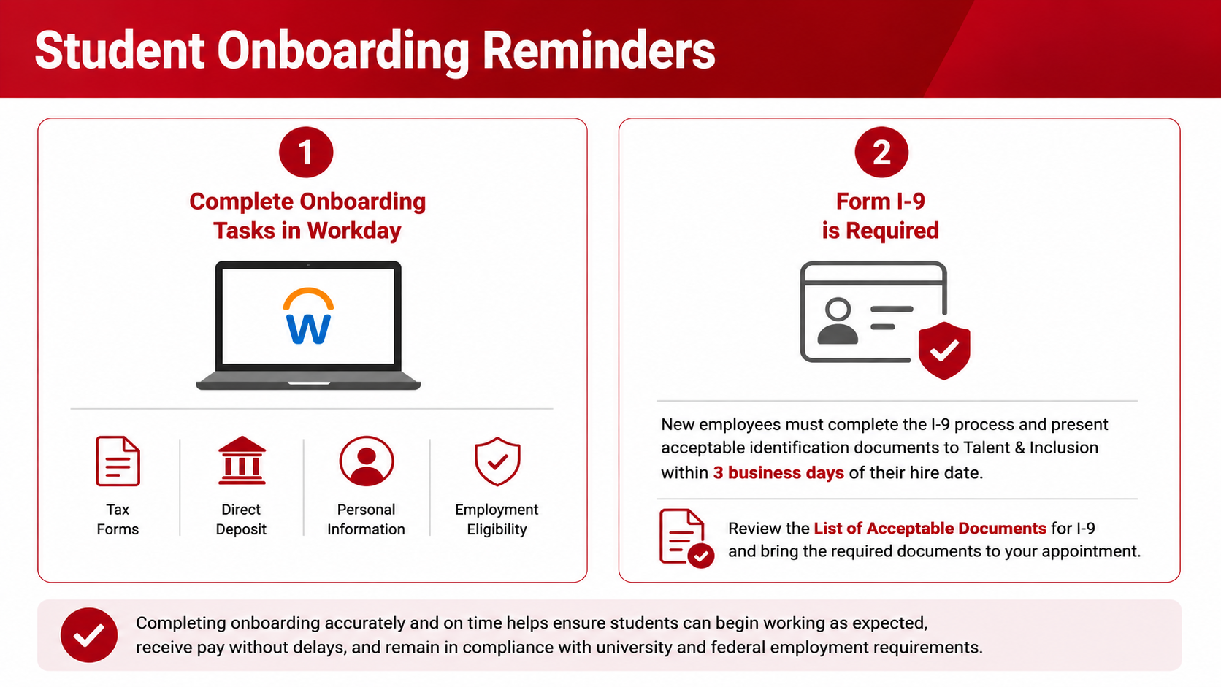
Notes:
Presenter: Talent - Leanne Kay
As supervisors, there are a few important onboarding reminders to keep in mind to ensure students are able to begin working and are paid on time.
First, all student employees must complete any required onboarding tasks in Workday. These tasks may include completing tax forms, setting up direct deposit, reviewing personal information, and completing employment eligibility requirements.
One of the most important onboarding requirements is the Form I-9. If the student is a new employee, they must complete step one of the I-9 process in Workday by their first day of work. Next, they must also present acceptable identification documents to Talent & Inclusion within three business days of their hire date. If this step is not completed, the student may not be eligible to continue working. Supervisors should encourage students to complete these requirements as soon as possible.
Students should refer to the List of Acceptable Documents linked in Workday when preparing for their I-9 appointment. Common examples include a U.S. passport or a combination of a driver's license and Social Security card.
Completing onboarding accurately and on time helps ensure students can begin working as expected, receive pay without delays, and remain in compliance with university and federal employment requirements.

Slide 23
Payroll Overview
Payroll Contact: payroll@wpi.edu
Agnieszka Lipinska-Wegner – Associate Director of Payroll
Jonathan Benoit (JB) – Payroll Administrator
Notes:
Presenter: Talent – Jonathan Benoit (JB)

Slide 24
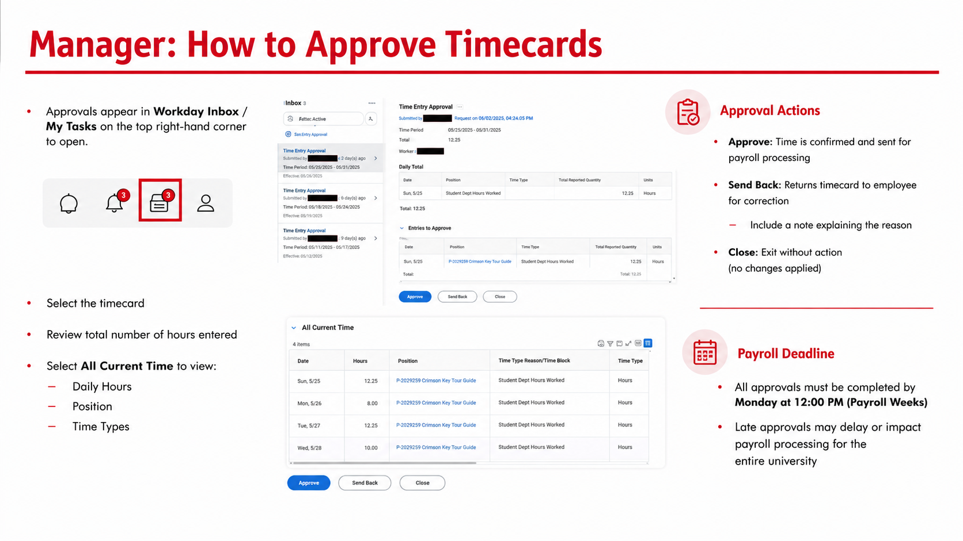
Notes:
Presenter: Talent – Jonathan Benoit (JB)

Slide 25
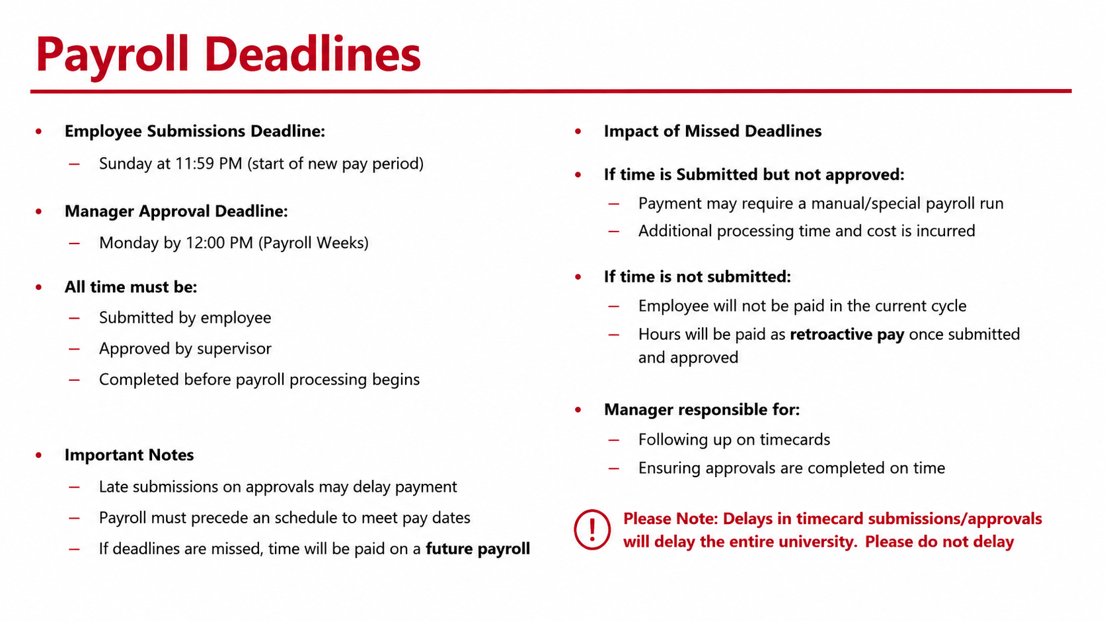
Notes:
Presenter: Talent – Jonathan Benoit (JB)

Slide 26
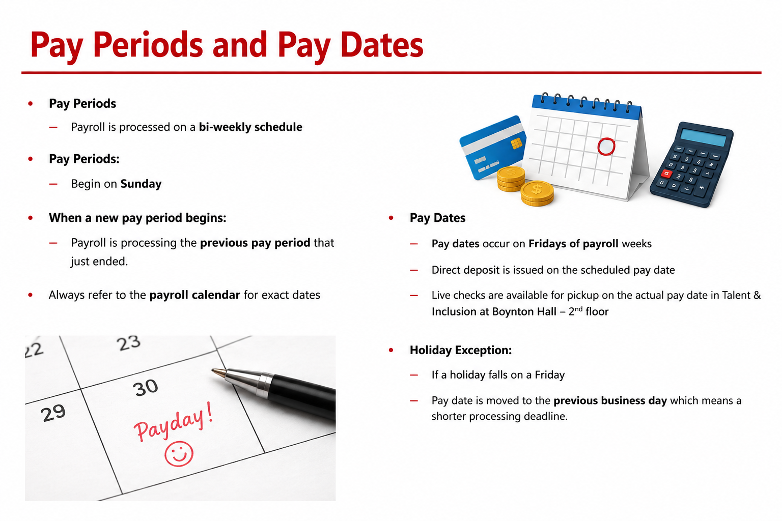
Notes:
Presenter: Talent – Jonathan Benoit (JB)

Slide 27
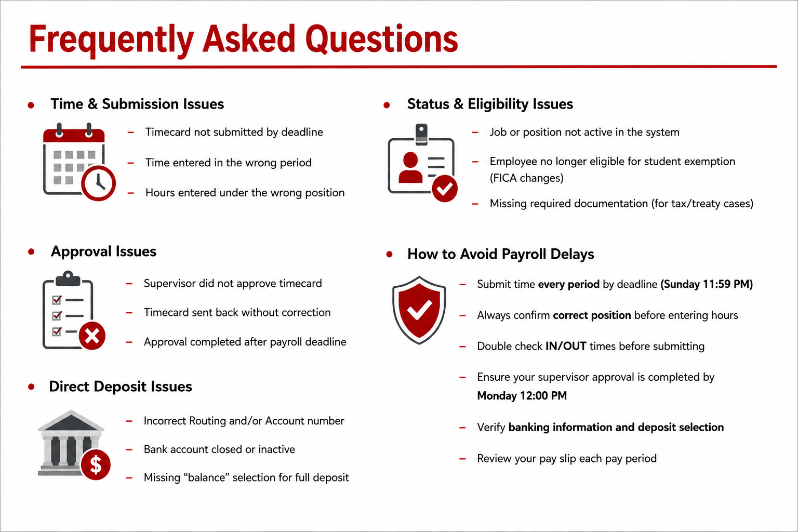
Notes:
Presenter: Talent – Jonathan Benoit (JB)

Slide 28
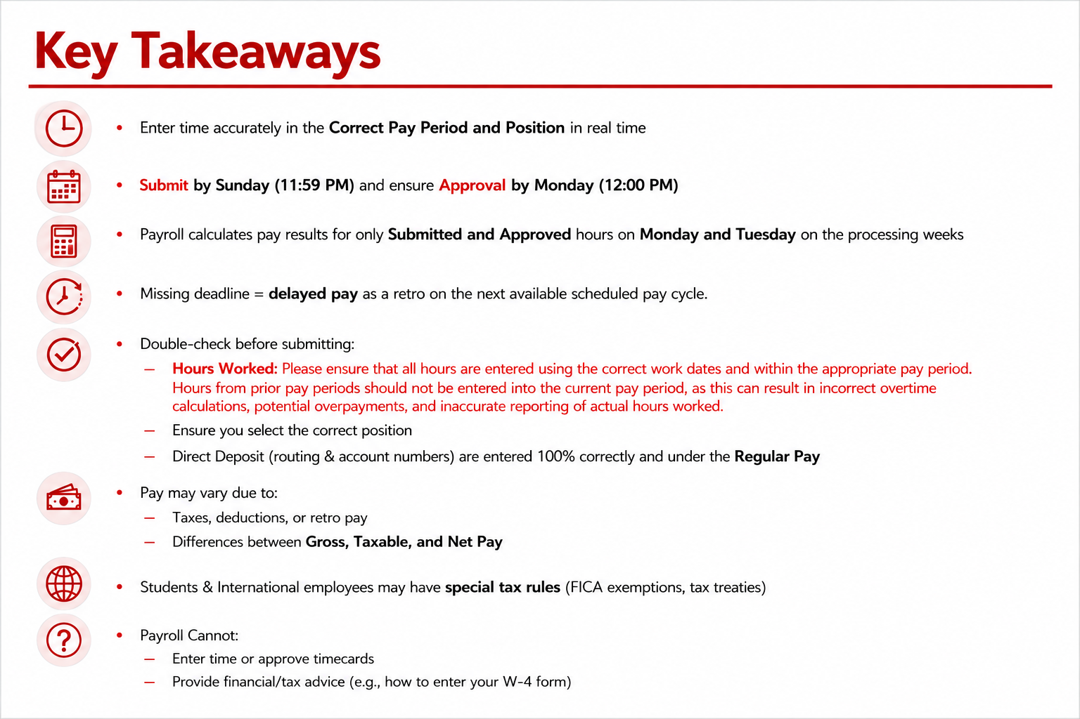
Notes:
Presenter: Talent – Jonathan Benoit (JB)

Slide 29
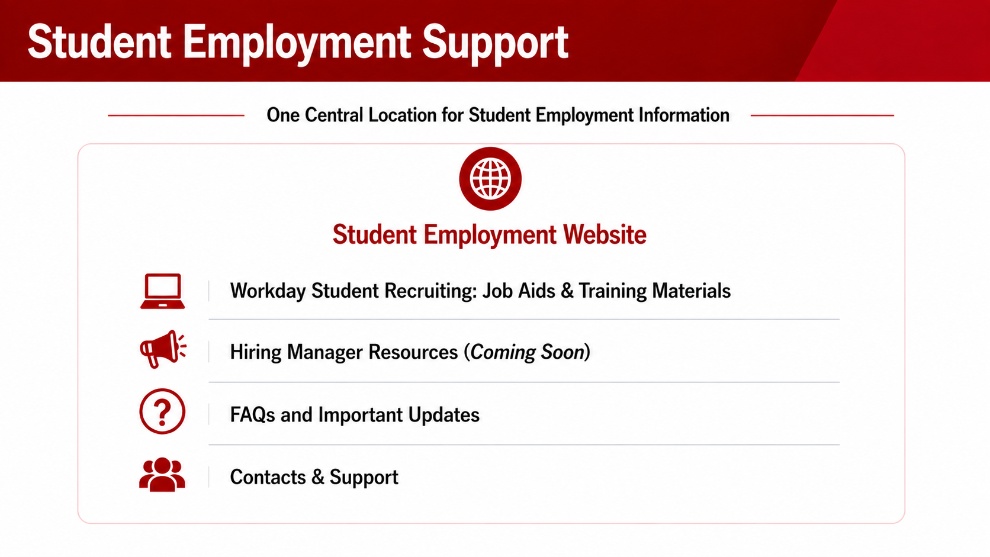
Notes:
Presenter: Talent - Leanne Kay
As we wrap up today's training, I'd like to leave you with one important resource.
The Student Employment website should be your primary destination for student employment information throughout the year. Rather than trying to remember every detail from today's presentation, we encourage you to bookmark this site and refer to it whenever questions arise.
The site contains information about Federal Work Study, student hiring, payroll, onboarding requirements, and important contacts across Talent & Inclusion, Financial Aid, and Payroll.
We're also excited to share that a new Hiring Manager Resources section will be launching soon. This area will serve as a centralized resource hub for supervisors and hiring managers and will include Workday Student Recruiting job aids, quick reference guides, hiring checklists, training materials, and other helpful resources.
Over the coming weeks, additional documentation and job aids related to Workday Student Recruiting will be added to the site as they become available.
Our goal is to ensure supervisors have easy access to the resources they need throughout the student employment lifecycle

Slide 30
Thank you! Any questions?
Notes:
Presenter: Talent - Leanne Kay
Thank you for attending (or reviewing) the 2026 student employment supervisor training!
We’d also like to thank our campus partners in the Office of Financial Aid & Payroll for their ongoing support.
With appreciation,
Talent & Inclusion | Student Employment

