Slide 1
Tuition Exchange & Tuition Benefit Educational Session
Presented by Gina Havel & Carlie Rudzinski

Slide 2
Employees at WPI
Tuition at WPI for Undergraduate, Graduate, or PhD Program
Requirements: Employee must be in a benefits eligible position and have worked a minimum of six (6) months of continuous service on or before the first day of the term
Undergraduate & Graduate Classes: WPI provides financial assistance for these classes.
  If you would like to take a class and not enroll in a specific degree program reach out to the Registrars office
  If you would like to enroll in a graduate program, please reach out to grad@wpi.edu
    Personal Checklist for Admissions Application
  You can take up to 2 classes per term (undergraduate classes) or semester (graduate classes)
Cost: Tuition waived by WPI
Required Forms to submit to benefits@wpi.edu:
  Tuition – On-Campus Remission
  Tuition – WPI Graduate Level Course Job Related Designation Form
    This form is to be used by the supervisor to designate, based on course content and job responsibilities, that the course(s) taken is job related and should be excluded from taxation. If this form is NOT filled out, you will be taxed.

Slide 3
Employees at WPI
Tuition for Off Campus Undergraduate, Graduate, or PhD Programs
Requirements: must have worked a minimum of 6 months of continuous service as a full-time benefited employee. Credit earning courses may ONLY be taken at an accredited institution of higher learning
Cost: Employees receive a reimbursement of 75% of any mandatory fees up to the total sum of $2,000 per academic year. The amount of graduate and PhD program tuition is subject to all applicable taxes, per section 127 of the IRS guidelines
Required Forms to submit to benefits@wpi.edu:
  WPI Request for Employee Off-Campus Educational Assistance Form
  A copy of the course description(s) must be attached to the request) and obtain approval from their supervisor and Division of Talent & Inclusion prior to enrollment.
    Classes must be job related or part of a job-related degree program, as approved by a supervisor or department head and the Division of Talent & Inclusion.
    If the course takes place during work hours, a Department Head signature will be required.
    Once the employee has completed the class, a copy of their final passing grade and receipt of payment for the class must be submitted to Talent & Inclusion for the reimbursement to be processed within 60 days of the completion of the course.

Slide 4
Employees at WPI
On or Off Campus Non-Credit Courses
Requirements: Employee must be in a benefits eligible position and have worked a minimum of six (6) months of continuous service on or before the first day of the term
Cost: Non-credit courses (i.e., Continuing Education Units, courses, seminars, etc.) taken at WPI or off campus must be approved by a department head, and all direct costs of attendance are charged to the department. These courses should contribute directly to the employee’s present position.
Required Forms to submit to benefits@wpi.edu:
  WPI Request for Employee Off-Campus Educational Assistance Form
  A copy of the course description(s) must be attached to the request) and obtain approval from their supervisor and Division of Talent & Inclusion prior to enrollment.
    Classes must be job related or part of a job-related degree program, as approved by a supervisor or department head and the Division of Talent & Inclusion.
    If the course takes place during work hours, a Department Head signature will be required.
    Once the employee has completed the class, a copy of their final passing grade and receipt of payment for the class must be submitted to Talent & Inclusion for the reimbursement to be processed within 60 days of the completion of the course.

Slide 5
Undergraduate Study at WPI – Dependent Children
Requirements: Employee must have worked a minimum of 1,450 hours or more for three (3) years of continuous service on or before August 1st (for the fall terms) or on or before January 1st (for the spring terms) of the year the student will begin classes.
Dependent Children: may attend the undergraduate school with tuition costs waived for up to 16 terms (full-time or part-time enrollment in each of A, B, C, D, and E terms count as one of the sixteen terms allowed). Tuition benefits for dependent children with documented disabilities who are attending WPI will be extended to up to six years to address inequities and increase accessibility.
Cost: Tuition Waived by WPI*
  *Please note that recipients of the WPI tuition benefit are not eligible to receive WPI Academic Merit Scholarships, WPI University Awards, or WPI need based scholarships.
Required Forms to submit to benefits@wpi.edu:
  Tuition – Dependent Children PDF Form

Slide 6
Off Campus Undergraduate Study – Dependent Children
Requirements: Employee must have worked a minimum of 1,450 hours or more for three (3) years of continuous service on or before August 1st (for the fall terms) or on or before January 1st (for the spring terms) of the year the student will begin classes.
  Each child is eligible for not more than 4 academic years (8 semesters or the equivalent) of tuition assistance except when the specified length of baccalaureate curriculum is greater than four years, in which case the full period will be covered.
  Children may take, at no charge, one or two courses at WPI during E-Term on a space-available basis provided that the course has already met the minimum paid enrollment required for regular course status.
Cost: WPI will pay up to $2,600 per semester ($5,200 per academic year) per child.
  This pertains to undergraduate degree programs ONLY
  Tuition and mandatory fees ONLY
Required Forms to submit to benefits@wpi.edu:
  Tuition – Dependent Children PDF Form
  Itemized Bill

Slide 7
Spouse or Domestic Partner of WPI Employee
Requirements: must have worked a minimum of 1,450 hours or more for 3 years of continuous service as a full-time benefited employee.
Undergraduate & Graduate Classes: WPI provides financial assistance for these classes.
  If you would like to enroll in a graduate program, please reach out to grad@wpi.edu
    Personal Checklist for Admissions Application
  You can take up to 2 classes per term (undergraduate classes) or semester (graduate classes)
Cost: Tuition waived by WPI
Required Forms to submit to benefits@wpi.edu:
  Tuition – On-Campus Remission

Slide 8
Tuition Reimbursement Frequently Asked Questions
Question: How will I receive my tuition reimbursement from an outside college or university?
Answer: Reimbursement will be issued in the last pay date of the month by Payroll
Question: If my dependent is attending WPI, do I need to submit the form every semester?
Answer: Yes – Please email the completed form to benefits@wpi.edu

Slide 9

Contact & Resources
Benefits Policy & Manual
Tuition Remission Forms
Benefits Team – Benefits@wpi.edu

Slide 10
Tuition Exchange Scholarship
Tuition Exchange -tuitionexchange.org
WPI Tuition Exchange Liaison officer: Gina Havel Palmatier, ghavel@wpi.edu

Slide 11
Tuition Exchange Scholarship "Export"
Dependent's eligibility to apply for Tuition Exchange scholarship is based on your employment status at WPI:
ELIGIBLE EMPLOYEE: Any faculty or staff member who has completed three years of continuous full-time employment at WPI as of August 31st of the year the employee’s dependent child would matriculate at a TE school is eligible to apply.
Participation in the program will cease upon termination of employment, including retirement. If the parent’s employment status with WPI changes (terminated, leaves/resigns), their student’s eligibility for future Tuition exchange scholarship is also rescinded. When benefits-eligible employment at WPI ends, tuition benefits continue through semester in progress but will not continue beyond that.
TE is a competitive scholarship -
  Our certification of eligibility as an export allows the student the opportunity to be considered for a tuition exchange scholarship at another member institution. Selection criteria are school-specific and may vary between schools. Award decisions will come from the other school. WPI Tuition Exchange liaisons have no input or influence on the scholarship selection criteria implemented at other schools.

Slide 12

Navigating the TE Process
2027-28
TE EZ-Application is open NOW!
Two Steps:
  Student applicant (not the parent!) creates TE account using their own email address that will remain with them after high school.
  Student logs in and completes TE EZ-Application.
  https://te.tuitionexchange.org/applicantsignin
  Select 2027-2028 year if seeking a Tuition Exchange Scholarship for Fall 2027/Spring 2028.
https://tuitionexchange.org/how-to-apply/
Notes:
The TE EZ-Application - is all about the student.
► The student should have an email account besides their high school email
address.
► Consider creating a Gmail, Yahoo, Hotmail or other commercial email account
option.
► Be sure the student email address is professional, considering something like
firstname.lastname2024@name of email provider.com.
► Never use the parent’s personal or work email address to create the account.
► If the student is also the eligible employee, still use a different student account email
address.
► The student is creating a Tuition Exchange account, which stays with the
student throughout their educational journey as a TE scholar.
► Should the student wish to transfer, take a leave of absence, or stop

Slide 13
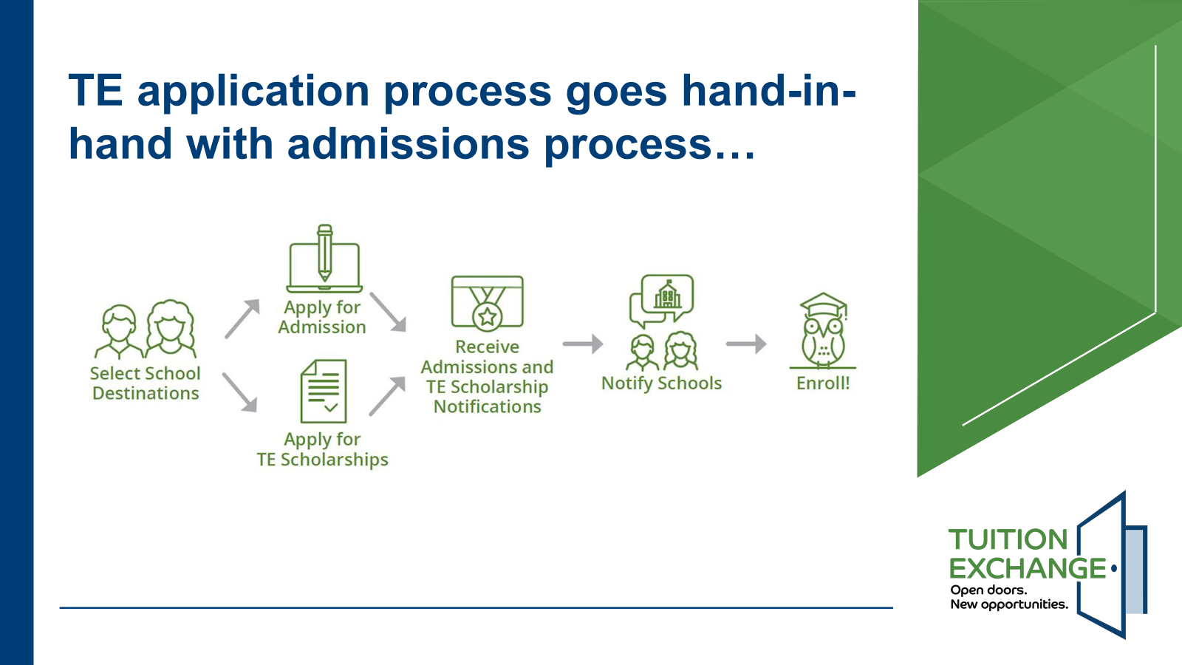
Notes:
Applying for Tuition exchange is separate from applying for Admissions or applying for Financial aid.
Refer to the school for application requirements and deadlines.

Slide 14
Important Questions to ASK!
The student is responsible for reading, understanding, and asking
questions about the TE scholarship offered by the Import school.
► What is your school’s TE scholarship amount?
► Can I receive additional institutional scholarships, too?
► What about Federal Pell Grant or State Tuition Grants?
► What are the scholarship renewal requirements (ex.-GPA?)
► Are there on-campus housing requirements?
► How many semesters are covered?
► Are students attending Graduate School eligible for Tuition Exchange?
► Does the TE scholarship cover summer school and study abroad?

Slide 15
Final Reminders
► The TE-EZ Application is all about the student!
► For employer-eligible questions, the eligible employee contacts their
Human Resource Office or Tuition Exchange Liaison Officer.
► If the eligible employee leaves their employment, the TE scholarship is canceled.
► For Import eligibility questions, first-time students contacts their Admission
Counselor and continuing students should contact Financial Aid.
► Tuition Exchange is not an employee benefit!
► Tuition Exchange is a scholarship opportunity.
► Not all students will qualify for a Tuition Exchange scholarship.

Slide 16
Tuition Exchange Family Resources
TE Family Webinars (live and pre-recorded)
TE Family FAQ’s
https://tuitionexchange.org/family-resources/

Slide 17
Contact & Resources
Benefits Policy & Manual
Tuition Remission Forms
Benefits Team – Benefits@wpi.edu
Tuition Exchange -tuitionexchange.org
WPI Tuition Exchange Liaison officer: Gina Havel Palmatier, ghavel@wpi.edu

