Slide 1
Roles, Responsibilities, Accomplishments
Kent Rissmiller
Dean, ad interim
Interdisciplinary &
Global Studies Division
Notes:
This PowerPoint Template includes a series of slide masters with predefined layouts and color schemes for formatting slides
Slide Masters are displayed when you right click on a slide and select Layout from menu

Slide 2
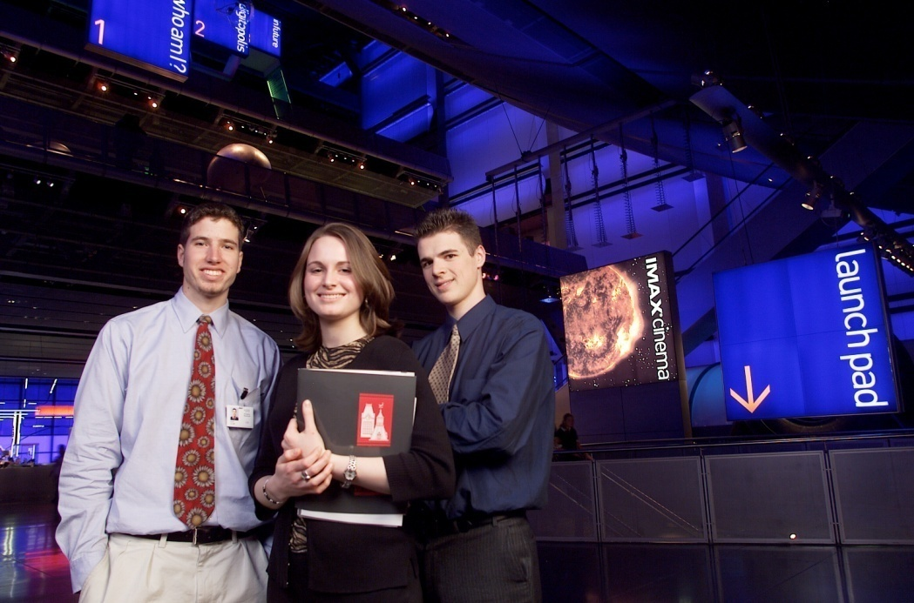
Dean of Interdisciplinary
& Global Studies
Primary Responsibility (I) :
To ensure that WPI offers high-quality IQP opportunities for all students whether on- or off-campus
Planning, budgeting, staffing, hiring and space(?)

Slide 3
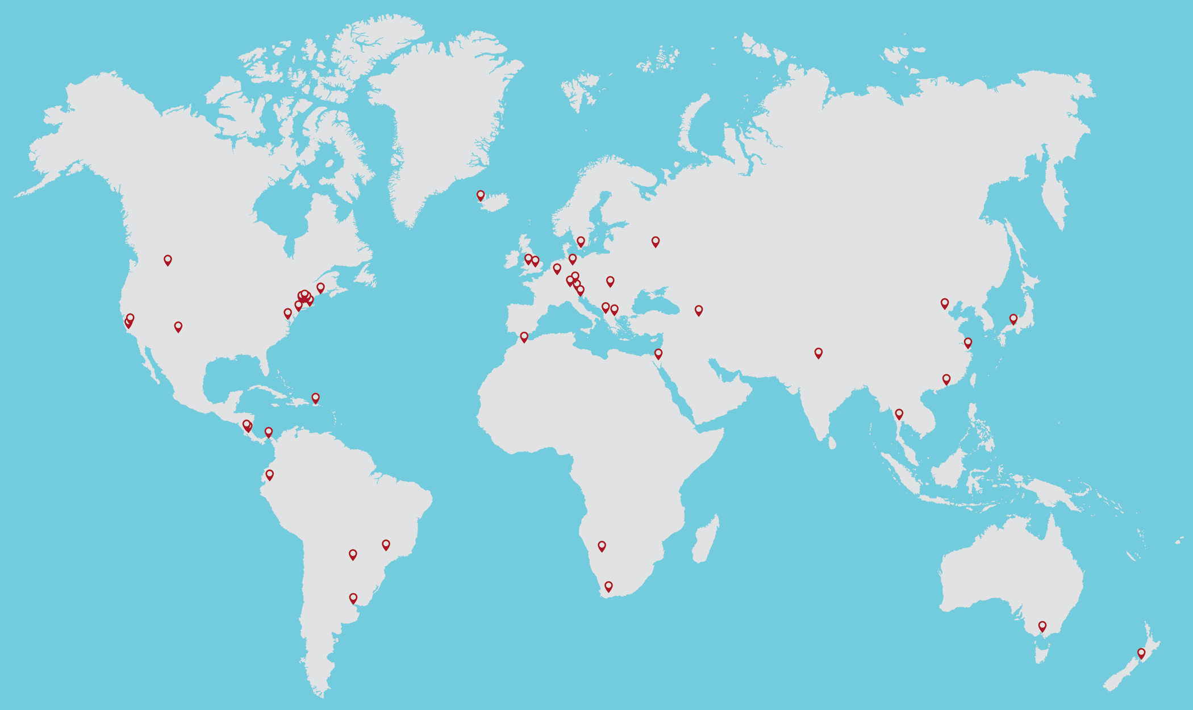
Support “Global Projects for All”
Program Year | 16-17 | 17-18 | 18-19 | 19-20
IQP Sites | 28 | 35 | 40 | 41
IQP Terms | 34 | 44 | 48 | 47

Slide 4
Students in the Global Program
Program Year (E, A, B, C, D) | 16-17 | 17-18 | 18-19 | 19-20
Sophomores | 991 | 1001 | 1048 | 1082
IQP Applicants | 793 | 883 | 971 | 960
% Sophomores Applied | 80% | 88% | 93% | 89%
Number of IQP Students Placed | 707 | 741 | 827 | 936
% of Applicants Placed | 89% | 84% | 85% | 98%
% of Sophomores Placed | 71% | 74% | 79% | 87%*

Slide 5
“Global Projects for All”
Also Includes Support for:
HUA Centers:
London, Argentina, Morroco, Japan
MQP Centers (10):
Silicon Valley, Mitre, Lincoln Labs, Beijing
Individually Sponsored Residential Projects
IQPs – Berlin
MQPs – Stockholm, Zurich
Exchanges
Konstanz

Slide 6

While supporting on-campus projects

Slide 7
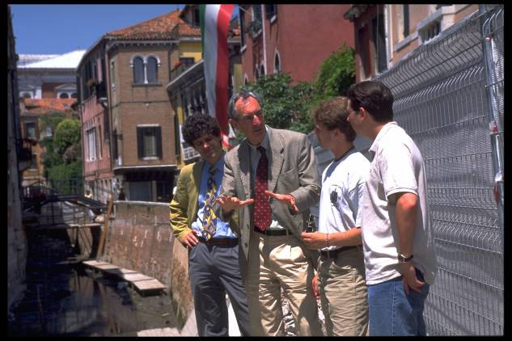
Meeting the mission requires…
Dedicated Faculty
Advisers & Directors
With training in advising and safety
Work with the Morgan Center and Center for PBL on adviser training
IGSD staff on safety
Mentoring by senior faculty
And the cooperation and collaboration of the Provost, Deans and Department Heads

Slide 8
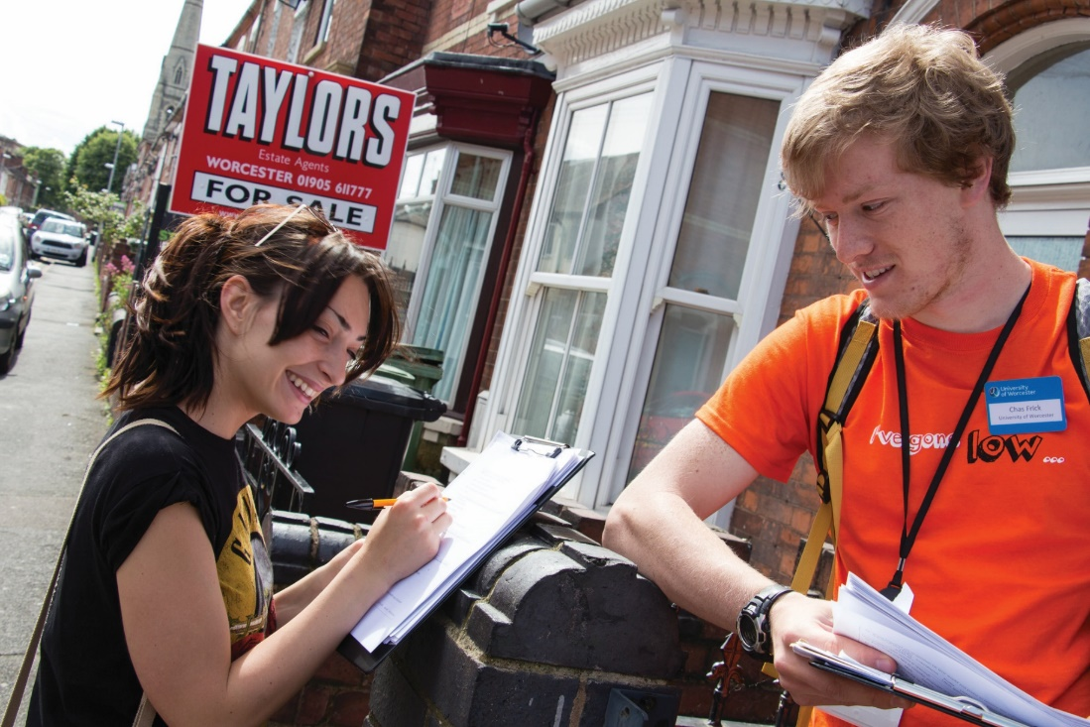
Dean of Interdisciplinary
& Global Studies
Primary Responsibility (II):
Ensuring the safety and well-being of all our program participants…
  Safety training for students & faculty
  IGSD Staff & 24/7 Duty Officer
  New Associate Dir. for International Risk Management
  International SOS
  Global Health Insurance

Slide 9
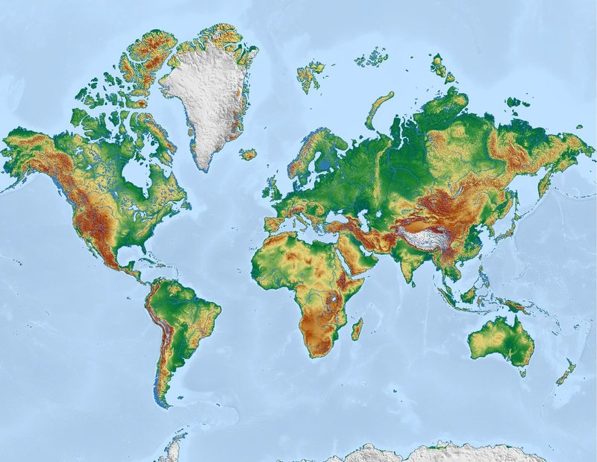
I Oversee our Study Abroad Staff
Who (with Center Directors):
Approve our programs
Publicize offerings
Manage the application process
Review students’ eligibility
Gather health and travel information
Assist with visas
Manage student/faculty housing
Counsel students and faculty
Manage the accounting and expensing of all of this (in lots of currencies!).

Slide 10
Oversee IQP Quality Control
Faculty training on…
Setting expectations for teams, coaching teams, team dynamics, grading, working with sponsors, negotiating shared responsibilities…
Program Assessment…
As ongoing feedback, student and faculty reports on learning outcomes, summer review in support of learning outcomes and accreditation.

Slide 11
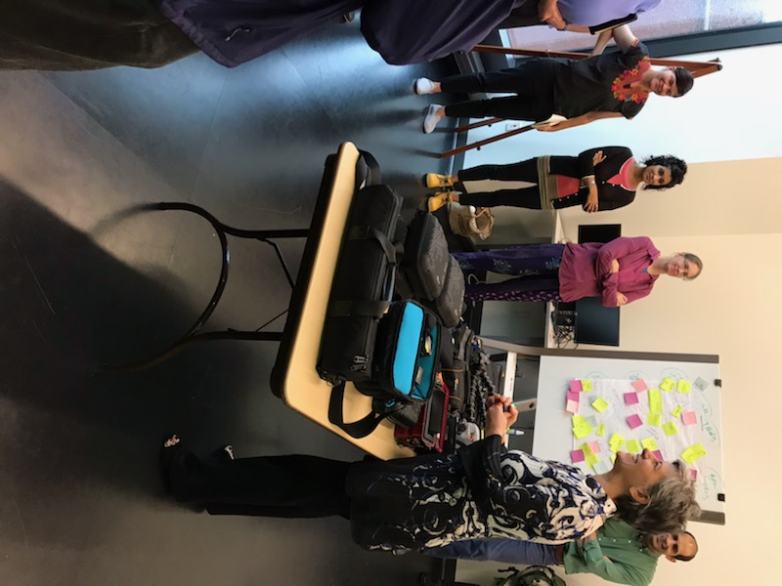
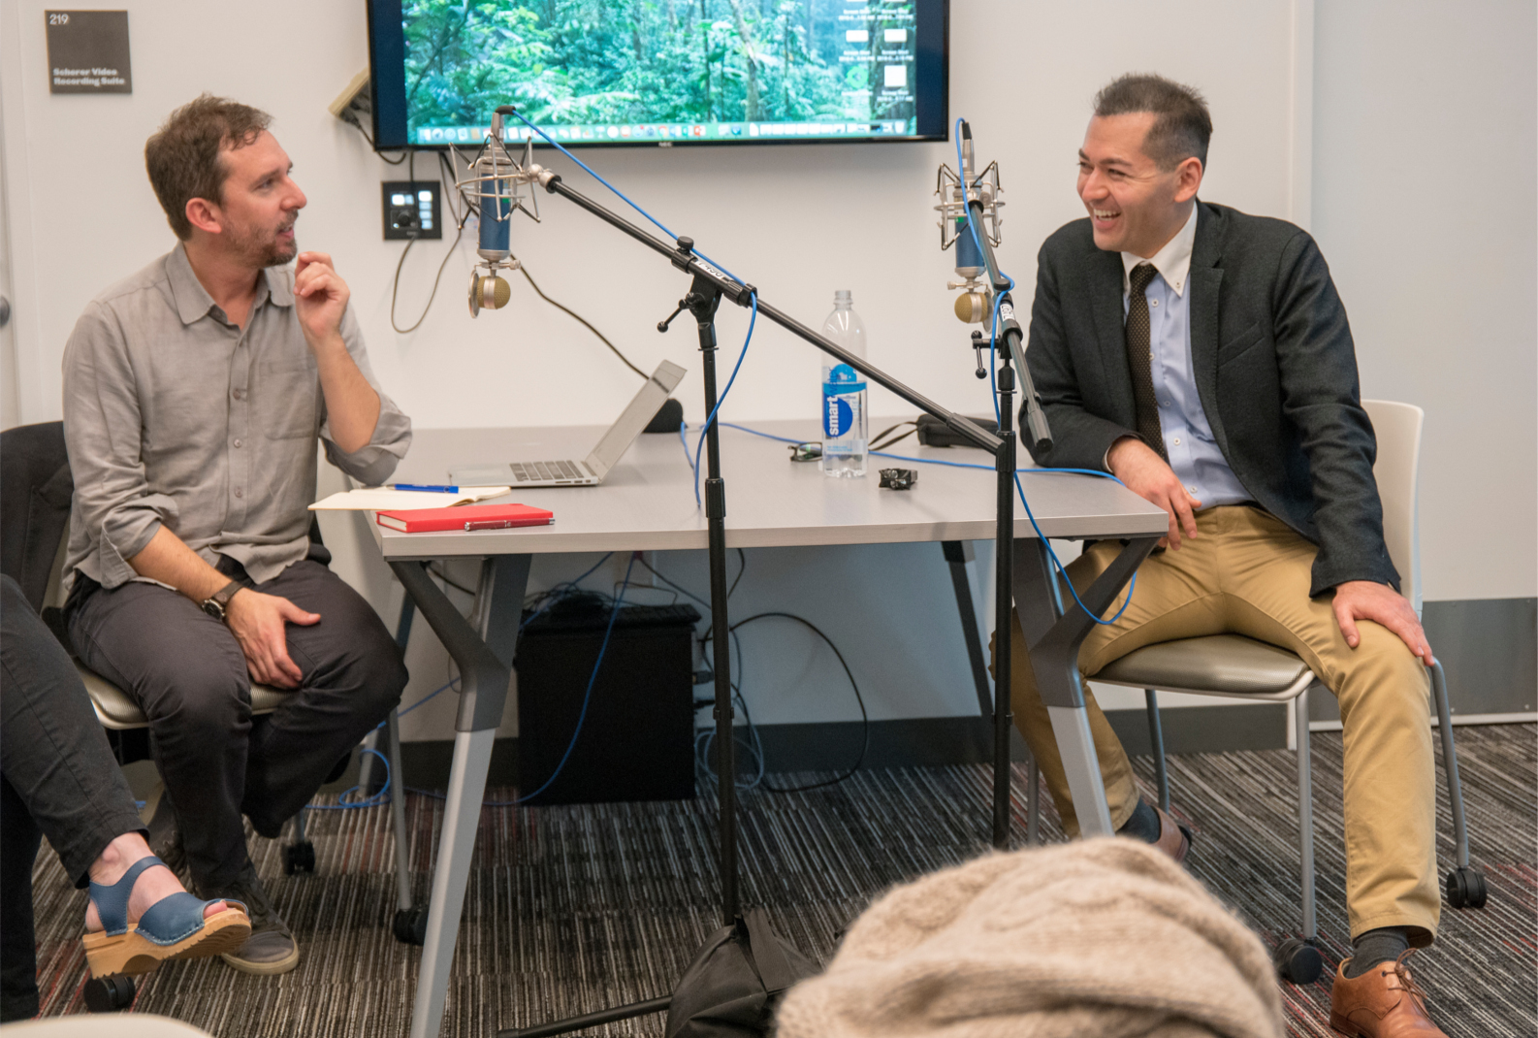
The Global Lab
Facilitating and communicating global research for faculty and students

Slide 12
Participate in Outreach…
I also
Foster Global Partnerships
Partner with Advancement and outreach to Alums
Represent the Projects Programs
  ASEE, IIE Global Engineering Exchange Conference, Workshop on PBL at Farleigh Dickinson Univ., Summer Institute on Project-Based Learning

Slide 13
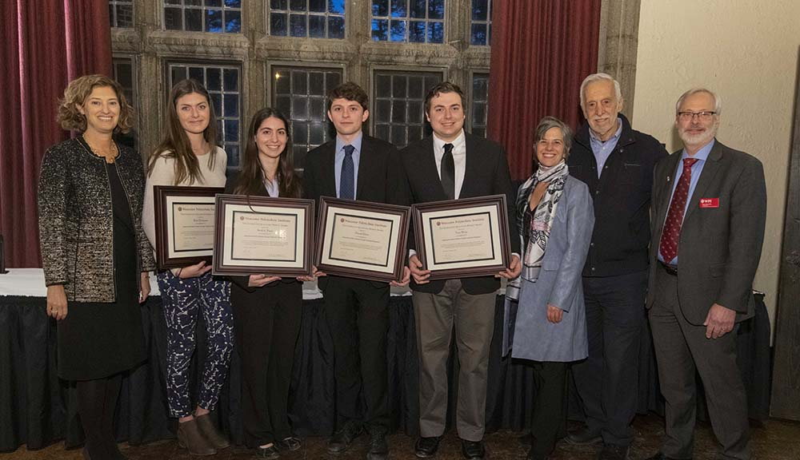
President’s IQP Awards Winner
Reducing Flood Risk in Shkodra Through Community Engagement.

Slide 14
Goats Go Global!

