Slide 1
Steam Pipe Replacement to Impede Traffic between Riley & Daniels Halls
November 26th – December 14th
November 20, 2018

Slide 2
Steam Utility Replacement
Project Description
The Steam Utility Piping between Riley & Daniels Halls has developed a leak. We will begin the pipe replacement work on Monday November 26th, with expected completion by December 14th.
While all Riley & Daniels Halls entrances will remain open, the following will be impacted:
  Pedestrian and Vehicle access will be blocked in between Riley & Daniels Halls
  Riley Hall Accessible Ramp will be closed
This work will not disrupt heating services to those residence halls during the remainder of the term; we will perform the final steam piping connections during the winter term break, and Riley & Daniels Halls will be without heat for two days within that timeframe (December 22nd – 24th).
Please contact rpobrien@wpi.edu with questions or for assistance.

Slide 3
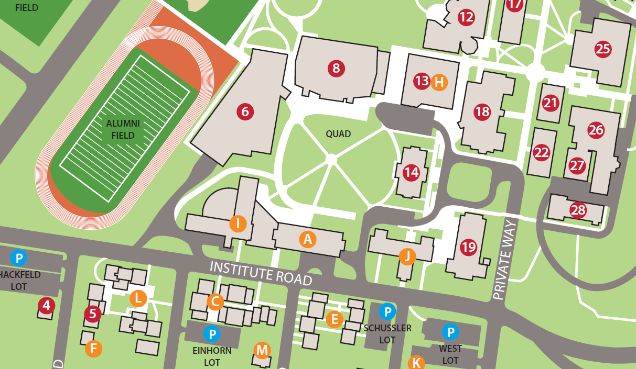
Steam Utility Replacement
Project Locus
Steam Utility Replacement Project

Slide 4
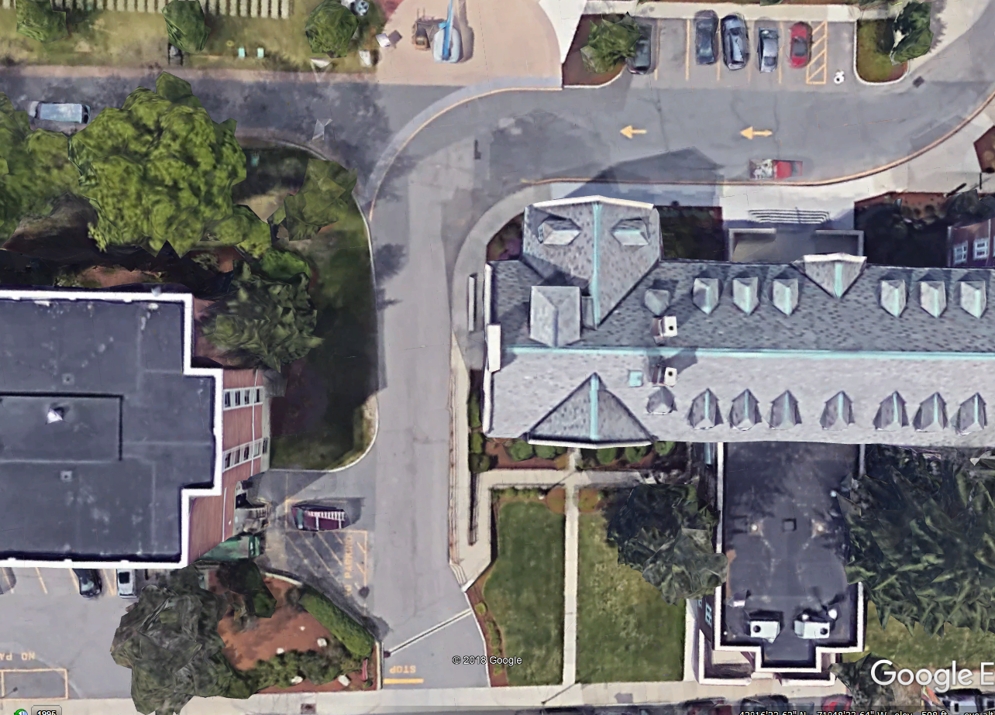
Temporary Campus Impacts
Handicap Accessible Parking Remains Open
Construction Fence
New Steam Utility
Accessible Ramp is Closed
Riley Hall Entrance Remains Open

Slide 5
Temporary Pedestrian Routes
Construction Fence
No Pedestrian Access Through Construction Area
New Steam Utility
Pedestrian Access Routes

Slide 6
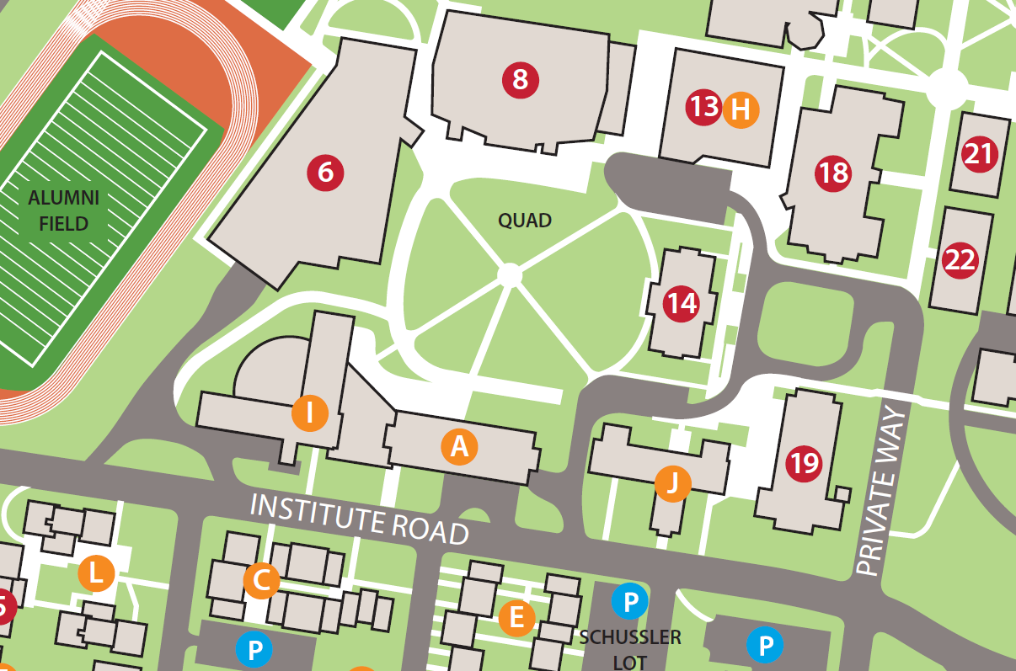

Temporary Emergency Vehicle Access
Harrington Auditorium
Foisie Innovation Ctr & Messenger Hall
Sports & Recreation Center
Project Center
Higgins Labs
Stratton Hall
Bartlett Center
Morgan Hall
Daniels Hall
Alden Memorial
Riley Hall
No
Access

Slide 7

Temporary Commercial Vehicle Access
Harrington Auditorium
Foisie Innovation Ctr & Messenger Hall
Sports & Recreation Center
Project Center
Higgins Labs
Stratton Hall
Bartlett Center
No Access
Morgan Hall
Daniels Hall
Alden Memorial
Riley Hall
No
Access

