Slide 1

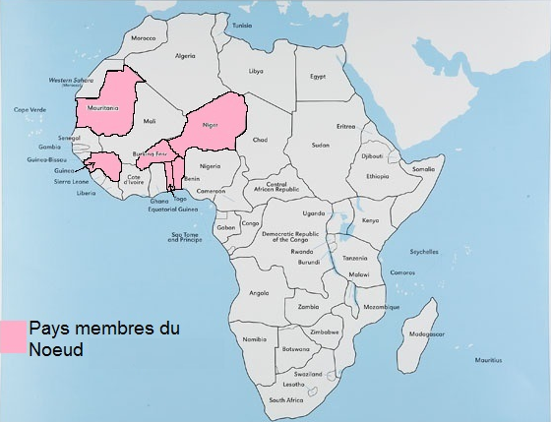






MS4SSA-NIGER Node
Activities done since May 2017
Benin Burkina Faso Guinea
Mauritania Togo Niger

Slide 2
Activities done since May 2017
Exchange and sharing of information with the academic authorities (Teachers-researchers of the ENS, the Rector/President of the University and the University Council) and politicians (Cabinet of Ministers);
Passage on June 26, 2017, live on Nigerien public television (“Télé Sahel”) at 8:30 pm at the time of the news as “Guest of the TV News” to explain the missions of the Node;
Share the results of the conference with the Nigerien Government (communication in Cabinet Council of the Primer Minister and Council of Ministers to the Presidency of the Republic). To this end, the Council of Ministers congratulated the MS4SSA team from Niger for this result;

Slide 3
Activities done since May 2017
Presentation of the project to the group of local education partners composed of TFPs and civil society;
Exchanges with other member countries of the Node;
Participation in several videoconferences with WPI and NJCTL;
Integration of the MS4SSA into the logical framework of the Multi-Year Expenditure Document (DPPD) of the Ministry of Secondary Education;
Funding of the MS4SSA Trainer Training Workshop and Training of Experimental Teachers by Ministry of secondary school;
Pilot schools have been chosen throughout the country;
Establishment and operationalization of the organizing committee of a workshop/training for participants from Node member countries from 17th to 24th June 2018.

Slide 4
Activities done since May 2017
The translation of the modules to be used during the training from 17th to 24th June 2018:
Translation strategy: It is provided individually by members of the MS4SSA team in Niger, each according to their disciplinary skills, supported by competent people in English;
What was done: the modules sent by the NJCTL and used during the training were identified and then categorized by discipline;
What's going on: These modules are being translated;
What has been discussed: the WPI modules to be translated are waiting;
Difficulties: No particular difficulties;
Alignment of curricula between French and English: NJCTL modules do not fully cover our programs throughout the 2nd level of secondary school (for the 1st level it is acceptable).

Slide 5
Activities to be conducted
Train an important pool (20 per country) of qualified trainers of trainers (Inspectors and Faculty members) in Mathematics and Science;
Train a significant number (120 per country each year) of secondary school teachers in post (1st and 2nd level of secondary schools) educational and disciplinary;
Training at the selected pilot schools will be provided by the trained secondary teachers under the supervision of the trainers of trainers (Inspectors and Faculty members) trained in the first place.

