Slide 1




MS4SSA Progress Update
Wole Soboyejo
Worcester Polytechnic Institute (WPI)

Slide 2
Initiation of MS4SSA Program
Idea of the MS4SSA program originated in 2015 from a discussion with Jee-Peng Tan at the World Bank
With the support of Sajitha Bashir and the World Bank Team (Hari, Toby, Ryoko, Saori & others) the idea has gone from concept to reality in 3 years
Key partnership with Bob Goodman and NJCTL team
First web-conference in November of 2016
Selection of African nodes in April of 2017
WPI Workshop between May 15th and May 26th 2017

Slide 3
Progress at WPI Workshop
Global best practices were presented by countries with recent success in STEM – Shanghai approach (China), JICA African programs and the Indian approach
NJCTL modules introduced along with social constructivism pedagogy and tools such as clickers
WPI’s Project-based modules introduced along with pedagogy of project-based learning
Training introduced K-12 STEM modules in mathematics and science (NJCTL) and WPI Project Based Learning, Robotics and Materials modules

Slide 4
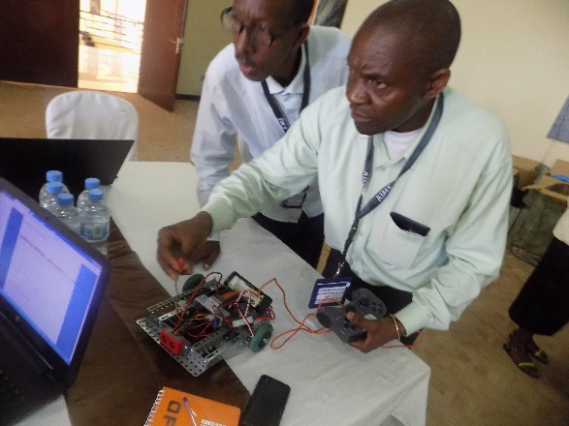

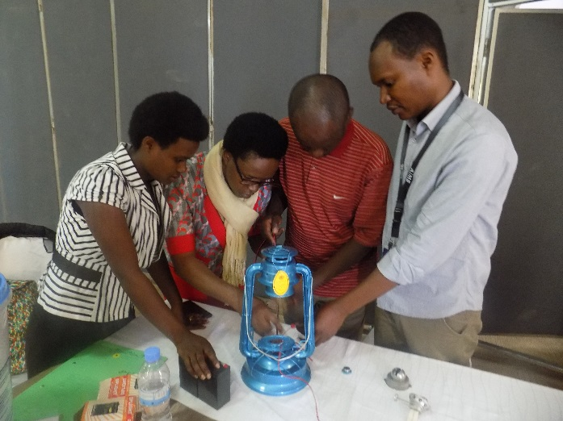
MS4SSA Progress Since 2017 Workshop
Launch of the Nigerian node in Abuja in July 2017
Launch of the Rwandan node in March/April 2018
In-country implementation in Rwanda since May 2018 – 30 schools (REB, AIMS, University of Rwanda)
Plans to initiate node in Niger in June 2018
Plans to initiate node in the Gambia in August 2018

Slide 5
Building the MS4SSA Backbone
Significant efforts to build the back-bone of the MS4SSA program
Links to African governments and stakeholders
Country initiatives – Mauritius, Lesotho, Gambia
Translation of modules and assessments into French - Niger
MS4SSA content development in Project-Based Learning and Robotics
Assessments and analyses of data + feedback
Development of implementation strategies – for nodes and countries

Slide 6
Implementation Strategy
MS4SSA to help with the initiation of African Nodes as they build their capacity to serve as nodes – Kim Hollan (MS4SSA contact)
Strategies for Nodes – Rwanda, Nigeria, Niger, Gambia
Key role of Gambia (NJCTL modules) and Nigeria (WPI modules) in the initiation of African nodes and countries
MS4SSA secretariat to help non-node African countries to initiate while the nodes build capacity – Carrie West (MS4SSA contact)

Slide 7
Objectives of Web Conference
Progress updates by the African nodes – Rwanda, Nigeria, Gambia and Niger
Assessment of initial data obtained from responses to questionnaires completed by trainers and teachers in selected African countries
Country updates from representatives of participtating African countries
Discussion and formulation of strategy for the next stage of the implementation effort

Slide 8



MS4SSA
Math and Science for
Sub-Saharan Africa
THANK YOU!
THANK YOU!

