Slide 1
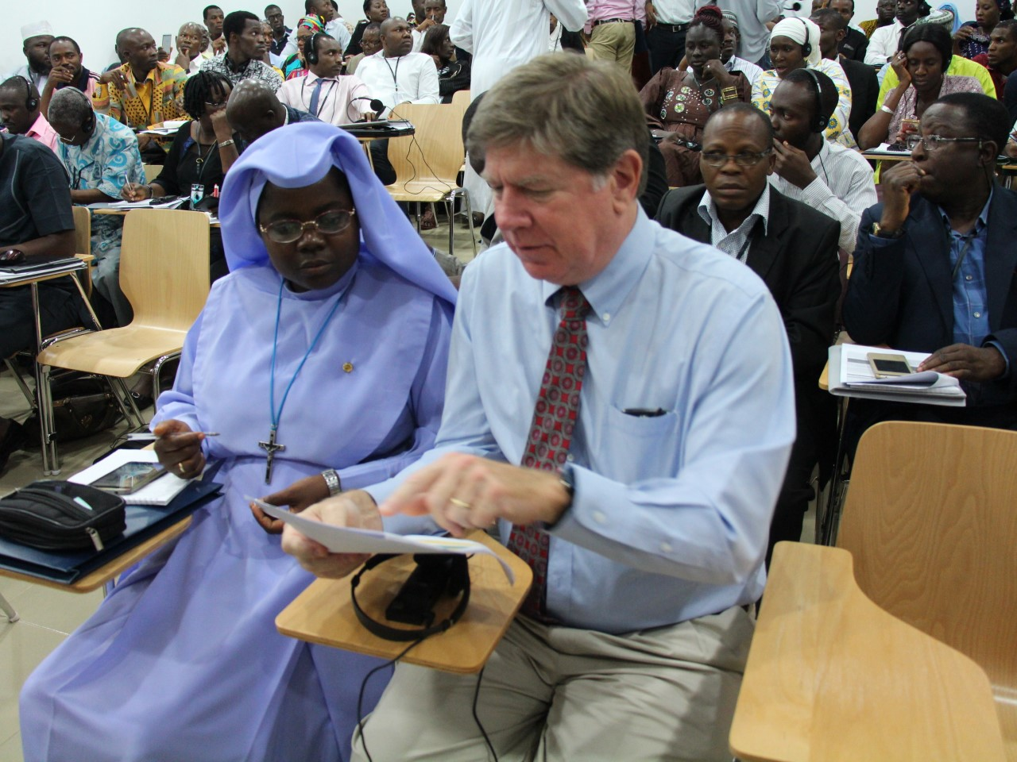
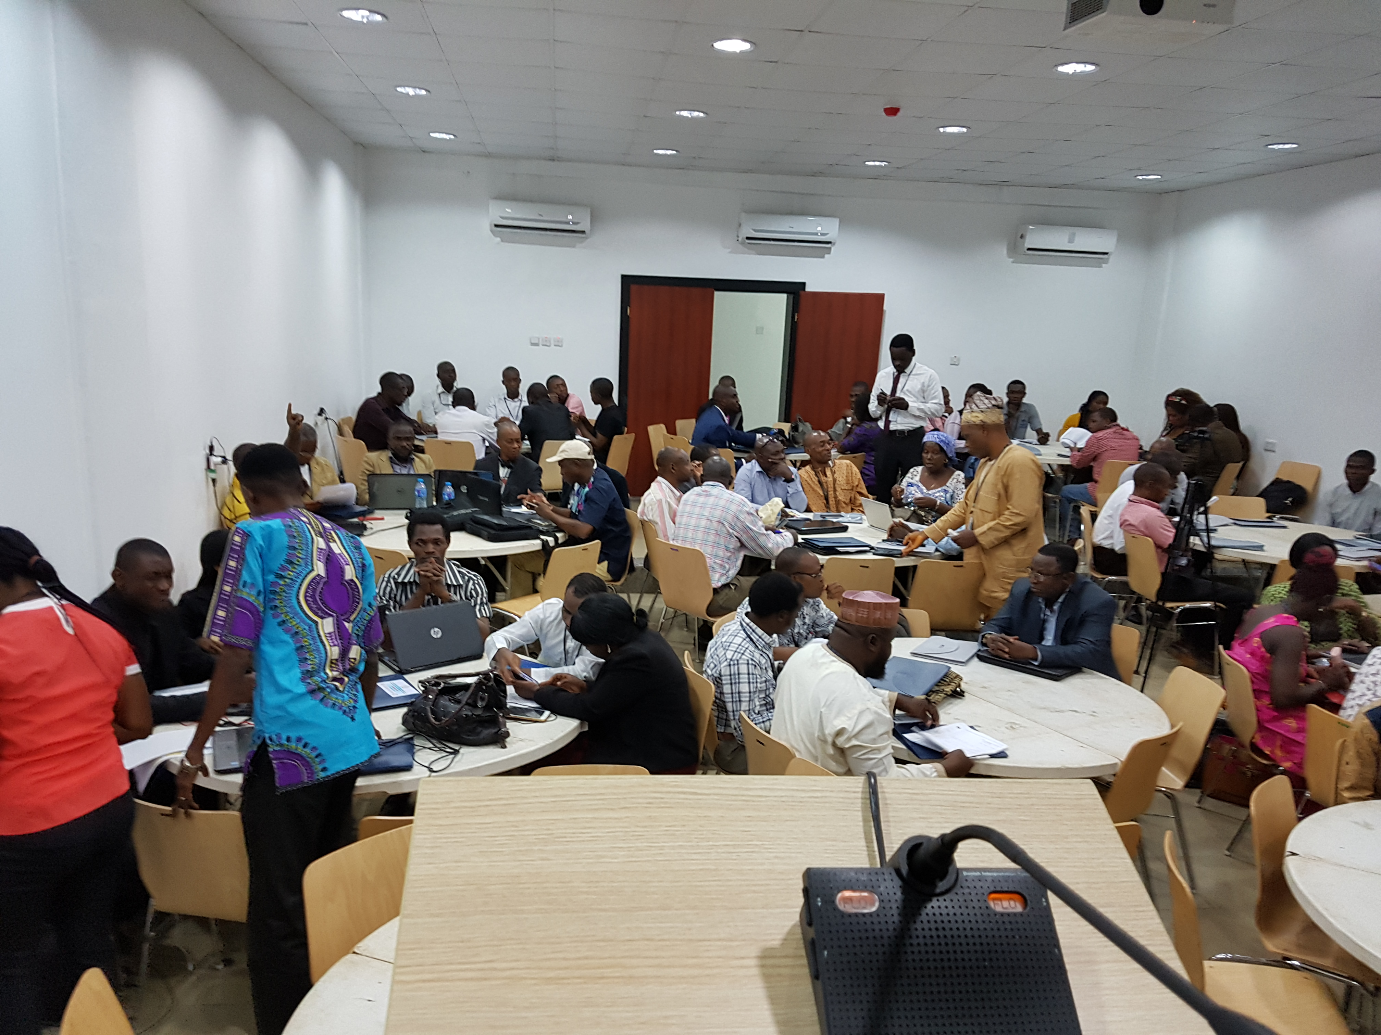
MS4SSA Nigeria Node was launched on 10th July, 2017

Slide 2
Simple organization
Nigeria as a node to promote MS4SSA in Nigeria!
Nigeria as a node capable of providing services to countries within its catchment
Nigeria as a node collaborating with other nodes for a continent-wide success plan
Learning from across the world.

Slide 3
Partnerships that make up the node
Pan African Materials Institute (PAMI) of the African University of Science and Technology (AUST), Abuja, Nigeria
College of Education Ikere Ekiti as a hub
Federal Capital Territory Administration Department of Science and Technology as a Hub.
Bauchi and Anambra states as catalytic regional hubs.
Teacher Registration Council of Nigeria (TRCN) as a Quasi-Government regulator for teacher certification
The Nigerian Academy of Science as a custodian of quality
Professional associations in Mathematics, Materials Research Society, Nigeria Union of Teachers(NUT), Nigeria Teachers Institute (NTI), Private sector (National Association of Proprietors of Private Schools, NAPPS) and Other STEM professional bodies as knowledge diffusion groups.
Science Teachers Association of Nigeria (STAN)
Parent-Teacher-Associations at all levels

Slide 4
Objectives simplified
What is the MS4SSA Nigeria node brand?
How do we show we are improving kids ?
How do we build credibility ?
How do we extract data and show that the training is effective?
How do we gain traction ?

Slide 5
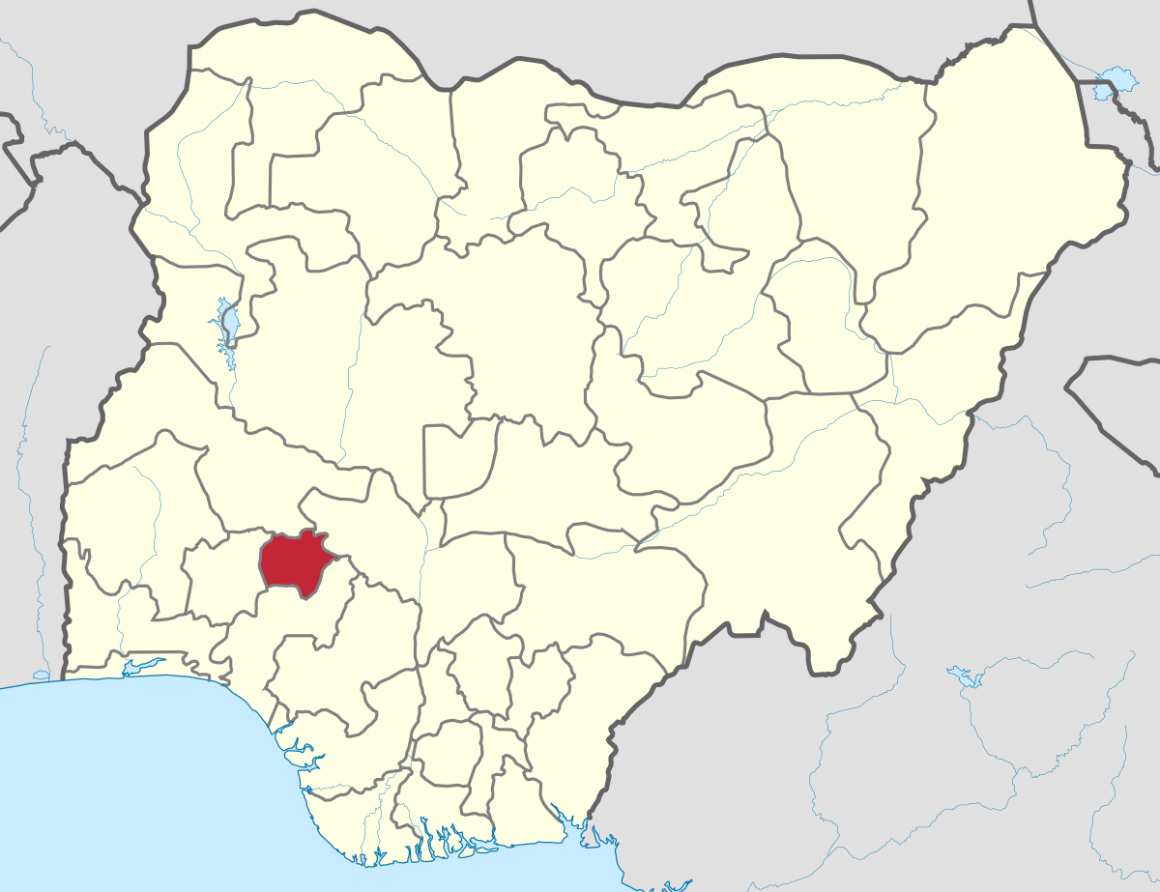
Ekiti State has commenced Pre-Practice Level Training for Teachers

Slide 6
What, How?
Which equipment is the best to deploy? Hand signals, or Clickers or Kindle?
System for data collection
- using big data analytics
- hierarchical structure with multiple layers of data
- Hierarchical data collection/feedback mechanism
Who pays for what?

