Slide 1
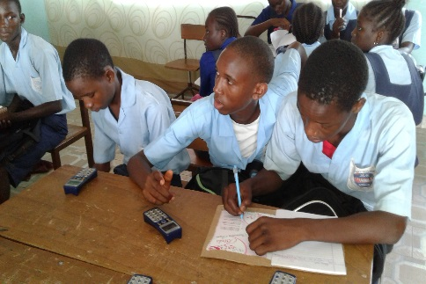
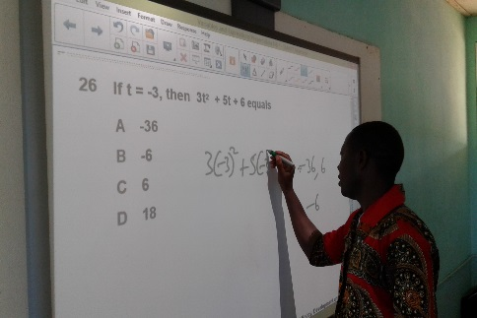
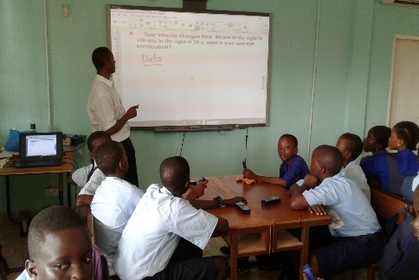

The Promise of the PSI-PMI in The Gambian Education System
Lessons on the Design, Implementations,
and Drivers of Impact

Slide 2
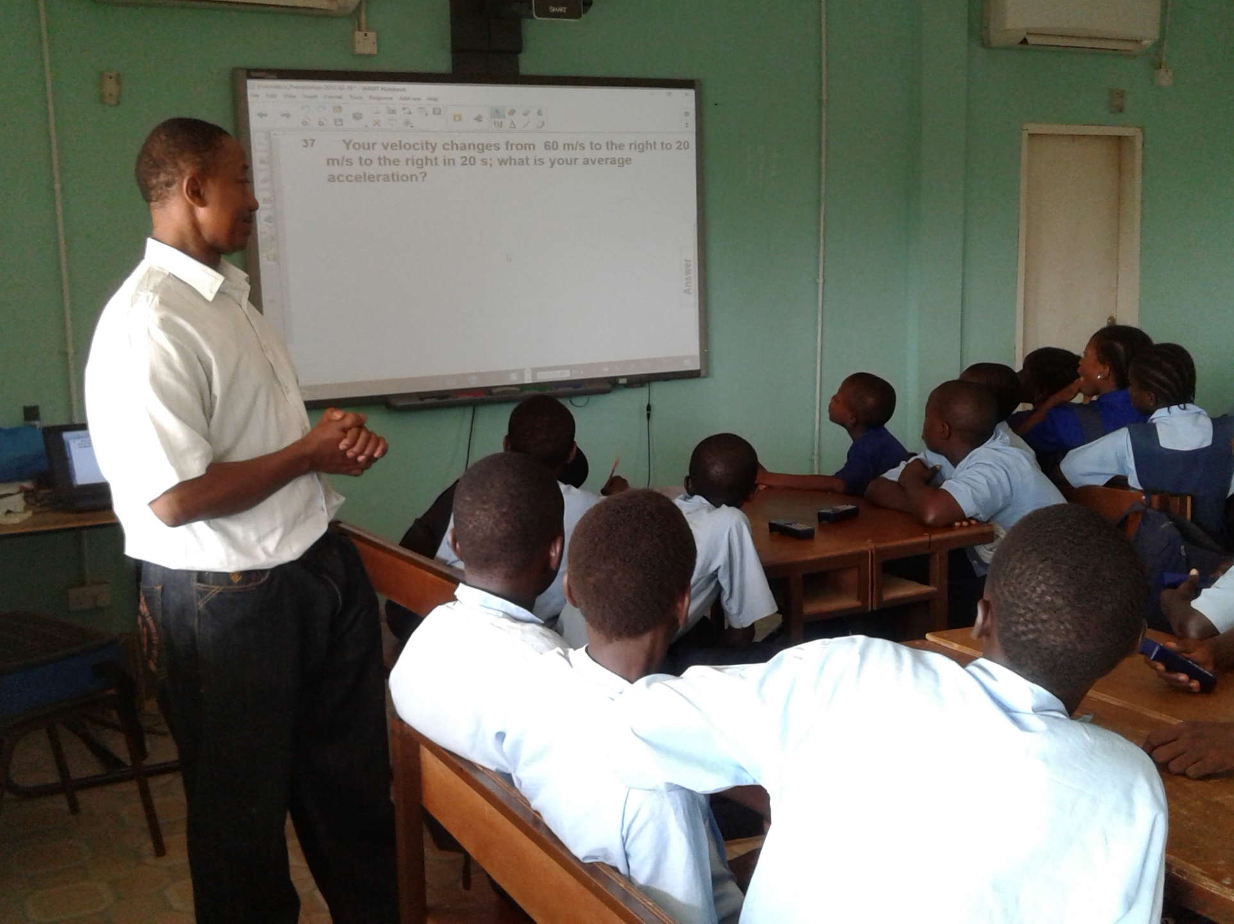
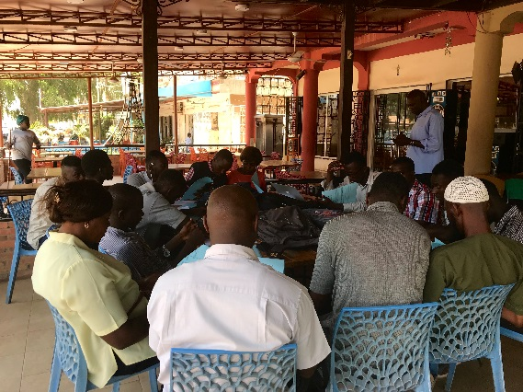

Background: PSI-PMI in The Gambia and this Study
PSI-PMI in Gambia
PSI-PMI pilot program started in August 2012; initially with 12 upper basic schools (UBS) and senior secondary schools (SSS)
Students’ instruction:
- January 2013, Cohort 1 (12 schools, region 1 and 2)
- January 2014, Cohort 2 (12 schools, from all regions)
- Currently, 3021 SSS students in total are PSI-PMI program students with 1301 in grade 10, 1296 in grade 11 and 424 in grade 12
16 SSS, 83 teachers, and 424 (SSS grade 12) students currently covered who have been exposed to the program for 3 years. – Reference Population of the study
About this study
Nature: Retrospective study to evaluate the program and draw lessons
Methodology: Constructed a comparable group through matching procedures
Objective: Focused primarily on how to make it work, rather than whether it works or not
Notes:
Note: PSI-PMI for Progressive Science Initiative and Progressive Math Initiative

Slide 3
Outline of this presentation Three set of questions explored
Are the design and the content adapted to the local context?
01
What are implementation challenges and what lessons can we draw?
02
Drivers of impact: Is the program improving learning? And how?
03

Slide 4
1. Design and Content
What has been done?
Prior to the teachers’ training, the NJCTL reviewed the mathematics and science curricula and determined that 90% of The Gambian curricula were covered by PSI-PMI program.
The Gambia Basic Education Certificate Examination (GABECE) was modified for PSI-PMI students (30 out of 40 questions were from the standard GABECE and 10 were from PSI-PMI courses).
The Ministry of Education and NJCTL created modules that are needed for the West African Senior School Certificate Examination.

Slide 5
1. Design and Content
Issues Identified
What can be done?
Majority of teachers (85%) see a significant gap between the content and the regular curriculum (more prominent, 92%, on science subjects)
Significant amount of breakdown of the equipment (especially the clickers, on average, only 61.9% of them are still functional; they are hard to be repaired or replaced locally)
Work with teachers and local experts to align PSI-PMI content with local curricula (content adaptation) from the beginning
Consider local environment/context for purchasing/manufacturing equipment (technology adaptation – need to anticipate causes of malfunction)
Ensure that teachers can add content without losing functionalities

Slide 6
2. Implementation and its challenges
Maintenance and dealing with technical failures
Lack of on site support (rely on a 1-person team at the ministry)
Need for replacement of equipment or know how to address minor breakdowns
Anticipating necessary complementary factors
Unreliable electricity – later addressed by provision of solar panels
That lack of laptop drags back the efficiency of class preparation by teachers
Printouts to students will prove very useful
Teacher training design should factor in initial know how with technology- not a one-size fit all (even more important when scaling up)
What has been done?
What has been done?
Extensive teacher training
Cohort 1 teachers: 7 trainings in total directly by NJCTL between August 2012 to Summer 2017
Cohort 2 teachers: NJCTL selected four top performers from cohort 1 (August 2013) and trained them as trainers. These teachers then trained cohort 2 under the supervision of NJCTL.
Cohort 3 teachers: MoBSE took over and use top performers from previous 2 cohort to train the third cohort (April 2016)
Gradual student coverage
About 26 students per school on average – not all students in a given schools can participate the program – mostly limited by lab size. (varied mechanism of selecting participant students)
Science and Technology Directorate at the ministry in charge of supervision

Slide 7
2. Implementation and its challenges
Issues Identified
What can be done?
Maintenance and dealing with technical failures
Lack of on site support (rely on one person at the ministry)
Need for replacement of equipment or know how to address minor breakdowns
Anticipating necessary complementary factors
Unreliable electricity – later addressed by provision of solar panels
That lack of laptop drags back the efficiency of class preparation by teachers
Lack of printouts to students
Teacher training design should factor in initial know how with technology- not a one-size fit all (even more important when scaling up)
Enable timely and local maintenance of the equipment periodically
Address the problem of unreliable electricity (e.g. Solar panels in The Gambia)
Provide sufficient equipment and supporting materials (e.g. guidelines, books) in time to the school
Prior to the subject training, provide computer skills training to the program teachers, especially for those who do not have familiarity with the computer/technology
Consider technology training at teacher colleges

Slide 8
3. Impact and its drivers
Maintenance and dealing with technical failures
Lack of on site support (rely on a 1-person team at the ministry)
Need for replacement of equipment or know how to address minor breakdowns
Anticipating necessary complementary factors
Unreliable electricity – later addressed by provision of solar panels
That lack of laptop drags back the efficiency of class preparation by teachers
Printouts to students will prove very useful
Teacher training design should factor in initial know how with technology- not a one-size fit all (even more important when scaling up)
What we found?
Practices, attitudes, and perceptions
Teachers
Favorable views by overwhelming majority despite the issues identified (over 80% math teachers and 95% science teachers)
Majority of teachers with negative views are those with less teaching experience (9 years vs 3 years)
Greater interaction and participation are observed as the most prominent features that teachers point out. (also helps in simplifying course materials and preparation)
Students
Self-reported great interest in the subject due to participating PSI-PMI program
Learning outcomes
The PSI-PMI program students scored 21% higher on a math test relative to non-PSI-PMI comparable group of students from non PSI-PMI matched schools
They scored about the same magnitude higher than comparable group of students in the same schools who are not taking PSI-PMI
Students in PSI-PMI schools who did not take PSI-PMI scored the same as students in non-PMI-PSI schools
Who benefits most: The effect is driven entirely by students who are higher baseline performers (better performance in GABECE Math- grade exit exam) and the effect seems not to be driven by socioeconomic factors

Slide 9
3. Impact and its drivers
Next Steps
What can be done?
Confirm impact results with WASSCE
Assess why does it benefit only high performers and what can be done on it?
Be aware that all results indicate that the program benefits mostly high performers and may be detrimental to the poorest performers (need to identify the causes in the implementation, especially with teachers)
Design pilot programs so that you can learn from it (sampling etc.)

Slide 10
Key takeaways and recommendations
Overall promising but potential concerns about equity on learning
Impact Drivers
Be aware that all indicates that it benefits mostly high performers (need to identify the causes in the implementation, especially with teachers)
Design pilot so that you can learn from it (sampling etc. )
03
Impact Drivers
Prior to the subject training, provide computer skills training to the program teachers, especially for those who do not have familiarity with the computer/technology
Provide sufficient equipment and supporting materials (e.g. guidelines, books) in time to the school
Enable timely and local Maintenance of the equipment periodically and on need.
Address the problem of unreliable electricity by providing solar panel or generator
02
Implementation
Implementation
01
Design
Design
Work with teachers and local experts to align PSI-PMI content with local curricula (content adaptation) from the beginning
Considering local environment/context when for purchasing/manufacturing equipment (technology adaptation)
Ensure that teachers can add content without losing functionalities

Slide 11
Annex 1: Heterogeneous Impact of PSI-PMI
Note: GABECE score in reverse order

Slide 12
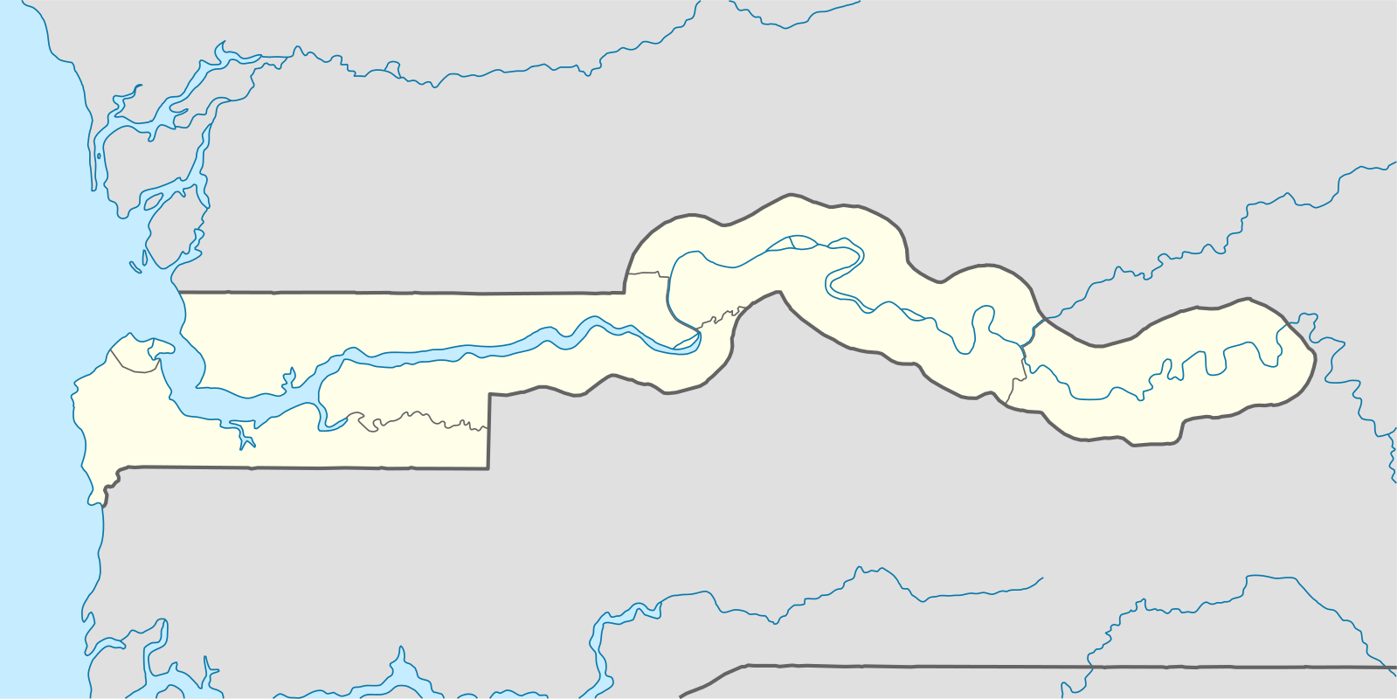
Annex 2: PSI-PMI Program Schools in The Gambia
3
7
6
12
5
2
1
9
8
50 km
1 Fatoto UBS/SSS
2 Diabugu UBS/SSS
3 Niani SSS
4 Kaur SSS
5 Tahir Ahamadiyya SSS
Njaba Kunda UBS/SSS
Essau SSS
Mayork SSS
9 Siffoe UBS/SSS
10 St. Peter's UBS/SSS
11 July 22nd Academy
Kotu
Nusrat
Muslim SSS
St. Joseph’s SSS
Gambia SSS
Note: Schools # 11-16 are located in region 1, in red rectangular in the map

