Slide 1
Center for Imaging and Sensing (CIS)
Raunak Borwankar, Ian Costanzo, Gene Bogdanov, Sasidhar Tadanki, Reinhold Ludwig
ECE Department
Worcester Polytechnic Institute
100 Institute Road
Worcester, MA 01609
Phone: 508-831-5231
October 10, 2017

Slide 2
Center Organization
Objective
To assist our industrial partners in their quality assurance and imaging requirements
What we deliver
Inspection and imaging methodologies
Fundamental sensor and instrumentation research
Turn-key prototype system development
Circuit design, simulations, layouts
Organization
Two full-time ECE faculty
Funded graduate research assistants
ECE software/hardware tools, shop resources

Slide 3
Approach
Regular meetings with our partners
Company-specific research updates
Demonstration of prototypes
Presentations by undergraduate/graduate project students
Use of industry standard tools
HFSS, ADS, Matlab, SolidWorks, etc.
Dissemination of research
Research reports
Conference/journal publications
Student theses

Slide 4

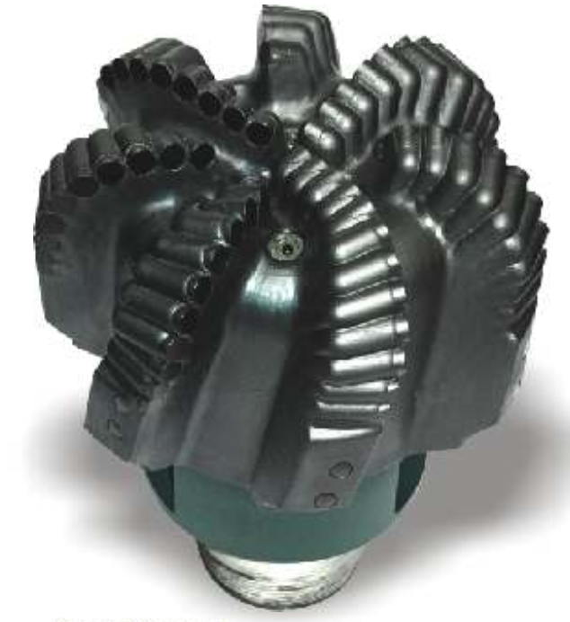
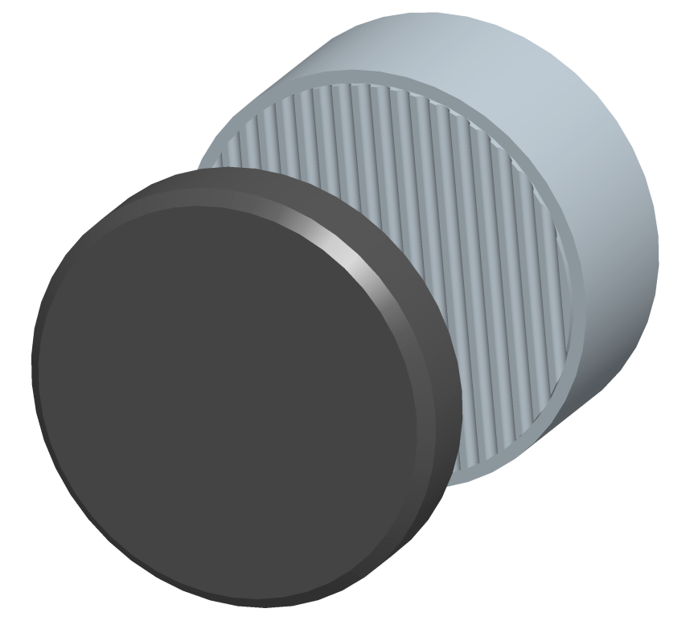
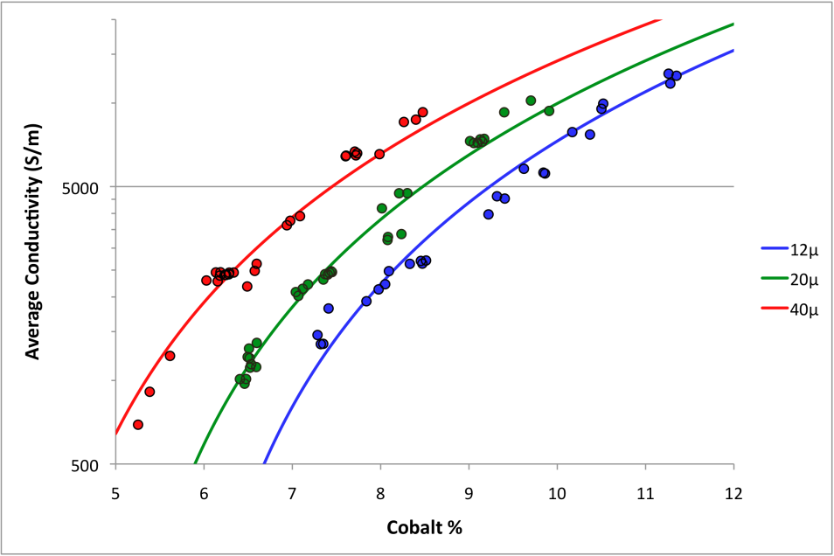
1st Example: Electrical Impedance Tomography (EIT) of Polycrystalline Diamond Cutters
Problem description
Have to characterize cutter performance nondestructively
Need to detect hidden defects in a cost-effective way
Approach
Measure electrical conductivity
Diamond table conductivity depends on residual metal content
Metal content is correlated with cutter performance characteristics
Localized conductivity measurement can detect defects (metal-rich zones, cracks)
Tungsten Carbide Substrate
Polycrystalline Diamond
PDC Bit

Slide 5
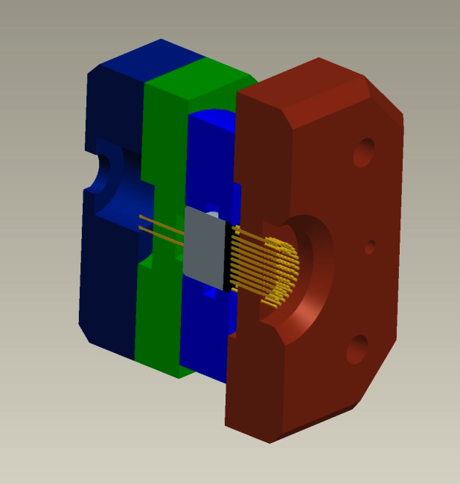
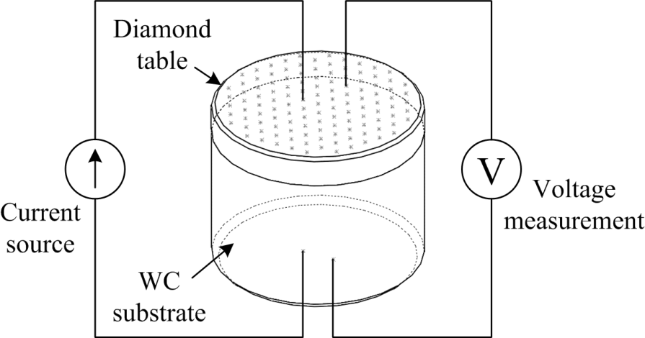
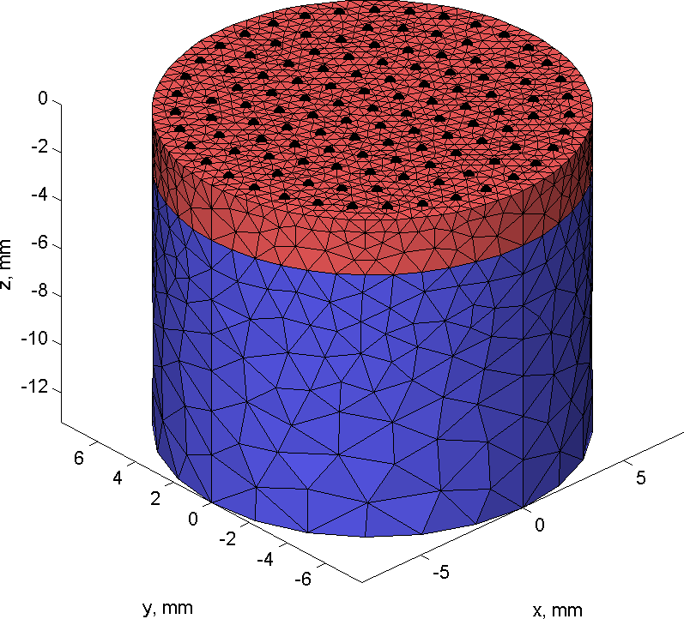
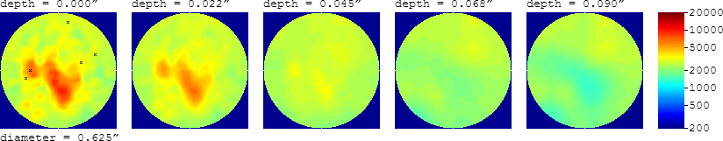
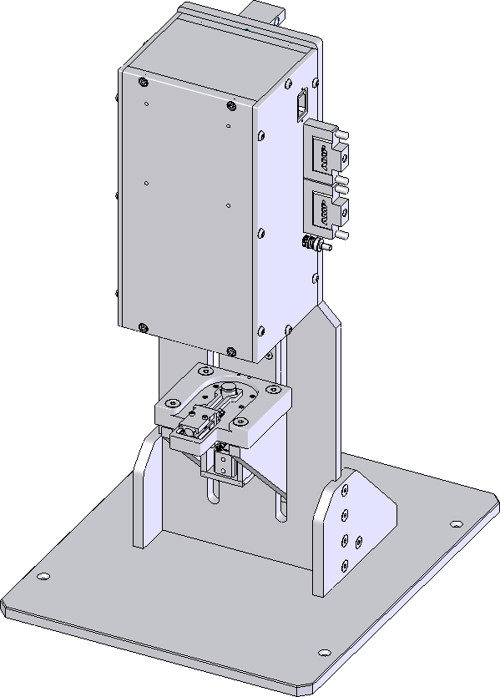
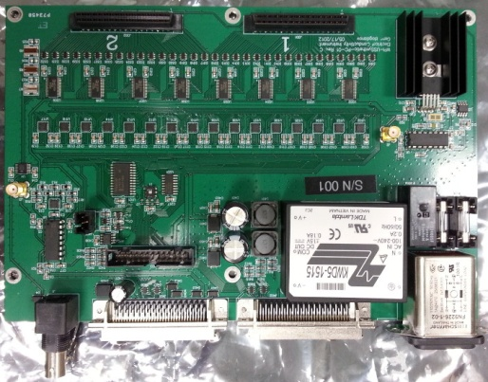
EIT System Development
What we built
EIT data acquisition system
Sensor with 120+2 pogo pins
Analog front end (custom PCB)
Pneumatic system for placing cutter in contact with the sensor
Machine vision system for diamond table thickness measurement
Custom-developed 3D EIT software
FEM forward solver
GPU-accelerated iterative inverse solver
Outcomes
Two machines in industrial use for more than 5 years
Conductivity dataset acquired and reconstructed in 5 sec
1 journal paper, 3 conference papers
1 patent granted
~3000 measurements
Conductivity reconstruction is a nonlinear
inverse problem with ~3000 unknowns

Slide 6
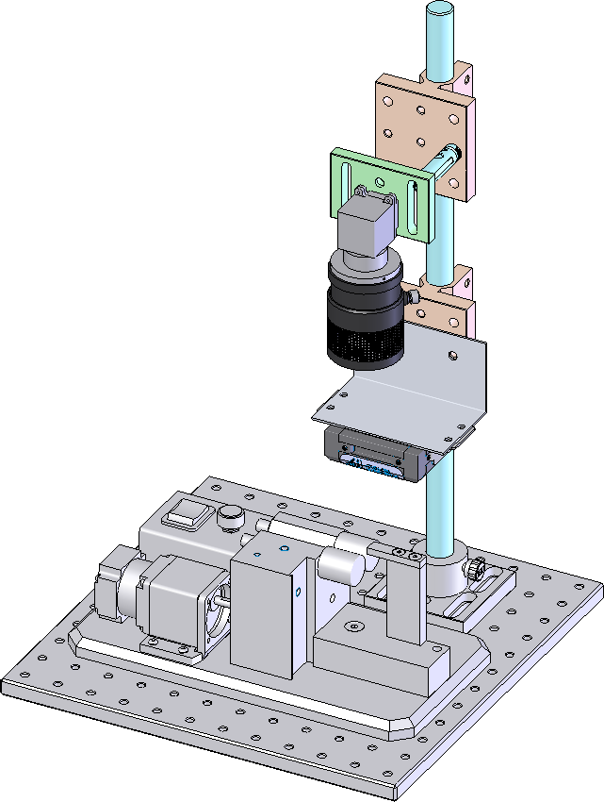
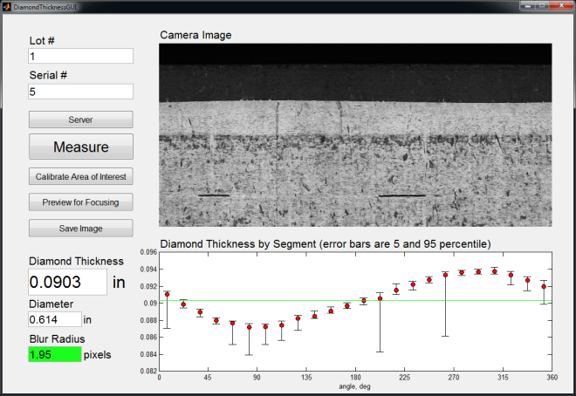
2nd Example: Machine Vision System for Diamond Thickness Measurement
Problem description
Diamond cutter EIT requires diamond thickness for quantitative conductivity measurements
What we built
Machine vision system using specular reflection contrast
Cutter is rotated by an existing roller system
Full rotation is detected by image correlation
Blur radius measurement for focusing
Outcome
One prototype in use and coupled to one of the EIT machines

Slide 7
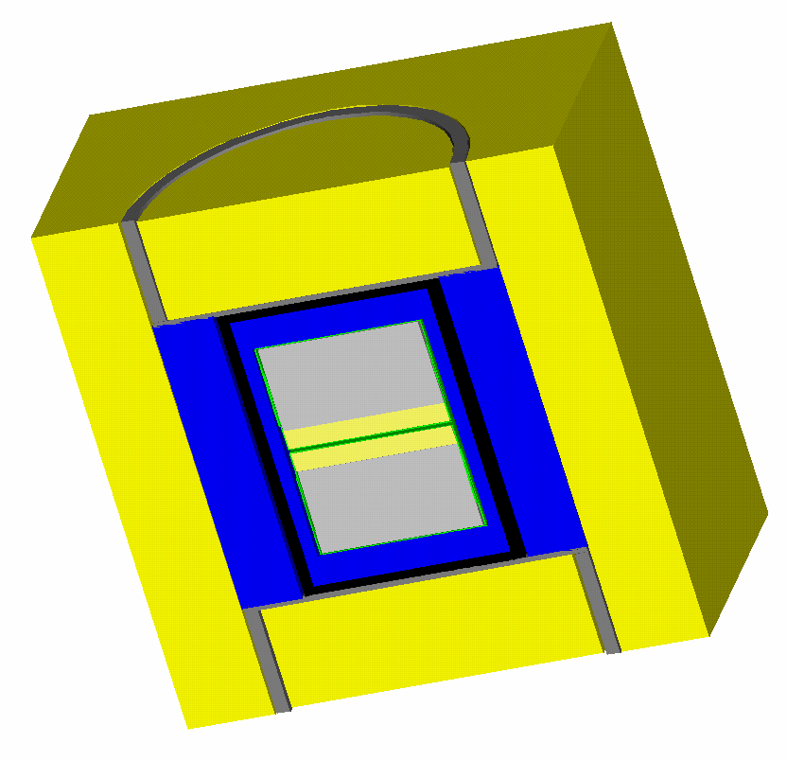
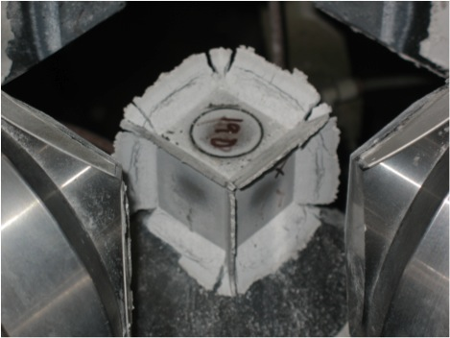
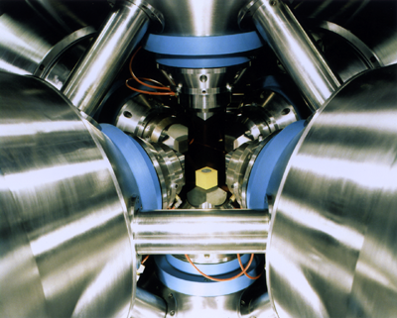
3rd Example: High-Pressure Gasket Moisture Content Measurement
Problem description
Soft material is used as a gasket and pressure transmission medium
Excess moisture gasket can cause failure during decompression
Potential catastrophic damage to press anvils
Need a nondestructive method of monitoring gasket moisture content
Approach
Electric RF field/moisture interaction
Pressure cell assembly
Pyrophyllite
Cube (gasket)
Steel
Current Ring
Metal Disc
Salt Bushing
Heater Assembly

Slide 8
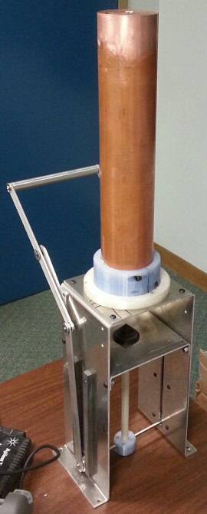
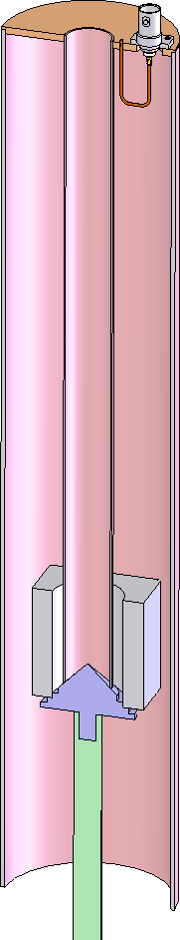
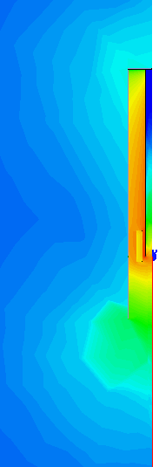
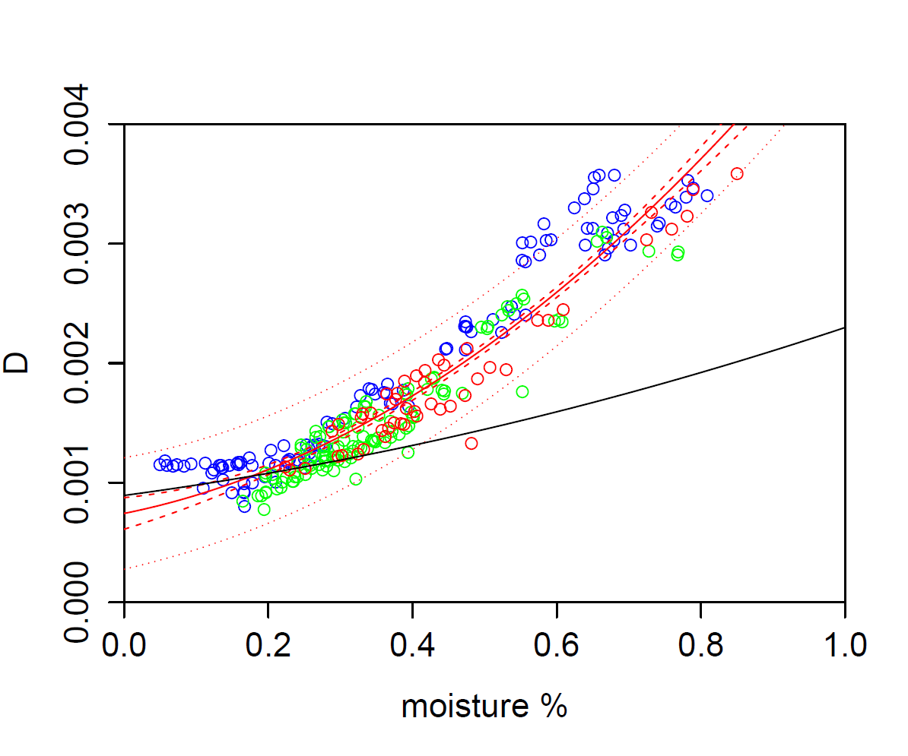
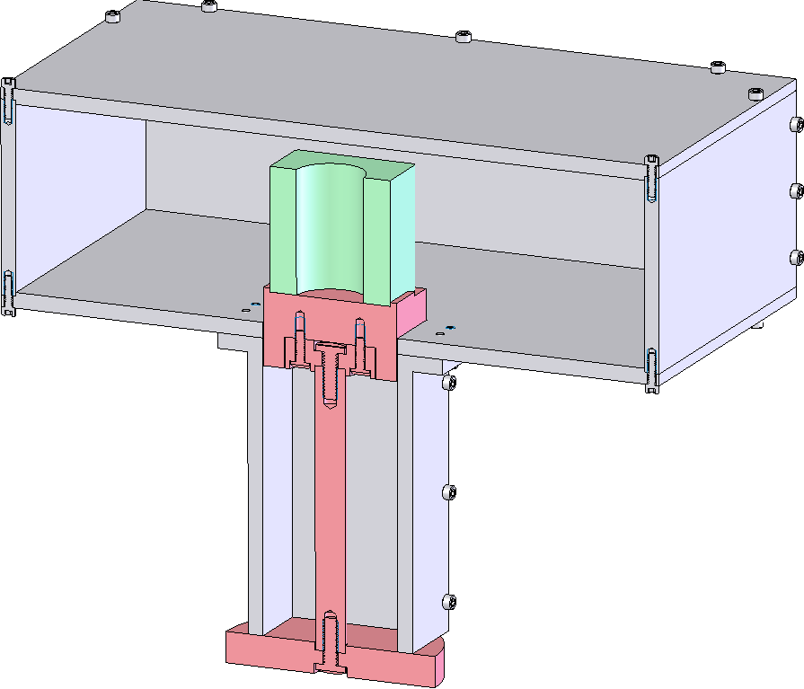
High-Pressure Gasket Moisture System
What we built
Coaxial resonator sensor
Sample loader
Rapid moisture content estimation software
Experimental multimode cavity sensor
Outcomes
5 moisture meters installed at our industrial partner
3 QNDE papers
1 patent application filed
experimental
sensor

Slide 9
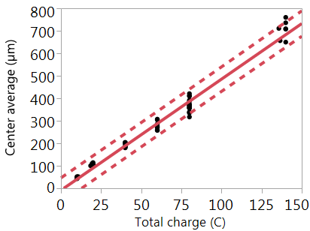
4th Example: Electrochemical Leaching of Polycrystalline Diamond
Problem description
Metal must be removed from polycrystalline diamond to a certain depth to meet performance specifications
Existing process using HF-HNO₃ mix is slow, inconsistent, prone to yield issues, and dangerous
Our partner needs a replacement process
Approach
Electrochemical metal removal
Amount of metal is related to accumulated charge
Nontoxic chemicals
Citric Acid
(-) electrode
Co²⁺
Masking
Voltage
Source
(+) electrode
e⁻
HEAT

Slide 10
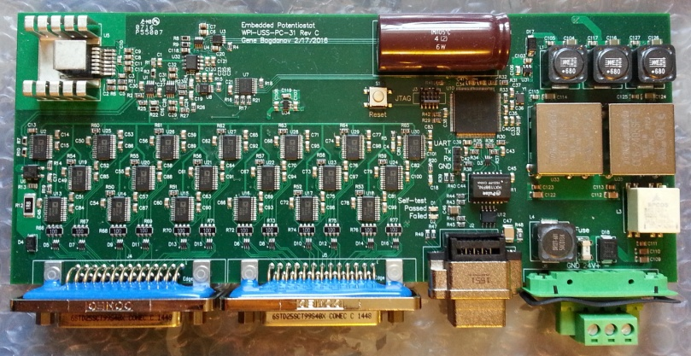
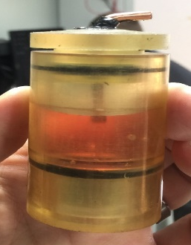
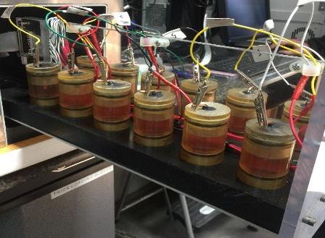
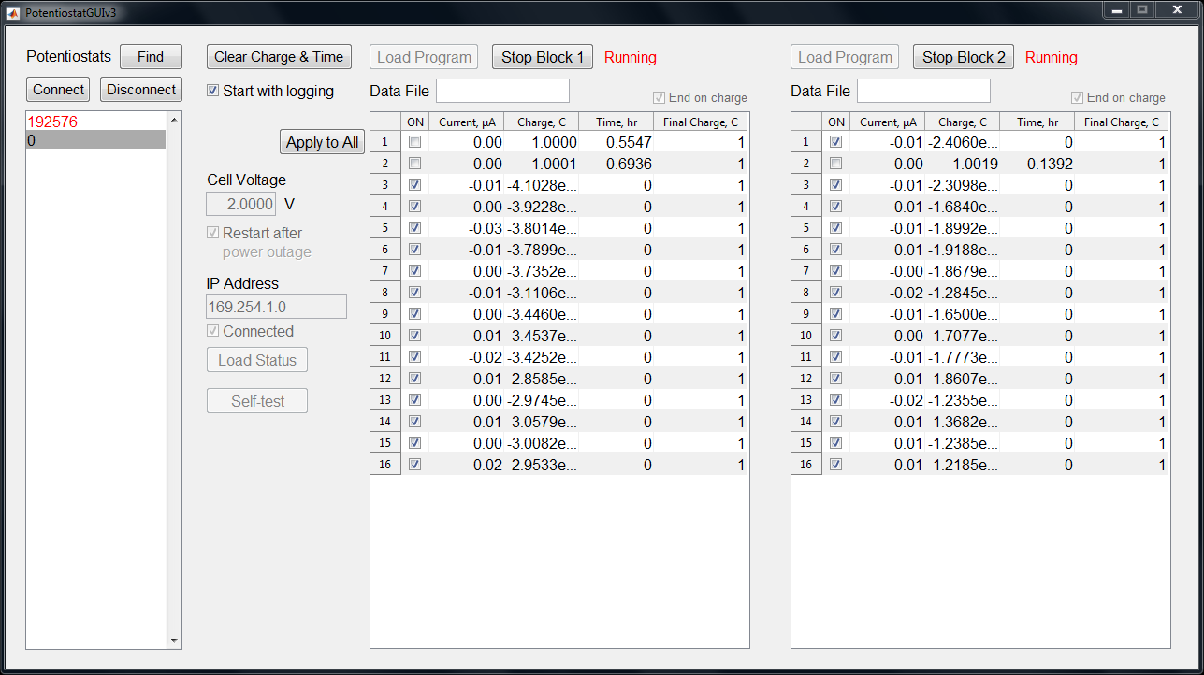
Electrochemical Leaching System
What we built
Multichannel (48-channel) potentiostat
Applies voltage to cells
Measures current in each leaching cell
Accumulates charge
Stops current when reaching calculated charge level
Ethernet connectivity
Central control software for large number of potentiostats
Individual cutter cells (jointly developed)
Oven for heating cells (jointly developed)
Outcomes
6 potentiostat prototypes deployed (24, 32 and 48-channel versions)
Large amount of data collected
1 patent application filed

Slide 11
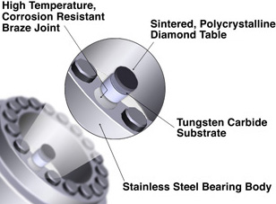
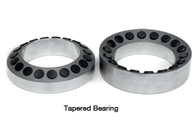
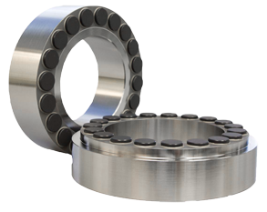
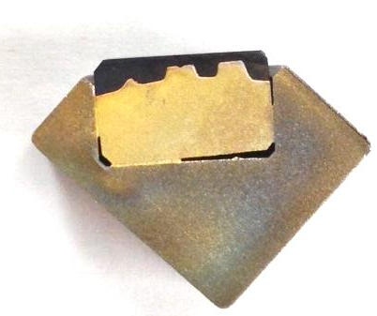
5th Example: Lock-in Thermography for Bearing Braze Joint Inspection
Problem description
Bearings for well drilling use polycrystalline diamond
Diamond-tipped inserts are brazed into the bearing body
Poor braze joints cause premature failure
Need a nondestructive braze joint inspection
Approach
Low braze joint area results in weak thermal contact with the body
Measure thermal conduction from inserts to the body via lock-in thermography

Slide 12
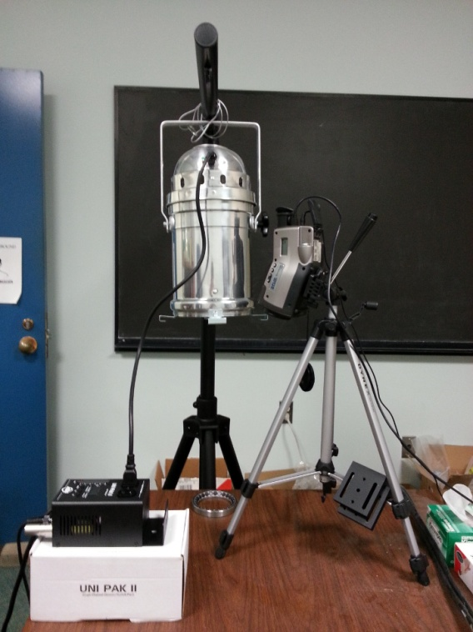
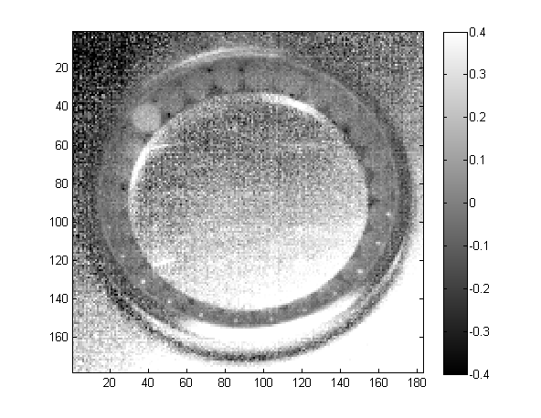
Bearing Braze Joint Inspection System
What we built
Lock-in thermography system
Heating by 1000 W halogen lamp
Sinusoidal modulation of lamp output
IR camera images surface temperature evolution over time
Software to compute phase shift between heat source and temperature
Robust measure of thermal diffusivity
Outcomes
1 prototype constructed
Successfully detected 1 bad braze joint in a limited number of samples

Slide 13

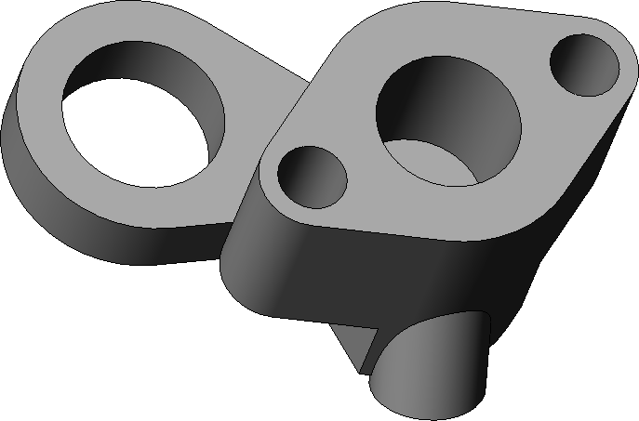
6th Example: Bore Inspection
Problem description
Need to detect surface-breaking pores with resolution of 100µm in diameter on bore wall
Approach
Machine vision
Specular reflection contrast
Bore wall strongly reflective
Pores less reflective
Fast, low cost
No sophisticated part manipulation (e.g. rotation-translation)

Slide 14
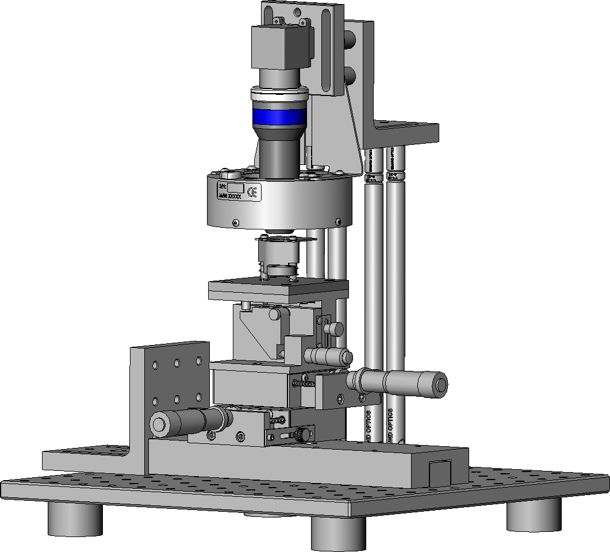
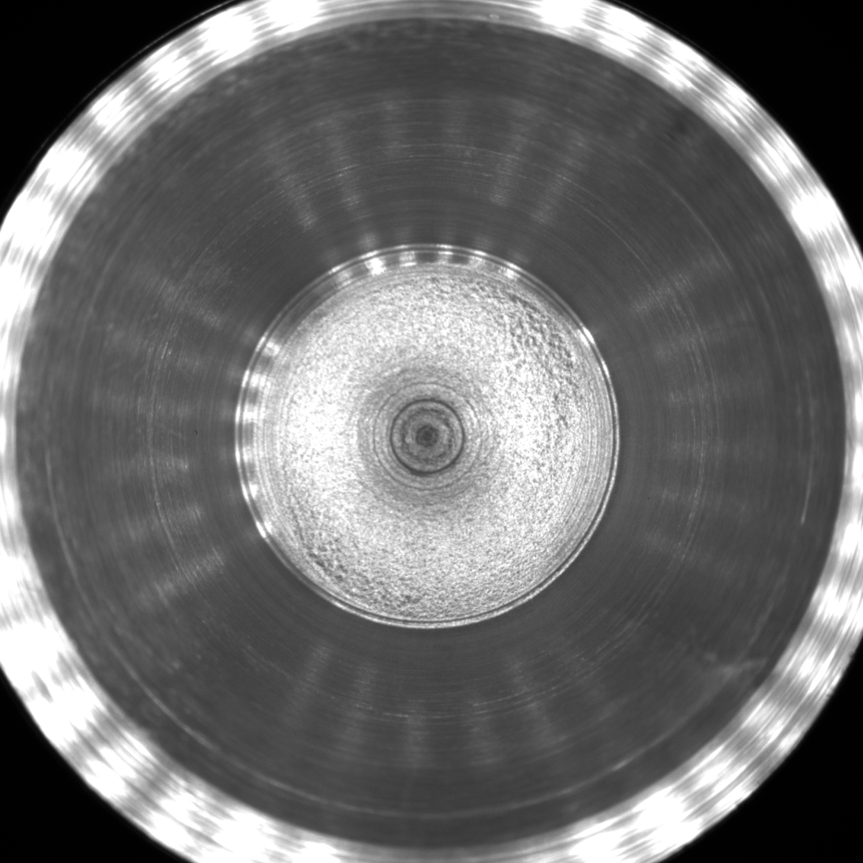

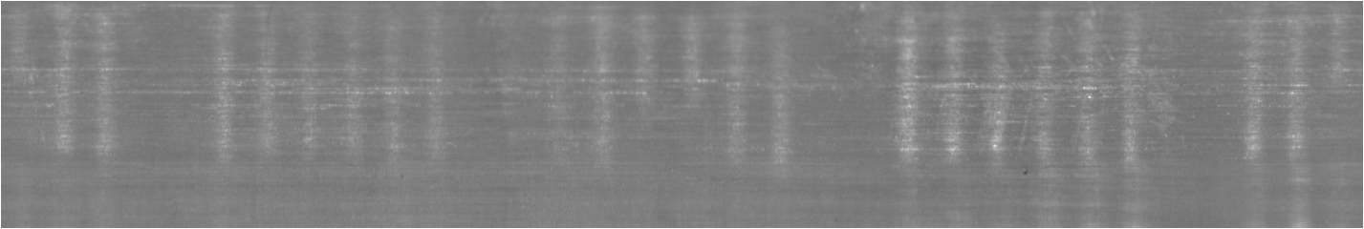
Bore Inspection System
What we built
Imaging system
High-resolution 5 MP camera
Wide angle, short standoff lens
Ring light illumination
Sample loader
Image processing software
Bore wall unwrapping
Defect detection
Outcomes
Simulated pores detected on wide-bore (0.452”) parts
Parts modified: rough bore bottom
Revision is under development to improve contrast
Axial illumination
Camera
Lens
Ring light
Sample
xyz stages
Slide
unwrapped bore

Slide 15
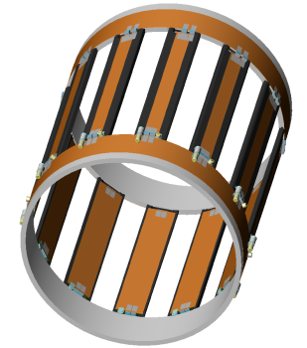
7th Example: Magnetic Resonance Imaging Dual-Tuned Head Coil
Problem description
Demand for dual-tuned clinical MRI transmit/receive head coils for sodium (²³Na) and hydrogen (¹H) at 3T for stroke imaging
Wide frequency separation between ²³Na at 34 MHz and ¹H at 128 MHz
Higher frequency circuits inhibit the performance at the lower frequency, which is most critical
Approach
Experimental coil design
Birdcage at low frequency (34 MHz)
TEM-like coil at high frequency (128 MHz)

Slide 16
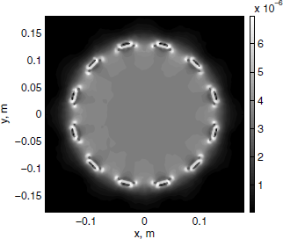
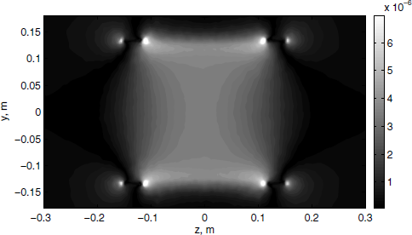
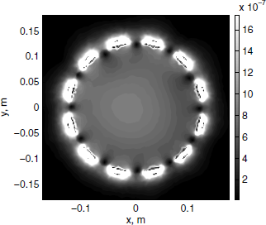
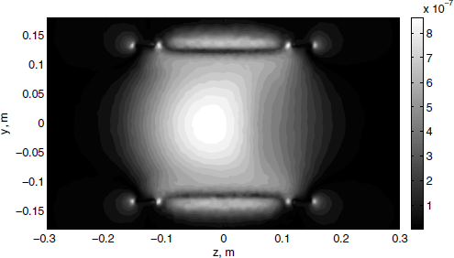
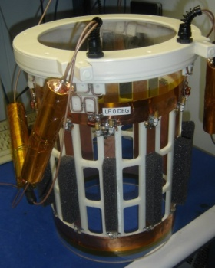
MRI Dual-Tuned Head Coil
What we built
Simulated competing coil designs
Experimental birdcage-TEM coil
Typical dual-tuned birdcage coil
Dual-tuned TEM coil
Built and tested a prototype birdcage-TEM coil
Outcomes
NIH SBIR grant awarded
Prototype performed similarly to simulation
B₁ field with load:
top – 34 MHz (²³Na)
bottom – 128 MHz (¹H)

Slide 17
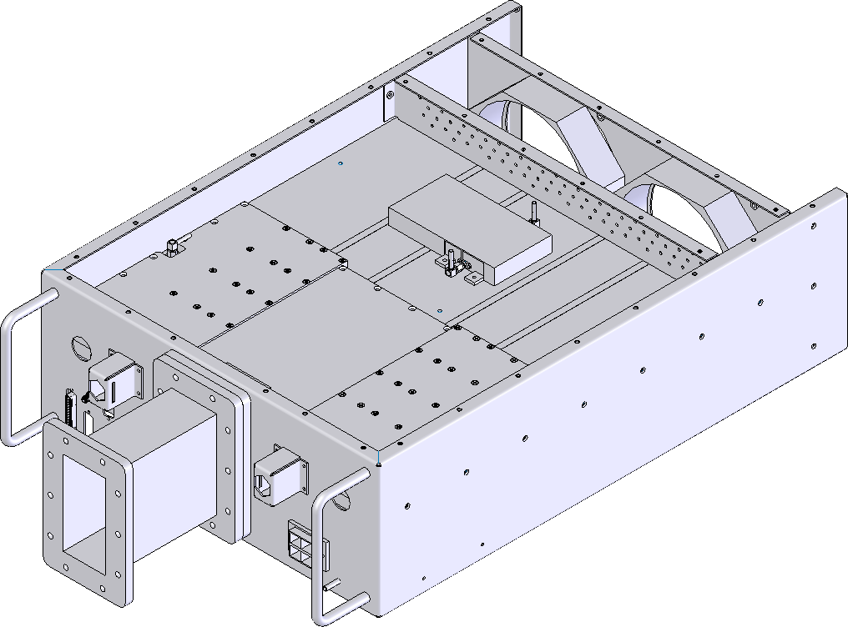

8th Example: Solid-state 2 kW 2.45 GHz Microwave Generator
Problem description
Semiconductor industry looking to replace magnetron MW generators with solid-state versions
More controllable and reliable
Challenges
small package (4U rackmount)
waveguide output
efficient, pulsing capable
low cost, short development time
Approach
Combine outputs of eight 330 W solid-state power amplifier modules

Slide 18
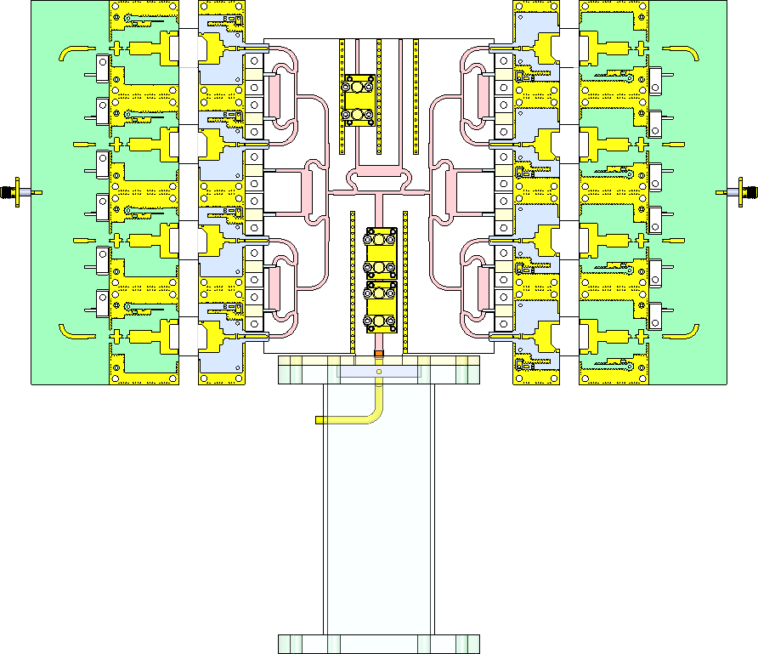
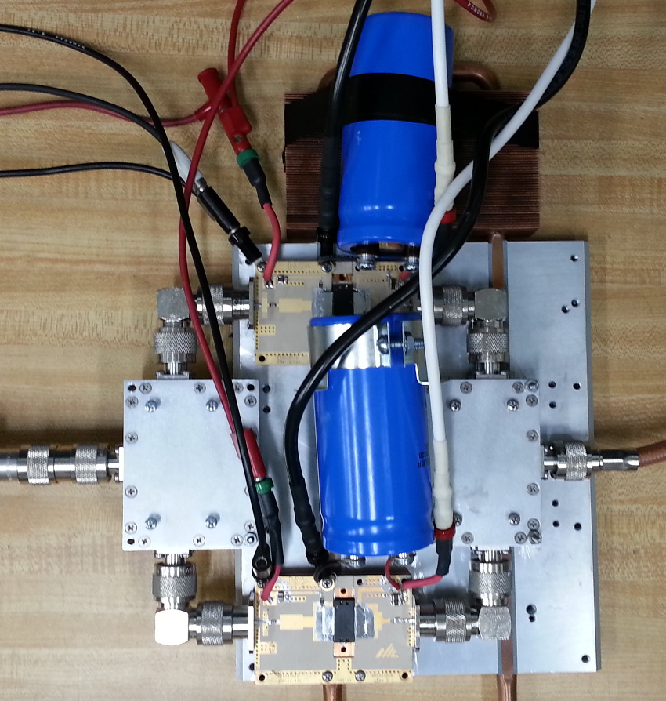
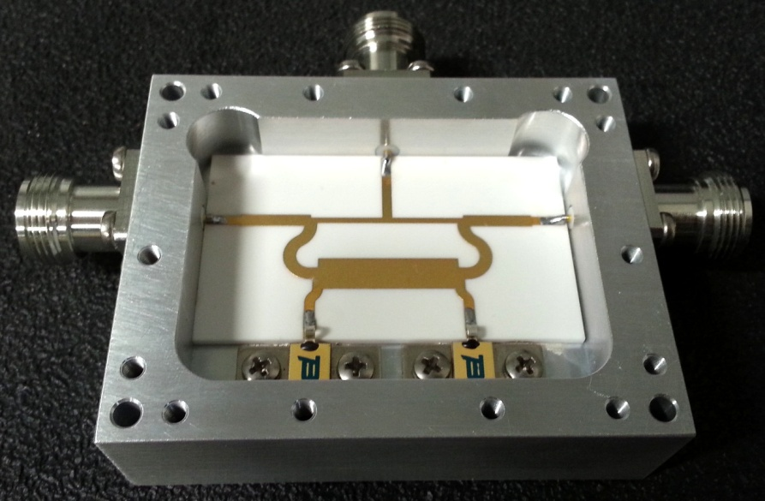
Solid-state Microwave Generator
What we did
Designed output stage with custom MW components:
power combiners
power dividers
directional couplers
waveguide transition
Tested 2-way combined 330 W modules
Outcomes
2-way prototype performed well
up to 550 W output
no oscillation
pulsing capable
8-way output
stage layout
2-way combined prototype
custom 2-way combiner

