Slide 1
Good vs. Bad Debt
James A. Valis, CFP®
Financial Advisor and Founding Partner
Securities offered through LPL Financial, Member FINRA/SIPC. Investment advice offered through Private Advisor Group, a registered investment advisor. Private Advisor Group and Blackstone Valley Wealth Management, LLC. are separate entities from LPL Financial.
Notes:
Thank you all for being here. Today I hope to provide you with an understanding of the basics of debt; the good, the bad, and the ugly. As we go through the presentation, please feel free to ask questions or ask for clarification on anything discussed. I may defer some questions that require a more detailed answer to the end.

Slide 2
Topics of Discussion
Credit and Good Habits
The Debt Difference: Good vs. Bad
How Much is Too Much Debt?
Manage & Minimize Debt (including student loans)
Budgeting Basics

Slide 3
Building Credit
Apply for a secure credit card
Backed by a cash deposit you make up front; the deposit amount is the amount of your credit limit
Use the card to buy things, make payment before due date each month
Apply for a credit-builder loan
Forced savings program
Money borrowed is held by the lender and not released until loan is repaid
Get a co-signer
Parent or other trusted individual who will help back you while you build credit
Become authorized user on someone else’s credit card
Get credit for the rent you pay
Use a rent-reporting service to put history on your credit report
Notes:
Before we discuss good and bad debt, let’s talk about building credit. Part of building credit is showing lenders that you can be responsible for a loan of sorts, and that if they lend you something, you can pay it back. If you have no history, it can be tricky to begin building credit. Here are some options that can help you build credit and establish yourself as a worthy lendee.
To have a FICO score, for example, you need at least one account that’s been open six months or longer, and you need at least one creditor reporting your activity to the credit bureaus in the last six months.

Slide 4
Build Your Score with Good Habits
Make all payments on time for all bills
Keep credit card debt low
Pay balance in full each month if possible; do not let debt balance exceed 30% of your credit limit
Don’t open too many new accounts at once
Keep accounts open as long as possible
Check credit reports annually for errors and discrepancies
Notes:
Building a good credit score takes time, probably at least six months of on-time payments.
Practice these good credit habits to build your score and show that you’re creditworthy.
Generally, to build credit, you have to incur some sort of debt. There is however, a difference between good and bad debt.

Slide 5
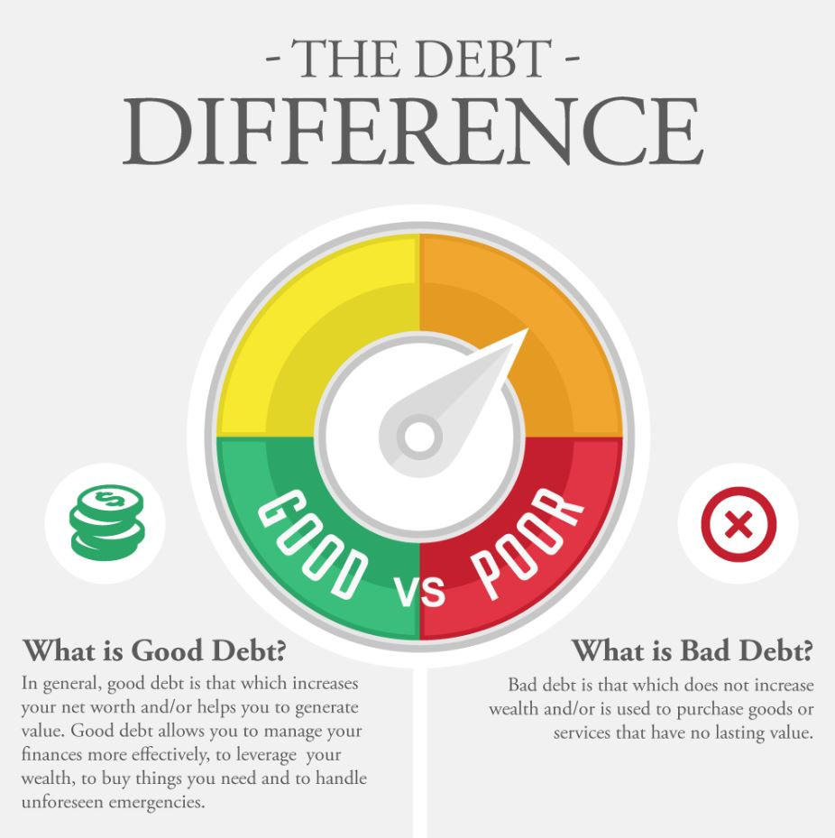
Notes:
By definition, debt is simply the process of one party borrowing money from another party. And for most of us, debt is a necessary part of life. We borrow money so that we can buy goods or services that we could otherwise not afford right now. We borrow with the promise and expectation of repaying the borrowed funds sometime in the future – a time when expect to have money to do so.
In this sense, all debt is the same: We take now and we give back in the future. But because debts can have positive or negative consequences, they are typically thought of as a good debt or a bad debt.
That reality makes it wise for all borrowers to weigh their overall balance of good debt vs. bad debt.

Slide 6
What is Good Debt?
Good debt is that which increases net worth and/or helps generate value
Allows you to manage your finances more effectively, leverage wealth, and to buy things you need, handle unforeseen emergencies
Examples:
Real estate
Borrowing but saving time and money
Investing to increase future earnings (EDUCATION)
Entrepreneurial endeavors
Even “Good debt” can have negative aspects
High interest rates
Not taking advantage of tax breaks
Too much debt, or debt held too long
Notes:
The difference between good debt and bad debt is that good debt helps to increase your net worth or generate value. It can help you manage your finances more effectively, to leverage your wealth, to buy things you need and to handle unforeseen emergencies. Examples of good debt are taking our a mortgage, buying things that save you time and money, such as borrowing to weatherize your home that will save money on your utility bills, buying essential items, investing in yourself by borrowing for more education, or starting a business.
It is also important to understand that even good debt can have negative aspects. For example, the interest rate is variable or higher than otherwise available, you do not take advantage of various tax breaks on a mortgage or home equity loan. You have too much secured debt which puts your assets in jeopardy, you carry too much debt into retirement when your income is reduced, or when your monthly debt repayment is more than 36% of your gross monthly income

Slide 7
What is Bad Debt?
Does not increase wealth
Is used to purchase goods or services that have no lasting value
Potential high interest rate
Examples of “bad debt”
Car loans with unfavorable loan terms
Credit card debt
Retail store credit card debt
Notes:
In contrast to good debt, bad debt is that which does not increase wealth and/or is used to purchase goods or services that have no lasting value. While no one would argue against ever buying a non-essential item, you can put yourself into crippling debt too easily by not restraining yourself from buying luxuries that you don’t really need, or that exceed your income or your ability to pay for in a timely manner.
Bad debt can also be any form of debt that carries a high interest rate. Making only the minimum payments on your high-interest credit cards, while continuing to keep balances on your accounts month after month, is the most common form of bad debt.
The amount you pay in interest, late fees and any penalties may exceed the value of the product or service you finance.
Borrowing money from questionable sources like payday lenders and finance companies can also considered a form of bad debt; So, too, is any amount of borrowing that lowers your credit score.

Slide 8
Too Much Debt?
Monthly Debt
Payment
Debt to Income Ratio
40% high
36% acceptable
<30% best
Debt-heavy warning signs
Spending more than you earn
Skipping payments on some bills to pay others
Paying minimum credit card payment
Being maxed out on your credit cards
Receiving late notices
Debt to Income Ratio
Gross Monthly Income
Notes:
When looking for a loan, a bank will typically look at your debt-to-income ratio. This is the amount of debt you have, compared to the income you make. The bank generally will consider 36% as acceptable, but in reality you should be aiming for 30% or less.
If you have any of the listed warning signs of being too debt heavy, you should consider how to manage and minimize your debt.

Slide 9
Manage & Minimize Debt
Create and follow a realistic budget
Have a debt repayment plan
Pay highest interest rates first or smaller debts first
Be consistent
Adjust your lifestyle
Get a higher paying job or 2nd job to increase income
Start saving 15% of income
Talk to creditors directly
Goal = Minimize debt and manage cash flow
Notes:
Start by creating a realistic budget that you can stick to. More on that later. Next, create a debt repayment plan. Determine the best option for you, whether it is to pay the debts with highest interest rates or the smallest debts. Remain consistent in your repayments, and adjust your lifestyle by cutting back where you can. Spend less and save more.

Slide 10
Managing Student Loan Debt
Income-based Repayment Programs
Certain conditions apply
Public Service Loan Forgiveness
Volunteer
AmeriCorps, Peace Corps, military
Pre-Pay Principal
Begin pre-payment as early as possible
Request holiday and birthday gifts be payments to loan principal
Loan Consolidation
Private lenders, makes sense only with lower interest rate
Notes:
Undoubtedly, many of you will be leaving the WPI campus within the next few years with some student loan debt. With that, there is good news and bad news. The bad news is, many of you will be leaving here with debt. The good news is that there are a few different ways you can manage it.
Income-Based Repayment Programs -If your payments on eligible federal student loans are in excess of 15% of your earnings above 150% of the poverty level under a 10-year standard repayment plan, you may be eligible for an income-based repayment program. Under this program, your outstanding loan balance may be forgiven after 25 years of qualifying repayment.
Another program, Pay As You Earn (PAYE), also caps repayments based on your income, and will forgive outstanding federal student loans after 20 years. Under PAYE, payments must exceed 10% of what you earn above 150% of the poverty level under a standard 10-year repayment plan.
To be eligible, you must have taken your first federal loan after September 30, 2007 and at least one loan after September 30, 2011.
Public Service Loan Forgiveness -Certain federal loans may be forgiven after 10 years of qualifying payments if you take a job with federal, state or local government, a non-profit and other public service organizations.
Volunteer -There are a number of programs, e.g., AmeriCorps, Peace Corps, the military, in which service will accrue a benefit that reduces an outstanding loan balance in an amount that varies depending upon the program.
Pre-Pay Principal -Pre-payment of principal may help lower the lifetime interest costs of a loan. To raise cash to fund pre-payments, one idea is to ask that birthday and holiday gifts be cash and direct any raises, bonuses or overtime pay to pre-payments. If you do pre-pay principal, be sure to target the loans with the highest rate of interest.
Loan Consolidation -You can consolidate your federal loans through the Direct Loan program, or through a private lender if you have private loans. However, this may only make sense if you can obtain an overall lower interest rate.

Slide 11
Budgeting Basics
Examine your financial goals
Short-term vs. long-term
Identify your current monthly income and expenses
Fixed expenses vs. discretionary expense, plus out-of-pattern expenses
Evaluate your budget
Income > Expenses
Monitor your budget
Stay on track
Stay disciplined
Use a system to review that works best for you
Notes:
Do you ever wonder where your money goes each month? Does it seem like you're never able to get ahead? If so, you may want to establish a budget to help you keep track of how you spend your money and help you reach your financial goals.
Before you establish a budget, you should examine your financial goals. Start by making a list of your short-term and long-term. Next, ask yourself: How important is it for me to achieve this goal? How much will I need to save? Armed with a clear picture of your goals, you can work toward establishing a budget that can help you reach them.
To develop a budget that is appropriate for your lifestyle, you'll need to identify your current monthly income and expenses. You can jot the information down with a pen and paper, or you can use one of the many software programs available that are designed specifically for this purpose.
Start by adding up all of your income. Next, add up all of your expenses. To see where you have a choice in your spending, it helps to divide them into two categories: fixed expenses (e.g., housing, food, clothing, transportation) and discretionary expenses (e.g., entertainment, vacations, hobbies). You'll also want to make sure that you have identified any out-of-pattern expenses, such as holiday gifts, car maintenance, home repair, and so on. To make sure that you're not forgetting anything, it may help to look through canceled checks, credit card bills, and other receipts from the past year. Finally, as you list your expenses, it is important to remember your financial goals. Whenever possible, treat your goals as expenses and contribute toward them regularly.
Once you've added up all of your income and expenses, compare the two totals. To get ahead, you should be spending less than you earn. If this is the case, you're on the right track, and you need to look at how well you use your extra income. If you find yourself spending more than you earn, you'll need to make some adjustments. Look at your expenses closely and cut down on your discretionary spending. And remember, if you do find yourself coming up short, don't worry! All it will take is some determination and a little self-discipline, and you'll eventually get it right.
You'll need to monitor your budget periodically and make changes when necessary. But keep in mind that you don't have to keep track of every penny that you spend. In fact, the less record keeping you have to do, the easier it will be to stick to your budget. Above all, be flexible. Any budget that is too rigid is likely to fail. So be prepared for the unexpected (e.g., leaky roof, failed car transmission).
Here are some additional tips to stay on track: • Involve the entire family: Agree on a budget up front and meet regularly to check your progress • Stay disciplined: Try to make budgeting a part of your daily routine • Start your new budget at a time when it will be easy to follow and stick with the plan (e.g., the beginning of the year, as opposed to right before the holidays) • Find a budgeting system that fits your needs (e.g., budgeting software) • Distinguish between expenses that are "wants" (e.g., designer shoes) and expenses that are "needs" (e.g., groceries) • Build rewards into your budget (e.g., eat out every other week) • Avoid using credit cards to pay for everyday expenses: It may seem like you're spending less, but your credit card debt will continue to increase.

Slide 12
Questions? Comments? Experiences?
Notes:
Thank you very much for your time today. Does anyone have any questions?

Slide 13
Sources:
Good Debt vs. Bad Debt. Debt.org. https://www.debt.org/advice/good-vs-bad/ Accessed 9/13/16
“How to reduce Debt” Emoney Education Center
Strategies for Managing Student Loan Debt. FMG Suite, LPL Tracking # 1-449790.
“How to Build Credit”. Erin Elissa & Bev O’Shea. Nerdwallet.com. July 26, 2016.
Securities offered through LPL Financial, Member FINRA/SIPC. Investment advice offered through Private Advisor Group, a registered investment advisor. Private Advisor Group and Blackstone Valley Wealth Management, LLC. are separate entities from LPL Financial.

