Slide 1

Current & Pending (C&P) Updates for Proposals and Reports
Workshop sponsored by
Research Solutions Institute (RSI) and Office of Research Integrity and Compliance (ORIC) October 20, 2021 @ 12pm via Zoom

Slide 2
A bit of background
Responsibility for C&P/Other Support document has shifted from Office of Sponsored Programs (OSP) to investigators. Why?
Updated guidance from National Sciences Foundation (NSF), National Institutes of Health (NIH) and others in response to high-profile fraud and misconduct cases
Agencies are emphasizing disclosure of much more than just current and pending awards
Some agencies (e.g., NIH) expect C&P to be a PI work product, and will require PIs to sign/certify
Investigators are often the only ones who know where all their support is
A note on terminology:
Current & Pending (NSF)
Other Support (NIH)
Previous/Current/Pending Support (Department of Defense [DOD])
…We’re just going to call it C&P for the sake of simplicity
Notes:
NIH Other Support is normally asked as a JIT or solicitation specific
it's also required on NIH annual reports whenever there is a change in active support.

Slide 3
Objectives for this workshop
Help you understand the changes and how to move forward
Learn what does and does not have to be disclosed on C&P
Explore the grey areas (there are many!)
Talk about your own situations – are there specific things that YOU are wondering, ”Do I have to disclose?”

Slide 4
OSP update
OSP Policy/Procedure update
Announced in email to the faculty on August 17
Due to additional disclosures now required for NSF C&P and NIH Other Support, OSP cannot support these documents for faculty
What changed?
Federal investigations over the last few years have identified many researchers who failed to disclose foreign support for their research programs
Several researchers fired, arrested, barred from federal funding
Response: updated guidance on C&P, with more required disclosures from the PI
Bottom line
OSP doesn’t have – and can’t feasibly get – all the information that’s now needed to do a C&P

Slide 5
Now what?
OSP isn’t doing C&P….now what?
Faculty can access reports on your sponsored research activity in InfoEd. An InfoEd User Guide is available here
We encourage you to maintain an active SciENcv profile for this information.
NIH is finalizing the SciENcv template for Other Support and anticipates that the template will be available beginning in FY 2022
NSF already uses SciENcv templates for C&P and biosketch
It is the responsibility of each investigator to provide the most accurate information for these documents.

Slide 6
Updated point of views
Old School (PI view)
C&P is a list of my current & pending awards
This is how I show the sponsor that I have an active research program, but not so much that I’m overcommitted
New school C&P (Sponsor view)
C&P is a snapshot of all your research activity and support. This is how they determine:
Is there another agency, or a private sponsor co-funding this research?
Is there also a foreign government supporting this research?
Are you requesting funding for things you already have, or that someone else should be paying for?
Do you have the bandwidth to do the work?

Slide 7
Disclosures
What do we need to disclose that we (maybe) didn’t disclose before?
Consulting work
Equipment loans*
Donated materials*
Donated supplies*
Donated labor*
Financial support for students/postdocs/lab personnel
* These and other similar things are sometimes referred to as “in-kind contributions.”

Slide 8
What’s new…and tricky areas
Support/Activity | Needs to be disclosed | Does not need to be disclosed
Consulting | Consulting that falls outside of your appointment | Consulting that is permitted by your appointment and consistent with WPI’s "Outside Activities" policies and procedures
Travel | Travel supported/paid by an external entity to perform research activities with an associated time commitment | Travel supported/paid by an external entity to attend a conference or workshop
Start-ups | Startup company based on non-WPI-licensed Intellectual Property (IP) | Startup company based on WPI-licensed Startup company
WPI-provided resources | In-kind contributions that support the research activity for use on the project/proposal being proposed. (Facilities) In-kind contributions not intended for use on the project/proposal being proposed to NSF and have an associated time commitment (C&P) | Start-up funds (unclear) Professional development funds (unclear)
Personnel | Postdoctoral scholars, students or visiting scholars supported by an external entity, and there is an associated time commitment Mentoring if with support from external entity | Visiting scholars in labs if they don’t benefit the proposal Mentoring as part of appointment Graduate and postdoctoral researchers time on project funded by the project

Slide 9
Resources
Proposal & Award Policies & Procedures Guide (PAPPG)
PAPPG is used by OSP and RSI to review proposals for compliance
Includes “Significant Changes and Clarifications”
PIs should review PAPPG as they plan their NSF proposals
FAQs
NSF C&P FAQs published June 28, 2021
Table
NSF Pre-Award and Post-award Disclosures table relating to Biosketches and C&P

Slide 10
Key changes as of January 25, 2022
Separate Project/Proposal Section vs. In-Kind Contribution Section
Provide Active, Pending and Completed (within past 3 years)
Report Total Award Amount (with indirect costs)
Report Calendar Months per Budget Period for the Entire Project
Supporting Documentation for Foreign Support/Appointments
Signature of each PD/PI and Senior Key Personnel
Submit Updated Other Support if Undisclosed Support is Discovered

Slide 11

C&P = NIH Other Support
Excludes
Training Awards
Prizes
Includes
All foreign and domestic entities
Financial support for laboratory personnel
Provision of high-value materials that are not freely available (e.g., biologics, chemical, model systems, technology, etc.)
Gifts
Start-up support*
Shared facilities or core equipment*
* From NIH Other Support FAQs Q. 16 and 21

Slide 12
In-Kind contributions
External Resources with no dollar amount:
office/laboratory space
equipment
supplies
materials (data, samples, etc.)
employees – including visiting scholars/students working in lab supported by a domestic or foreign entity

Slide 13
In-Kind contributions...where to include
Intended for use on the project being proposed
Report as part of the Facilities and Other Resources or Equipment section of the application
Not intended for use on the project being proposed
Report in Other Support

Slide 14
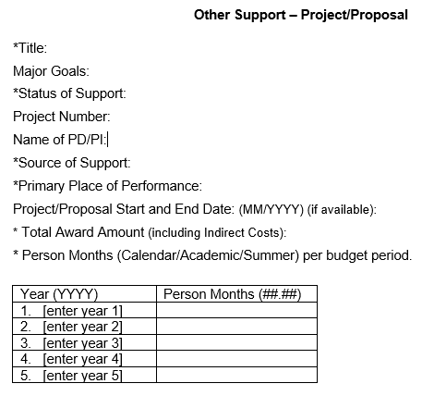
C&P new format…
PROJECT
Active, Pending or Completed (within past 3 years)
Group into sections based on Status of Support
PRIMARY PLACE OF PERFOMRANCE
Primary location where project or activity is being executed
Example: WPI, Worcester, MA
TOTAL AWARD AMOUNT
For Active: Total Award based on Notice of Award
For Pending: Based on Proposed Total Costs
For Completed: Not required
LEVEL OF EFFORT
For Active: level of effort in person months for current budget period and proposed for future
For Pending: Proposed level of effort for each budget period
For Completed: Not required

Slide 15
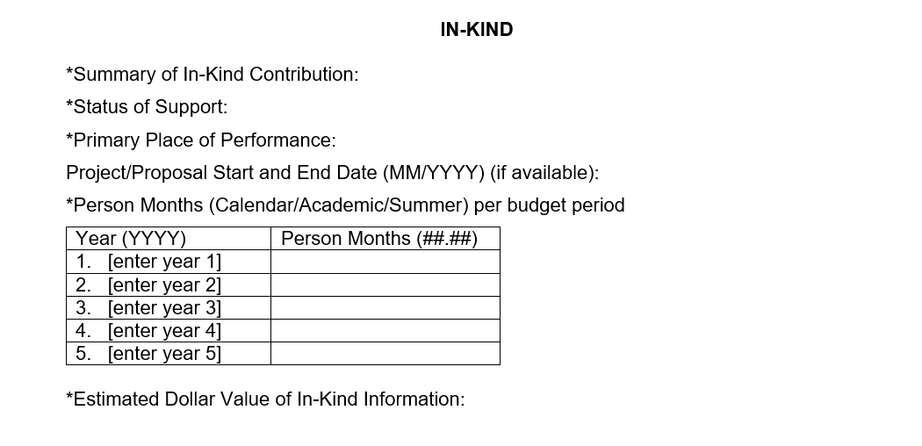
C&P new format…In-Kind
Active and Pending Only
In-kind resources with no associated time commitment, can list zero effort, but must provide the estimated dollar value
The effort and dollar value cannot both be zero
Only resources uniquely available to the researcher must be reported

Slide 16
C&P new format…Signatures
Each PD/PI or other senior key personnel must electronically sign their respective Other Support form prior to submission.
Includes Mentors/Co-Mentors on Mentored Career Awards
This signature certifies that the statements are true, complete and accurate.
Flatten PDF to be submitted to NIH
Do not send to OSP PDFs that are locked, or secured
Applicants and recipients must maintain the original electronic signature and make it available upon request
Up to department to determine best practice of keeping original electronic copy

Slide 17
Resources
SciENcv
Instructions for using SciENcv
For more information
FAQs
Keep in mind
Err on the side of disclosure (NIH)
If used on project—facilities; if not—other support
NIH Other Support Page
Instructions
Samples
NIH Other Support FAQs

Slide 18
Department of Defense (DOD)
All key personnel must disclose C&P support in grant applications related to research and research-related educational activities
To support protection of IP, controlled information, key personnel, and information about critical technologies relevant to national security; and
To limit undue influence, including through foreign talent programs, by countries to exploit US technology within the DOD research, science and technology, and innovation enterprise

Slide 19
Department of Defense (DOD)
Include in Senior Key Person Profile form for all key personnel, whether the individuals' efforts under the project are to be funded by the DOD:
A list of all current projects the individual is working on, in addition to any future support the individual has applied to receive, regardless of the source
Title and objectives of the other research projects
The percentage per year to be devoted to the other projects
The total amount of support the individual is receiving in connection to each of the other research projects or will receive if other proposals are awarded
Name and address of the agencies and/or other parties supporting the other research projects
Period of performance for the other research projects
DOD proposals for other types of awards may have different requirements;
check program solicitation and direct any questions to RSI

Slide 20
Conflicts of Interest (COI)
Some C&P items may also have to be disclosed internally on your Financial COI (FCOI) disclosure
Note: It's up to you to make all the necessary disclosures
FCOI disclosure should include all significant financial interests, regardless of whether you believe there is a conflict (It's up to the institution, not the investigator, to determine if there is a conflict.)
FCOI disclosure needs to happen before the proposal

Slide 21
Foreign Appointments
Foreign appointments/affiliations: do they go on biosketch, C&P, or FCOI? It depends!
 | C&P | FCOI | Biosketch
If the appointment supports your research activities in any way. Otherwise, no | n
Disclose all appointments in question 6 of FCOI form even if unpaid. If paid, also disclose details of compensation in question 11. |  | n (always include)
always include, even if unpaid. |  |  | n

Slide 22
Consulting
Consulting work: does it go on biosketch, C&P, or FCOI? It depends!
 | C&P | FCOI | Biosketch
NIH: YES if your consulting is related to research. Otherwise, NO. | n
NSF: Policy is ambiguous. Best practice: just include it. | n
Unless it is in a field unrelated to your WPI appointment. |  | n
Consulting does not go in biosketch |  |  | n

Slide 23
Start-up companies
Start-up companies: do they go on biosketch, C&P, or FCOI? It depends!
 | C&P | FCOI | Biosketch
if the company is completely unrelated to your field (e.g. catering) | n
if you are doing research with the company (SBIR, STTC, etc.) | n
if the company is based on IP licensed from outside of WPI | n
Income from the company goes in question 11 Ownership/equity goes in question 12 |  | n (Always include)
Start-up company information |  |  | n

Slide 24
Any questions?
Gabriel Johnson
Director, Office of Research Integrity and Compliance (ORIC)
Antje Harnisch
Assistant Vice Provost for Research, Research Solutions Institute (RSI)

